Slide 1
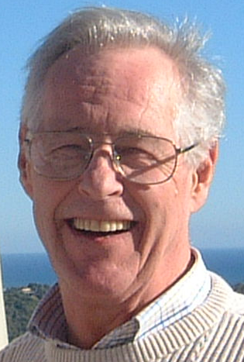
Vernon Robert Young
15-11-1937 – 30-03-2004
There are good ships and wood ships and ships that sail the sea. But there are no ships like friendships, wherever they may be.
Nice Oct 23 2003

