Slide 1

Introdução à programação para ciência e engenharia em Python
Iuri Soter Viana Segtovich
Parte 3: python científico

Slide 2
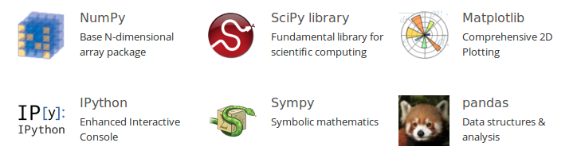
Python científico

Slide 3
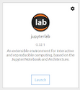
Anaconda navigator / Jupyter lab

Slide 4
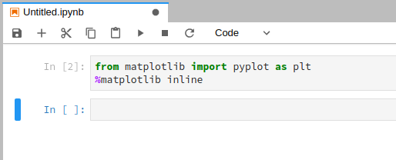
matplotlib

Slide 5
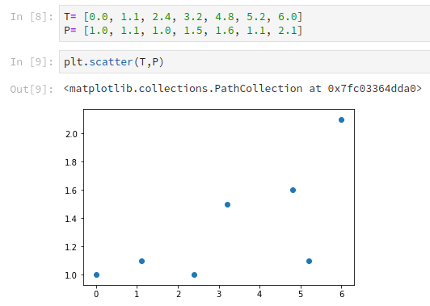
scatter

Slide 6
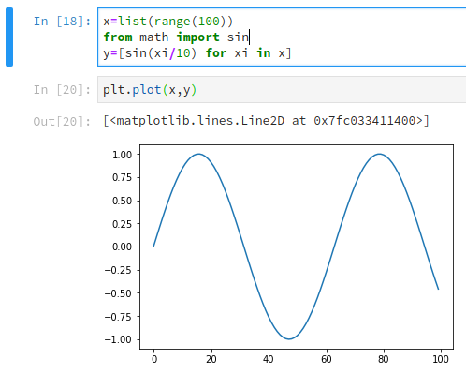
plot

Slide 7
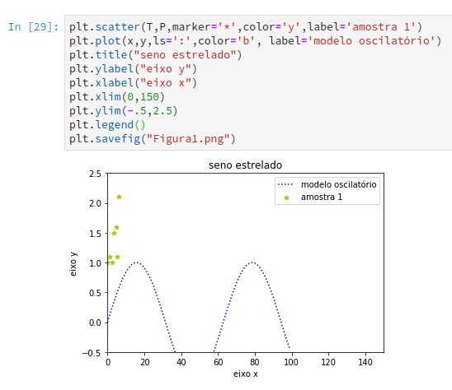
savefig

Slide 8
Multi-plot-Fu
https://static1.squarespace.com/
static/
530562f9e4b06fd3c041e221/
t/
5956de46099c01c37e5fa0b3/
1498865226277/
MatplotlibHotTopics.pdf

Slide 9
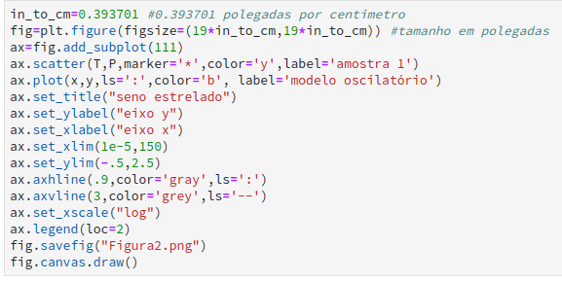
O caminho OOP

Slide 10
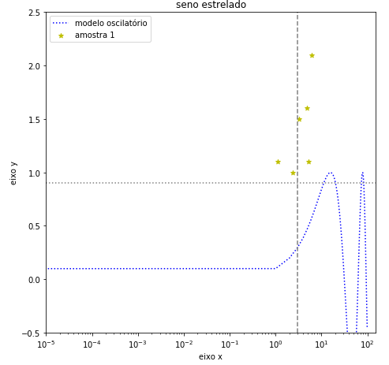

Slide 11
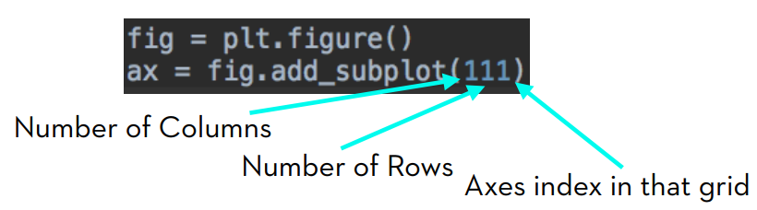

Slide 12
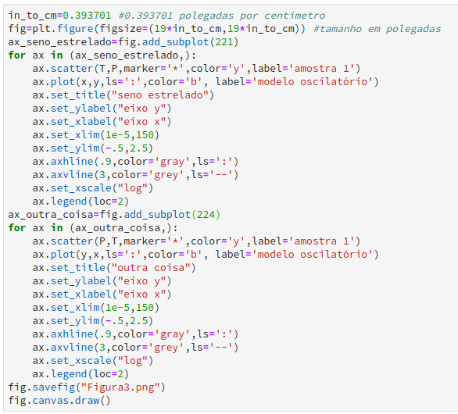

Slide 13
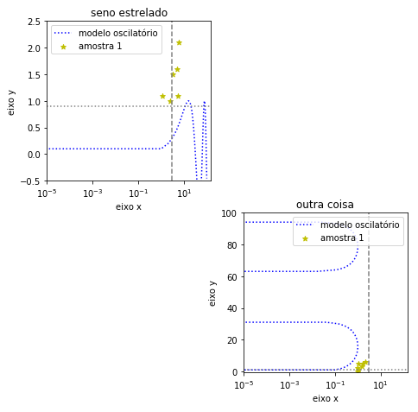

Slide 14
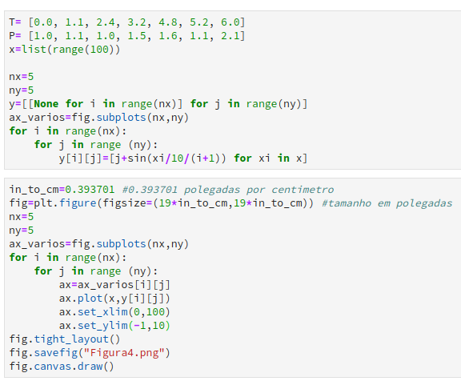

Slide 15
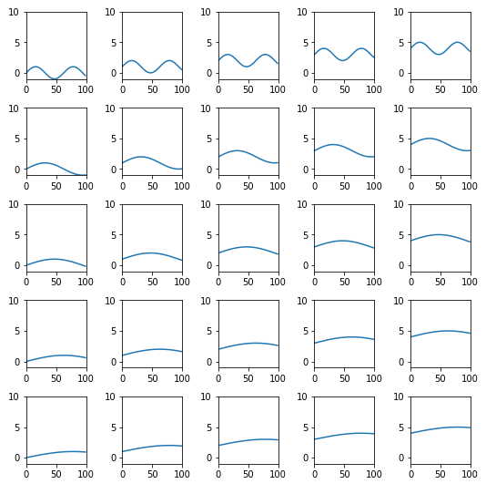

Slide 16
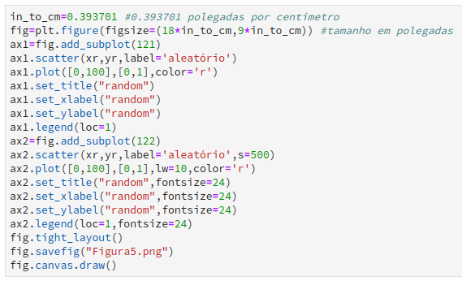
fontsize, labelsize

Slide 17
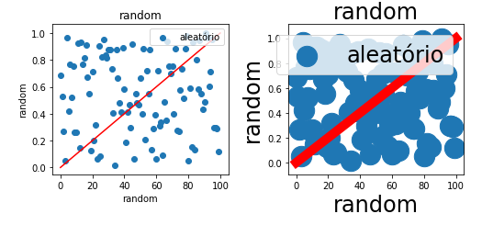

Slide 18
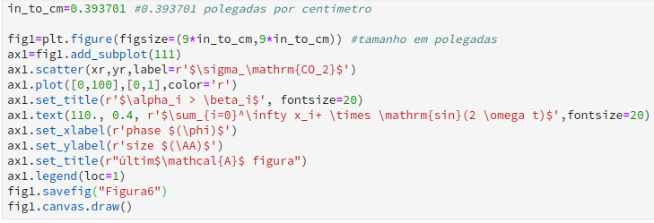
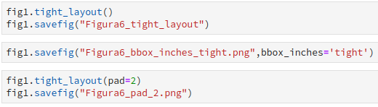

Slide 19
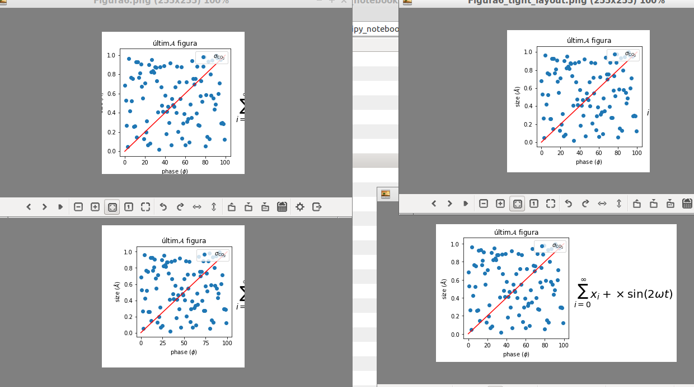

Slide 20
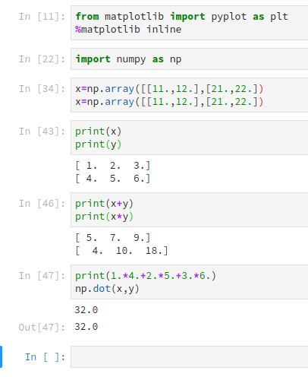
numpy

Slide 21
numpy
Array
Operações Termo-a-termo
Produto interno

Slide 22
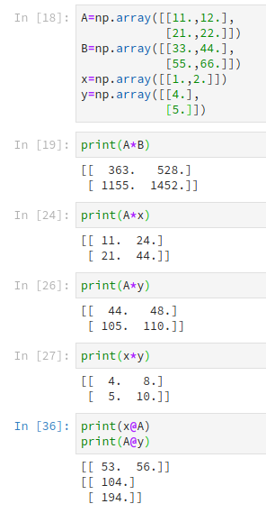
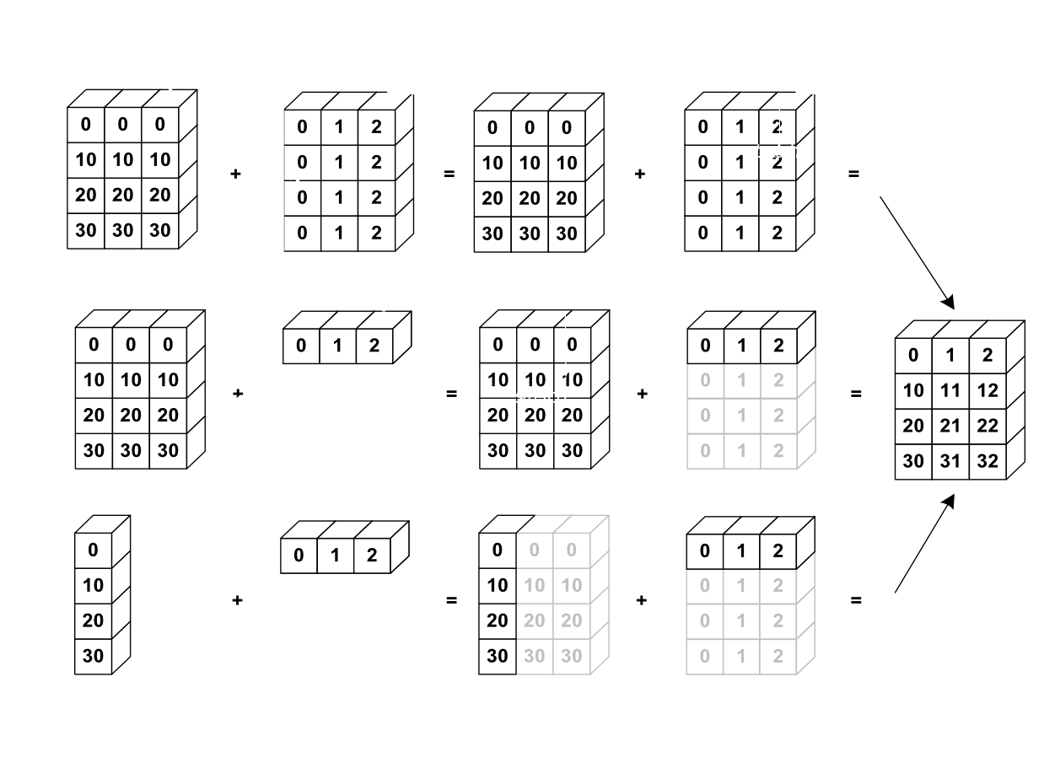
broadcasting

Slide 23
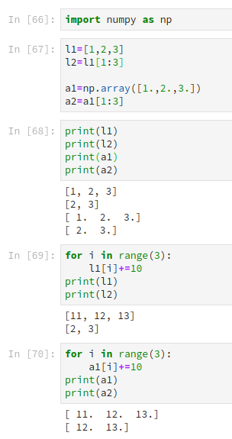
numpy
slice

Slide 24
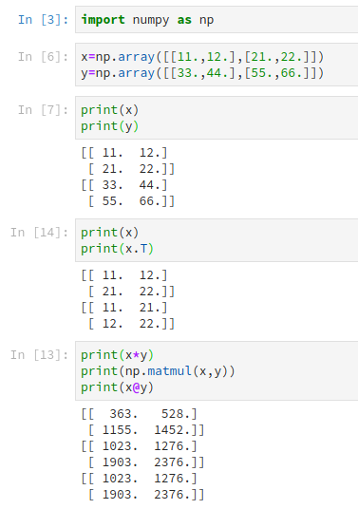
numpy
2d array
Matrix ops

Slide 25
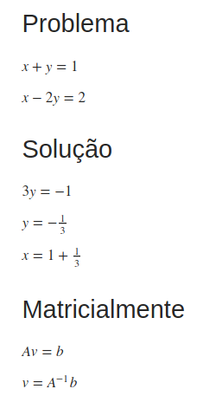
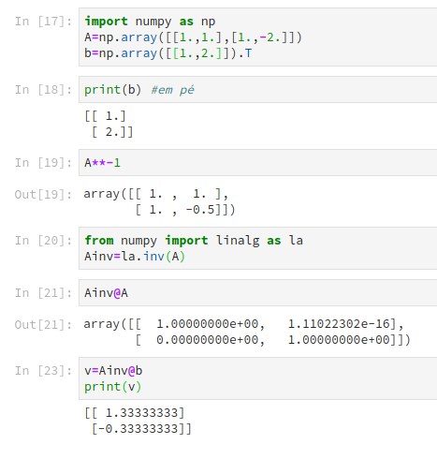
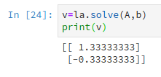
linalg

Slide 26
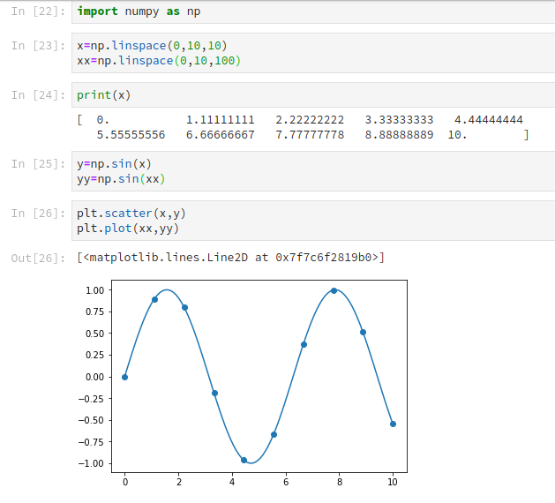
numpy
linspace

Slide 27
scipy

Slide 28
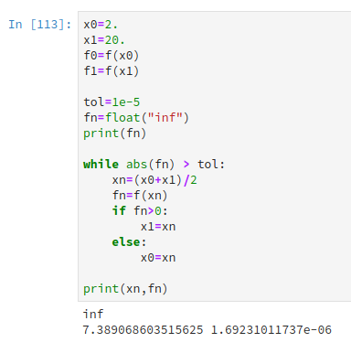
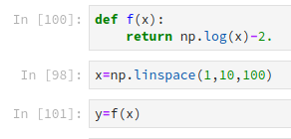
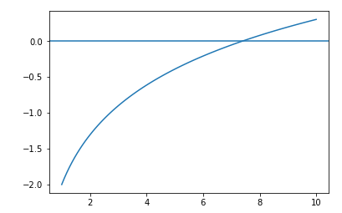
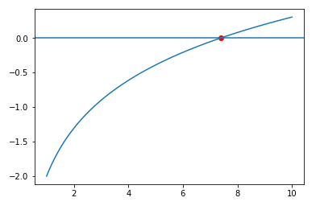
Exercise bisect

Slide 29

Scipy solver

Slide 30
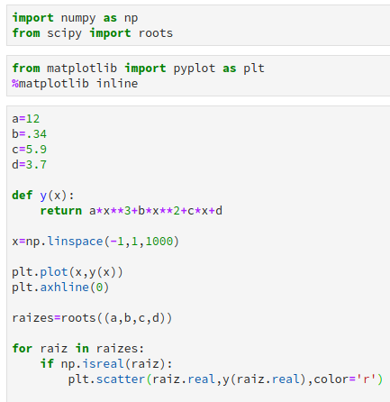
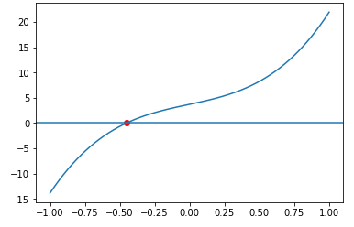
Scipy roots

Slide 31
Aplication psat antoine

Slide 32
Exercise minimize

Slide 33
Scipy fmin

Slide 34
Application param

Slide 35
Exercise trapez

Slide 36
Scipy integrate

Slide 37
Application particle dist
Generate random
Plot hist
Def gaussian
integrate

Slide 38
Exercise numdiff

Slide 39
Scipy numdiff

Slide 40
Sympy symdiff

Slide 41
Mais Sympy mgaitan

Slide 42
Exercise euler

Slide 43
Scipy ode

Slide 44
Application reator

Slide 45
Pandas

Slide 46
Numba (mgaitan)

Slide 47
# refs:
>- python cheat https://www.cheatography.com/davechild/cheat-sheets/python/pdf/
>- jupyter cheat https://www.cheatography.com/weidadeyue/cheat-sheets/jupyter-notebook/pdf/
>- numpy manual https://docs.scipy.org/doc/numpy/reference/generated/numpy.genfromtxt.html
>- scipy manual https://docs.scipy.org/doc/scipy/reference/optimize.html
>- matplotlib examples https://matplotlib.org/examples/pylab_examples/simple_plot.html

