Slide 1
python tutor

Slide 2
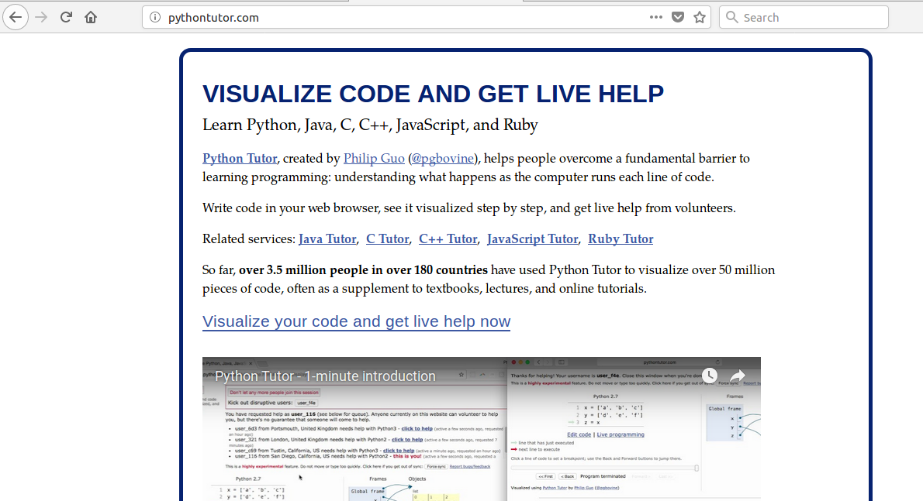
http://pythontutor.com/

Slide 3
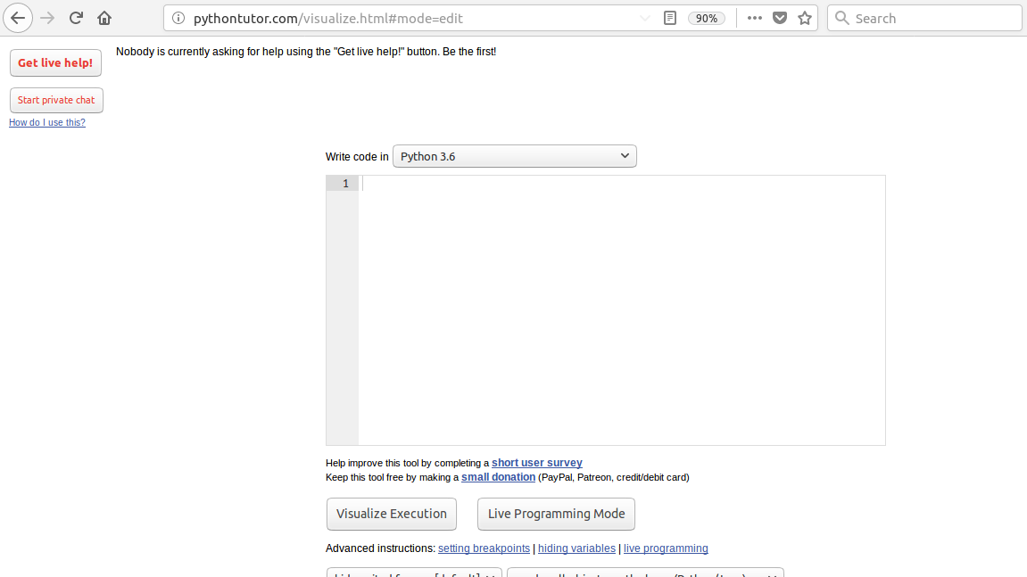
http://pythontutor.com/ visualize.html#mode=edit

Slide 4
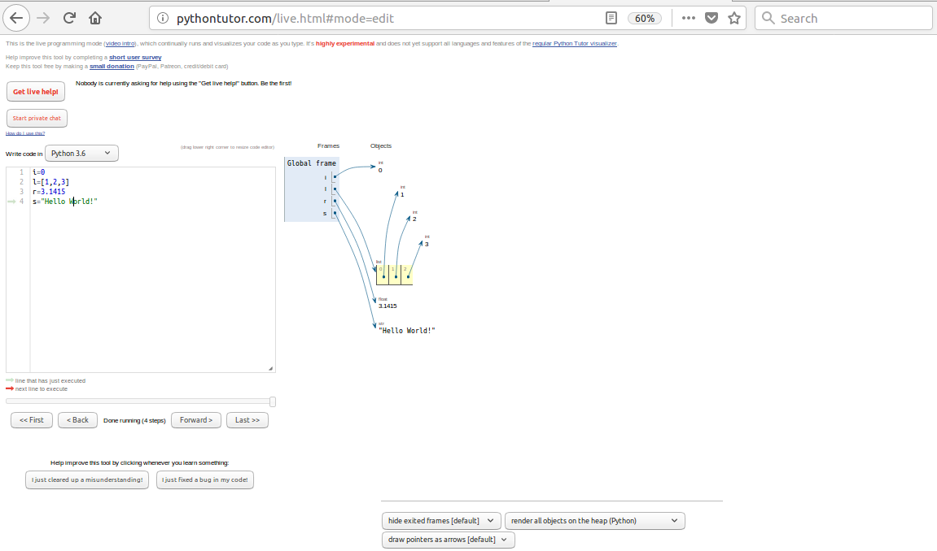
http://pythontutor.com/ live.html#mode=edit

