Slide 1
scipy
Matplotlib
Numpy
scipy
Sympy

Slide 2
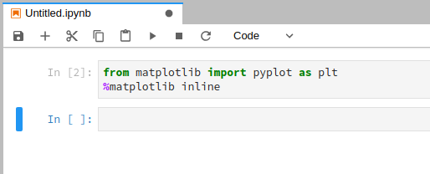
matplotlib

Slide 3
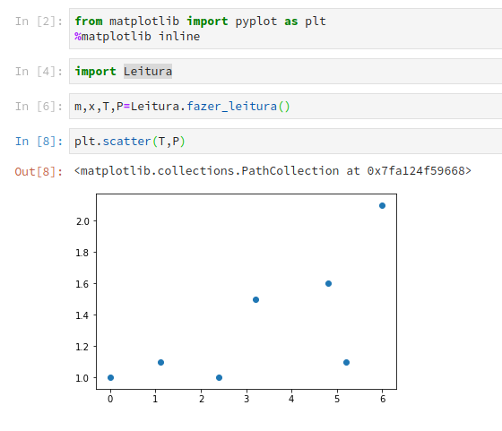
matplotlib

Slide 4
Formatações
Subplot
Save

Slide 5
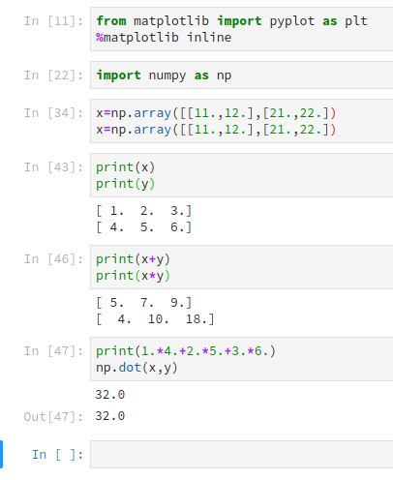
numpy
Array
Operações Termo-a-termo
Produto interno

Slide 6
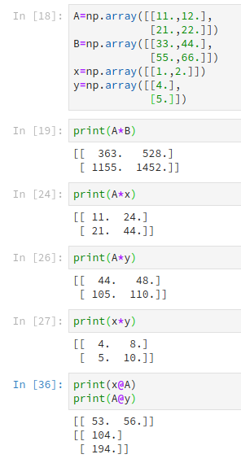
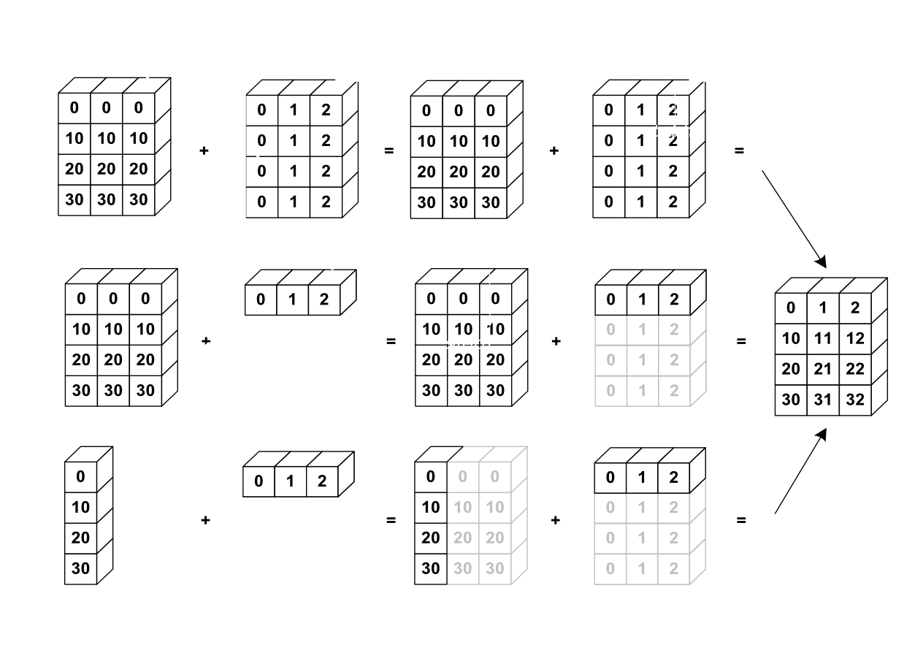

Slide 7
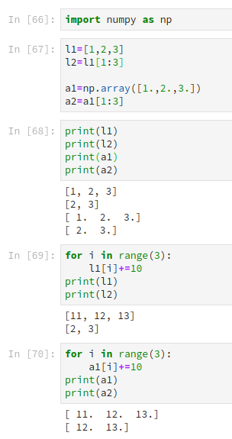
numpy
slice

Slide 8
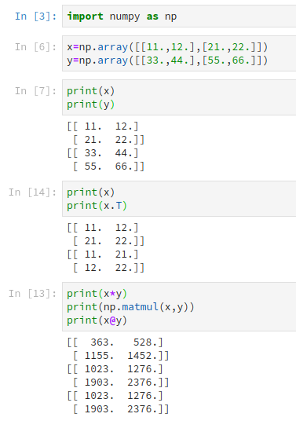
numpy
2d array
Matrix ops

Slide 9
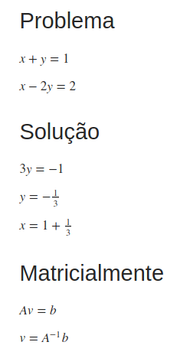
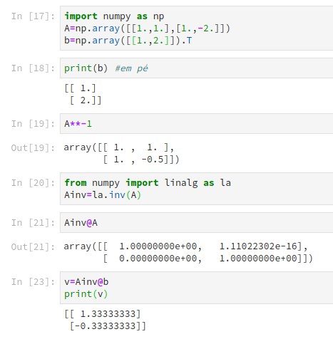
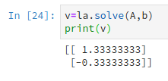
linalg

Slide 10
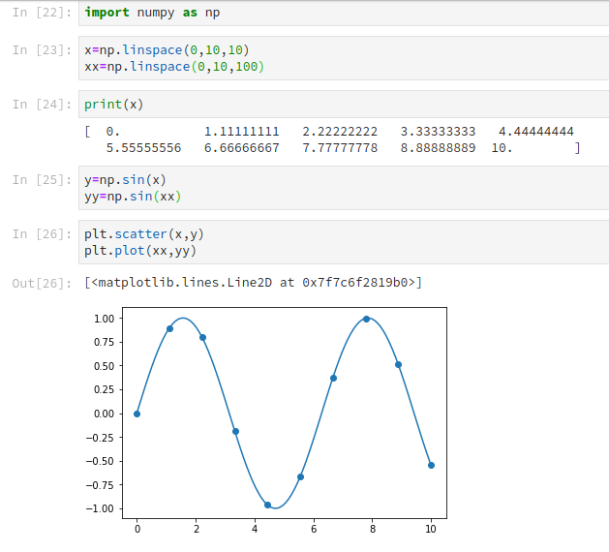
numpy
linspace

Slide 11
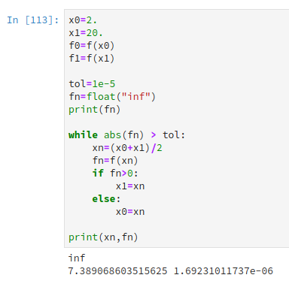
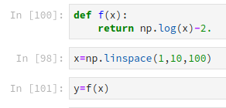
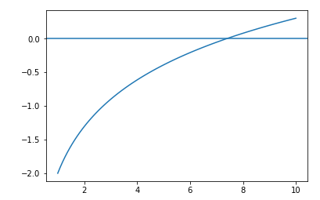
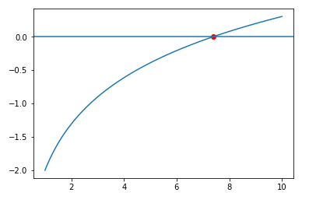
Exercise bisect

Slide 12

Scipy solver

Slide 13
https://nbviewer.jupyter.org/github/mgaitan/curso-python-cientifico/blob/fcefyn/Clase%205.ipynb

Slide 14
Aplication psat

Slide 15
Exercise minimize

Slide 16
Scipy fmin

Slide 17
Application param

Slide 18
Exercise numdiff

Slide 19
Sympy symdiff

Slide 20
Exercise trapez

Slide 21
Scipy integrate

Slide 22
Application particle dist
Generate random
Plot hist
Def gaussian
integrate

Slide 23
Exercise euler

Slide 24
Scipy ode

Slide 25
Application fentras

