Slide 1

get python+numpy+matplotlib+scipy+etc via ANACONDA

Slide 2
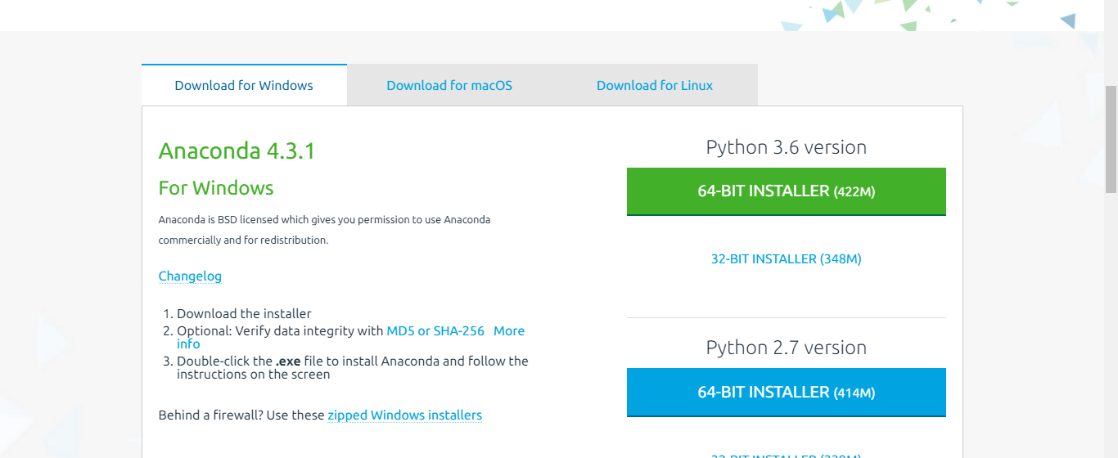

Slide 3

try SPYDER

Slide 4
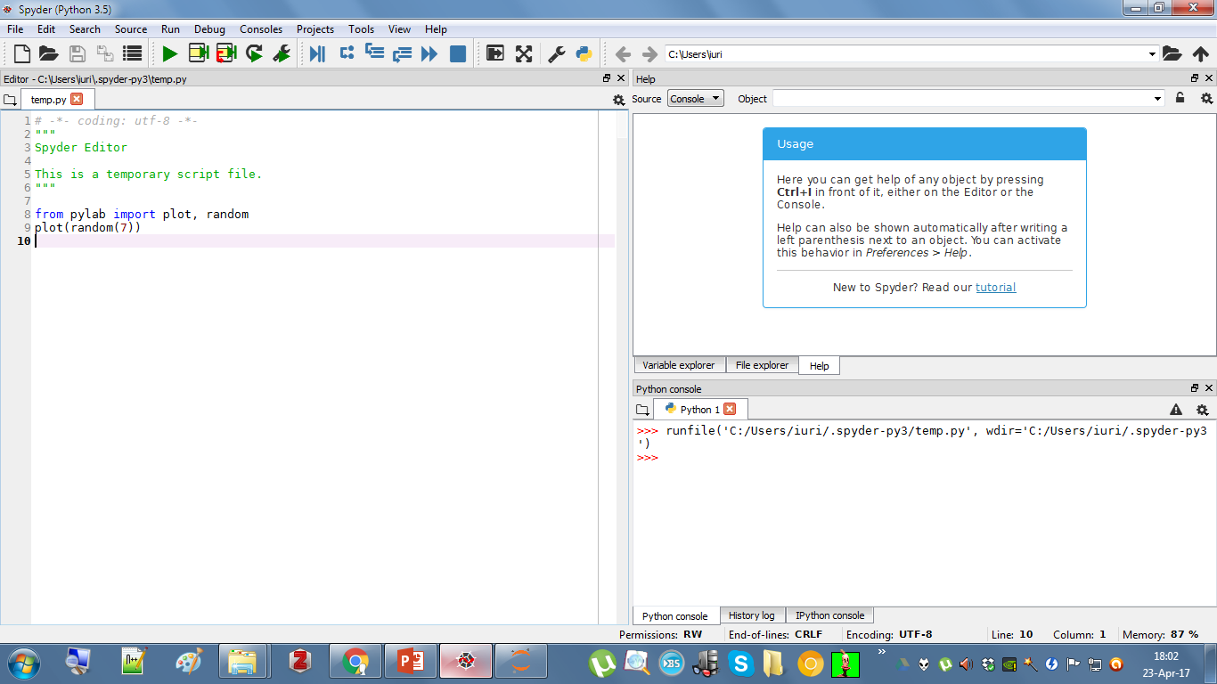

Slide 5
