Slide 1
Juniper Internship Experience
Presenter: Rui Han
Manager: Kevin Qin

Slide 2
What I’ve done
The project A
Spotlight Solution Test
The project B
How Reverse Proxy Work
Workday Problem
Our Solution
Reproduce and Fixing
Conclusion

Slide 3
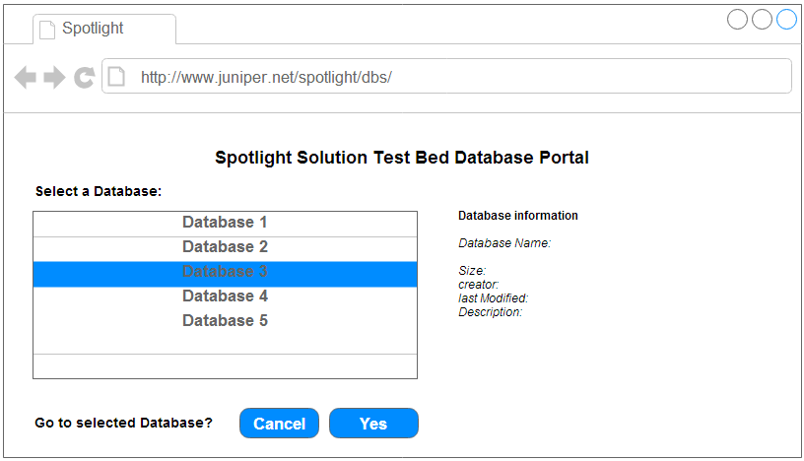
Project A
Objective: Create an interface to modify the Spotlight database contents

Slide 4
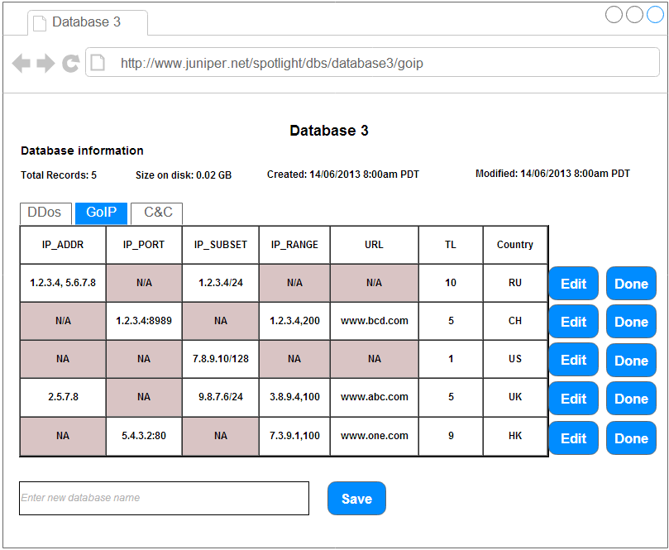
Project A
Objective: Create an interface to modify the Spotlight database contents
Notes:
Talk about how many percentage done,

Slide 5
Project A
Different format of IP address (range, subnet, array of IPs, etc.)
Cause Repetition of IP
How to efficient update
i.e. Update properties of one IP in an IP range
How to efficient search
How to avoid conflict
Etc.

Slide 6
Things Learned in Project A
High level idea of SecIntel Project
Concept of NoSQL and MongoDB hands-on
Start programming Python
PyMongo Driver
How to like a unexpected project assignment

Slide 7
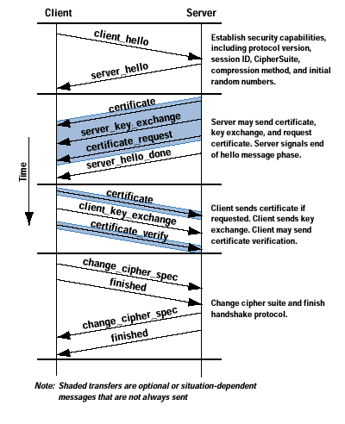
The Project B
SSL Reverse Proxy
Inspect SSL encrypted traffic (HTTPS)
if server’s private key is accessible.
Decrypt HTTPS traffic so the regular
IDP inspection can be applied
Does not terminate SSL session,
does not generate new packets
SRX
Encrypted data
Plain text

Slide 8
The implementation
Software
SSL RSA crypto operation is CPU intensive
RSA processing required during SSL handshake between client and server, is the bottleneck
RSA software APIs are not thread safe. It requires a global lock
Hardware
XLR chipset has built-in crypto engine
IDP SSL packet processing thread block the call to API
Test show the waiting time is very small
IDP SSL-inspection can process 1 Gbps of HTTPS traffic (512-bit)

Slide 9
Workday Issue and Proposed Solutions
HTTPS Throughput(3DES-SHA, key size 1024B) with IDP Recommended Policy n 1NGSPC[3 flow spu] is 89% less than 1CGSPC[1.5 flow spu]
FPC performance monitoring show CPU usage is 99% in the rate of 300 sessions/second for Private key size of 1024-bit

Slide 10
PR Reproduce
junos-srx1k3k-12.1I20130729_1810_ruihan-domestic.tgz
Traffic: BreakingPoint (idp-bps3)
Case 0 (work as designed):
Server: 1024-bit or 2048-bit RSA key
Proxy: matched 1024-bit or 2048-bit RSA key
Case 1 (abnormal):
Server: 1024-bit RSA key
Proxy: 1024-bit unmatched or 2048-bit RSA key
Case 2 (abnormal):
Server: 2048-bit RSA key
Proxy: 2048-bit unmatched or 1024-bit RSA key

Slide 11
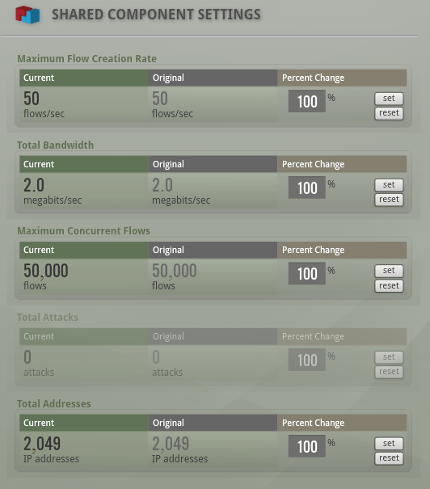
Investigate the SSL-Inspection
junos-srx1k3k-12.1I20130729_1810_ruihan-domestic.tgz
Traffic: BreakingPoint (idp-bps3)

Slide 12
Investigate the SSL-Inspection
junos-srx1k3k-12.1I20130729_1810_ruihan-domestic.tgz
Traffic: BreakingPoint (idp-bps3)
Case 1 (Server: 1024-bit RSA key):
Proxy key installation Scenarios:
matched 1024-bit RSA key,
unmatched 1024-bit RSA key,
2048-bit RSA key
Case 2 (Server: 2048-bit RSA key):
Proxy key installation Scenarios:
matched 2048-bit RSA key,
unmatched 2048-bit RSA key,
1024-bit RSA key

Slide 13
Case 1 SPU Performance
Two SPU card fpc 10 and fpc 7:
Monitoring the last 60 seconds using
> Show security idp monitoring performance spu
Key size is 1024-bit

Slide 14
Case 2 SPU Performance
Key size is 2048-bit
Key correct case: Sessions Not Decrypted = 0
Bad performance

Slide 15
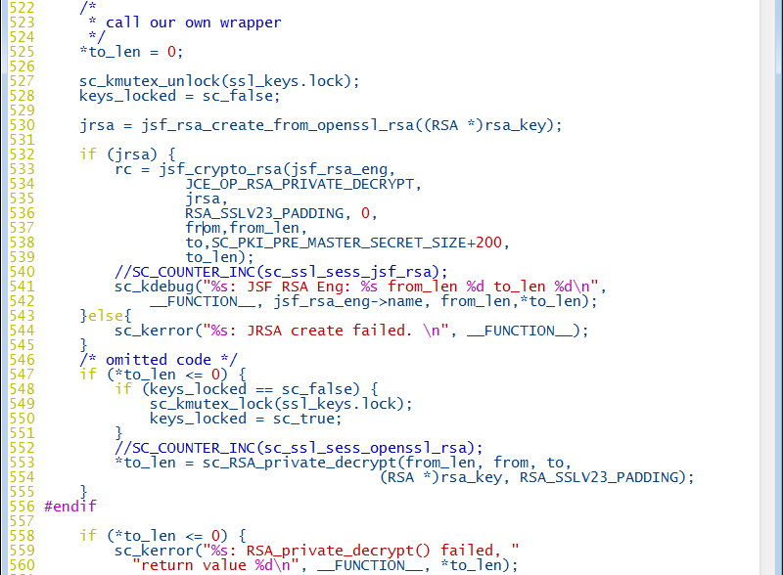
What Happened?

Slide 16
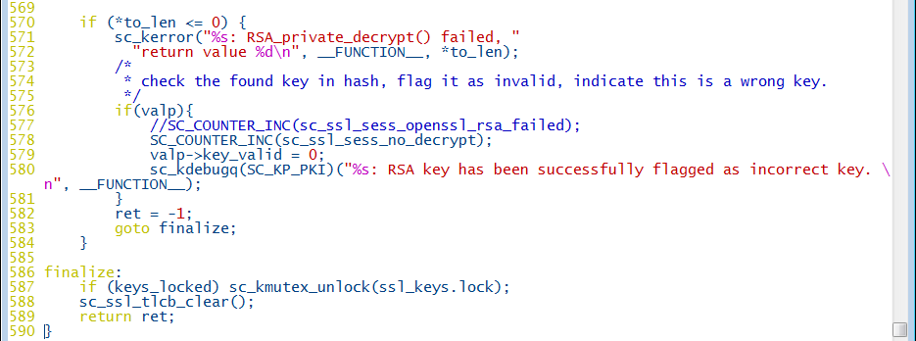
Solution to the Problem

Slide 17
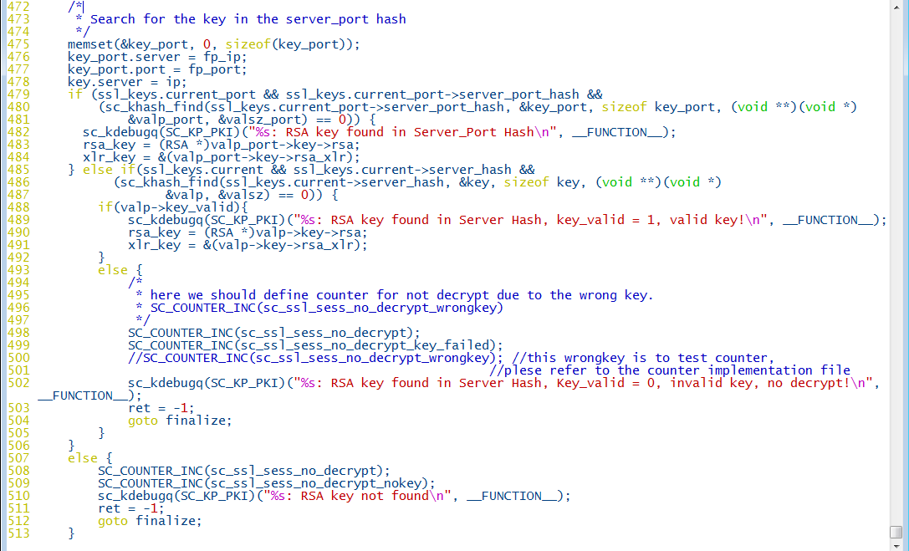
Solution to the Problem(cont.)

Slide 18
Testing Modified Image
junos-srx1k3k-12.1I20130802_2211_ruihan-domestic.tgz
Traffic: BreakingPoint (idp-bps3)
Case 1 (Server: 1024-bit RSA key):
Proxy key installation Scenarios:
matched 1024-bit RSA key,
unmatched 1024-bit RSA key,
2048-bit RSA key
Case 2 (Server: 2048-bit RSA key):
Proxy key installation Scenarios:
matched 2048-bit RSA key,
unmatched 2048-bit RSA key,
1024-bit RSA key

Slide 19
Case 1 SPU Performance
Two SPU card fpc 10 and fpc 7:
Monitoring the last 60 seconds using
> Show security idp monitoring performance spu
Key size is 1024-bit

Slide 20
Case 2 SPU Performance
Key size is 2048-bit
Key correct case: Sessions Not Decrypted = 0
Bad performance

Slide 21
Future Works
Effective solution that match PKI key pair
Potential efficiency issues
Compatible with key size larger than 1024-bit JSF-NGXLP

Slide 22
Things I learned
Perfect software solution generalize to all use cases, both good and bad
“Love what you are working on”
“Focus on your goal”
“Success in any endeavor requires single-minded attention to detail and total concentration.”
“Execution! Execution!! Execution!!!”

Slide 23
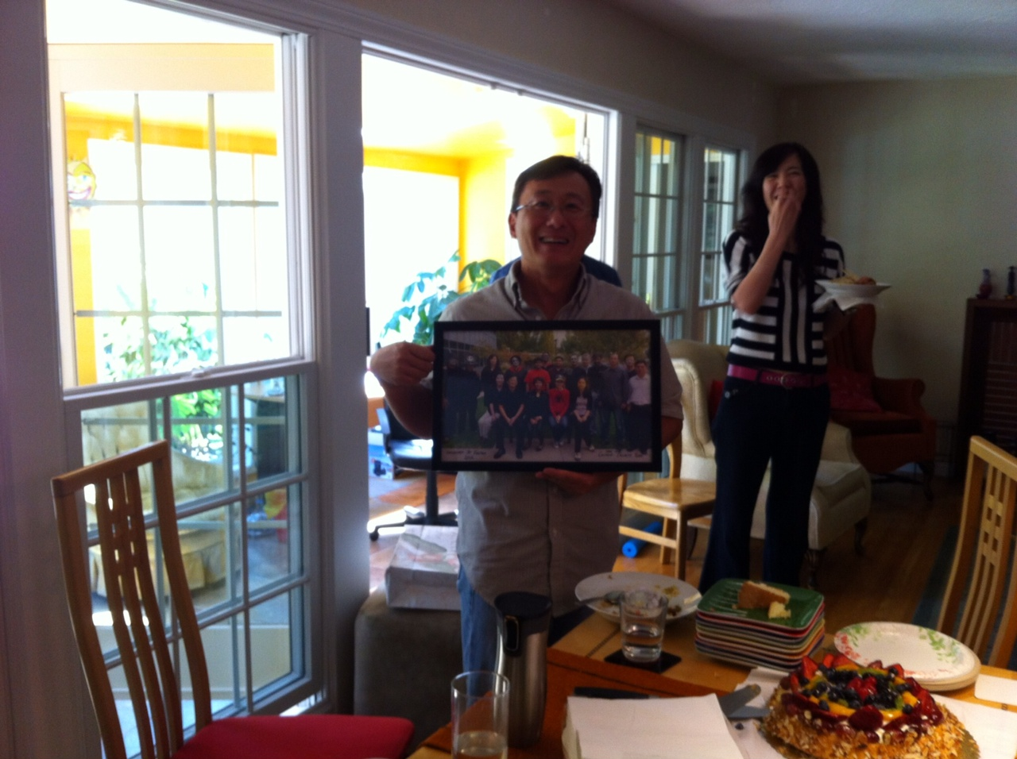
Farewell Party for Chris

Slide 24
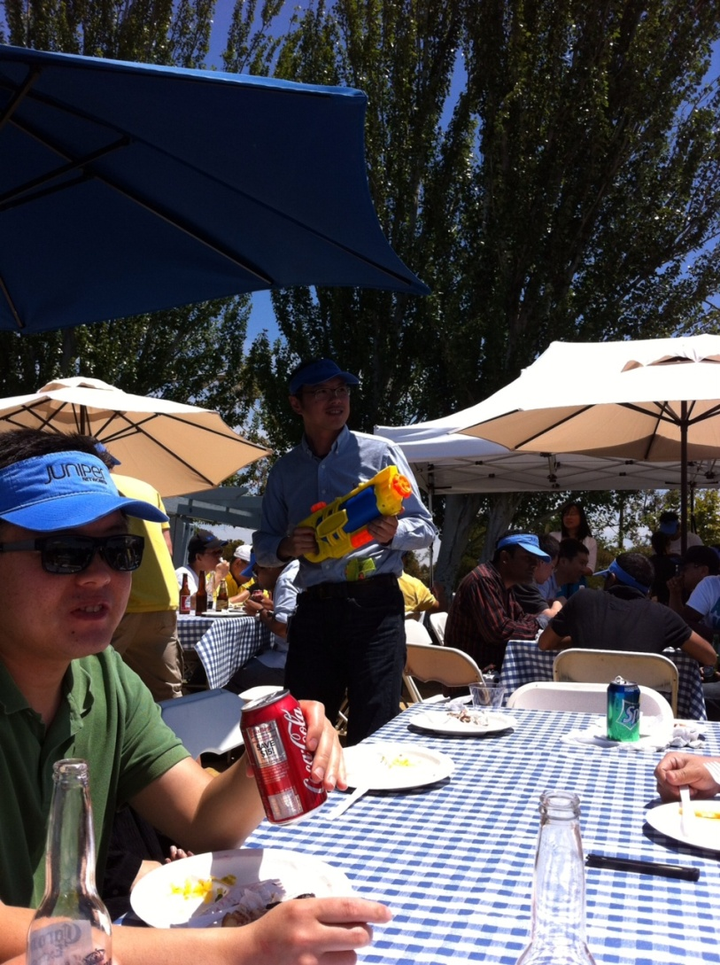
Juniper SSD SBU Summer Picnic

Slide 25

Great American

