Slide 1
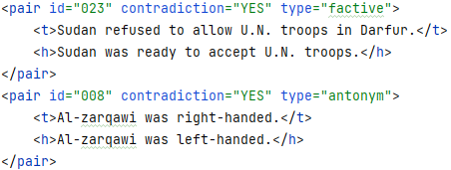
Finding contradictions in texts

Slide 2
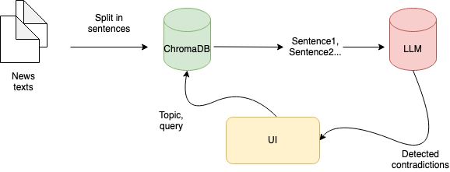
Application architecture

Slide 3
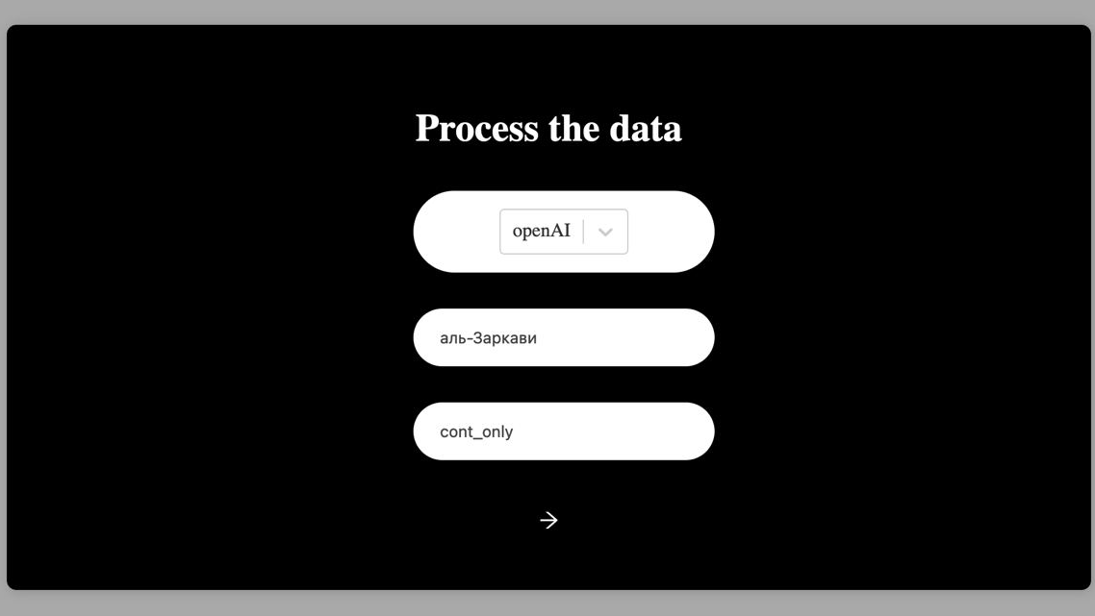
Model
Topic of interest
Collection of files

Slide 4
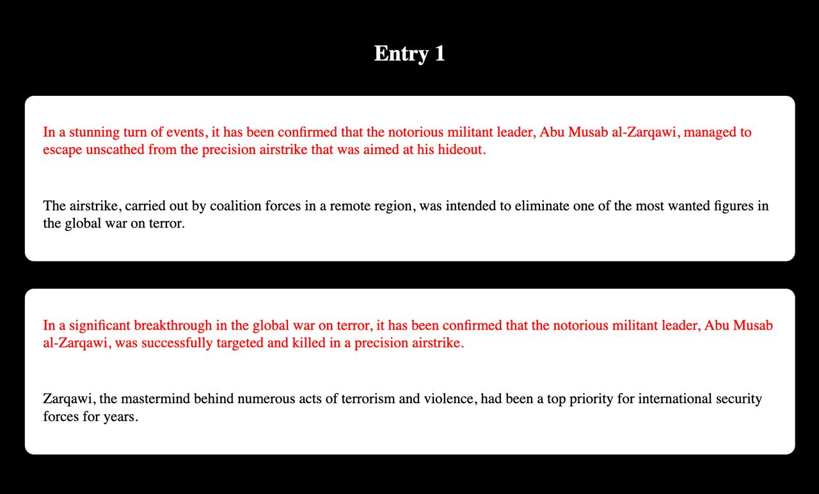

Slide 5
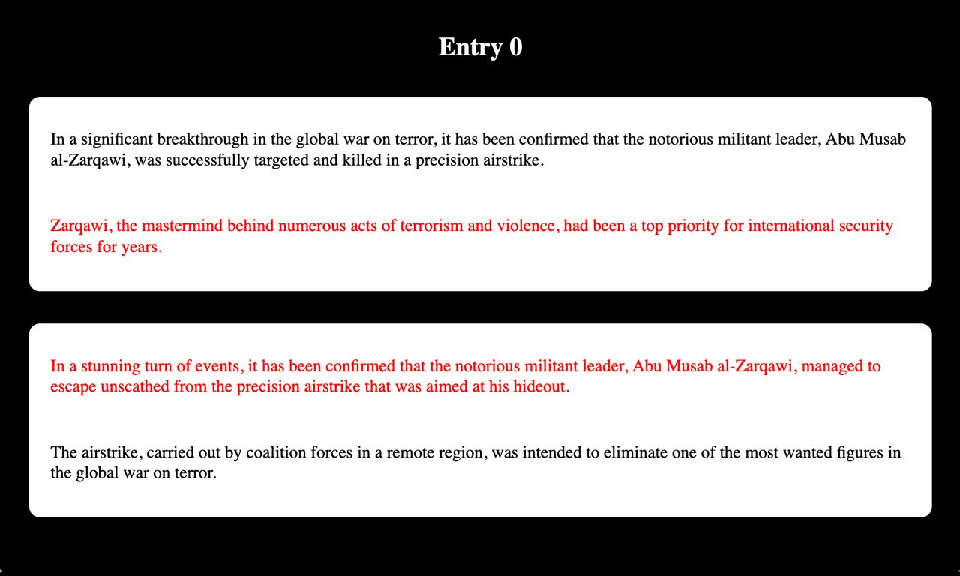

Slide 6
Limitations
OpenAI is a paid service
Tested on a dataset of a limited size
Prior to detecting contradictions, it is required to index the data
The rate of detection on the real data is not perfect
Might require high computing power

Slide 7
Next possible steps
Switch to a fine-tuned opensource model (e.g. Llama2)
Try different embeddings for the database (currently used Multilingual SentenceBERT)
Detect statements before putting into the database
Feedback loop from a user to mark faulty results
Refine UI

Slide 8
Repository: https://github.com/iurshina/bellingcat_contradictions

