Slide 1
Linux iptables – Firewall Basics

Slide 2
Fire...Wall? What’s that?
A Firewall is a network security system that controls network traffic, usually with a ruleset
2 types:
  Network firewall – The Palo Alto
  Host-based firewall – iptables (What we’re covering)
Notes:
There are more specific types within those cats, but that’s all we need to know for now

Slide 3
But first, networking basics
Network traffic always has a protocol, direction, and destination
Protocol – TCP & UDP
Direction – In or out?
Source/Destination – Port number & IP address
  8.8.8.8:53
  2A02:586:6E07:3600:318D:7532:DE9C:69EA:80443
Notes:
For our purposes, source is more important as destination tends to be our machine with host-based firewalls

Slide 4
Iptables & Linux
Iptables is the Linux’s primary firewall configuration utility
Managed via the command line tool iptables/ip6tables
Present on ALL Linux machines in CCDC
Notes:
Side note: iptables was actually succeeded by another, more robust firewall system in 2013, but it has yet to gain widespread use

Slide 5
Adding & removing rules
iptables -P INPUT DROP
ip6tables -A INPUT -p tcp --dport 80 -j ACCEPT
iptables
iptables -D INPUT 1
Notes:
Changes chain default, direction INCOMING traffic default block
Allow input from ANY to TCP port 80
Delete rule #1
Mention iptables vs ip6tables

Slide 6
Listing rules
iptables -nL --line-numbers
ip6tables -S
-P INPUT DROP
-P FORWARD DROP
-P OUTPUT ACCEPT
-A INPUT -p tcp -m tcp --dport 80 -j ACCEPT
-A INPUT -i lo -j ACCEPT

Slide 7
How can this help you?
Iptables, by default, can only be managed by root
Allows you to block traffic to known red team IPs
  Integrates with Intrusion Protection Systems (IPS) such as Fail2Ban and Artillery’s honeypot system
Prevents use of unauthorized network services

Slide 8

Application
The iptables commands can easily be scripted for maximum l33tn3ss
  I used this to great success on the Fedora mail server
http://go.iu.edu/2a1T - My script

Slide 9


Questions?
http://go.iu.edu/2a1U - DigitalOcean Tutorial
http://go.iu.edu/2a1V - ArchWiki: Simple Stateful Firewalls
DO ArchWiki

Slide 10
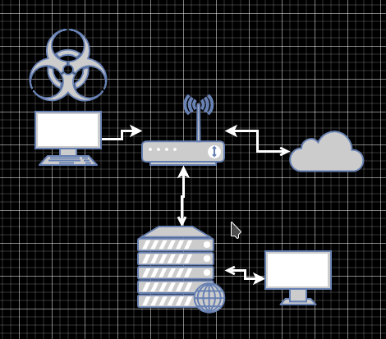
Lab time!(?)

