Slide 1
CA4006 assignment 1
James Nolan 14316461 & Warren Purcell 15404058

Slide 2
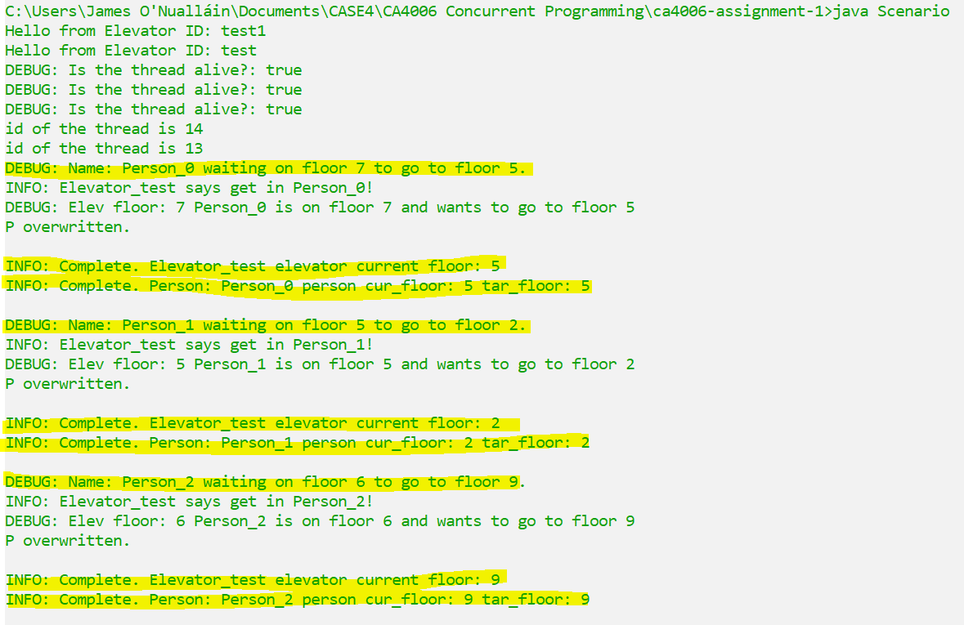
What is working
Scenario class which is main Thread
Elevators started on main thread.
People initialised on main thread.
Passed to the manager class.
Elevator object extending Thread.
Picks up a person from a destination.
Presently just taking a person and going straight to destination. Then picks up next in waiting list.
Person object not on it’s own thread.
Standard getters and setters.
An elevator manager object.
Manager class interacts with Elevator threads through a “button press”.
Todo
Introduce more elevators.
Introduce more people.
Put elevator manager on it’s own thread.
Vanilla: One elevator on it’s own thread.
TODO: Make elevator pick people up on floors it visits.

Slide 3
Our present problems
Stupid way of handling the Person object in elevator.java.
Encountered weird issues such as system print outs killing threads.
Debugging is a bit messy.
Threads dying when people are still waiting. Introduce a monitor to manage waiting?
Introducing a second elevator causes chaos.

