Slide 1
Ad classification on Divar dataset

Slide 2
dataset
947653 ads
min length: 1, max length: 349
split to training and test sets -> 3 to 1
split is done in a stratified fashion
metric -> accuracy on test set
pre-processing:
Tokenization
stemming?
removing numbers and punctuations?

Slide 3
Different classification methods
SVM
ANN
CNN
RNN

Slide 4
SVM
features -> n-grams
feature values -> binary, count, tf-idf
kernel -> linear

Slide 5
SVM results
 | Binary | Count | Tf-idf
Unigrams | 86.9 | 86.92 | 87.46
Unigrams & Bigrams | 87.14 | 87.19 | 88.59
Unigrams & Bigrams & Trigrams | 86.82 | 86.81 | 88.46

Slide 6
ANN
Average of the embeddings of words in an ad
vocab size = 50000
Should pad sentences
maximum length = 200
Number of layers?
Dropout or Batch Normalization?
Different approaches for word embeddings:
pre-trained word embeddings
train embeddings on the training set
randomly initialize embeddings

Slide 7
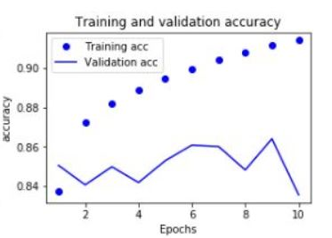
Embedding approaches: Fast Text pre-trained
test accuracy -> 86.4

Slide 8
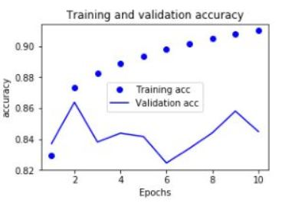
Embedding approaches: Random init
test accuracy -> 86.38

Slide 9
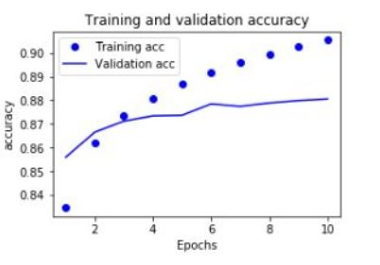
Embedding approaches: train on training set!
test accuracy -> 88.06

Slide 10
Other parameters
2 layers
Dropout or batch normalization or both?
Both!
Drop out after Batch Normalization

Slide 11
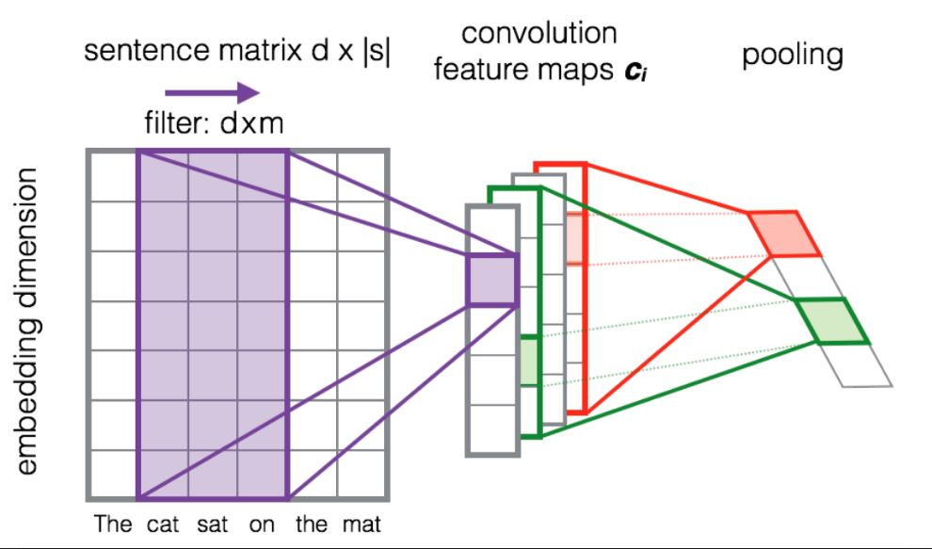
CNN

Slide 12
CNN
Transform the sentence to a matrix of size l * d
Apply 1d convolution on sentences the pooling
Basically encoding n-grams where n is the kernel size
Choose multiple kernel sizes(n) the concatenate in the end
Average pooling worked better

Slide 13
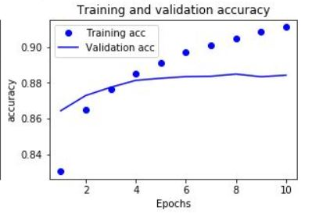
Kernel sizes
2, 3, 4 + Average Pooling
test accuracy -> 88.46

Slide 14
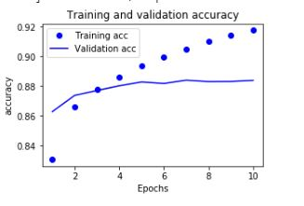
Kernel sizes
3, 4, 5 + Average pooling
Test accuracy -> 88.39

Slide 15
RNN
LSTM or GRU -> bi-directional LSTM
how many layers? 1
hidden state size -> 300
only pad each batch not the whole dataset
Final out of RNN:
Global max pooling
Attention
Just the last state!

Slide 16
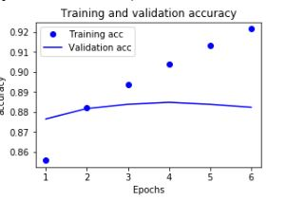
RNN with only the last state
Test accuracy -> 88.48

Slide 17
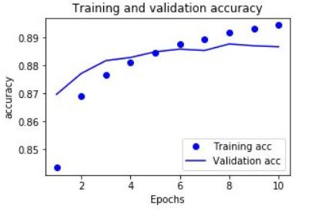
RNN with global max pooling
test accuracy -> 88.78

Slide 18
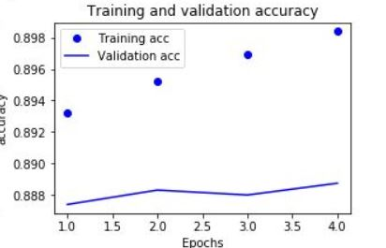
RNN with attention
Test accuracy -> 88.87

Slide 19
CNN + RNN
CNN ignores the order of n-grams
We could use an RNN with a conv1d and pooling layer
pooling makes sequences shorter which results in faster RNN training

Slide 20
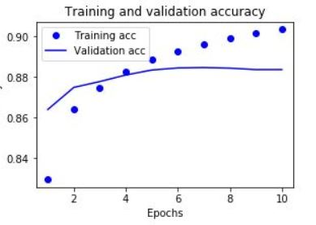
CNN + RNN
kernel size = 2, Average pooling size = 5
Test accuracy -> 88.46

Slide 21
Results
model | Accuracy on test set
SVM + Uni_bi-grams + tf-idf | 88.59
ANN + average embeddings | 88.06
CNN(2,3,4) | 84.46
CNN(3,4,5) | 88.39
BiLSTM + attention | 88.87
BiLSTM + max pooling | 88.78
BiLSTM | 88.48
CNN + RNN | 88.46

