Slide 1



Transfer Learning for ASR to Deal with Low-Resource Data Problem in Farsi
Presenter: Maryam Asadolahzade

Slide 2
Agenda
Goal
Motivation
Method
Architecture
Input-Output
Dataset
Results
Conclusion

Slide 3
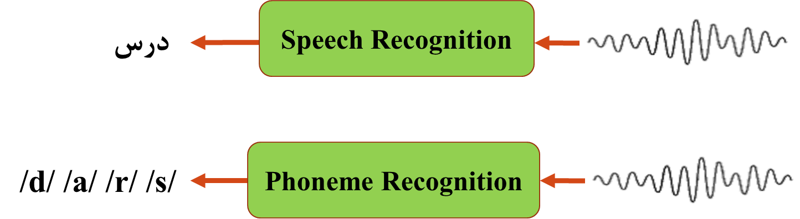
Goal

Slide 4
Motivation
What is state-of-the-art in ASR? End-to-End ASR
Challenge: Problem with low-resource languages:
no sufficient data for training
How to solve it? Transfer learning
Use a high-resource language such as English for training the network.
Previous work: Transfer Learning from English to German

Slide 5
Method
General idea
Architecture
Input
Output

Slide 6
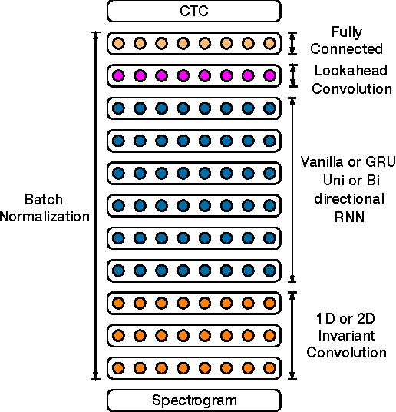
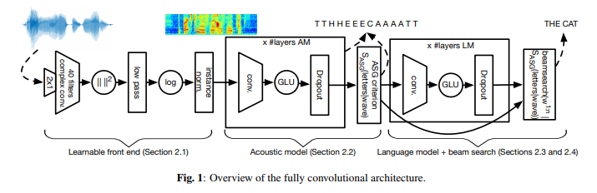
Method: General Idea
Transfer Network
Frozen Layers
Train with English Corpus
Fine-tune with Persian Corpus

Slide 7
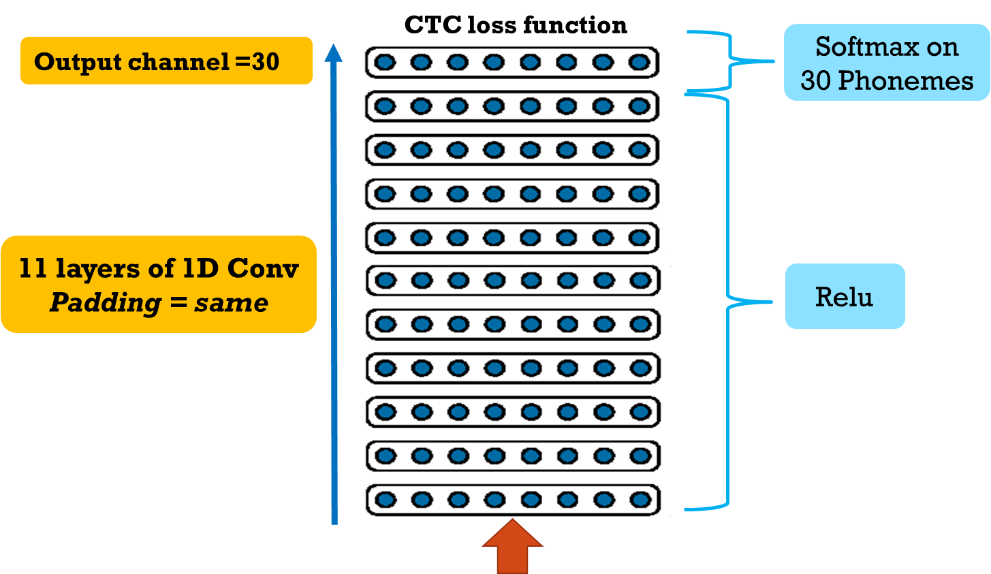
Method: Architecture

Slide 8
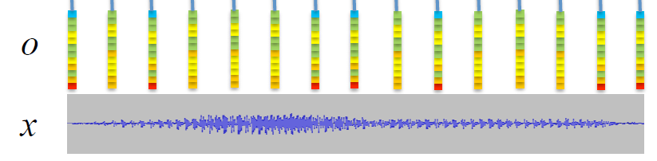
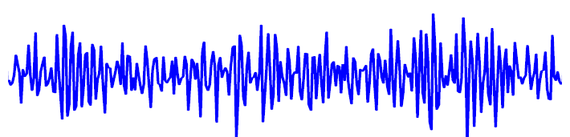
Method: Input
Frame of 30 ms

Slide 9
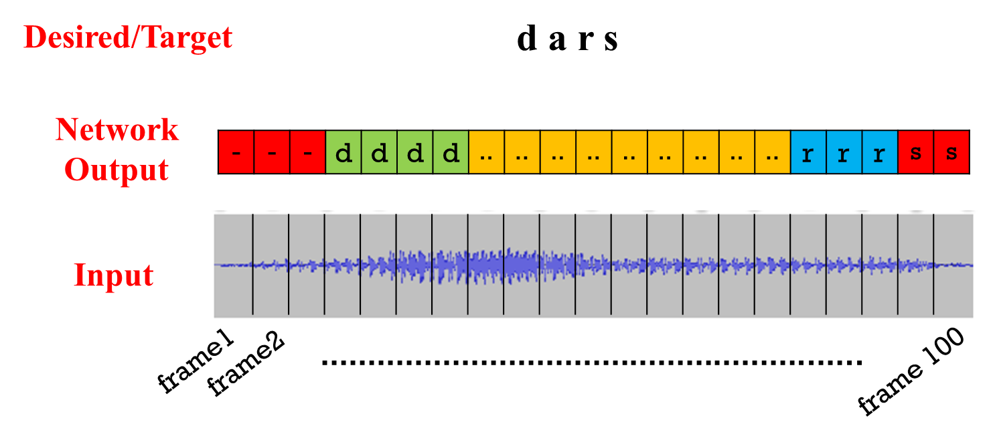
Method: Input - Output

Slide 10
Results
Dataset
Metric
Experiments

Slide 11
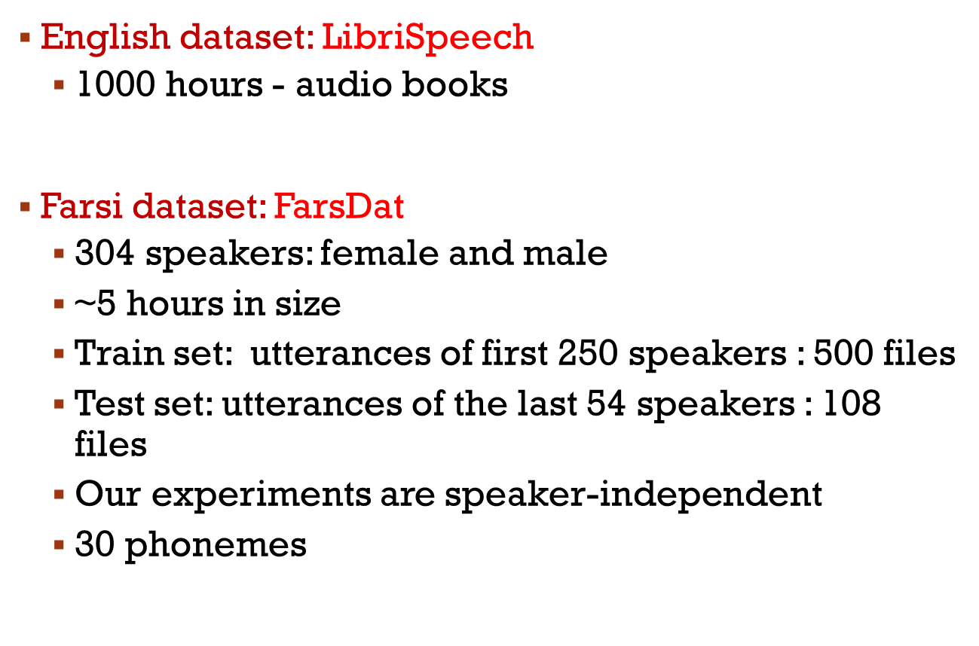
Datasets: Two datasets

Slide 12

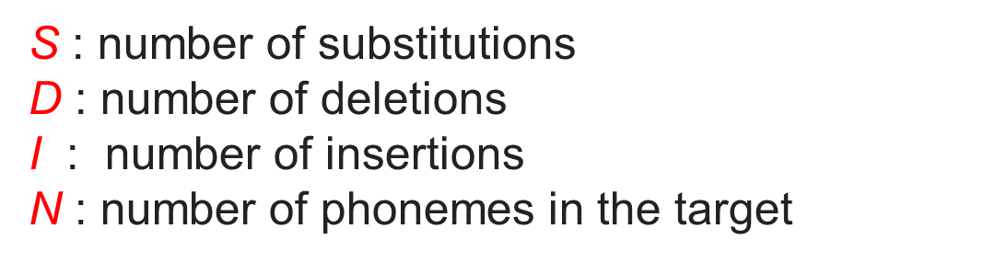
Evaluation: Phoneme Error Rate
PER

Slide 13
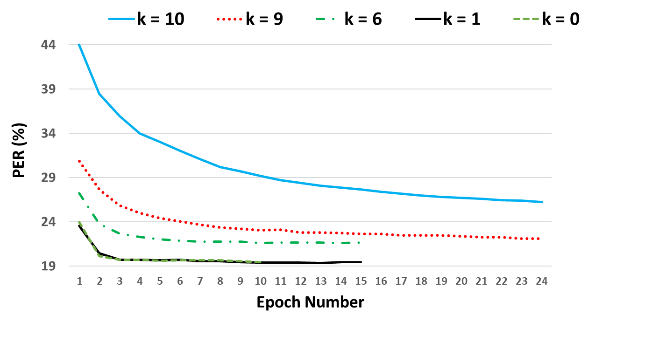
Experiments: effect of frozen layers
K: Number of frozen layers

Slide 14
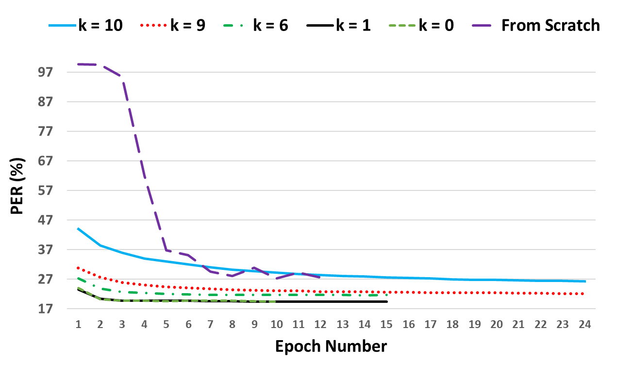
Experiments: effect of transferring
From Scratch

Slide 15
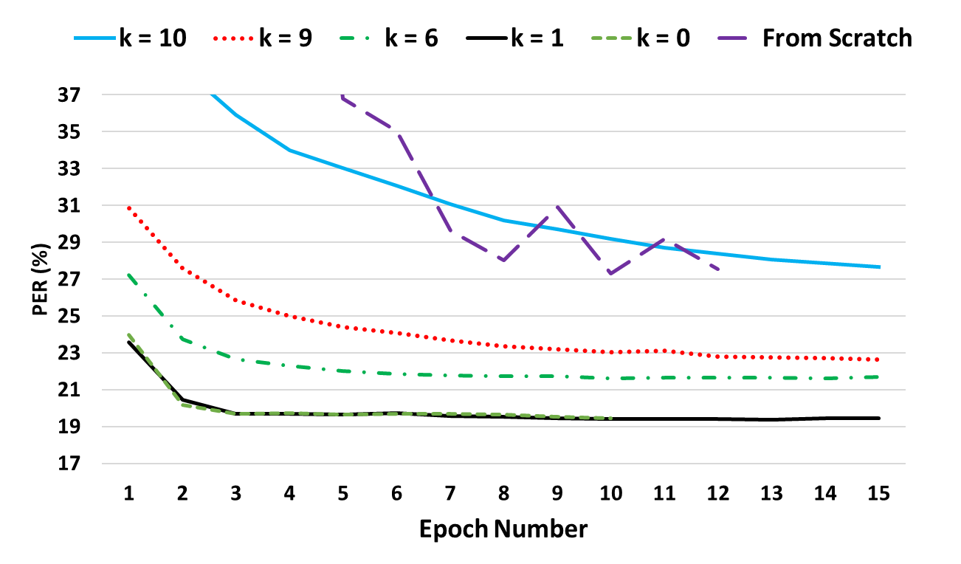
Experiments: effect of transferring
From Scratch
Goal
Method
Architecture
Input-Output
Results

Slide 16
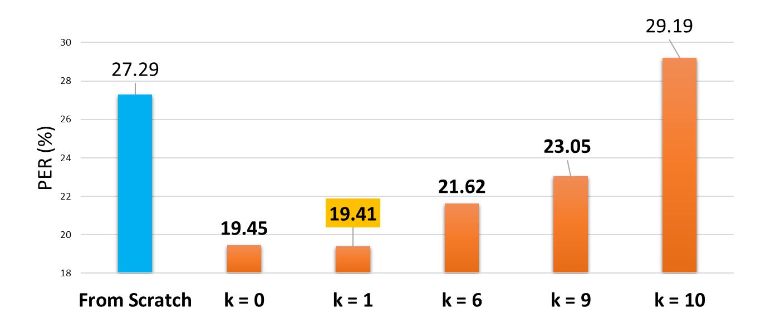
Experiments: Effect of transferring
Transferred

Slide 17
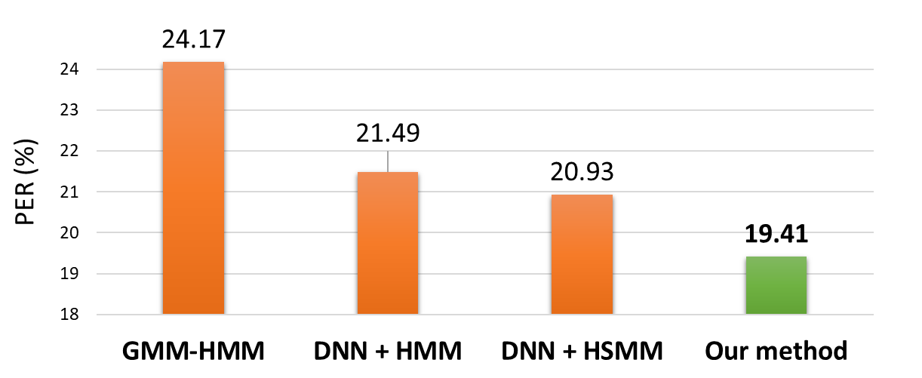
Experiments: Comparison with baselines
2.08%
1.52%
Baselines

Slide 18
Conclusion
Transfer learning for Farsi ASR
Can be seen as a kind of weight initialization
Reducing the training time
Reaching higher accuracy for the target language

