Slide 1
In the name of goad
Time Series Data Forecasting
Hossein Hosseinzadeh
Reza Bagherpour

Slide 2

Consumption Forecasting with a Hybrid Deep Learning

Slide 3
Dataset:
UK Domestic Appliance-Level Electricity (UK-DALE) dataset
records the power demand from five houses
record both the whole-house mains power demand every six seconds

Slide 4
Base line method
SVR (Support Vector Regresssion)
kernel type = rbf
C = 1000 (Penalty parameter C of the error term)
gamma = 0.0001 (Kernel coefficient)
epsilon = 0.1
RMSE: 1.055
MAPE: 20.909
MAE: 0.500

Slide 5
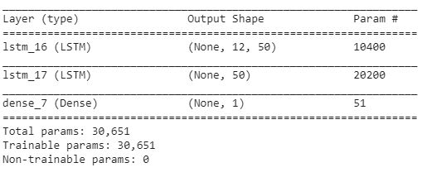
LSTM + DENSE
Model : 2 LSTM Layer + 1 Dense Layer for output
Data for LSTM : (N_samples, Time step, N_features)
RMSE: 1.055 → 0.029
MAPE: 20.909 → 12.477
MAE: 0.500 → 0.015

Slide 6
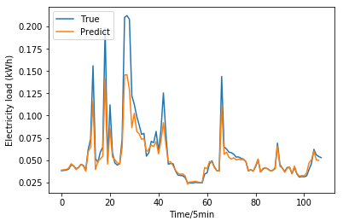
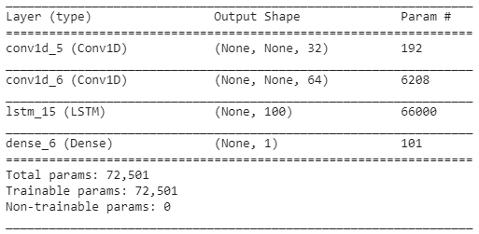
CNN+LSTM
Model : 2 CONV layer + 1 LSTM+ 1 Dense
Actual and Prediction Load(CNN + LSTM)

Slide 7
RMSE: 1.055 → 0.029 → 0.027 MAPE: 20.909 → 12.477 → 7.396 MAE: 0.500 → 0.015 → 0.014

Slide 8
Generalization model (Electric Power Price Forecasting)
Electric Power Price Forecasting Using Data Mining Techniques
Data: The NYISO Website [Online]. Available: http://www.nyiso.com
The k-mean algorithm classification according to type of day, into three classes
k-NN algorithm divide the classified data into two patterns for month
The historical electricity price data of 2014 as input pattern
The accuracy verified by samples of 2015
ARIMA model

Slide 9
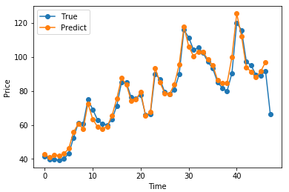
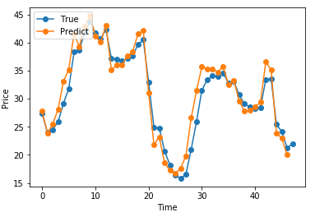
CNN + LSTM
5-6 February
9-10 February
MAPE: 4.16 → 3.57
MAPE: 7.24 → 5.7

Slide 10
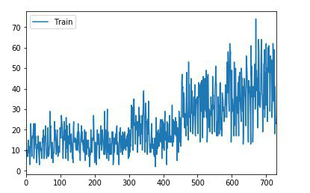
Number of passengers prediction
Data : Alibab dataset
One Feature Prediction as past model

Slide 11
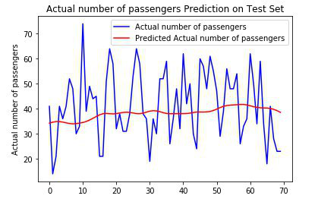
LSTM Univariate Time Series

Slide 12
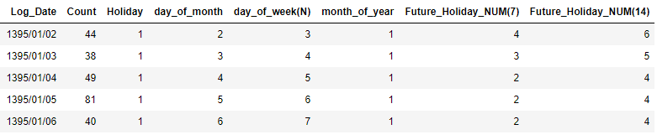
Feature engineering

Slide 13
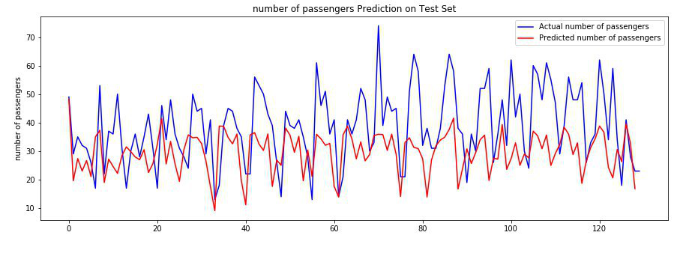
Random forest as baseline model
RMSE: 0.2

Slide 14
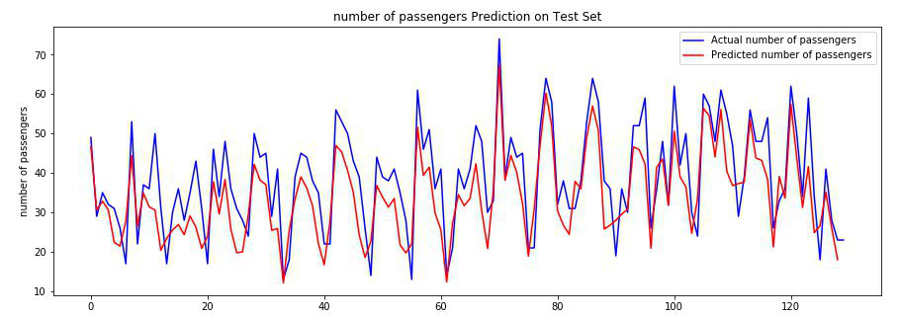
LSTM Multivariate Time Series
RMSE: 0.14

Slide 15
The end

