Slide 1

Recommender system
Deep
Shaghayegh jalali
Mahdi lotfi

Slide 2

What is the recommender system?
A Recommender System refers to a system that is capable of predicting the future preference of a set of items for a user, and recommend the top items.

Slide 3




Types of recommender systems:
Content based systems
Hybrid filtering
Content based systems use meta data such as genre, producer, actor, musician to recommend items say movies or music.
combining collaborative filtering, content-based filtering, and other approaches
Collaborative filtering
similarity
In collaborative filtering the behavior of a group of users is used to make recommendations to other users.
Nearest-neighbor-based methods are based on the similarity between pairs of items or users.

Slide 4
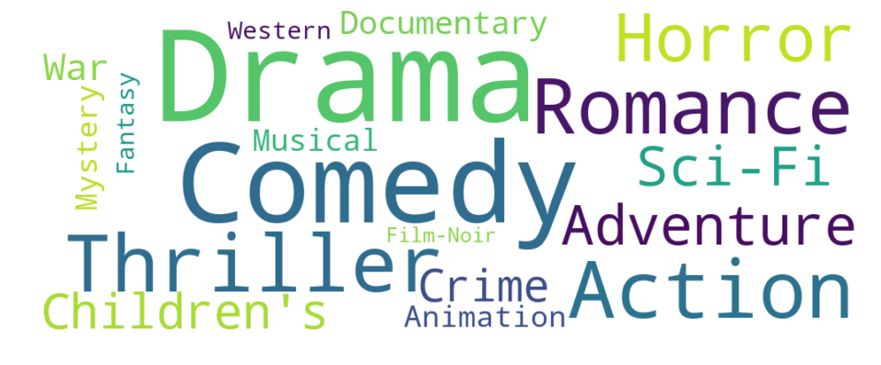
Dataset
Movielens
movies.csv
movieId
title
Rating.csv
genres
userId
movieId
rating
timestamp

Slide 5
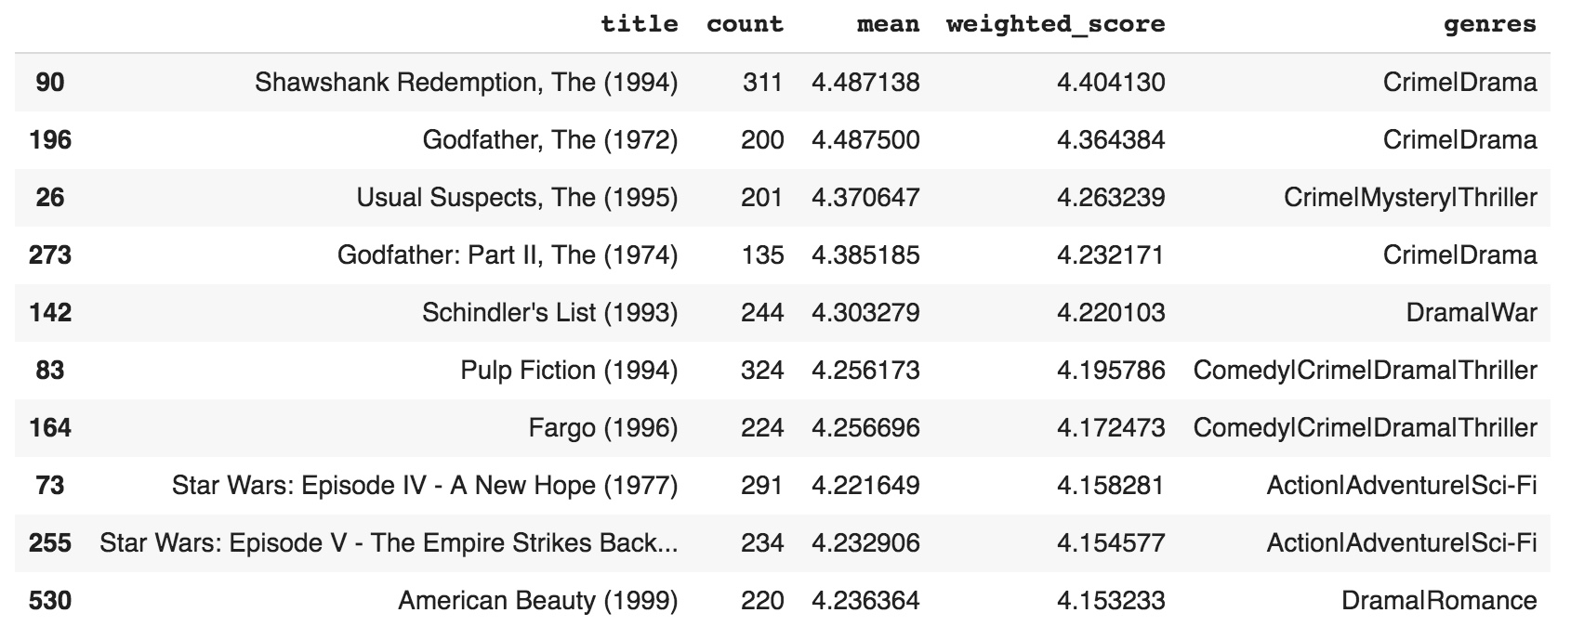
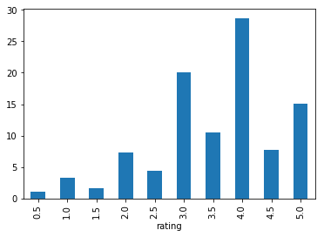
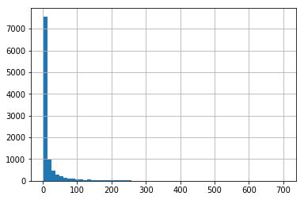
data mining
rating
Best movies
number_of_ratings
Wighted score

Slide 6
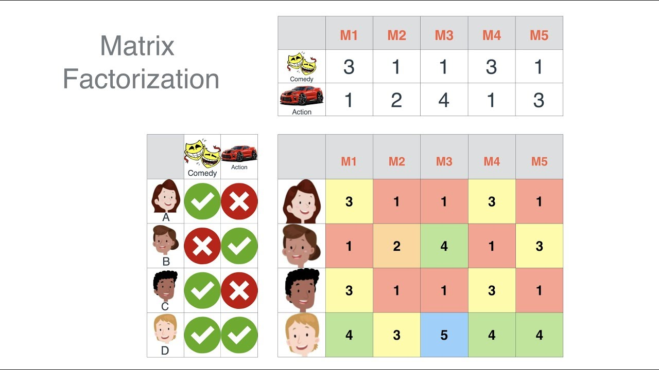

Slide 7
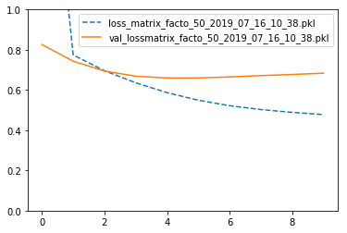
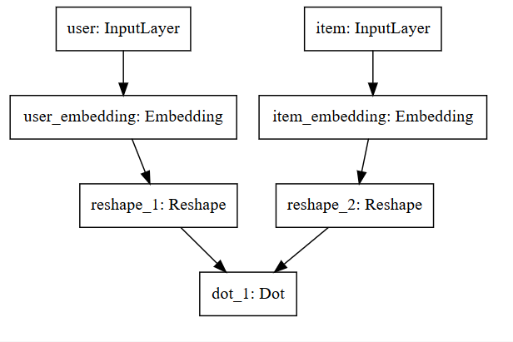
Models 20m
loss: 0.4778 - val_loss: 0.6836

Slide 8
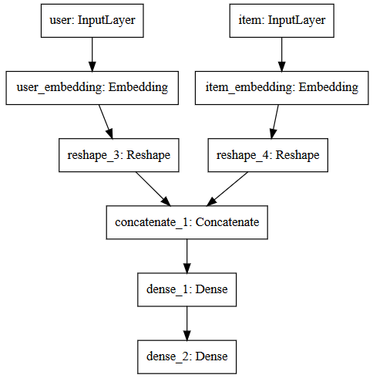
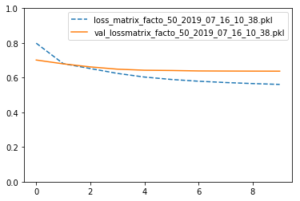
Models 20m
loss: 0.5610 - val_loss: 0.6372

Slide 9
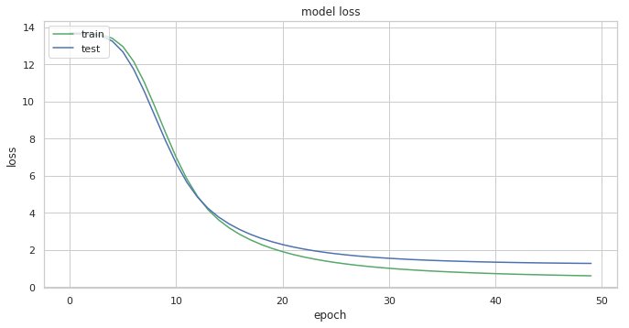
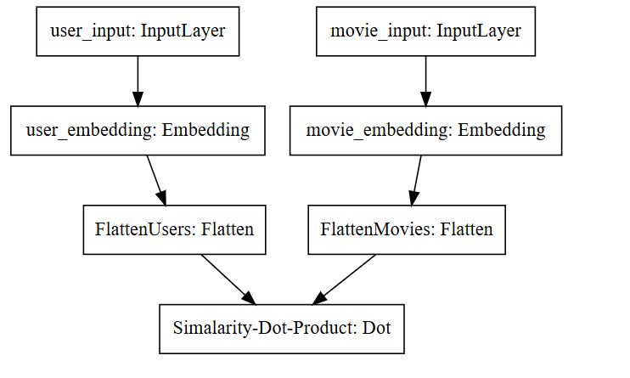
Models on 100k
loss: 0.6141 - val_loss: 1.2818

Slide 10
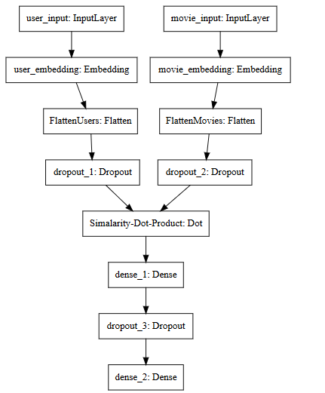
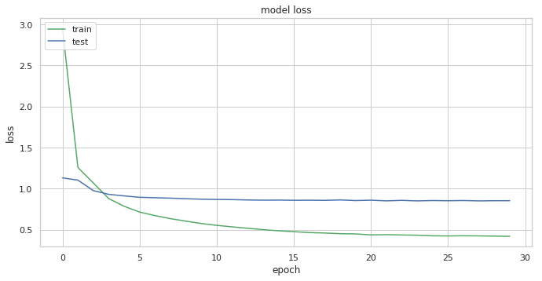
Models on 100k
Loss 0.4213 - val_loss: 0.8544

Slide 11


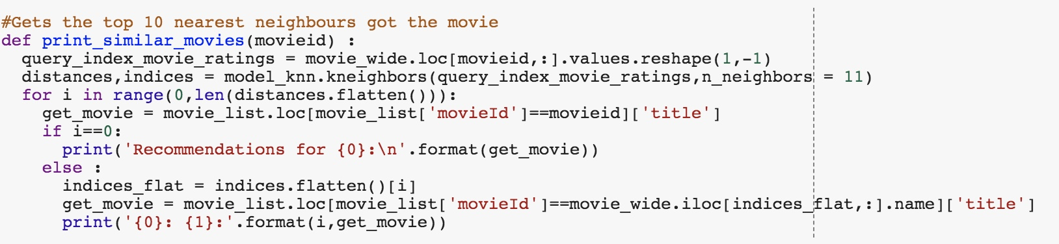

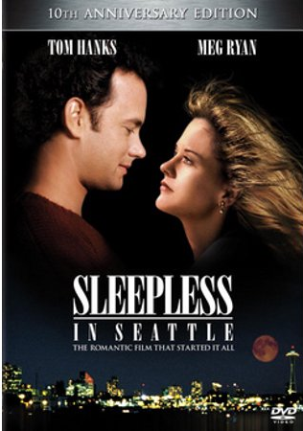
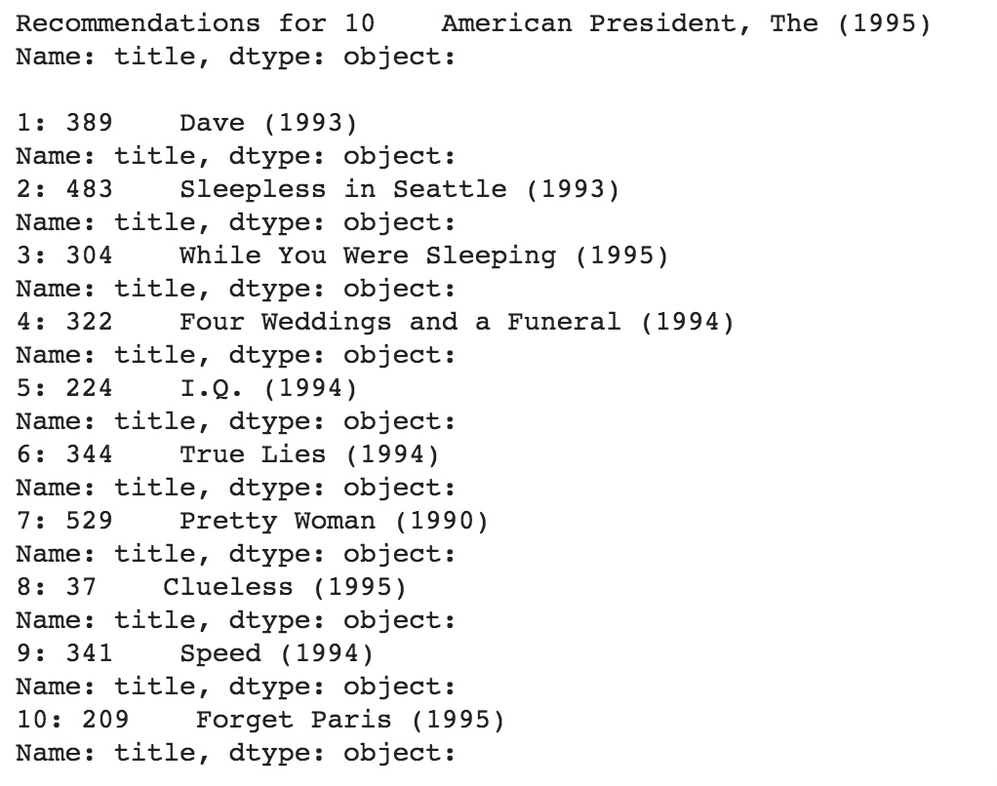


Machin learning

Slide 12
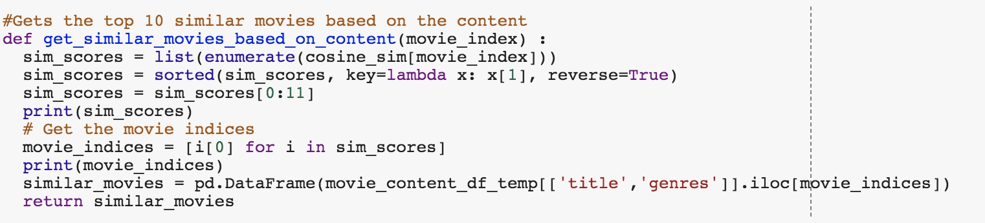

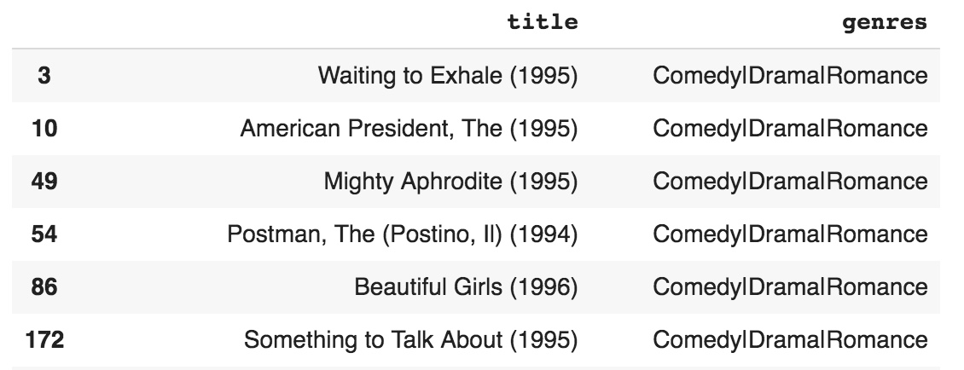
Machin learning

Slide 13
Thank you!
Any questions?
Shaghayegh jalali
Mahdi lotfi
9772068
97722185

