Slide 1
Easy data augmentation language Model

Slide 2
Data augmentation
Benefits:
Produce More Training data specially when we have small dataset
Reducing overfitting
Tasks for Text:
sentiment analysis, topic labeling , language detection, intent detection

Slide 3
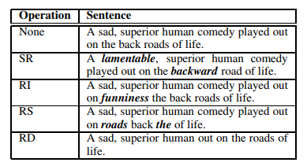
EDA: Easy data augmentation for boosting performance on text classification
Synonym replacement(SR)
Random insertion(RI)
Random swap(RS)
Random deletion(RD)
Number of words that should change
n=αl

Slide 4
benchmarks
SST-2 ,CR ,SUBJ ,TREC ,PC
We hypothesize that EDA is more helpful for smaller datasets
SST-2 , Text-Clustering: cluster 200 different texts related to games and sports

Slide 5
Our approach
Synonym replacement
Random insertion
Random swap
Random deletion
Random deletion+ Synonym replacement
Random not+ opposite

Slide 6
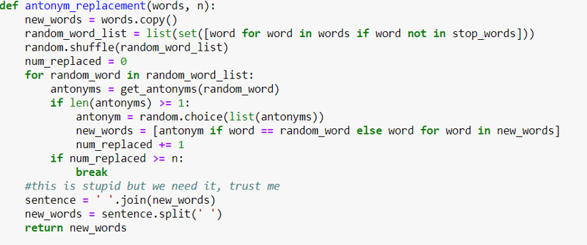

Slide 7
α= 0.05
Num_aug=16

Slide 8
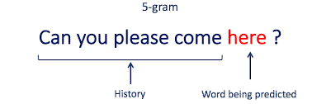
Language Model
Language Modelling is the core problem for a number of of natural language processing tasks such as speech to text, conversational system, and text summarization.
A trained language model learns the likelihood of occurrence of a word based on the previous sequence of words used in the text.

Slide 9

Language modeling
We used lstm for our model to predict the next words and we trained on 2 datasets
The accuracy of with-without augmentation has shown
Our model predict not bad according to that we ran it 5 epochs

Slide 10
Language Model after 5 epoch
SST-2 | Text-Clustering of games data
3.8 | 6.1
3.5 | 6.2
4.0 | 6.3

Slide 11
Challenges
Our augment approach improves the accuracy but it wasn’t so much.
For our limitations we used just part of our datasets .
We just Run LM code in 5 epochs because it takes so much time to execute.

Slide 12


