Slide 1
A Deep Learning Approach for Finding Bad Smells in Software Systems
Raana Saheb Nassagh
Deep Learning Course – AI - IUST - 2019

Slide 2
Outlines:
Problem Definition
Related Works
The main Idea
Implementation
Evaluation & Results
Future Work

Slide 3
Outlines:
Problem Definition
Related Works
The main Idea
Implementation
Evaluation & Results
Future Work

Slide 4


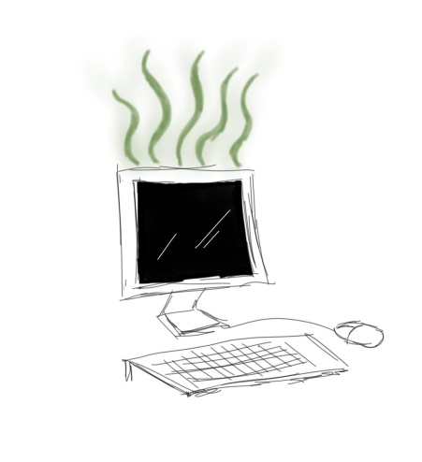
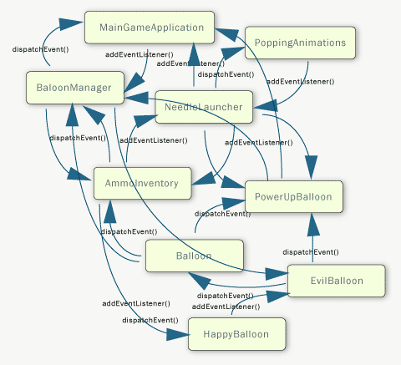
Problem Definition:
Flexibility
Maintainability
Reusability
God Class
Feature Envy
Lazy Class
Shotgun Surgery

Slide 5


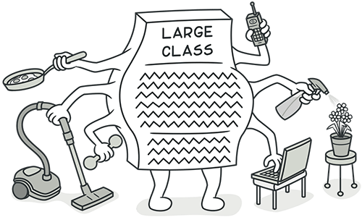
Problem Definition (Example):
Bad Smell
Refactoring
Large Class
Single Responsibility

Slide 6
Outlines:
Problem Definition
Related Works
The main Idea
Implementation
Evaluation & Results
Future Work

Slide 7

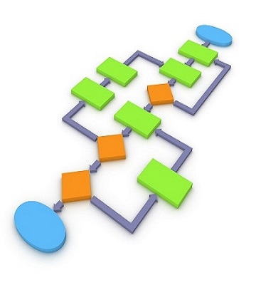
Related Works:
IPasma
InFusion
JDeodorant
Neural Network
Graph Modeling
Soft Computing

Slide 8
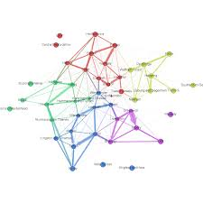

Related Works:
Graph Modeling
Clustering
Genetic Algorithm

Slide 9
What are the problems?
There is no tool that satisfies all bad smells
Not supporting all languages
The hole system is needed
There are no real features ..
Old systems / not user-friendly/not changeable
Complicated algorithms

Slide 10
Outlines:
Problem Definition
Related Works
The main Idea
Implementation
Evaluation & Results
Future Work

Slide 11

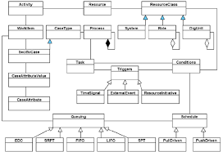
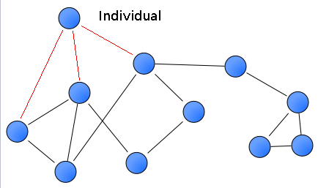
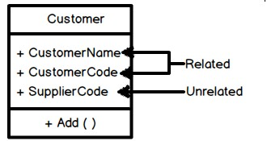
The main Idea: Find features
Features
Coupling
Cohesion

Slide 12
Feature Extraction:
Convert Code to UML Diagram
Visual Paradigm
Convert UML to XMI Format
Parse XMI Diagram and find Relations
Get dependency of classes with JavaCallGraph
Create weighted directional Graph
Find Graph properties (Indegree,load-c,..)
Find Cohesion properties (Lcom, Lcom2..)

Slide 13
Node Properties (Coupling) | Class Property (Cohesion) | Bad Smells
Degree Centrality | LCOM1 | God Class
Indegree Centrality | LCOM2 | Lazy Class
Outdegree Centrality |  | Feature Envy
Closeness Centrality |  | Shotgun Surgery
Load Centrality
Betweenness Centrality
Entropy
Critical

Slide 14
Outlines:
Problem Definition
Related Works
The main Idea
Implementation
Evaluation & Results
Future Work

Slide 15
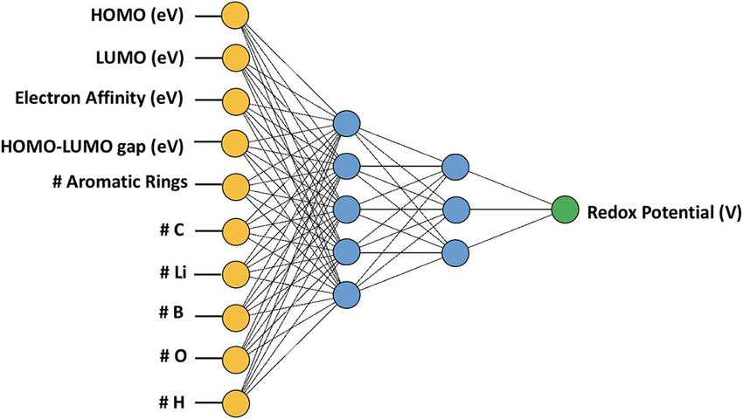
Simple Model:
Each class has 10 features
Has this class Bad Smells?

Slide 16
Simple Model:
model = Sequential()
model.add(Dense(64,activation='relu,input_shape=(10,)))
model.add(Dense(32, activation='relu'))
model.add(Dense(16, activation='relu))
model.add(Dense(8, activation='relu))
model.add(Dense(1, activation='sigmoid'))
model.compile(optimizer='sgd', loss='mean_squared_error', metrics=['acc'])
Normalization - Preprocess
Dropout - Activity_regularizer
Correlation – KBest - Polynomial
Cross Validation

Slide 17
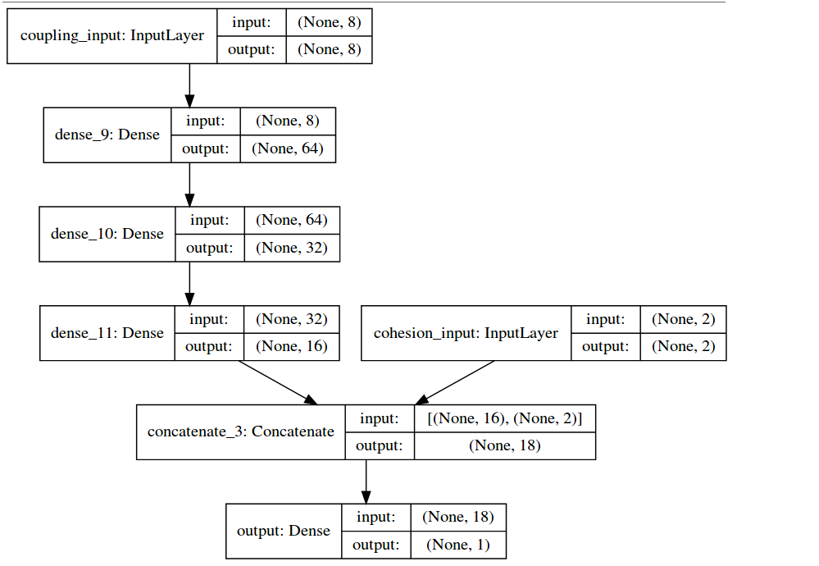
Model (improved):

Slide 18
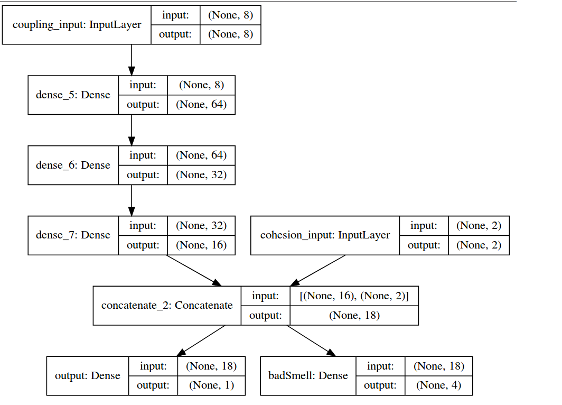
Model (improved):

Slide 19
Outlines:
Problem Definition
Related Works
The main Idea
Implementation
Evaluation & Results
Future Work

Slide 20
Evaluation & Results:
Source Codes:
Junit
Ganttproject
Mockito
IPlasma-Validation Set

Slide 21
Results:
Train Set | Test Set | Accuracy (Recognizing Bad Smell)
Junit | Ganttproject | 0.786
Junit | Mockito | 0.786
Ganttproject | Junit | 0.834
Ganttproject | Mockito | 0.786
Mockito | Junit | 0.767
Mockito | Ganttproject | 0.794
ALL [1500] | ALL[613] | 0.827

Slide 22
Results:
loss | output_loss (Is Bad) | badSmell_loss (Which Bad Smell) | output_acc (Is Bad) | badSmell_acc (Which BS)
0.21 | 0.09 | 0.10 | 0.88 | 0.70

Slide 23
Outlines:
Problem Definition
Related Works
The main Idea
Implementation
Evaluation & Results
Future Work

Slide 24
Future Work:
Test on many Source Codes
Test on other languages (independent?)
Are the neighbors of the nodes important?
Subnets of classes + Conv?

Slide 25
Outlines:
Problem Definition
Related Works
The main Idea
Implementation
Evaluation & Results
Future Work

Slide 26
References:
Bahareh Bafandeh Mayvan,Abbas Rasoolzadegan,Designpatterndetection based on the graph theory, Knowledge-Based Systems (2017), doi: 10.1016/j.knosys.2017.01.007
Savić, M., Ivanović, M. & Radovanović, M. Computing (2017) 99: 1055. https://doi.org/10.1007/s00607-017-0549-6
Gu, A., Zhou, X., Li, Z. et al. Arab J Sci Eng (2017) 42: 3551. https://doi.org/10.1007/s13369-017-2588-x
Chun Yong Chong , Sai Peck Lee , Automatic Clustering Constraints Derivation from Object-Oriented Software Using Weighted Complex Network with Graph Theory Analysis, The Journal of Systems & Software (2017), doi: 10.1016/j.jss.2017.08.017
Yu, F., Xia, X., Li, W. et al. Soft Comput (2017) 21: 5621. https://doi.org/10.1007/s00500-016-2303-y
Bian, T.; Hu, J.; Deng, Y. Identifying influential nodes in complex networks based on AHP. Phys. A Stat. Mech. Appl. 2017, 479, 422–436.
T. Bian, et al., Identifying influential nodes in complex networks based on AHP, Physica A (2017), http://dx.doi.org/10.1016/j.physa.2017.02.085
Salim Kebir, Isabelle Borne, Djamel Meslati, A Genetic Algorithm-Based Approach for Automated Refactoring of Component-Based Software, Information and Software Technology (2017), doi: 10.1016/j.infsof.2017.03.009

Slide 27
Thanks!

