Slide 1
Encrypted Packet Classification
Fatemeh mahdavi

Slide 2
Content
Introduction
Related Works
Methodology
Experimental Results
Challenges
References

Slide 3
Methodology
Dataset (VPN-nonVPN dataset (ISCXVPN2016))
Pre-processing
Architectures
Stacked Auto-Encoder (SAE) Deep Packet
1D CNN

Slide 4
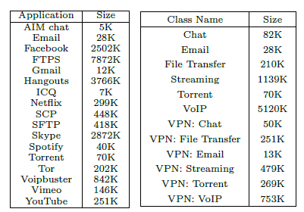
Dataset

Slide 5
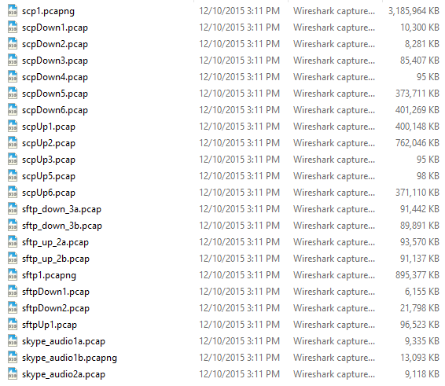
Dataset

Slide 6
Pre-processing

Slide 7

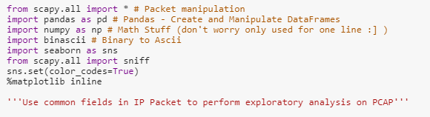

Pre-processing

Slide 8
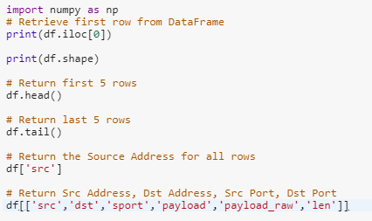

Slide 9
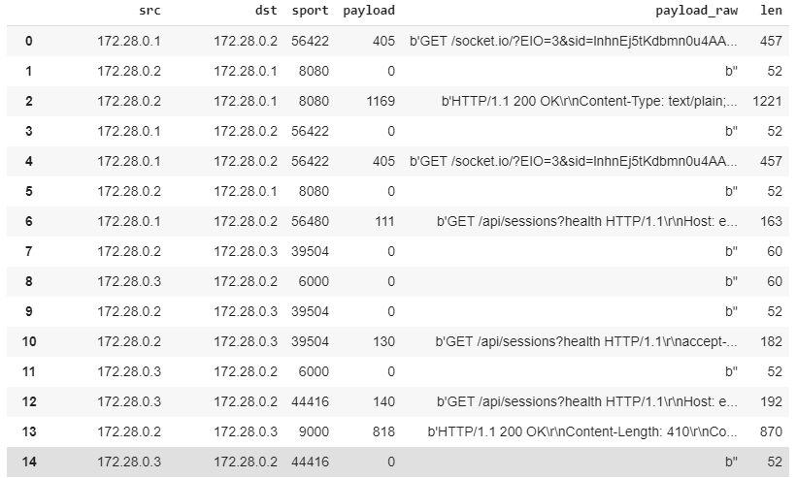
Pre-processing

Slide 10
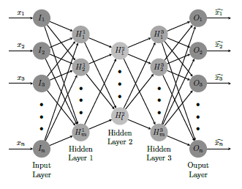
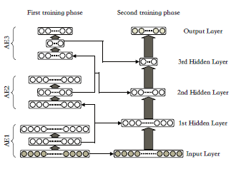
Stacked Auto-Encoder (SAE)

Slide 11
Stacked Auto-Encoder (SAE)
five fully-connected layers
made up of 400, 300, 200, 100, and 50 neurons
after each layer the dropout technique with 0.05 dropout rate (To prevent the over-fitting problem)
a softmax classifier with 17 neurons are added to final layer of application identification task SEA
a softmax classifier with 12 neurons are added to final layer of traffic characterization task SEA

Slide 12
1D CNN

Slide 13
1D CNN
two consecutive convolutional layers, followed by a pooling layer.
two-dimensional tensor is squashed into a one-dimensional.
Vector fed into a three-layered network of fully connected neurons which also employ dropout technique
Finally, a softmax classier is applied for the classification task.

Slide 14
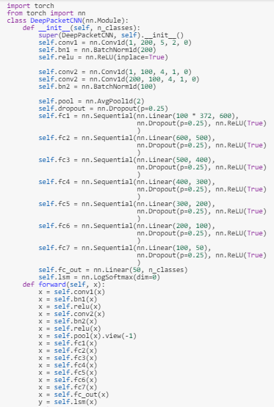

Slide 15
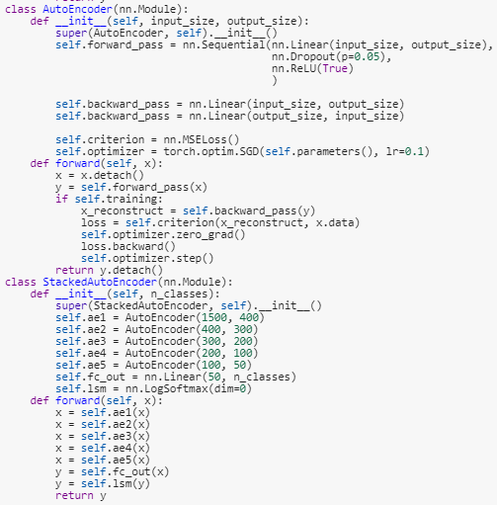

Slide 16
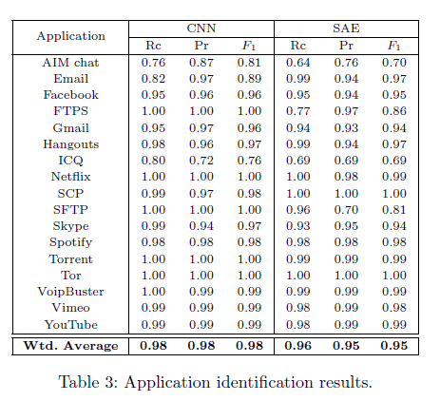
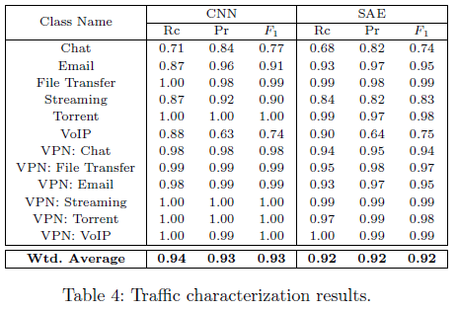
Experimental Results

Slide 17
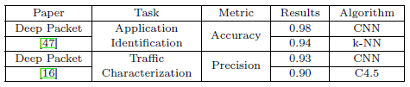
Experimental Results

Slide 18
Challenges
Preparation .pcap format files.
Time-consuming and complex training state because of large dataset.

Slide 19
References
[1] M. Lotfollahi, M. Jafari Siavoshani, R. Shirali Hossein Zade, M. Saberian, "Deep Packet: A Novel Approach For Encrypted Traffic Classification Using Deep Learning," arXiv:1709.02656v3 [cs.LG], 4 Jul 2018.
[2] G. D. Gil, A. H. Lashkari, M. Mamun, A. A. Ghorbani, "Characterization of encrypted and vpn traffic using time-related features," in 2nd International Conference on Information Systems Security and Privacy (ICISSP 2016), 2016.
[3] B. Yamansavascilar, M. A. Guvensan, A. G. Yavuz, M. E. Karsligil, "Application identification via network traffic classification," in Computing, Networking and Communications (ICNC), 2017 International Conference on IEEE, 2017.
[4] V. Paxson, S. Floyd, "Wide area traffic: The failure of poisson modeling," IEEE/ACM Transactions on Networking, vol. 3, no. 3, pp. 226-244, 1995.
[5] D. Wang, L. Zhang, Z. Yuan, Y. Xue, Y. Dong, "Characterizing application behaviors for classifying p2p traffic," in International Conference on Computing, Networking and Communications, ICNC, IEEE, 2014.
[6] J. Sherry, C. Lan, R. A. Popa, S. Ratnasamy, "Blindbox: Deep packet inspection over encrypted traffic," in Proceedings of the 2015 ACM Conference on Special Interest Group on Data Communication, SIGCOMM, ACM, New York, NY, USA, 2015.
[7] Z. Wang, "The applications of deep learning on traffic identification," BlackHat USA, 2015.

