Slide 1
Sentiment analysis using BERT (pre-training language representations) and Deep Learning on Persian texts
Soroush Karimi
Fatemeh Sadat Shahrabadi

Slide 2
problem statement
1

Slide 3
Sentiment analysis and natural language processing
Brand monitoring
Competitive research
Flame detection and customer service prioritization
Product analysis
Market research and insights into industry trends
Workforce analytics/employee engagement monitoring

Slide 4
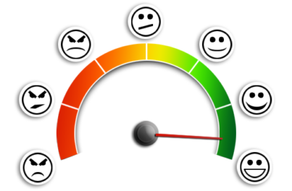
Input Sample
"ساعت خوبی بود از نظر ظاهر و سنسوراش خوب بود_x000D_ولی یه بدی بزرگی که داره بعد 3 ماه بندش خشک گرفت و پاره شد بندشم هیچ جا حتی دیجی نداشتx000D_عملا دیگه قابل استفاده نبود_x000D_ به نظرم با توجه به نظرات بقیه هم که گفتن پاره میشه تا وقتی که بند یدکی نداره نخرید پولتون میریزید دور"
"ارزش خرید نداره. هزینه بیشتر بکنید و گزینه های بهتر خریداری کنین."
"حتما گوشی واقعن خوبه خیلی خوبه a7 2018 رو بخرین واقعا برای اونایی که گوشی رو دست نگرفتنو نظر بد میدن همش اشتباه اصلا داغ نمیکنه اصلا هنگ نمیکنه و دوربینشم فوق العاده"

Slide 5
Output Sample
[('ساعت خوبی بود از نظر ظاهر و سنسوراش خوب بود_x000D_ولی یه بدی بزرگی که داره بعد 3 ماه بندش خشک گرفت و پاره شد بندشم هیچ جا حتی دیجی نداشتx000D_عملا دیگه قابل استفاده نبود_x000D_ به نظرم با توجه به نظرات بقیه هم که گفتن پاره میشه تا وقتی که بند یدکی نداره نخرید پولتون میریزید دور',
array([-3.9536180e-03, -5.5351005e+00], dtype=float32),
'Negative'),
('ارزش خرید نداره. هزینه بیشتر بکنید و گزینه های بهتر خریداری کنین.',
array([-2.4673278e-03, -6.0058746e+00], dtype=float32),
'Negative'),
('حتما گوشی واقعن خوبه خیلی خوبه a7 2018 رو بخرین واقعا برای اونایی که گوشی رو دست نگرفتنو نظر بد میدن همش اشتباه اصلا داغ نمیکنه اصلا هنگ نمیکنه و دوربینشم فوق العاده',
array([-2.2144477 , -0.11565089], dtype=float32),
'Positive')

Slide 6
Challenges
2

Slide 7

Challenges
Named Entity Recognition
Anaphora Resolution
Parsing
Sarcasm
poor spelling, poor punctuation, poor grammar …

Slide 8

Past solutions
3

Slide 9
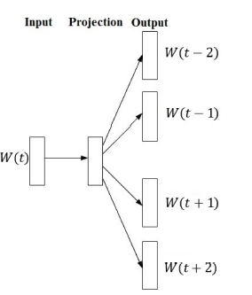
Skip-gram model
For learning vector representations of words
Unsupervised
150726 unlabeled sentences

Slide 10
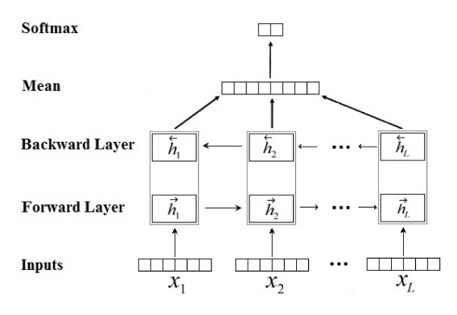
Bidirectional Long Short Term Memory (LSTM)

Slide 11
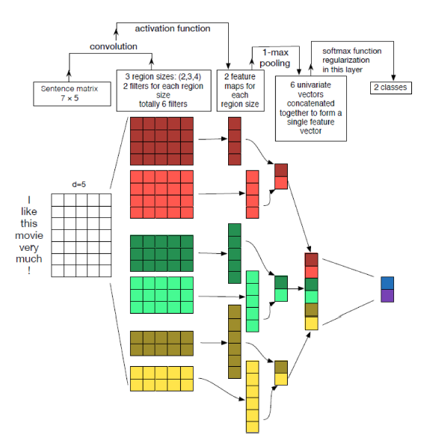
Convolutional Neural Network (CNN)

Slide 12
Our solution!
4

Slide 13
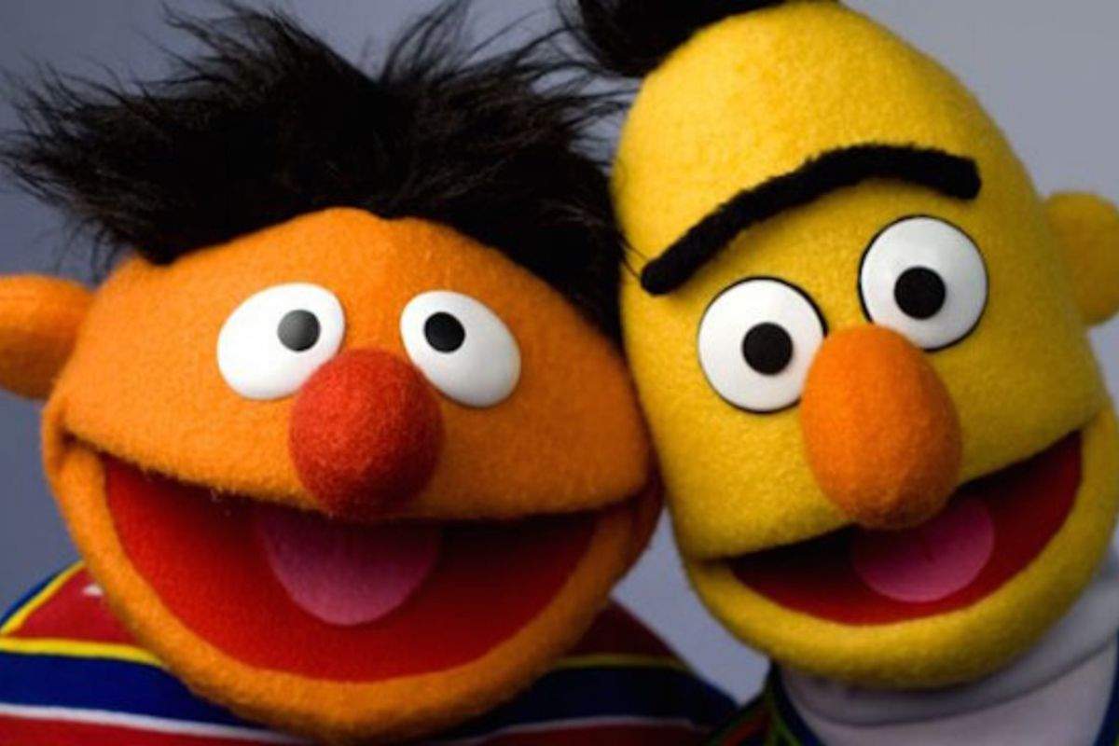
Bidirectional Encoder Representations from Transformers
first unsupervised, deeply bidirectional system for pre-training NLP
contextual Pre-trained representation

Slide 14
BERT Approach
mask out 15% of the words in the input, run the entire sequence through a deep bidirectional Transformer encoder, and then predict only the masked words
Input: the man went to the [MASK1] . he bought a [MASK2] of milk.
Labels: [MASK1] = store; [MASK2] = gallon

Slide 15
Past Results
5

Slide 16
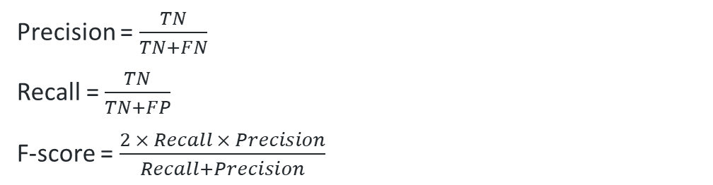
Computing results
 | predicted as negative | Predicted as positive
Negative | TN | FP
positive | FN | TP
Precision = $\frac{TN}{TN+FN}$
Recall = $\frac{TN}{TN+FP}$
F-score = $\frac{2 × Recall × Precision}{Recall+Precision}$

Slide 17
Computing results
Confusion matrix for NBSVM-bi:
 | predicted as negative | Predicted as positive
Negative | 123 | 262
positive | 51 | 4568
Confusion matrix for CNN:
 | predicted as negative | Predicted as positive
Negative | 201 | 184
positive | 139 | 4480
Confusion matrix for Bidirectional-LSTM:
 | predicted as negative | Predicted as positive
Negative | 201 | 184
positive | 170 | 4449

Slide 18
Final results
Approach | Precision | Recall | F-score
NBSVM-bi | 70.7 | 31.9 | 44.0
Bidirectional-LSTM | 54.2 | 35.2 | 53.2
CNN | 59.1 | 52.2 | 55.4

Slide 19
Our Results
6

Slide 20
Computing results
Confusion matrix for BERT (unbalanced data for fine-tuning and testing):
 | predicted as negative | Predicted as positive
Negative | 188 | 235
positive | 109 | 4472
Confusion matrix for BERT (balanced data for fine-tuning and unbalanced data for testing):
 | predicted as negative | Predicted as positive
Negative | 415 | 8
positive | 849 | 3732

Slide 21
Computing results
Confusion matrix for BERT (positive data twice the negative data for fine-tuning and unbalanced data for testing):
 | predicted as negative | Predicted as positive
Negative | 378 | 45
positive | 390 | 4191
Confusion matrix for BERT (balanced data for fine-tuning by increasing negative data and unbalanced data for testing):
 | predicted as negative | Predicted as positive
Negative | 267 | 205
positive | 480 | 5032

Slide 22
Final results
Approach | Precision | Recall | F-score
BERT (unbalanced data for fine-tuning and testing): | 0.44 | 0.63 | 0.51
BERT (balanced data for fine-tuning and unbalanced data for testing) | 0.32 | 0.98 | 0.48
BERT (positive data twice the negative data for fine-tuning and unbalanced data for testing) | 0.49 | 0.89 | 0.63
BERT (balanced data for fine-tuning by increasing negative documents and unbalanced data for testing) | 0.35 | 0.56 | 0.43

Slide 23
Compare Results
7

Slide 24
Compare results

Slide 25
Thanks for your attention

