Slide 1
Argument Reasoning Comprehension
Deep Learning Class Final Project Report
Ali Asghar Taghizadeh
Summer 2020

Slide 2
Outline
Problem definition
Related works
Proposed method
Results
Future works

Slide 3
What does reasoning mean in AI?
Building AI models that are able to perform decisions that are somehow related to logical relations between inputs.
Example:
Richardson, K., Hu, H., Moss, L. S., & Sabharwal, A. (2019). Probing Natural Language Inference Models through Semantic Fragments. http://arxiv.org/abs/1909.07521

Slide 4
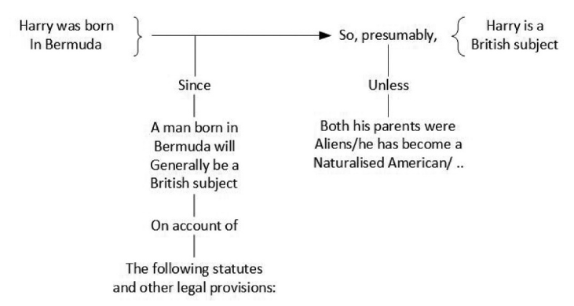
What is Argumentation Mining
Building AI models to deal with finding argumentative parts of a piece of text, classifying them ,relation between them, scoring it … .
Lytos, A., Lagkas, T., Sarigiannidis, P., & Bontcheva, K. (2019). The evolution of argumentation mining: From models to social media and emerging tools. Information Processing and Management, 56(6), 102055. https://doi.org/10.1016/j.ipm.2019.102055

Slide 5
Warrants are invisible
As a component of arguments warrants are not specified in utterance.
e.g:
It is raning; You should take a umbrella. => It’s bad to get wet.
warrant

Slide 6
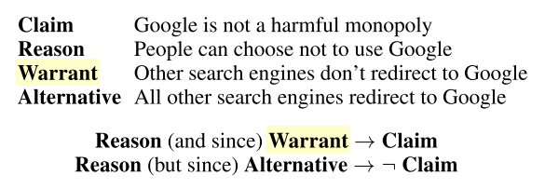
Our task:
Determine the right warrant, given the claim and reason for the topic being talked.
Example:
Training# | Development# | Test#
1210 | 316 | 444
Clark, P., Tafjord, O., & Richardson, K. (2020). Transformers as Soft Reasoners over Language. Figure 2. http://arxiv.org/abs/2002.05867

Slide 7
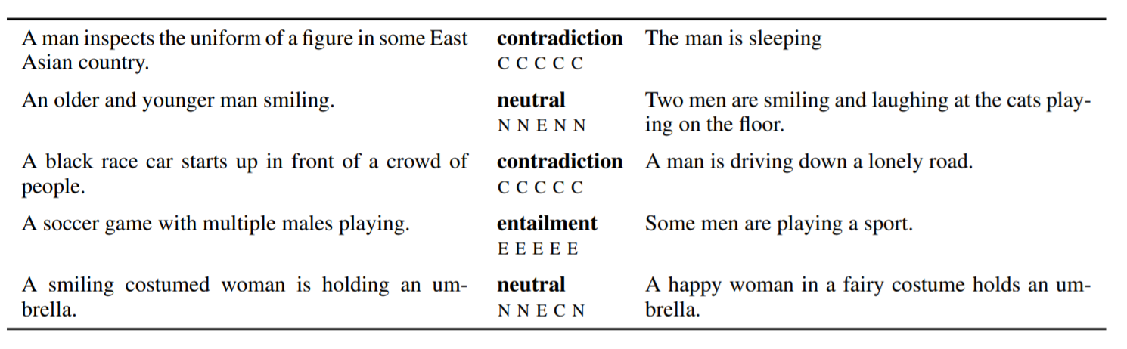
Related Tasks
The task of Natural Language Inference Is very related to this task.
Richardson, K., Hu, H., Moss, L. S., & Sabharwal, A. (2019). Probing Natural Language Inference Models through Semantic Fragments. http://arxiv.org/abs/1909.07521
Notes:
A large annotated corpus for learning natural language inference

Slide 8
Previous Works
Choi, et al. used a method previously proposed for NLI task (ESIM) and used NLI datasets to transfer knowledge from NLI tasks.
Botschen et al. used Knowledge Graphs to enhance the features.
Niven et al. Models based on Bert achieved state of the art results (73% acc on test set)

Slide 9
Challenge dataset
A new trend recently
If we change the claim to it’s opposite, will the model choose the alternative warrant?
Bert performance fell from near human performance to essentially random.

Slide 10
Proposed solutions
If it’s a challenge related to negation impact may the datasets used for logic learning be helpful.
If it’s due to lack of information we should use knowledge graphs.

Slide 11
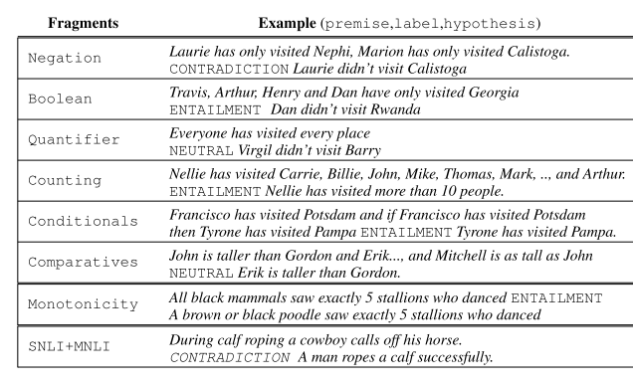
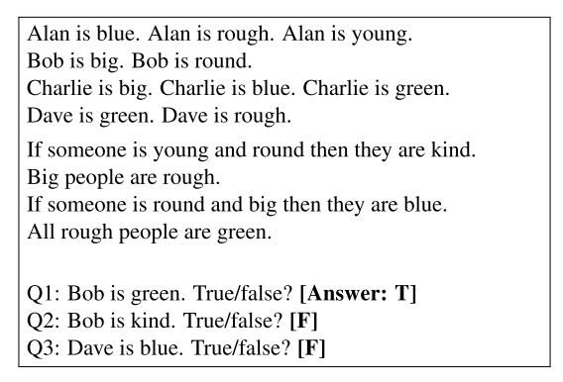
Learning Logic
Transformers as Soft Reasoners over Language
Probing Natural Language Inference Models
through Semantic Fragments

Slide 12
My experiments
On original task (acc):
On challenged task (acc):
On challenged task with logic fine tuning (acc):
distilbert | bert | SOTA (bert)
73% | 65% | 73%
distilbert | bert | SOTA(bert)
55% | 49% | 53% (max)
distilbert
50%

Slide 13
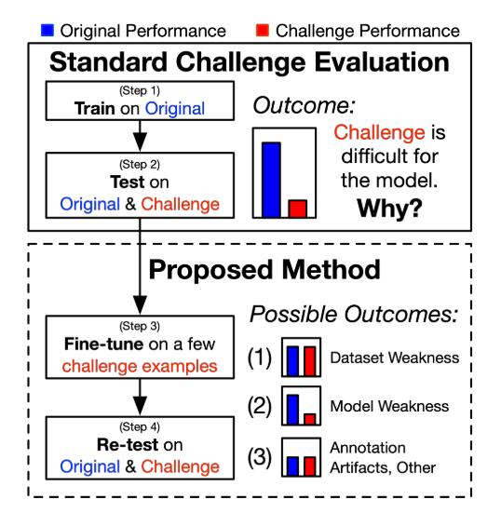
Inoculation by fine tuning
Liu, N. F., Schwartz, R., & Smith, N. A. (2019). Inoculation by fine-tuning: A method for analyzing challenge datasets. NAACL HLT 2019 - 2019 Conference of the North American Chapter of the Association for Computational Linguistics: Human Language Technologies - Proceedings of the Conference, 1, 2171–2179. https://doi.org/10.18653/v1/n19-1225

Slide 14
Using knowledge graphs
KnowBert
AdapterBert
Peters, M. E., Neumann, M., Logan, R. L., Schwartz, R., Joshi, V., Singh, S., & Smith, N. A. (2020). Knowledge enhanced contextual word representations. EMNLP-IJCNLP 2019 - 2019 Conference on Empirical Methods in Natural Language Processing and 9th International Joint Conference on Natural Language Processing, Proceedings of the Conference,
Wang, R., Tang, D., Duan, N., Wei, Z., Huang, X., ji, J., Cao, G., Jiang, D., & Zhou, M. (2020). K-Adapter: Infusing Knowledge into Pre-Trained Models with Adapters. http://arxiv.org/abs/2002.01808

Slide 15
Results with Knowledge graph
I have used knowbert for feature extraction only
Distilbert (acc)
50%

Slide 16
Refrences
Choi, H., & Lee, H. (2018). GIST at SemEval-2018 Task 12 : A network transferring inference knowledge to Argument Reasoning Comprehension task. 773–777.
Clark, P., Tafjord, O., & Richardson, K. (2020). Transformers as Soft Reasoners over Language. Figure 2. http://arxiv.org/abs/2002.05867
Habernal, I., Wachsmuth, H., Gurevych, I., & Stein, B. (2018). The Argument Reasoning Comprehension Task: Identification and Reconstruction of Implicit Warrants. 1930–1940. https://doi.org/10.18653/v1/n18-1175
Liu, N. F., Schwartz, R., & Smith, N. A. (2019). Inoculation by fine-tuning: A method for analyzing challenge datasets. NAACL HLT 2019 - 2019 Conference of the North American Chapter of the Association for Computational Linguistics: Human Language Technologies - Proceedings of the Conference, 1, 2171–2179. https://doi.org/10.18653/v1/n19-1225

Slide 17
Refrences
Lytos, A., Lagkas, T., Sarigiannidis, P., & Bontcheva, K. (2019). The evolution of argumentation mining: From models to social media and emerging tools. Information Processing and Management, 56(6), 102055. https://doi.org/10.1016/j.ipm.2019.102055
Niven, T., & Kao, H.-Y. (2019). Probing Neural Network Comprehension of Natural Language Arguments. Table 1, 4658–4664. https://doi.org/10.18653/v1/p19-1459
Peters, M. E., Neumann, M., Logan, R. L., Schwartz, R., Joshi, V., Singh, S., & Smith, N. A. (2020). Knowledge enhanced contextual word representations. EMNLP-IJCNLP 2019 - 2019 Conference on Empirical Methods in Natural Language Processing and 9th International Joint Conference on Natural Language Processing, Proceedings of the Conference, 43–54. https://doi.org/10.18653/v1/d19-1005
Richardson, K., Hu, H., Moss, L. S., & Sabharwal, A. (2019). Probing Natural Language Inference Models through Semantic Fragments. http://arxiv.org/abs/1909.07521
Wang, R., Tang, D., Duan, N., Wei, Z., Huang, X., ji, J., Cao, G., Jiang, D., & Zhou, M. (2020). K-Adapter: Infusing Knowledge into Pre-Trained Models with Adapters. http://arxiv.org/abs/2002.01808

Slide 18
Used libraries and repositories
https://huggingface.co/
https://github.com/allenai/kb

Slide 19
