Slide 1

Personality Detection from Personality Cafe
Samin Fatehi Aug 2020

Slide 2

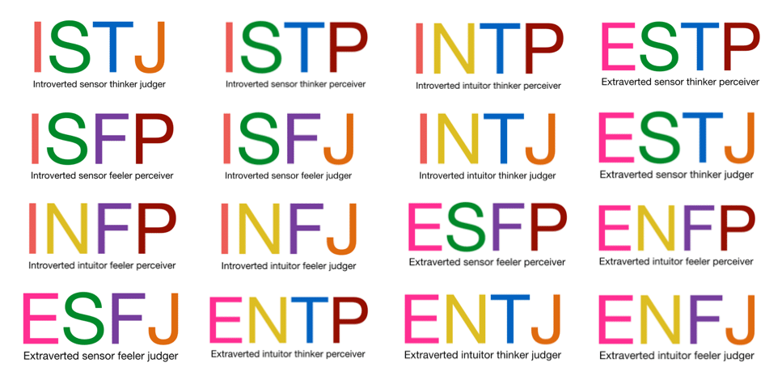

Dataset
MBTI Personality traits
8675 rows
50 posts from Personality Cafe
2

Slide 3
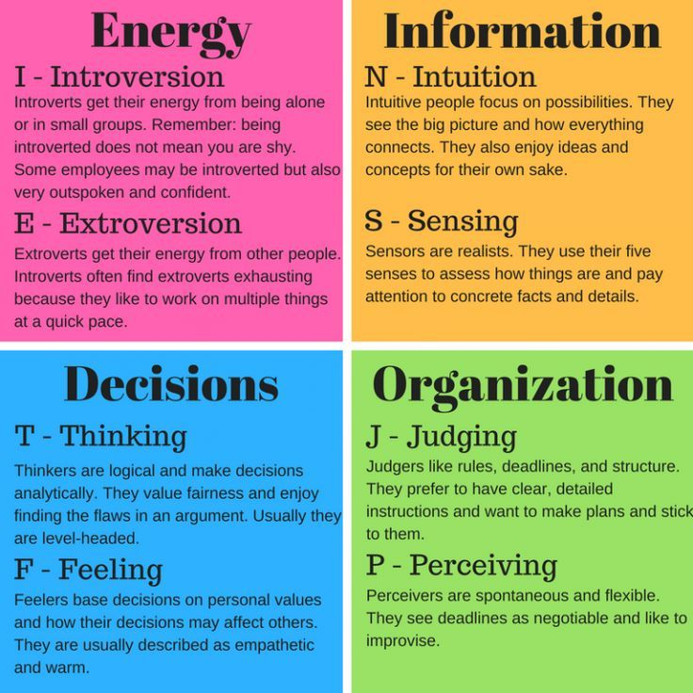
Baseline
traits | Recurrent Neural Network
I/E | 67.6%
N/S | 62%
T/F | 77.8%
J/P | 63.7%
TF-IDF
LSTM
3

Slide 4
Features
BERT
Finetuning
Feature Extraction
TF-IDF
4

Slide 5
Features
BERT
Finetuning
Feature Extraction
4

Slide 6
Features
Traits | Accuracy
I/E | 83.92%
N/S | 89.26%
T/F | 80.94%
J/P | 75.96%
BERT
Finetuning
Feature Extraction
5

Slide 7
Features
Traits | Accuracy
I/E | 75.82%
N/S | 86.05%
T/F | 56.21%
J/P | 55.05%
BERT
Finetuning
Feature Extraction
MLP
6

Slide 8
Hyper-parameters optimization
Traits | Accuracy
I/E | 75.82%
N/S | 86.05%
T/F | 56.21%
J/P | 55.05%
7

Slide 9
Hyper-parameters optimization
Random Search
Traits | Accuracy
I/E | 75.82%
N/S | 86.05%
T/F | 56.21%
J/P | 55.05%
Grid Search
Genetic Algorithm
Bayesian Optimization
…
7

Slide 10
Hyper-parameters optimization
Random Search
Traits | Accuracy
I/E | 75.82%
N/S | 86.05%
T/F | 56.21%
J/P | 55.05%
Grid Search
Genetic Algorithm
Bayesian Optimization
…
7

Slide 11
Hyper-parameters optimization
Traits | Accuracy | Accuracy (with optimization)
I/E | 75.82% | 75.61%
N/S | 86.05% | 87.51%
T/F | 56.21% | 57.40%
J/P | 55.05% | 65.69%
8

Slide 12
Hyper-parameters optimization
MLP
RNN
Traits | Accuracy | Accuracy (with optimization) | Accuracy (with optimization)
I/E | 75.82% | 75.61% | 75.26%
N/S | 86.05% | 87.51% | 87.51%
T/F | 56.21% | 57.40% | 62.66%
J/P | 55.05% | 65.69% | 63.71%
9

Slide 13
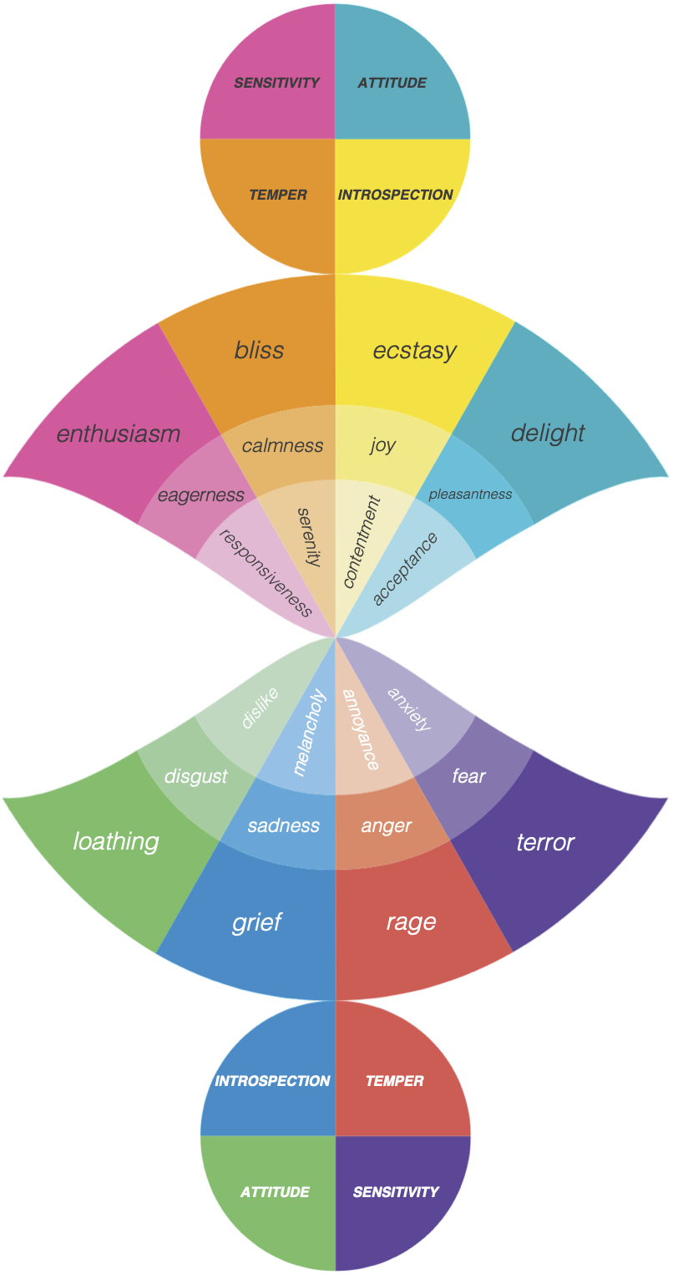
Features
BERT
SenticNet (concept-level sentiment analysis)
hourglass
AffectiveSpace
“I went to the market to buy fruits and vegetables.”
buy_fruit
buy_vegetable
10
pic from https://sentic.net/

Slide 14
Results
Traits
Accuracy | I/E | N/S | T/F | J/P
Baseline (deep models) | 67.60% | 62 % | 77.80 % | 63.70 %
Baseline (Gradient Boosting) | 78.17 % | 86.06 % | 71.78 % | 65.70 %
MLP | 75.82 % | 86.05 % | 56.21 % | 55.05 %
MLP (with optimization) | 75.61% | 87.51% | 57.40% | 65.69 %
MLP (with Sentic featuers) | 78.11% | 86 % | 60.58 % | 60.35 %
BERT Finetuning | 83.92% | 89.26% | 80.94% | 75.96%
11

Slide 15
Results
Traits
Accuracy | I/E | N/S | T/F | J/P
Baseline (deep models) | 67.60% | 62 % | 77.80 % | 63.70 %
Baseline (Gradient Boosting) | 78.17 % | 86.06 % | 71.78 % | 65.70 %
MLP | 75.82 % | 86.05 % | 56.21 % | 55.05 %
MLP (with optimization) | 75.61% | 87.51% | 57.40% | 65.69 %
MLP (with Sentic featuers) | 78.11% | 86 % | 60.58 % | 60.35 %
BERT Finetuning | 83.92% | 89.26% | 80.94% | 75.96%
11

Slide 16
Thank You.

