Slide 1

docker day
2017 Dec
Isfahan University of Technology

Slide 2


Alireza Omidi
aomidi@acm.org
Julia
Software Engineering BSc
Senior Student
Isfahan University of Technology
@a1ir3za
@alirezaomidi

Slide 3
Shipping Problem

Slide 4





Softwares are Complex

Slide 5


Slide 6
C o n t a i n e r

Slide 7
Docker Begins!
Container
VM
App
App
App
App
App
App
Bins/Libs
Bins/Libs
Bins/Libs
Bins/Libs
Bins/Libs
Bins/Libs
Docker
Guest OS
Guest OS
Guest OS
Host OS
Hypervisor
Infrastructure
Infrastructure

Slide 8
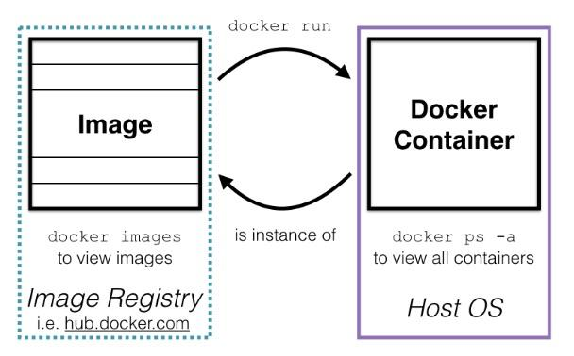
Image vs. Container

Slide 9
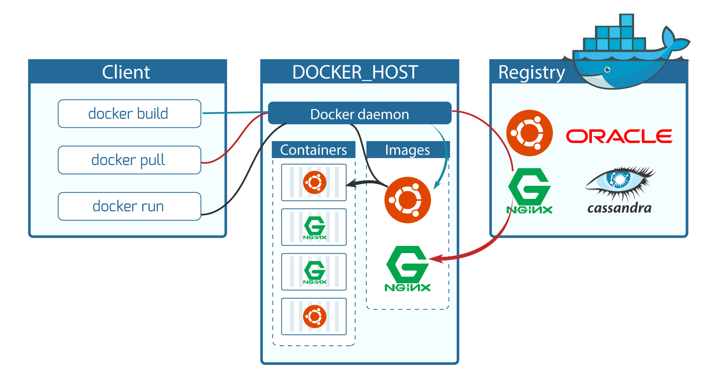
Image vs. Container

Slide 10
Demo
hub.docker.com
docker pull
docker run
docker images
docker ps
docker exec
Docker Basic Commands
Notes:
How to install:
https://docs.docker.com/engine/installation/linux/docker-ce/ubuntu/
curl -fsSL get.docker.com | sh
Play with Docker: http://play-with-docker.com
docker --version
Docker Hub: https://hub.docker.com
docker images
docker ps
Docker container types:
script
interactive
daemon
docker run hello-world
docker ps -a
for i in {1..10}; do docker run --rm hello-world | head -n 2 | tail -n 1; done
docker pull python
docker run -it python
docker run -it python:2.7
docker exec -it <containerid> bash
hostname

Slide 11
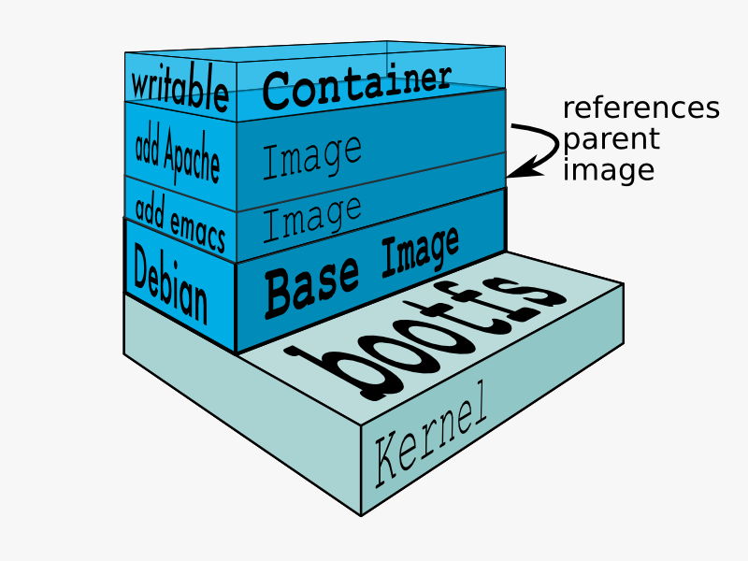
Docker Layers

Slide 12
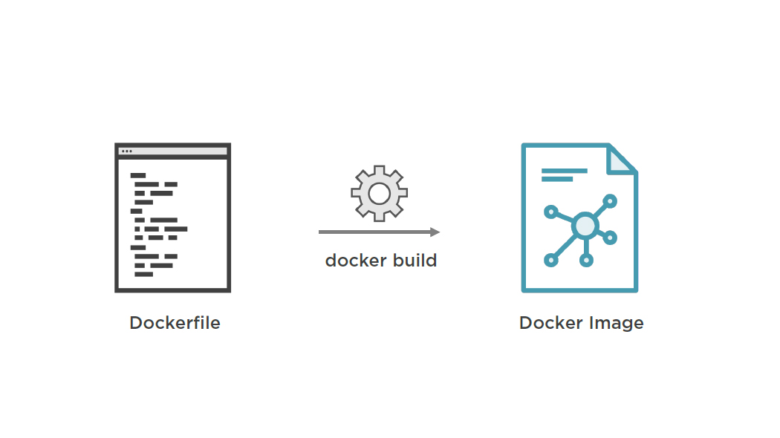
How to Create a Docker Image?

Slide 13
Dockerfile: An Example
FROM ubuntu
MAINTAINER Alireza Omidi
RUN apt-get update && apt install -y nginx
COPY index.html /usr/share/nginx/html/
CMD /usr/sbin/nginx -g “daemon off;”
EXPOSE 80

Slide 14
Demo
FROM
CMD, ENTRYPOINT
RUN
ADD, COPY
WORKDIR
MAINTAINER
LABEL
Dockerfile
Notes:
cd ~/Desktop/docker-day/codes/dockerfile/pinger
docker build -t pinger .
docker images
There also can be tags
docker run -it pinger

Slide 15
Docker Use cases

Slide 16
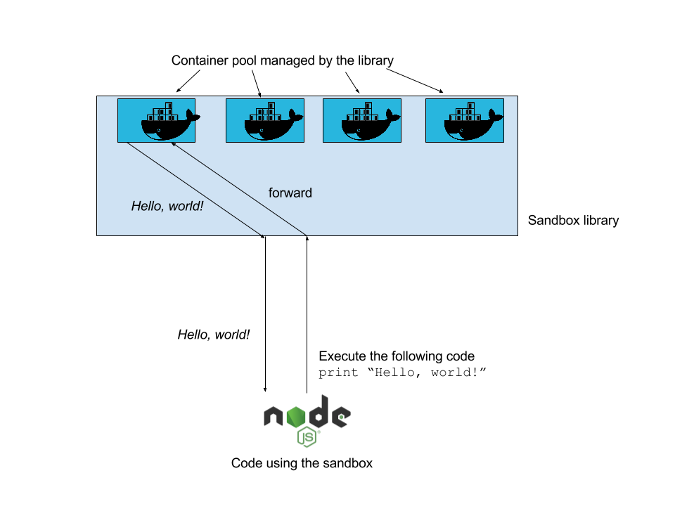
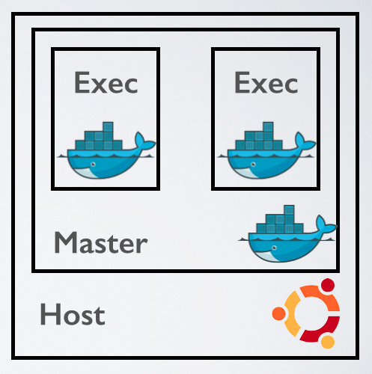
Sandboxing
Notes:
https://github.com/christophetd/docker-python-sandbox

Slide 17




Continuous(?) Integration
git push
Delivery
Production Server
System Admin
(The miserable one!)

Slide 18


Slide 19


Continuous Integration
git push
trigger
CI
docker pull
Tests ok
docker push
Docker Registry
Production Server

Slide 20
Docker Compose: An Example
votinglb:
image: dockercloud/haproxy
links:
- voting
ports:
- '80:80'
voting:
build: voting/
links:
- redis
results:
build: results/
links:
- redis
ports:
- "8000:80"
redis:
image: redis

Slide 21
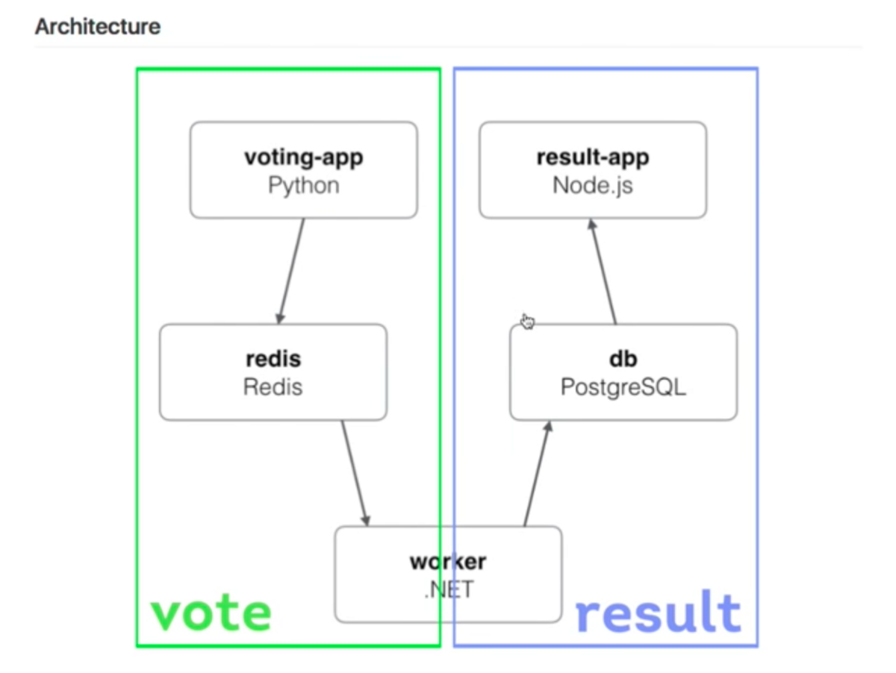
High Availability

Slide 22
Demo
docker-compose
Github
Docker Cloud
CI & High Availability
Notes:
https://github.com/alirezaomidi/voting-demo
cd ~/Desktop/docker-day/codes/voting-demo/
docker-compose up -d
http://localhost
http://localhost:8000
https://cloud.docker.com/app/alirezaomidi/repository/list
vim app.py
git add .
git commit -m ‘changed to tab vs space’
git push origin master
https://cloud.docker.com/app/alirezaomidi/repository/list
docker-compose scale voting=2

Slide 23
Distributed Docker

Slide 24
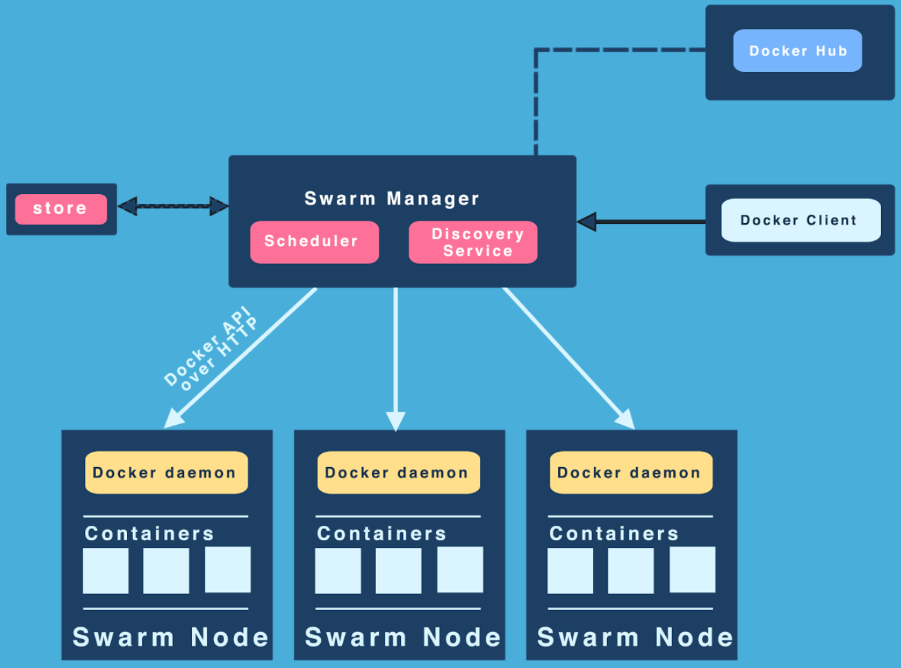
Swarm Mode

Slide 25
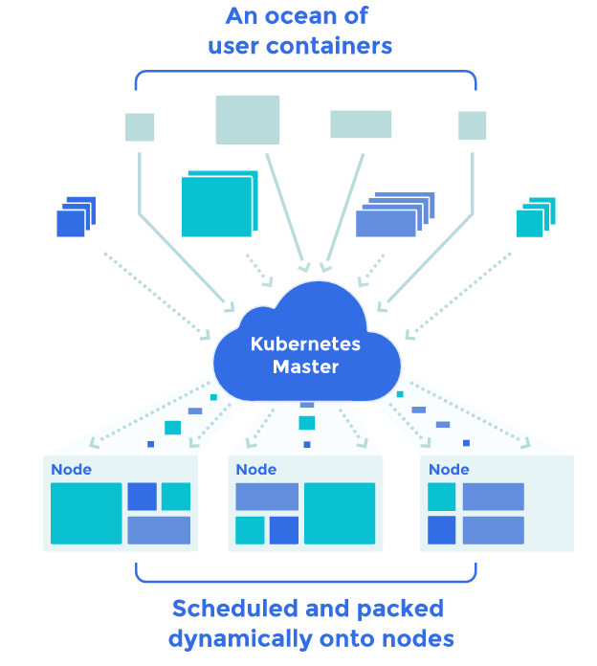
Kubernetes

Slide 26
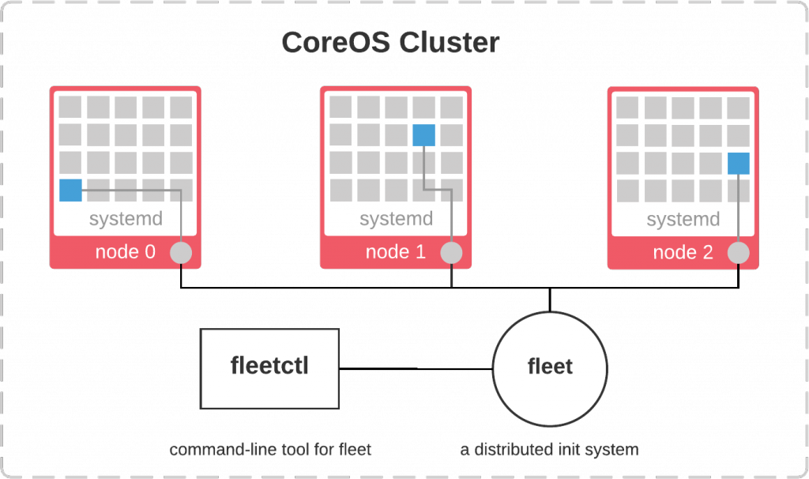
CoreOS

Slide 27
References
http://training.play-with-docker.com/
https://docs.docker.com/get-started/
https://kubernetes.io/docs/tutorials/kubernetes-basics/

Slide 28

Thank you!

