Slide 1

Kingday
Team:
SuxrobKhodja Sayfuddinov
Timurbek Kholmuzaev
Ulmasbek Rakhmatullaev
Ulugbek Khamdamov
Zafar Ubaydullaev
Sardorbek Khalimov
ID:
U1610237
U1610240
U1610244
U1610245
U1610254
U1610259

Slide 2

Overview
Kingday is a manufacturer dealing with textile productions.
The website that we created provides a full information about Kingday’s productions and shipment options.
In addition, from the website customers can choose design patterns and color variations that suits them.
From the admin panel sales manager can add or delete customers.

Slide 3
Goals & Problems
Problems | Goals
Many customers have a problem with directly connecting to the manufacturing company and purchase products from them easily with a few steps. | Save time for purchase using web technology
No search options | To enable buyer to pick from many color combinations
 | To enable direct contact with manufacturer

Slide 4



Project Idea
Our objective is to create an online store for manufacturer
The Website will show the products of the company with colour combinations and design patterns
Customers can search for the blankets among variety of design collections and see the price of the product

Slide 5
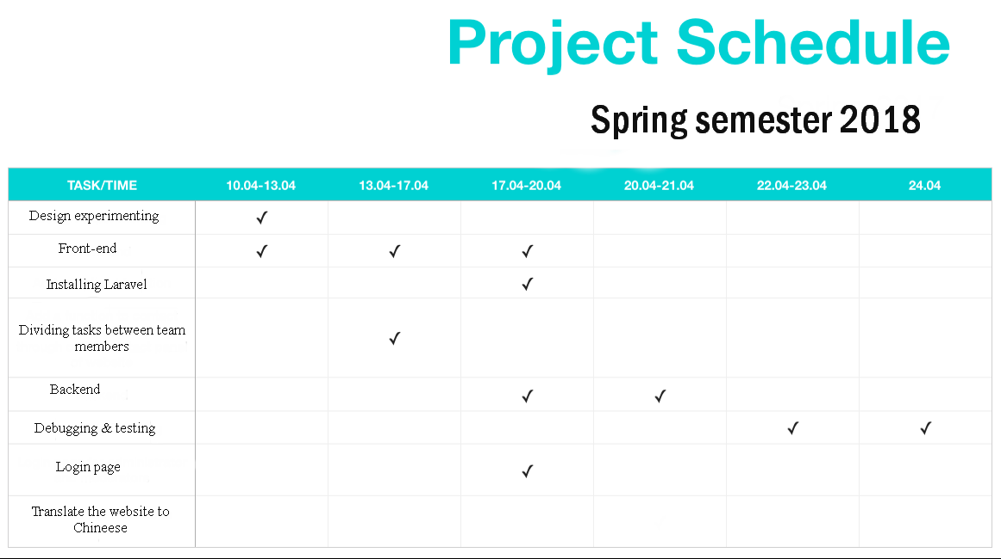
Project schedule
First Week-Design
Second Week-Frontend&Backend
Third Week-Backend
Fourth Week –Last Changes

Slide 6
Contribution
Below students worked on Laravel Framework (Backend)
Ulmasbek Rakhmatullaev
1) Login page
2) Admin page
3) Database
4) Making basket for storing items
Ulugbek Khamdamov
1) Events handling
2) Working on backend of Upload item page
3) Bug fixing
4) Input Validation using regular expressions
Sardorbek Khalimov
1) Data collect
2) Backdoor
3) Checkbox
Below Students worked on design of web-site (Front-end)
SuxrobKhodja Sayfuddinov
1) Scale design
2) Make comprehensive user interface
3) Bootstrap
Timurbek Kholmuzaev
1) Write to team
2) Making logo for the site
3) Buttons design
Zafar Ubaydullaev
1) Design corrections
2) Make website maximum simple and fast for user to load it
3) Make a support for tablet display

Slide 7


Slide 8
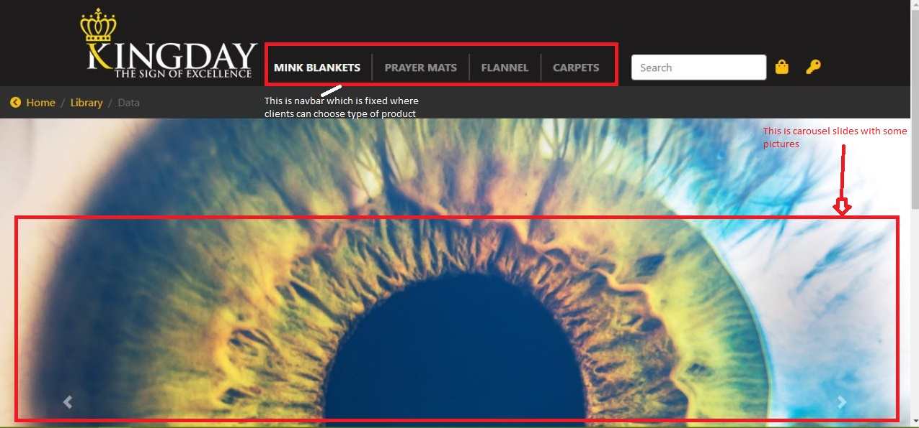
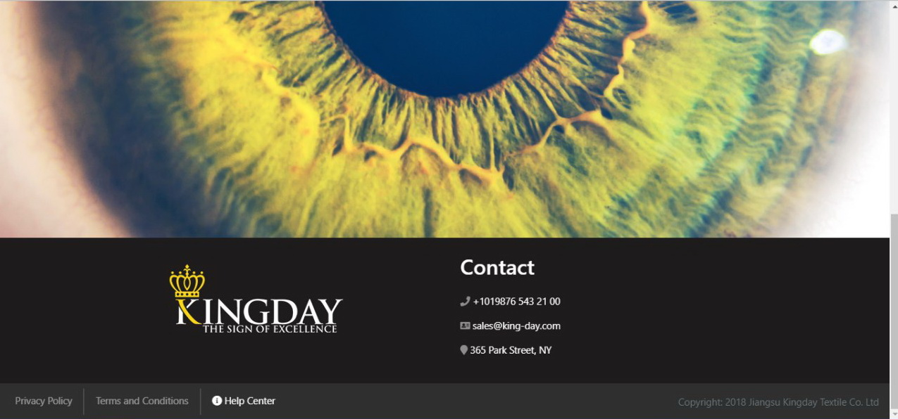

Slide 9
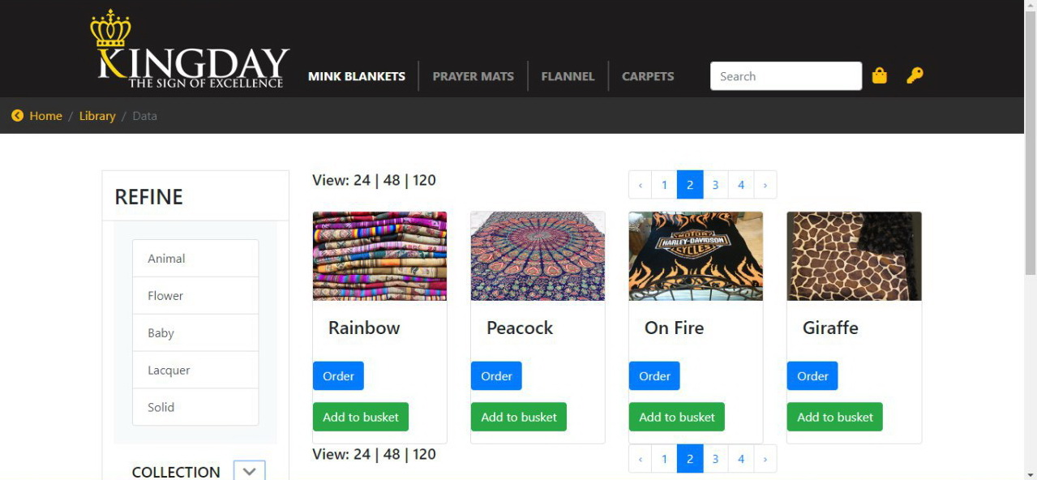
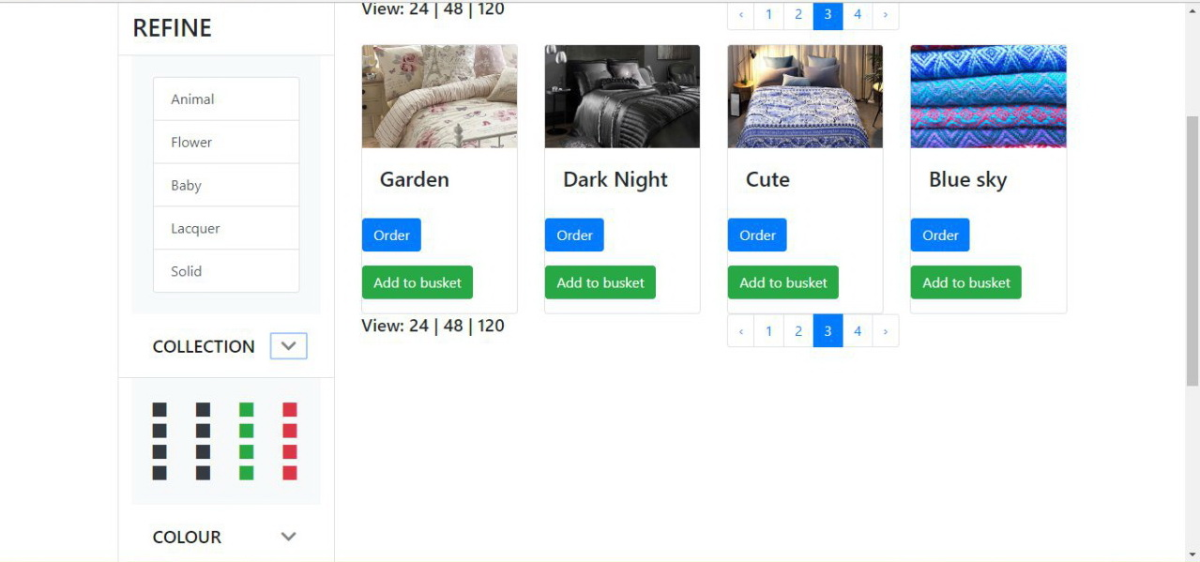
From this page client can pick one of the
different types of blanket’s and also client
can choose the color of the blanket then
client can put the chosen product to his or her basket.

Slide 10
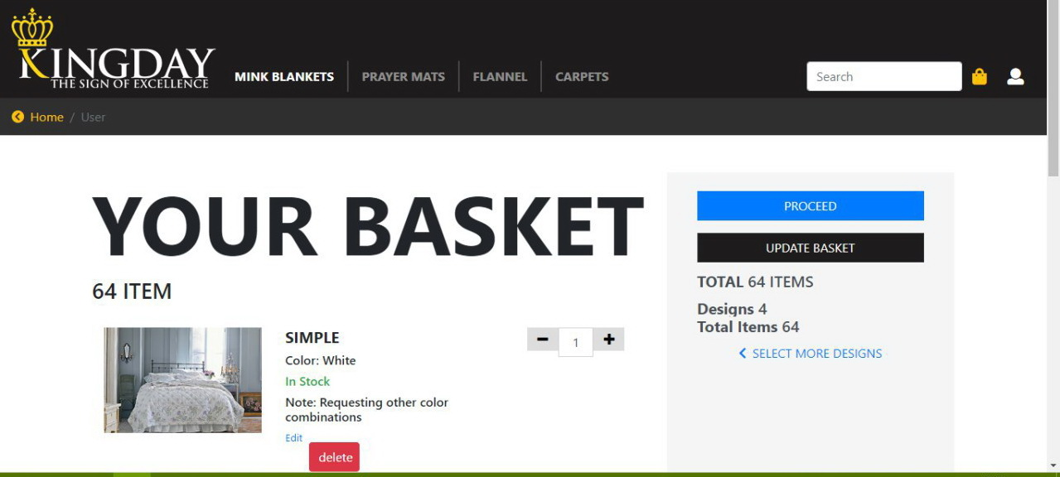
This page shows the items that client chose and their number

Slide 11
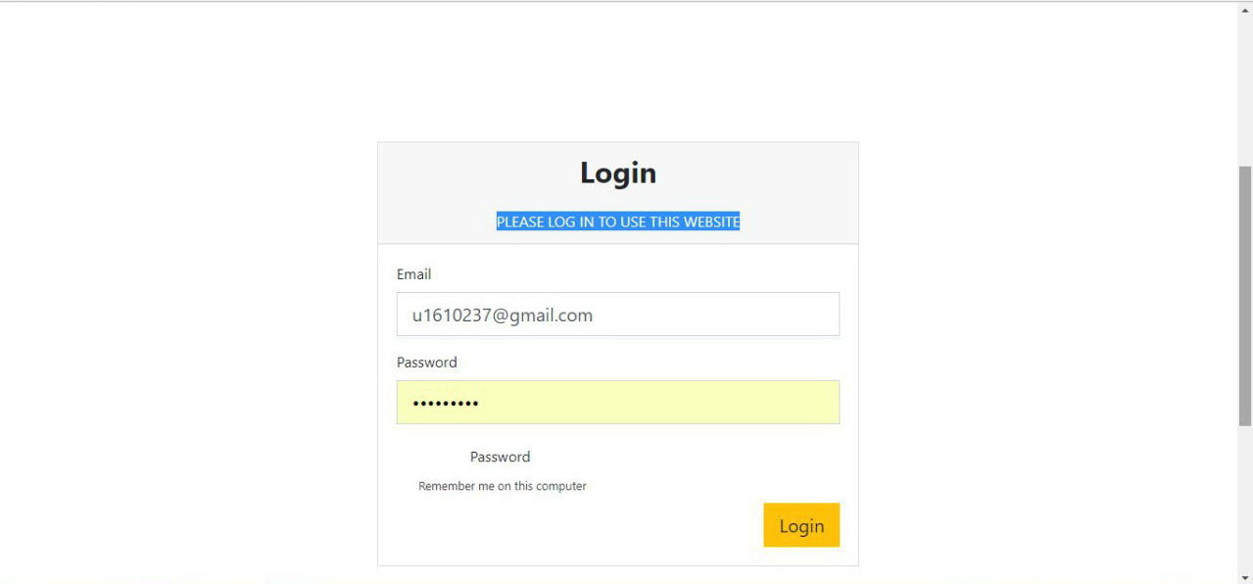

Slide 12
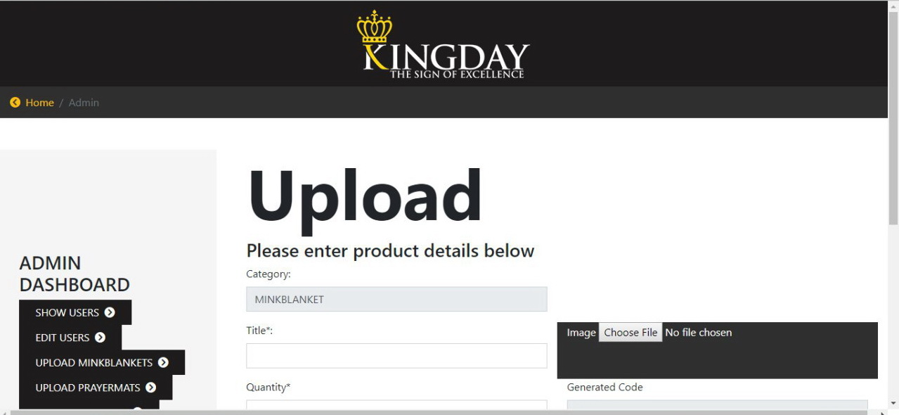
In these page registered admins can add new products

Slide 13


Slide 14
Link to our github repo
https://github.com/iuthub/design-project-ostore.git

