Slide 1
Online Rental Car Project_Elaboration_1
By: Xai Vang, Sampson Abrahams,
Samira Adam, & Sipxaysana Xayaxang

Slide 2

Table of Contents
Elaboration One
Vision
Scope
Use Case Diagram (updated)
Domain Model
Class/Design Model
Data Model
Sequence Diagram
System Sequence Diagram
Software Architecture Document

Slide 3
Elaboration: Vision
We envision a reservation application/system for small to medium size companies that can take in reservations. For example, a small Car Rental Company will be able to use this system for customers to reserve a car. This system should allow the company to be able to see things like, number of active rentals, pending rentals and view customer information.

Slide 4
Elaboration: Scope
The system/application should have database integration technology to store information such as customer data, car data, reservation data and more. The system should be able to allow the company to view its past and upcoming reservations

Slide 5
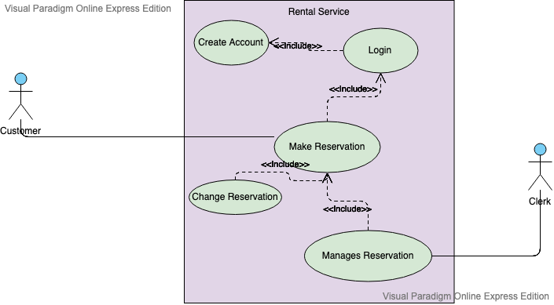
Use Case Diagram (updated)

Slide 6
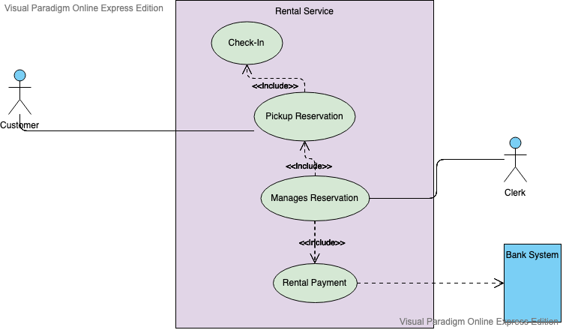
Use Case Diagram (updated)

Slide 7
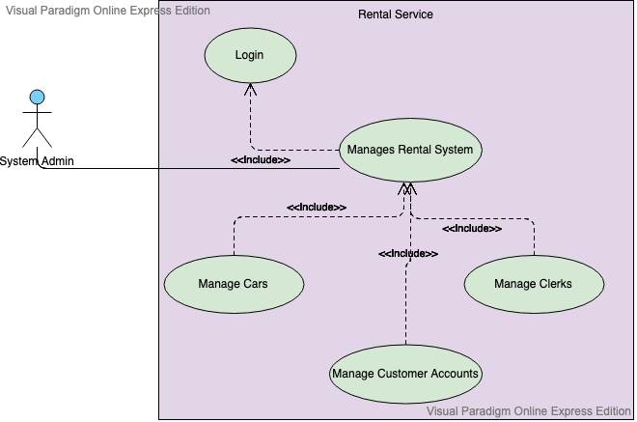
Use Case Diagram (updated)

Slide 8
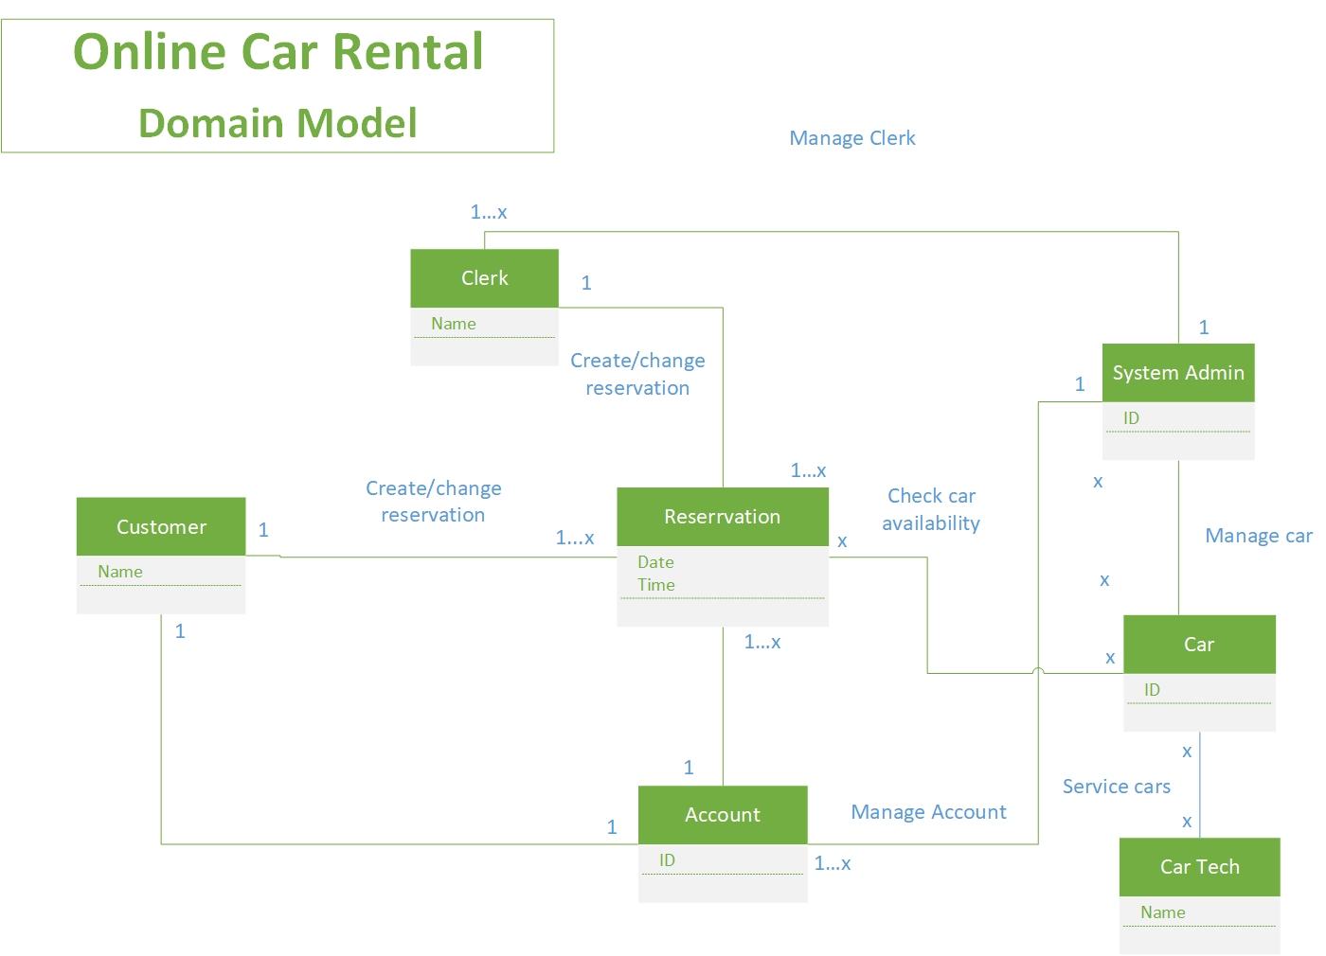
Domain Model
..

Slide 9
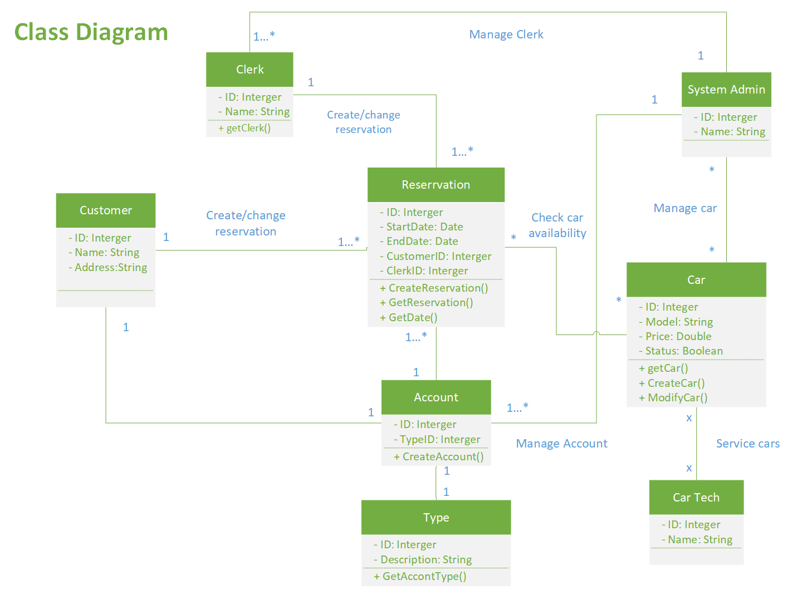
Class/Design Model

Slide 10
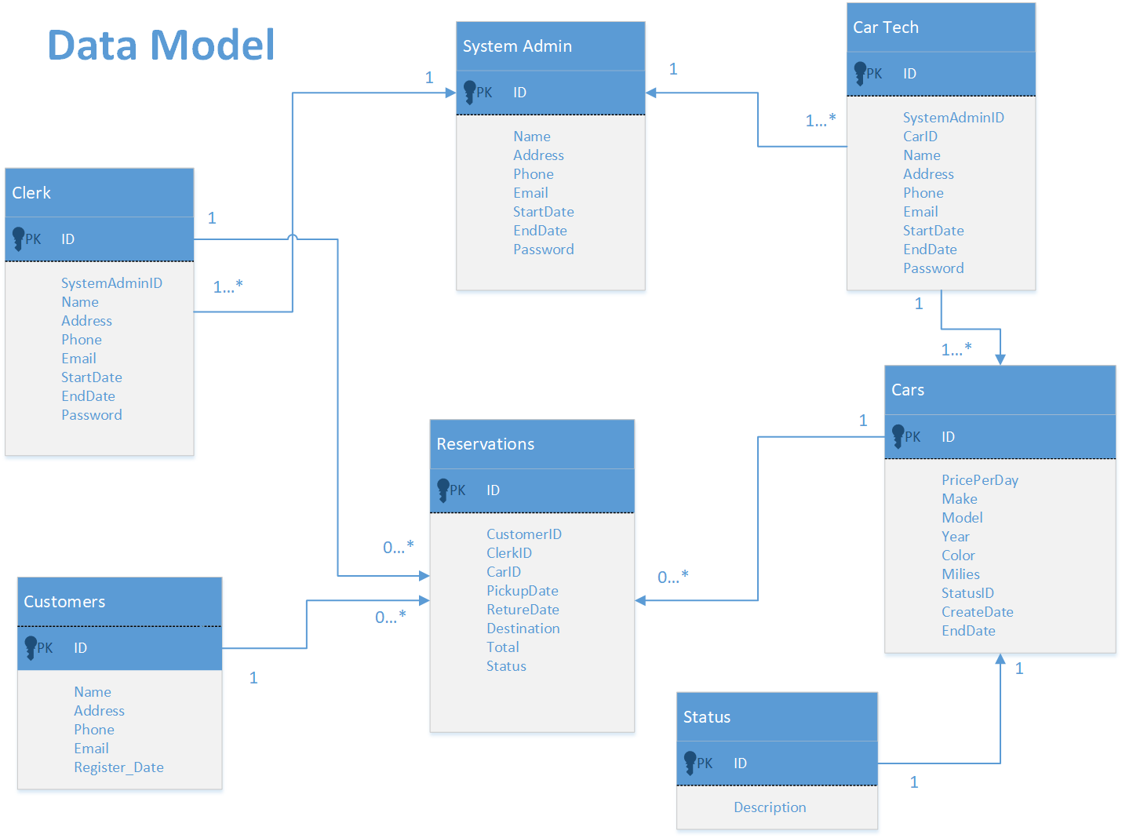
Data Model
…

Slide 11
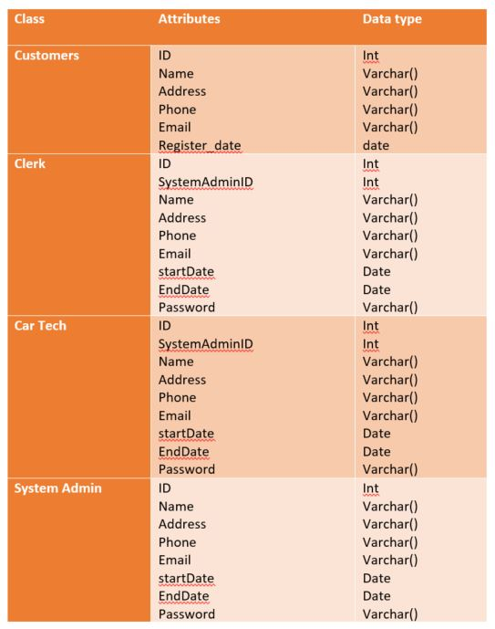
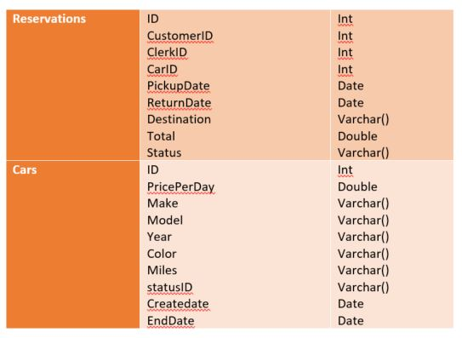
Data Model

Slide 12
Sequence Diagram
Make Reservation

Slide 13
Sequence Diagram (cont.)
Reservation Pickup

Slide 14
System Sequence Diagram
Manage rental system

Slide 15
Software Architecture Document
Architectural Representation:
This document presents the architecture as a series of views: logical view, process view, and deployment view.
Architectural Goals and Constraints:
Our goal is to handle peak traffic times and ensure every user doesn’t receive less. We are looking to ensure database consistency for reservations, transactions, pickup and drop off information and account logins for every user. Our account, reservations and transaction system will be ensured for protection of data from unauthorized users.
Programming View:
We plan to use HTML,MySQL (database), Java Servlet Programming, JSP, pache Tomcat (web server) onsite (RasPI), Cloud hosting (AWS, Azure, Google Cloud) to create/manage the code for the software. We intend for PC users to access this application by going straight to the website.

Slide 16
Software Architecture Document (continued..)
Logical View:
Using and viewing the Car Rental Company Site is part of 3 main packages:
User Interface: contains class for each of the forms the actors use to communicate with the system.
Business Services: contains control paths for interfacing with the reservation system, and account login/registration.
Business Objects: entity classes for the Car Rental company
Process View:
It describes the processes involved when the system is being executed including the interactions and configurations. It also describes the objects and classes.

Slide 17
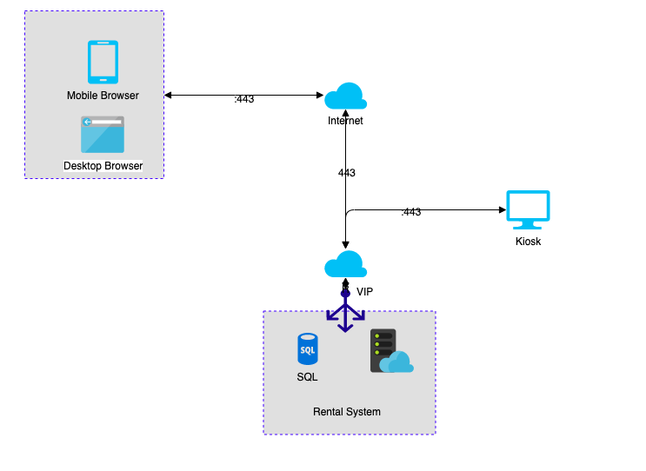
Software Architecture Document (continued..)
Technologies
IIS Webservices
Apache
HTML
JSP/JAVA
VIP Load balancer
SQL (MySQL)
High Availability
Cloud hosted
AWS, Azure, Google Cloud

