Slide 1
Online Rental Car
By: Xai Vang, Sampson Abrahams,
Samira Adam, & Sipxaysana Xayaxang

Slide 2

Table of Contents
Introduction
Vision
Scope
Business Case
Feasibility Studies
Software Development Methodology
Proposed System Functionalities
Hardware & Software Requirements

Slide 3
Introduction: Vision
Our goal is to create a reservation application and a system that can be used by small companies, such as S & M car rental company to keep/take in reservations and honor those reservations.

Slide 4
Vision
We envision a reservation application/system for small to medium size companies that can take in reservations. For example, a small Car Rental Company will be able to use this system for customers to reserve a car. This system should allow the company to be able to see things like, number of active rentals, pending rentals and view customer information.

Slide 5
Scope
The system/application should have database integration technology to store information such as customer data, car data, reservation data and more. The system should be able to allow the company to view its past and upcoming reservations

Slide 6
Business Case
Our belief is that small to medium size companies in the hostilely business such as a car rental company lack the technology know how to manage and create a reservation system/application for their business. The proposed system will allow general companies to simply use it rather than paper book keeping

Slide 7
Feasibility Studies
We are planning cold call and in addition to surveying small to medium size companies about their reservation systems/processes. If the data show value in the idea, we will continue on to setup technical requirements.

Slide 8
Software Development Methodology
In our limited introduction to SDLC processes, we believe that Agile methodology allows for the most flexibility as it relates to being able to shift in the moment and or fail and fail fast to understand quickly how we move forward. As Agile Methodology allows for ever changing requirements during development as the software is developed, key stakeholders must work together throughout the entire project, we believe it using Agile provides a competitive advantage

Slide 9
Proposed System Functionalities
The functionality of the application is to provide the companies and customers simply and easy to use car reservation system, this will allow customers place a reservations and companies a means to take said reservation and honor.

Slide 10
Hardware & Software Requirements
As we’re still in the early stages we have yet to decide what the end resulting code and hardware will be. For now as we see it, we believe we will:
MySQL (database),
Java Servlet Programming,
JSP
Apache Tomcat (web server) onsite (RasPI)
Cloud hosting (AWS, Azure, Google Cloud)

Slide 11
Use Case
Customer uses systems to make a reservation for a car (rental a car).
Customer pickup /drops off rental car.

Slide 12
Use Cases and Actors
Actors: Customer, Clerk, Car Tech, Payment Service
Customer uses systems to make a reservation for a car (rental a car)
Customer pickup /drops off rental car

Slide 13
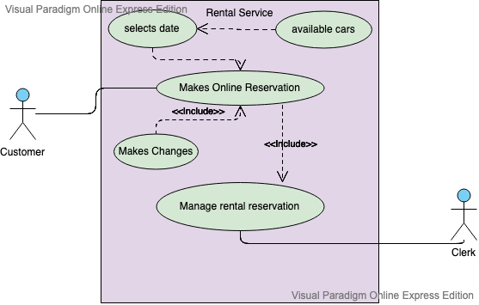
Case Diagram: Make Reservation
Fig. Make Reservation

Slide 14
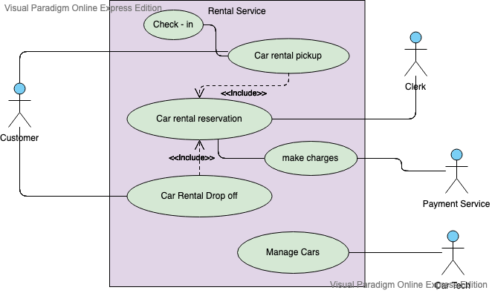
Case Diagram: Pickup/Drop off
Fig. Pickup/Dropoff

