Slide 1
Fiddler

Slide 2
What is Fiddler?
View web traffic
View Web Session Summary
Search and Filter Sessions
Select Parent or Child Session
View Web Session Statistics
View Web Session Content
Visualize Sessions Transfer Timeline
Using Filters
AutoResponder
Request Builder
Extending Fiddler UI
Text Encoding / Decoding

Slide 3
1. What is Fiddler?
Fiddler is a free web debugging proxy which logs and inspect all HTTP(s) traffic between your computer and the Internet.
Functions:
HTTP/HTTPS traffic monitoring and analysis
Request and response modification
Timing and network manipulation

Slide 4
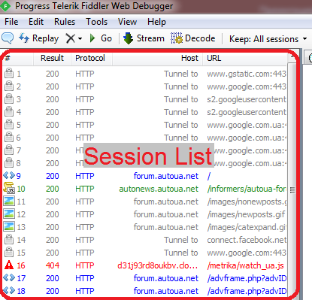
2. View web traffic
In Fiddler, click the File menu.
Ensure Capture Traffic is enabled.

Slide 5
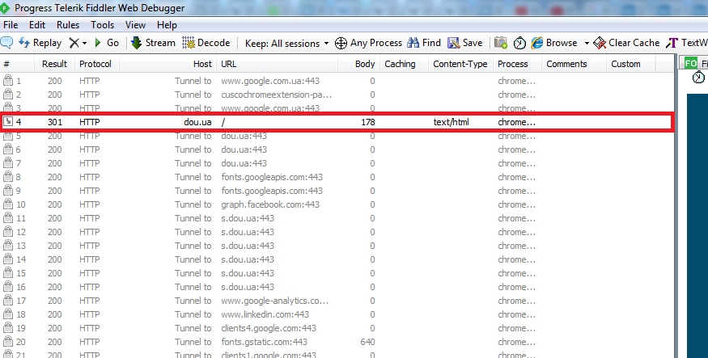
3. View Web Session Summary
To view the Fiddler ID Number, result code, protocol, hostname, content type, URL, body size, caching value, origin process, custom comments, and any custom columns for a web session:
Capture web traffic.
Find the web session in the Web Sessions List.

Slide 6
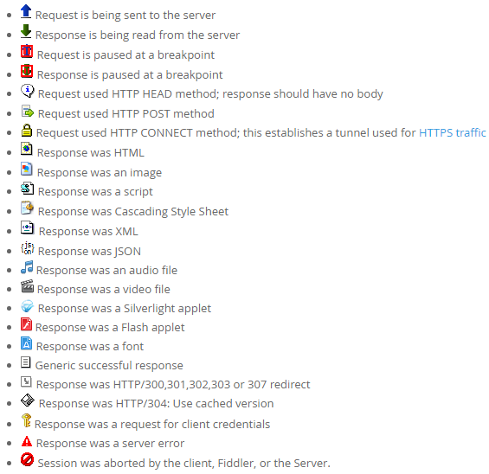
3. View Web Session Summary
Icons show status of request/response:

Slide 7
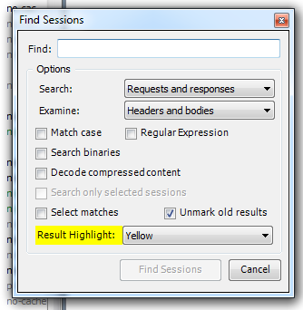
4. Search and Filter Sessions
To search through captured requests and responses:
Click Edit > Find Sessions... and specify search options in the dialog.
Enter a command in the QuickExec box.

Slide 8
5. Select Parent or Child Session
To select the parent session (the most recent request to the URL specified in the selected session's Referer header):
Select a session in the Web Sessions List.
Press P.
To select all child sessions (the later requests to the URL specified in the selected session's Referer header):
Select a session in the Web Sessions List.
Press C.

Slide 9
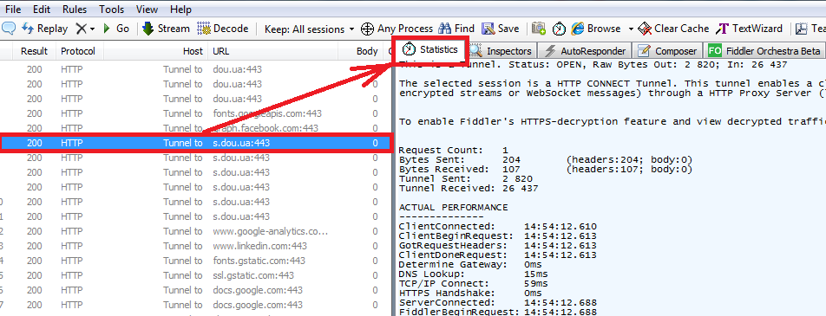
6. View Web Session Statistics
To view performance statistics for a web sesion:
Click on a web session in the Web Sessions List.
Click the Statistics tab.

Slide 10
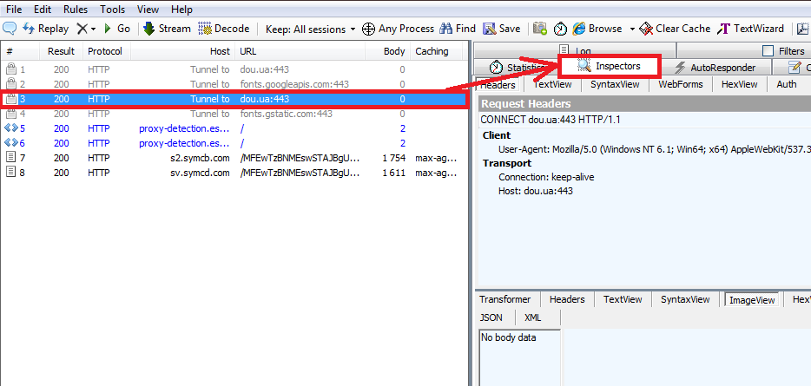
7. View Web Session Content
To view the content of a web session in a variety of formats:
Click on a web session in the Web Sessions List.
Click the Inspectors tab.

Slide 11
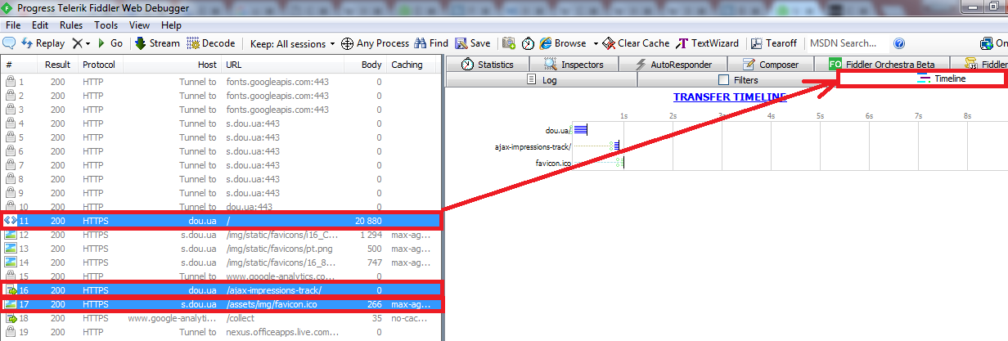
8. Visualize Sessions Transfer Timeline
To view a waterfall diagram of the transfer timeline for one or more web sessions:
Select one or more web sessions in the Web Sessions List. Hold down the CTRL key and click to select more than one session.
Click the Timeline tab.

Slide 12
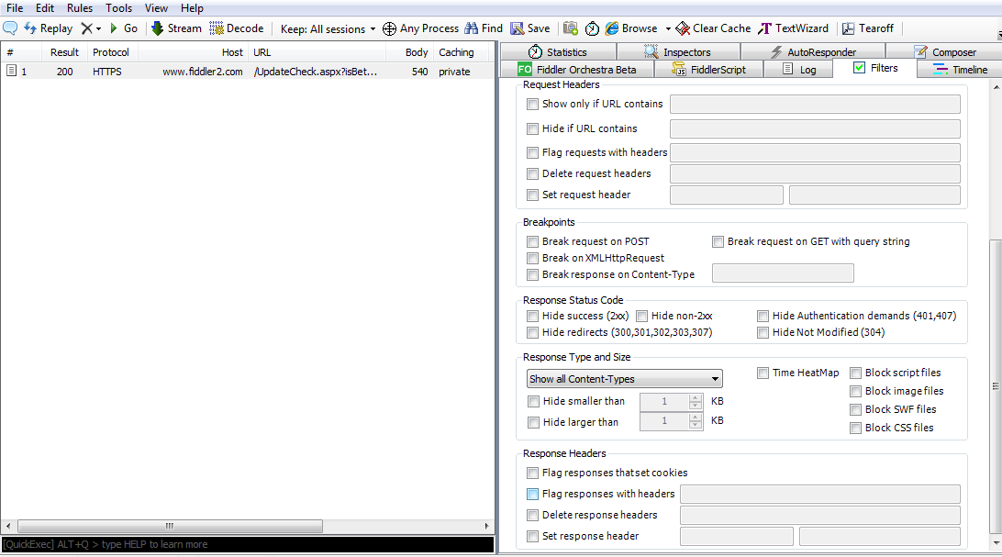
9. Using Filters
Flag, modify or remove headers from all requests and responses.

Slide 13
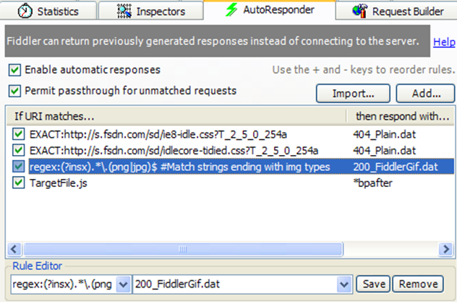
10. AutoResponder
Replay previously captured or generated traffic.

Slide 14
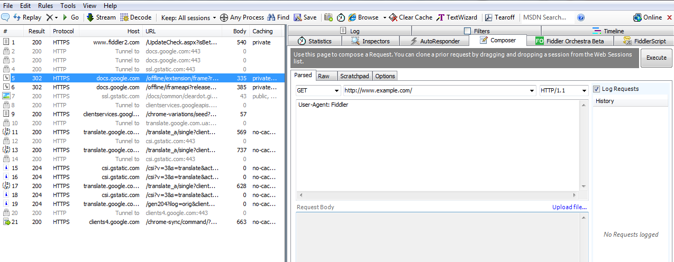
11. Request Builder
Create hand-built HTTP requests, or modify and reissue a request previously captured.

Slide 15
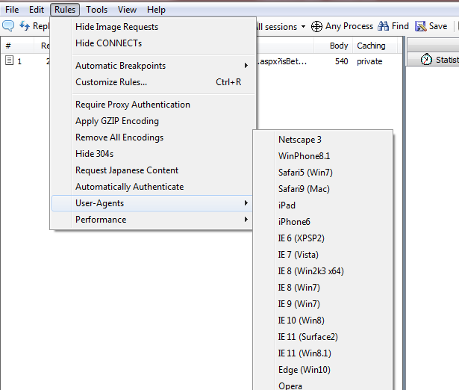
12. Extending Fiddler UI
FiddlerScript and extensions can add new menu items or tabs.

Slide 16
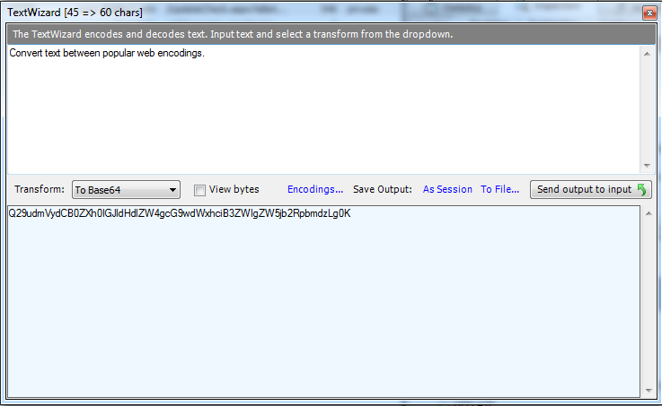
13. Text Encoding / Decoding
Convert text between popular web encodings.

