Slide 1
OSI model

Slide 2
CONTENTS
1. What is OSI?
2. OSI Layers
2.1. Layer 1: Physical Layer
2.2. Layer 2: Data Link Layer
2.3. Layer 3: Network Layer
2.4. Layer 4: Transport Layer
2.5. Layer 5: Session Layers
2.6. Layer 6: Presentation Layer
2.7. Layer 7: Application Layer

Slide 3

1. What is OSI?
The Open Systems Interconnection model (OSI model) is a model that was developed by the ISO and it describes the rules and procedures for the interoperability of diverse communication systems with standard protocols.
In this model, a networking system was divided into 7 layers. Within each layer, one or more entities implement its functionality. Each entity interacted directly only with the layer immediately beneath it, and provided facilities for use by the layer above it.

Slide 4
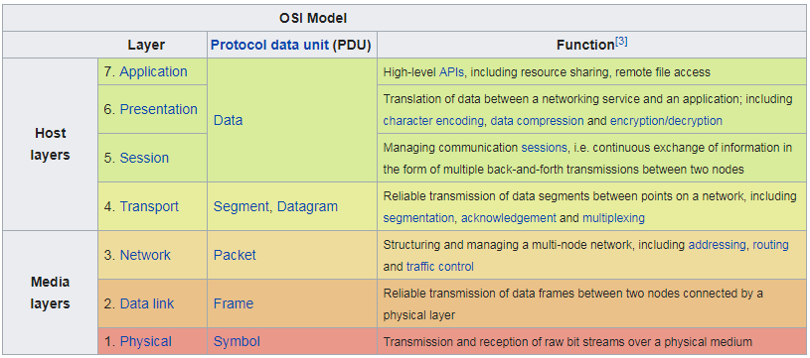
2. OSI Layers

Slide 5
2.1. Layer 1: Physical Layer
Specification for the physical components of the network.
Functions:
Bit representation – encode bits into electrical or optical signals.
Transmission rate – the number of bits sent each second.
Physical characteristics of transmission media.
Synchronizing the sender and receiver clocks.
Transmission mode – simplex, half-duplex, full duplex.
Physical Topology – how devices are connected: ring, star, mesh, bus topology.

Slide 6
2.2. Layer 2: Data Link Layer
Responsible for delivery of data between two systems on the same network
Functions:
Framing – divides the stream of bits received from network layer into manageable data units called frames.
Physical addressing – add a header to the frame to define the physical address of the source and destination machines.
Flow control – impose a flow control: control rate at which data is transmitted so as not to flood the receiver (Feedback – based flow control).
Error control – adds mechanisms to delete and retransmit damaged or lost frames. This is achieved by adding a trailer to the end of a frame.

Slide 7
2.3. Layer 3: Network Layer
Functions:
Responsible for delivery of packets across multiple networks.
Routing – provide mechanisms to transmit data over independent networks that are linked together.
Network layer is responsible only for delivery of indivadual packets and it does not recognize any relationship between those packets.

Slide 8
2.4. Layer 4: Transport Layer
Functions:
Responsible for source-to-destination delivery of the entire message.
Segmentation and reassembly – divide message into smaller segments, number them and transmit. Reassembly these messages at the receiving end.
Error control – make sure that the entire message arrives without errors – else retransmit.

Slide 9
2.5. Layer 5: Session Layers
Functions:
Dialog control – allows two systems to enter into a dialog, keep a track of whose turn it is to transmit.
Synchronization – adds check points (synchronization points) into stream of data.

Slide 10
2.6. Layer 6: Presentation Layer
Functions:
Translation:
Different computers use different encoding systems (bit order translation).
Convert data into a common format before transmitting.
Syntax represents info such as character codes – how many bits to represent data – 8 or 7 bits.
Compression – reduce number of bits to be transmitted
Encryption – transform data into an unintelligible format at the sending end for data security
Decryption – at the receiving end

Slide 11
2.7. Layer 7: Application Layer
Functions:
Contains protocols that allow the users to access the network (FTP, HTTP, SMPT, etc).
Does not include application programs such as email, browsers, word processing applications, etc.
Protocols contain utilities and network-based services that support email via SMTP, Internet access via HTTP, file transfer via FTP, etc.

