Slide 1
Kanban
balance approach

Slide 2
What is Kanban?
Kanban is a lean method to manage and improve work across human systems. This approach aims to manage work by balancing the demands with available capacity, and improving the handling of system level bottlenecks.
Principles:
Make work visible
Help work to flow
Limit work in progress

Slide 3
1. Make work visible
The first step in the introduction of Kanban is to visualize the workflow. This is done in the form of a Kanban board consisting of a simple whiteboard and sticky notes or cards. Each card on the board represents a task.

Slide 4

1. Make work visible
In a classic Kanban board model, there are three columns:
“To Do”: This column lists the tasks that are not yet started. (aka “backlog”)
“Doing”: Consists of the tasks that are in progress.
“Done”: Consists of the tasks that are completed.

Slide 5
2. Help work to flow
At the core of Kanban is the concept of “Flow”. This means that the cards should flow through the system as evenly as possible, without long waiting times or blockages. Everything that hinders the flow should be critically examined.

Slide 6
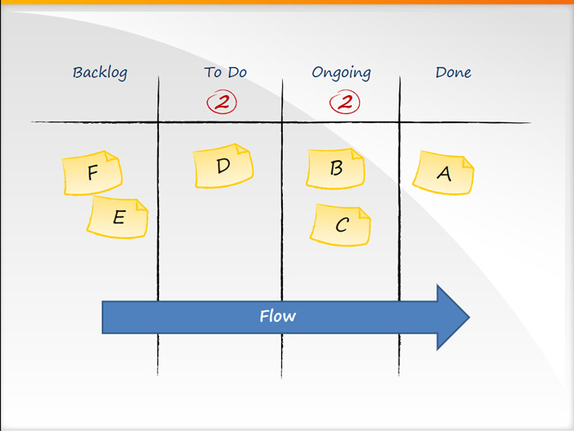
2. Help work to flow
The concept of Flow is critical and by measuring Flow metrics and working to improve them, you can dramatically improve the speed of your delivery processes while reducing cycle time and improving the quality of your products or services by getting faster feedback from your customers – internal or external.

Slide 7
3. Limit work in progress
A key aspect of Kanban is to reduce the amount of multi-tasking that most teams and knowledge workers are prone to do and instead encourage them to “Stop Starting! And Start Finishing!”

Slide 8
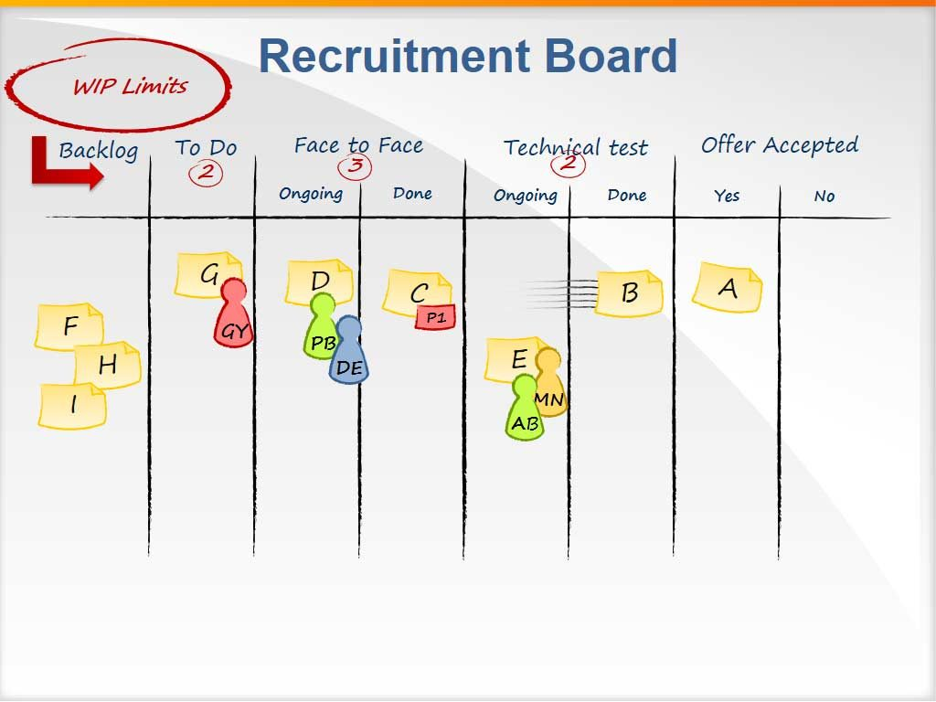
3. Limit work in progress
Work-in-Progress – Limits defined at each stage of the workflow on a Kanban board encourage team members to finish work at hand and only then, take up the next piece of work.

Slide 9
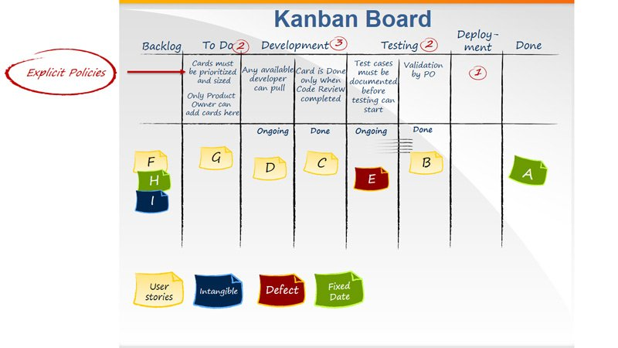
Software development
Kanban boards can show elaborate workflows depending on the complexity of the workflow and the need to visualize and examine specific parts of the workflow to identify bottlenecks in order to remove them.

Slide 10
The difference between Kanban and Scrum:
there are no timeboxs for anything in Kanban (nor for tasks, nor for sprints)
task is longer and less in Kanban
in Kanban the evaluation of the time frame for the task is optional or not at all
in Kanban "team speed" is absent and only the average time for the full implementation of the task is considered
It is impossible to use Kanban in pure form for development, as it is not a framework and a methodology, but you can apply the Kanban method to Scrum to get even better results.

