Slide 1
Scaled Agile Framework
(SAFe ®)

Slide 2
What is SAFe?
The Scaled Agile Framework (SAFe®) is a set of organization and workflow patterns intended to guide enterprises in scaling lean and agile practices.
SAFe synchronizes alignment, collaboration, and delivery for multiple Agile teams. Scalable and configurable, SAFe allows each organization to adapt it to its own business needs.
SAFe describes the roles, responsibilities, artifacts, and activities necessary to implement Lean-Agile development.

Slide 3
SAFe Configurations
SAFe supports the full range of development environments with four out-the-box configurations:
Essential SAFe
Portfolio SAFe
Large Solution SAFe
Full SAFe

Slide 4
Essential SAFe
The Essential SAFe configuration is the heart of the Framework and is the simplest starting point for implementation. It’s the basic building block for all other SAFe configurations and describes the most critical elements needed to realize the majority of the Framework’s benefits. Together, the Team and Program Levels form an organizational structure called the Agile Release Train (ART), where Agile teams, key stakeholders, and other resources are dedicated to an important, ongoing solution mission.

Slide 5
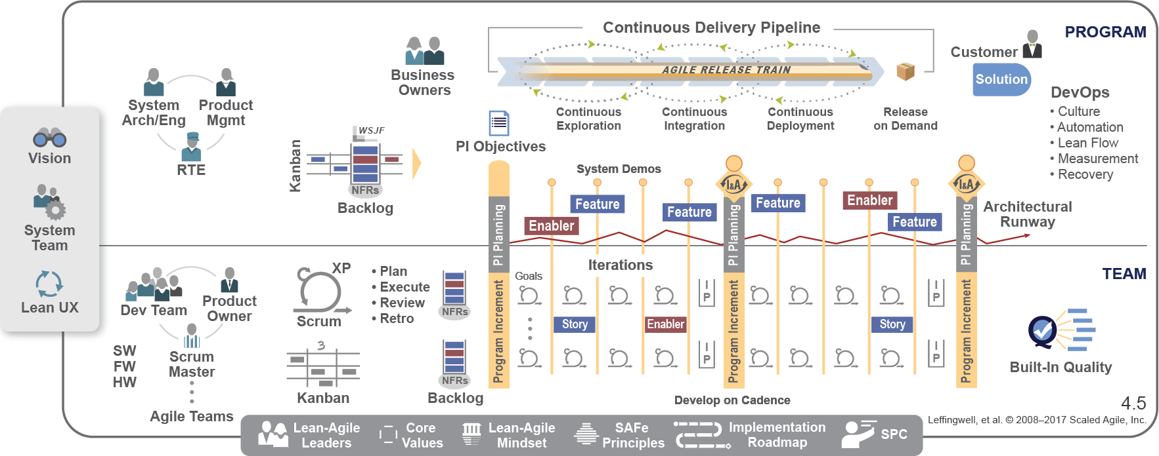
Essential SAFe
Essential SAFe consists of both the team and program levels.

Slide 6
Large Solution SAFe
The Large Solution SAFe configuration is for developing the largest and most complex solutions that typically require multiple Agile release trains and Suppliers, but do not require portfolio-level considerations. This is common for industries like aerospace and defense, automotive, and government, where the large solution—not portfolio governance—is the primary concern.
The Solution Train organizational construct of the Large Solution Level helps enterprises that face the biggest challenges—building large-scale, multidisciplinary software, hardware, and complex IT systems. Building these solutions requires additional roles, artifacts, events, and coordination. Enterprises that build largely independent systems or those that can be built with a few hundred practitioners may not need this configuration.

Slide 7
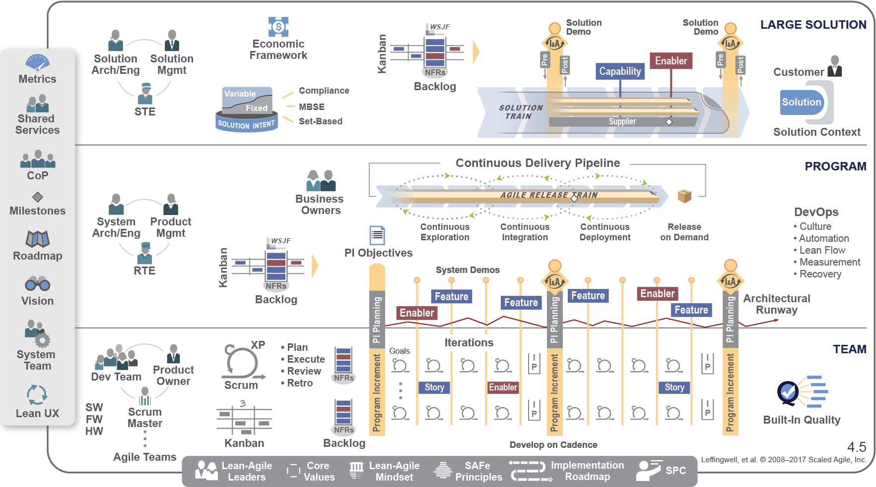
Large Solution SAFe

Slide 8
Portfolio SAFe
The Portfolio SAFe configuration helps align portfolio execution to the enterprise strategy, by organizing Agile development around the flow of value, through one or more value streams. It provides business agility through principles and practices for portfolio strategy and investment funding, Agile portfolio operations, and Lean governance.

Slide 9
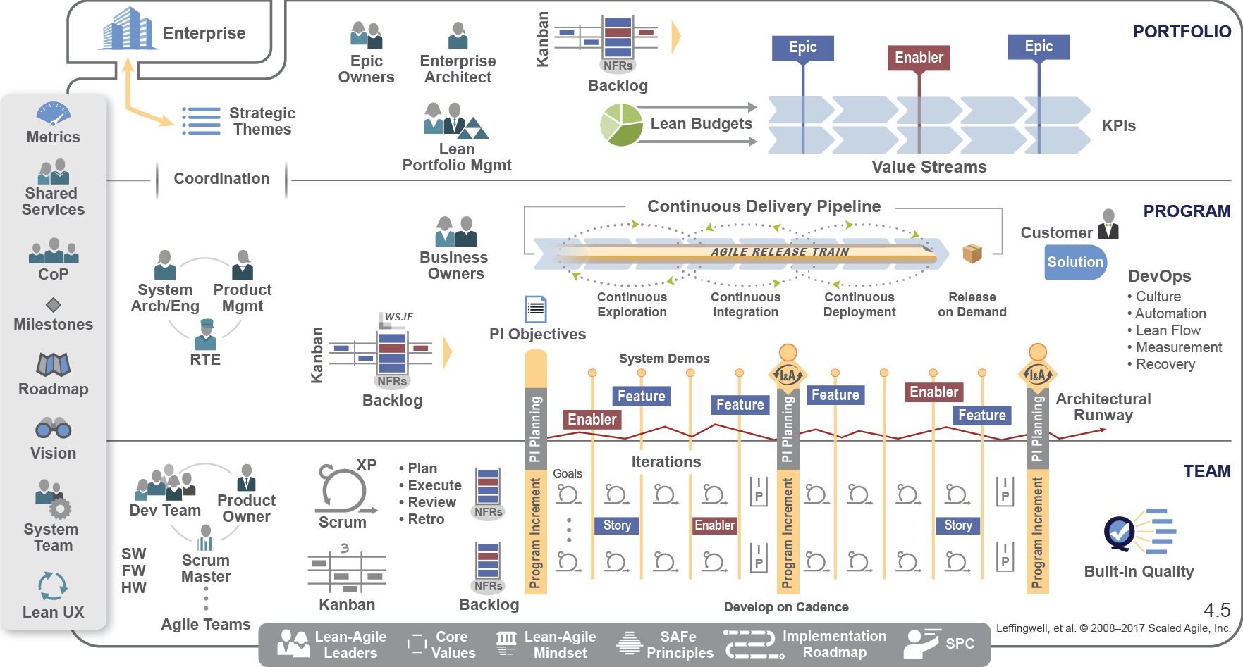
Portfolio SAFe

Slide 10
Full SAFe
The Full SAFe configuration is the most comprehensive version of the Framework. It supports enterprises that build and maintain large integrated solutions, which require hundreds of people or more, and includes all levels of SAFe: team, program, large solution, and portfolio. In the largest enterprises, multiple instances of various SAFe configurations may be required.

Slide 11
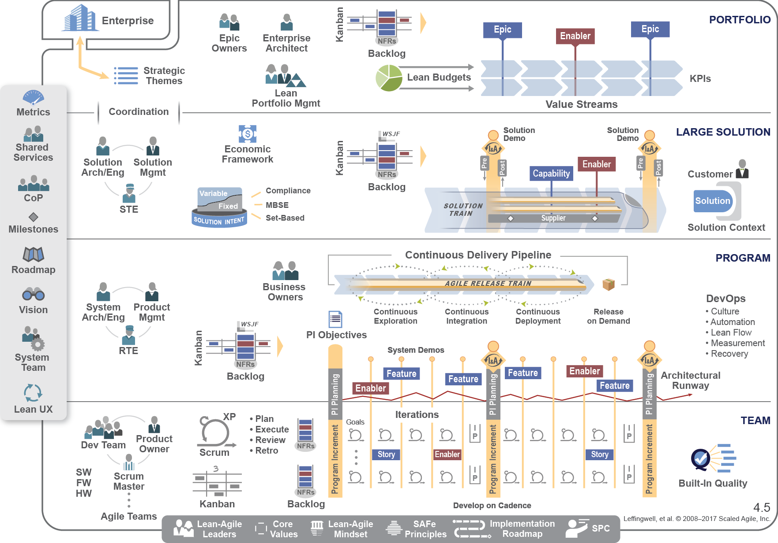
Full SAFe

Slide 12
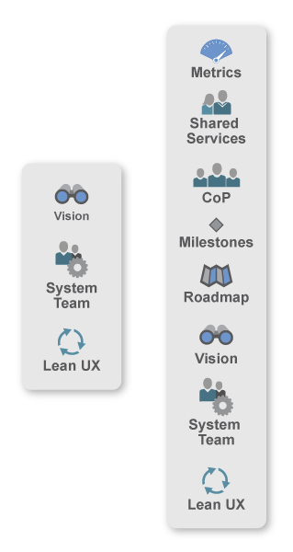
The Spanning Palette
Metrics – The primary measure in SAFe is the objective measurement of working solutions. Moreover, SAFe defines some additional intermediate and long-term measures as well, metrics that teams, programs, and portfolios can use to measure progress.
Shared Services – Represents the specialty roles that are necessary for the success of an ART or value stream, but that cannot be dedicated full time to any specific train.
Community of Practice (CoP) – A community of practice is an informal group of team members and other experts, acting within the context of a program or enterprise, that has a mission of sharing practical knowledge in one or more relevant domains.

Slide 13
The Spanning Palette
Milestones – A milestone is used to track progress toward a specific goal or event. These include fixed-date, Program Increment (PI) and learning milestones.
Roadmap – The roadmap communicates planned ART and value stream deliverables and milestones over a timeline.
Vision – The vision describes a future view of the solution to be developed, reflecting customer and stakeholder needs, as well as Features and Capabilities, which are proposed to address those needs.
System Team – This is a special Agile team that provides assistance in building and using the Agile development environment, including Continuous Integration and test automation and automating the delivery pipeline.
Lean User Experience (UX) – Lean UX is the application of Lean principles to user experience design. It uses an iterative, hypothesis-driven approach to product development, through constant measurement and learning loops (build-measure-learn). In SAFe, Lean UX is applied at scale, with the right combination of centralized and decentralized UX design and implementation.

Slide 14
The Foundation
Lean-Agile Leaders – Management has the ultimate responsibility for business outcomes. Leaders must be trained, and then become trainers of, these leaner ways of thinking and operating. To this end, SAFe describes a new style of leadership exhibited by the enterprise’s leaders.
Core Values – Four core values define the belief system for SAFe: Alignment, Built-In Quality, Transparency, and Program Execution.
Lean-Agile Mindset – Lean-Agile Leaders are lifelong learners and teachers. They understand and embrace Lean and Agile principles and practices.
SAFe Principles – SAFe practices are grounded in nine principles that synthesize Agile methods, Lean product development, systems thinking, and decades of field experience.
Implementation Roadmap – Implementing the changes necessary to become a Lean-Agile technology enterprise is a substantial change for most companies. SAFe provides an implementation roadmap to help guide organizations on this journey.
SAFe Program Consultants (SPCs) – SPCs are change agents who combine their technical knowledge of SAFe with an intrinsic motivation to improve their company’s software and systems development processes.

