Slide 1
Scrum
is an agile way to manage a project

Slide 2
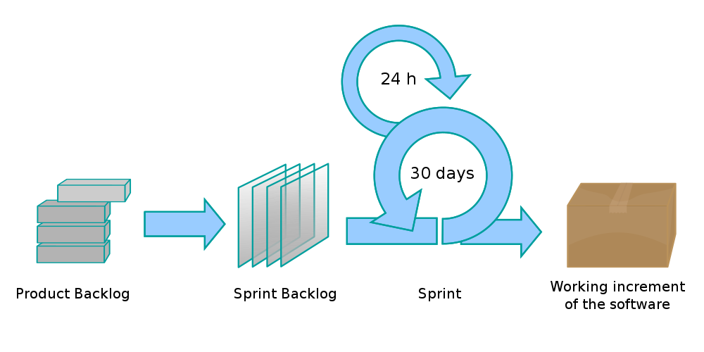
What is Scrum?
Scrum is an iterative and incremental framework for managing product development. Scrum allows in hard-fixed and short-term iterations, called sprints, to provide the end user running software with new capabilities, for which the highest priority is determined.

Slide 3
What is Scrum?
A key principle of Scrum is the dual recognition that customers will change their minds about what they want or need (often called requirements volatility) and that there will be unpredictable challenges—for which a predictive or planned approach is not suited. As such, Scrum adopts an evidence-based empirical approach—accepting that the problem cannot be fully understood or defined up front, and instead focusing on how to maximize the team's ability to deliver quickly, to respond to emerging requirements, and to adapt to evolving technologies and changes in market conditions.

Slide 4
Workflow
Sprint - iteration in the scrum, during which the functional growth of software is created. It is rigidly fixed in time. Duration of one sprint from 1 to 4 weeks.
Scrum methodology advocates for a planning meeting at the start of the sprint, where team members figure out how many items they can commit to, and then create a sprint backlog – a list of the tasks to perform during the sprint.
During an agile Scrum sprint, the Scrum team takes a small set of features from idea to coded and tested functionality. At the end, these features are done, meaning coded, tested and integrated into the evolving product or system.

Slide 5
Workflow
On each day of the sprint, all team members should attend a daily Scrum meeting, including the ScrumMaster and the product owner. This meeting is timeboxed to no more than 15 minutes. During that time, team members share what they worked on the prior day, will work on that day, and identify any impediments to progress.
The Scrum model sees daily scrums as a way to synchronize the work of team members as they discuss the work of the sprint.
At the end of a sprint, the team conducts a sprint review during which the team demonstrates the new functionality to the PO or any other stakeholder who wishes to provide feedback that could influence the next sprint.

Slide 6
Workflow
This feedback loop within Scrum software development may result in changes to the freshly delivered functionality, but it may just as likely result in revising or adding items to the product backlog.
Another activity in Scrum project management is the sprint retrospective at the end of each sprint. The whole team participates in this meeting, including the ScrumMaster and PO. The meeting is an opportunity to reflect on the sprint that has ended, and identify opportunities to improve.

Slide 7
Artifacts
The project backlog is a list of requirements for functionality, ordered by their degree of importance, to be implemented. Elements of this list are called user stories or backlog items. The project's wish log is open to editing for all participants in the scrum process.
The sprint backlog contains the functionality selected by the product owner from the product backlog. All functions are divided into tasks, each of which is evaluated by the scrum command. Every day the team evaluates the amount of work that needs to be done to complete the sprint.

Slide 8
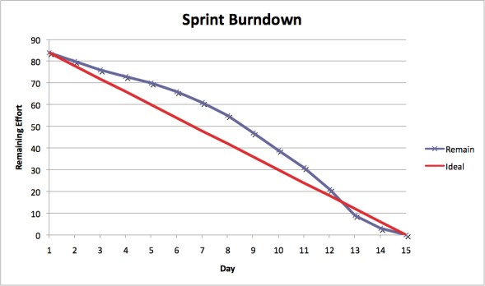
Artifacts
Additional artifacts resulting from the Scrum agile methodology is the sprint burndown chart and release burndown chart. Burndown charts show the amount of work remaining either in a sprint or a release, and are an effective tool in Scrum software development to determine whether a sprint or release is on schedule to have all planned work finished by the desired date.

Slide 9
Roles
The product owner represents the interests of end users and other interested parties in the product. The product owner is responsible for prioritizing the backlog during Scrum development, to ensure it’s up to par as more is learned about the system being built, its users, the team and so on.
The scrum master holds meetings, monitors compliance with all principles of the scramble, resolves contradictions and protects the team from distractions. This role does not imply anything other than the correct conduct of the scrum process.

Slide 10
Roles
Development Team is a cross-functional team of project developers, consisting of professionals of different profiles: testers, architects, analysts, programmers, etc. The size of the team is ideally between 3 and 9 people. The team is the only fully involved development partner and is responsible for the result as a whole. No one, except the team, can interfere with the development process during the sprint.

Slide 11
Main activities
Product backlog
requirements
priorities
Sprint backlog
Planning the sprint backlog
define a sprint goal
choice of user stories for the sprint
separation of user stories into tasks
estimate of effort
Daily Scrum
what is done, what will we do
Update tasks and burndown chart
Sprint review
Sprint retrospective

