Slide 1
Comparative analysis of SDLC models

Slide 2
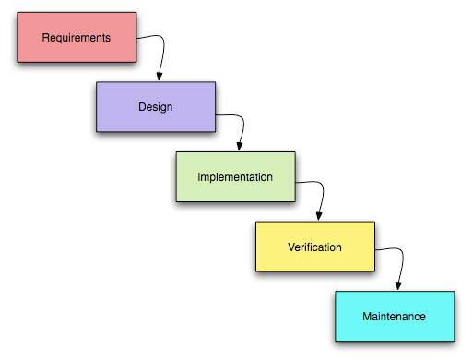
Waterfall model
The transition from one phase to another occurs only after the complete and successful completion of the previous phase.

Slide 3
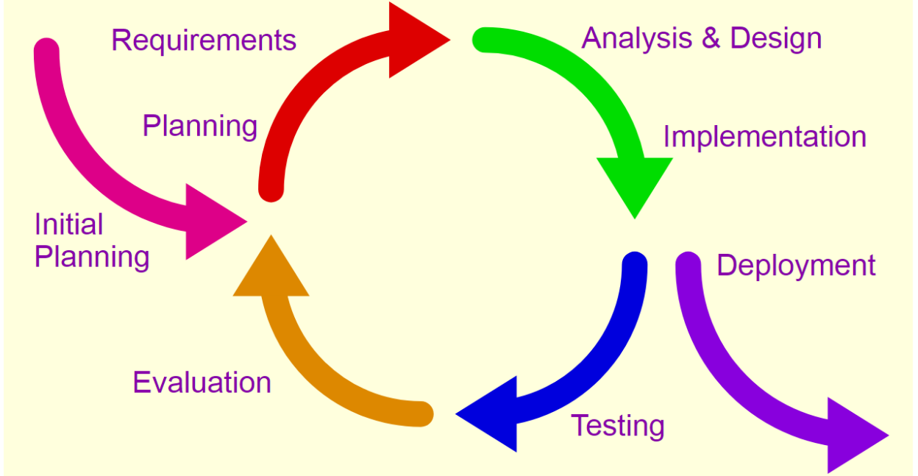
Iterative method
The work is carried in parallel with the continuous analysis of the results obtained and the correction of the previous stages of work. The project in each phase of development is a repeating cycle: plan-do-check-act cycle.

Slide 4
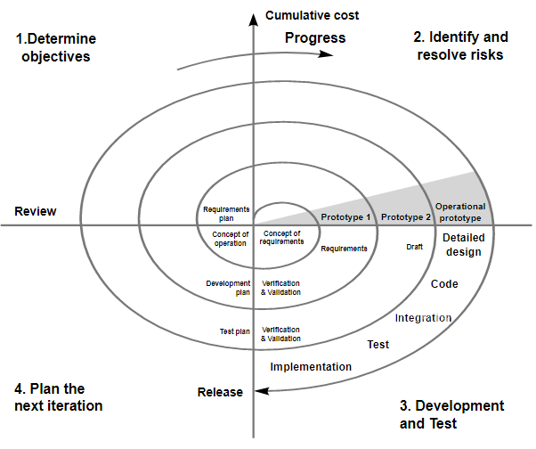
Spiral method
Each coil of the spiral corresponds to the creation of a fragment or version of the software, it clarifies the objectives and characteristics of the project, determines its quality and plans the work of the next coil of the spiral.

Slide 5
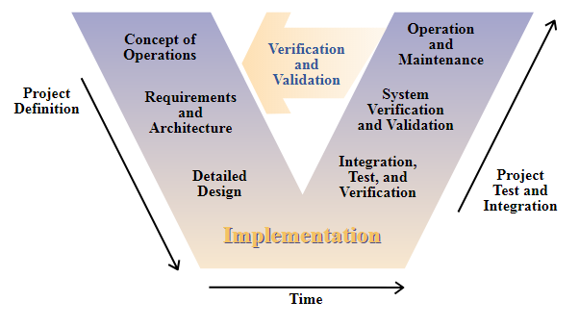
V-Model
The basic principle of the V-shaped model is that the detailed design of the project increases from left to right, simultaneously with time, and neither can reverse. Iterations in the project are made horizontally, between the left and right sides of the letter.

Slide 6
Features\Model | Waterfall | Iterative | Spiral | V-shape
Requirement Specification | Beginning | Beginning | Beginning | Beginning
Understanding Requirements | Well | Well | Well | Easily
Cost | Low | Low | Expensive | Expensive
Guarantee of Success | Low | High | High | High
Resource Control | Yes | Yes | Yes | Yes
Cost Control | Yes | No | Yes | Yes
Simplicity | Simple | Intermediate | Intermediate | Intermediate
Risk Involvement | High | Easily manage | Low | Low
Expertise Required | High | High | High | Medium
Changes Incorporated | Difficult | Easy | Easy | Difficult

Slide 7
Features\Model | Waterfall | Iterative | Spiral | V-shape
Risk Analysis | Only at beginning | No Risk Analysis | Yes | Yes
User Involvement | Only at beginning | Intermediate | High | Only at beginning
Overlapping Phases | No overlapping | No overlapping | Yes overlapping | No overlapping
Flexibility | Rigid | Less flexible | Flexible | Little flexible
Maintenance | Least | Promotes maintainability | Typical | Least
Reusability | Limited | Yes | Yes | To some extent
Interface | Minimal | Crucial | Crucial | Minimal
Documentation & Training required | Vital | Yes | Yes | Yes
Time Frame | Long | Very Long | Long | Acc to project size

