Slide 1
Comparative analysis of SDLC models

Slide 2
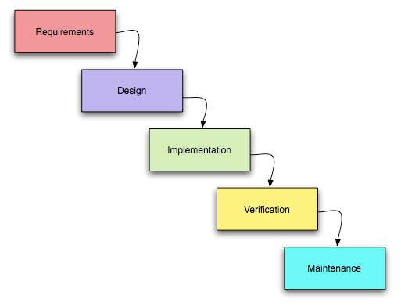
Waterfall model
The transition from one phase to another occurs only after the complete and successful completion of the previous phase.

Slide 3
Waterfall model
Advantages of the waterfall model
At each stage, formed a complete set of documentation, hardware and software that meets the criteria of completeness and consistency.
The implementation in a clear sequence of stages allows you to confidently plan the timing of work and the relevant resources (monetary, material and human).
Disadvantages of the waterfall model
No output or working software is produced until late in the life cycle.
It is based on the exact formulation of the initial requirements for the information system. High degree of uncertainty and risks.
Not a good choice for big or ongoing projects.

Slide 4
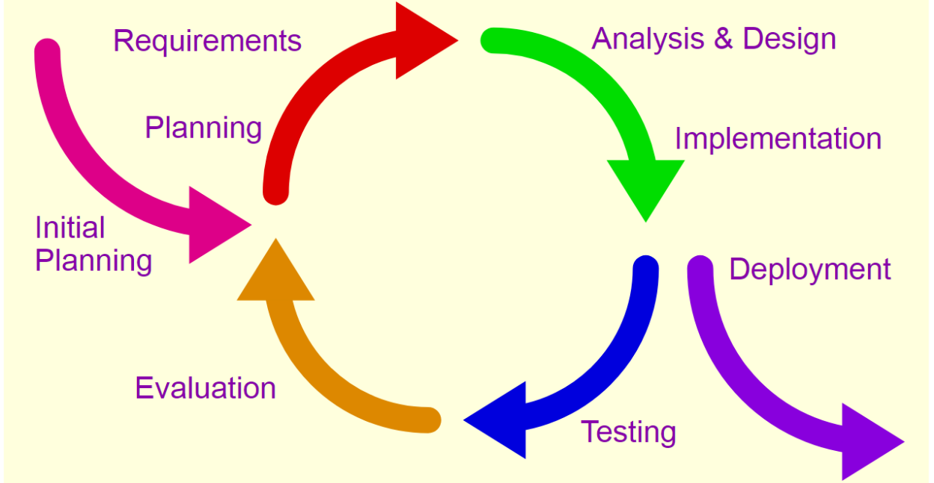
Iterative method
The work is carried in parallel with the continuous analysis of the results obtained and the correction of the previous stages of work. The project in each phase of development is a repeating cycle: plan-do-check-act cycle.

Slide 5
Iterative method
Advantages of the iterative model
Produces working software early during the lifecycle.
More flexible as scope and requirement changes can be implemented at low cost.
Testing and debugging is easier, as the iterations are small.
Low risks factors as the risks can be identified and resolved during each iteration.
Disadvantages of the iterative model
Not all the requirements are gathered before starting the development; this could lead to problems related to system architecture at later iterations.

Slide 6
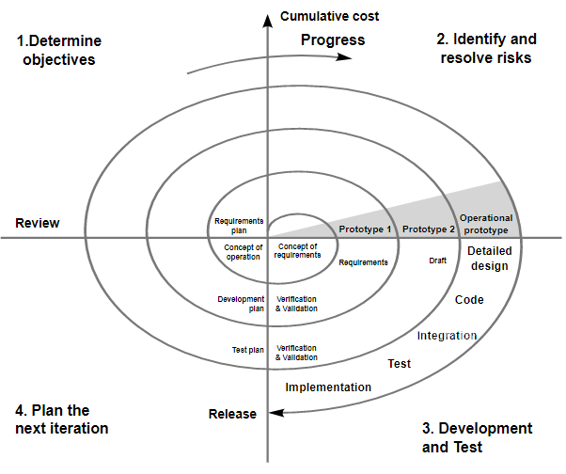
Spiral method
Each coil of the spiral corresponds to the creation of a fragment or version of the software, it clarifies the objectives and characteristics of the project, determines its quality and plans the work of the next coil of the spiral.

Slide 7
Spiral method
Advantages of the spiral model
Good for large and critical projects
Working software is produced early during the lifecycle.
Large amount of risk analysis.
Disadvantages of the spiral model
Involves higher cost.
Not suitable for smaller projects.
Project success depends on the risk analysis phase - hence, it requires highly specific expertise in risk analysis.

Slide 8
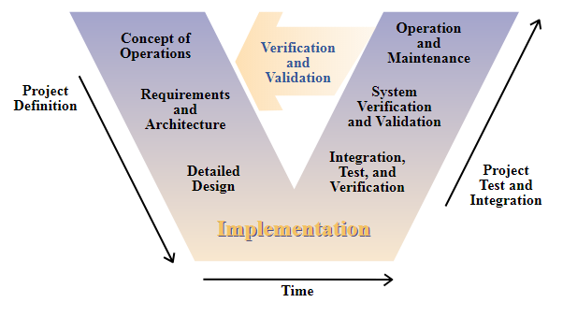
V-Model
The basic principle of the V-shaped model is that the detailed design of the project increases from left to right, simultaneously with time, and neither can reverse. Iterations in the project are made horizontally, between the left and right sides of the letter.

Slide 9
V-Model
Advantages of the V-model
Simple and easy to use.
Planning, designing happens well before coding.
Disadvantages of the V-model
High rigidity and low on flexibility.
No early prototypes are produced.

Slide 10
Comparison of various SDLC models
Features\Model | Waterfall | Iterative | Spiral | V-shape
Requirement Specification | Beginning | Beginning | Beginning | Beginning
Understanding Requirements | Well | Well | Well | Easily
Cost | Low | Low | Expensive | Expensive
Guarantee of Success | Low | High | High | High
Resource Control | Yes | Yes | Yes | Yes
Cost Control | Yes | No | Yes | Yes
Simplicity | Simple | Intermediate | Intermediate | Intermediate
Risk Involvement | High | Easily manage | Low | Low
Expertise Required | High | High | High | Medium
Changes Incorporated | Difficult | Easy | Easy | Difficult

Slide 11
Features\Model | Waterfall | Iterative | Spiral | V-shape
Risk Analysis | Only at beginning | No Risk Analysis | Yes | Yes
User Involvement | Only at beginning | Intermediate | High | Only at beginning
Overlapping Phases | No overlapping | No overlapping | Yes overlapping | No overlapping
Flexibility | Rigid | Less flexible | Flexible | Little flexible
Maintenance | Least | Promotes maintainability | Typical | Least
Reusability | Limited | Yes | Yes | To some extent
Interface | Minimal | Crucial | Crucial | Minimal
Documentation & Training required | Vital | Yes | Yes | Yes
Time Frame | Long | Very Long | Long | Acc to project size

