Slide 1
SiteController
SecureSiteController
AdminSiteController
Membership.My.Registration.App
Membership.New.Registration.App
Admin.Member.Activate.App
Club.Configuration.Fixture.App
Membership.New.Fee.App
Admin.Member.List.All.App
Club.Configuration.General.App
RegistrationApi
AdminMemberApi
CaptchaApi
FeeApi
ConfigurationClubApi
ConfigurationFixtureApi
PlayerServices
MemberServices
ConfigurationServices
Player
Junior
Guardian
ConfigurationItem
Team
Fee
JuniorInfo
Member
AddressDetail
Opponent
Kit
ContactDetail
FixtureType
ActivationEmail
Location

Slide 2
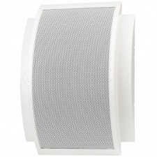
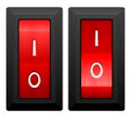
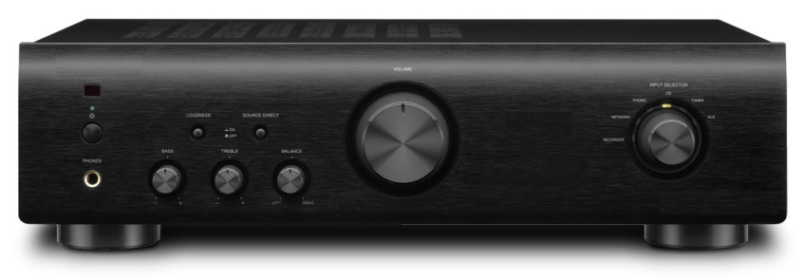
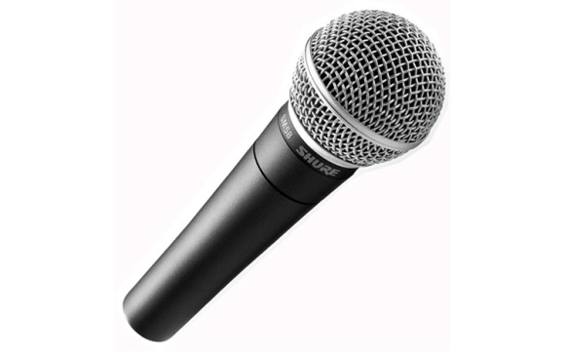
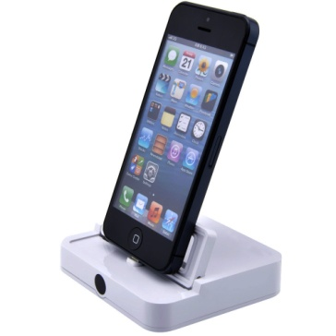
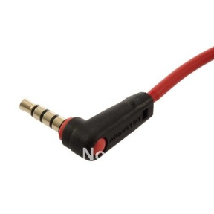
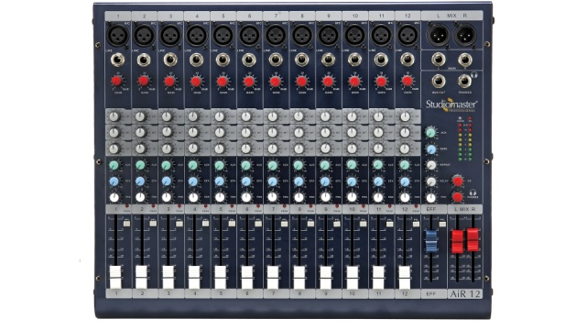
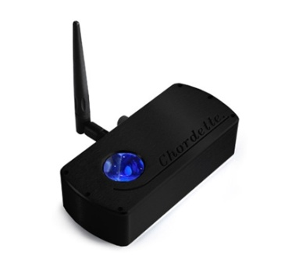
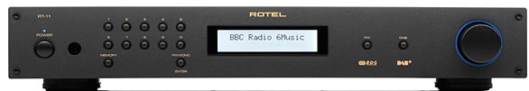
Speakers
Speaker Switches
Amplifier
Roaming Microphone
Mixer
AUX Lead
iPod Charger
DAB Radio
Bluetooth DAC

