Slide 1
Member Admin and Registration
SiteController
SecureSiteController
AdminSiteController
Membership.My.Registration.App
Admin.Member.Activate.App
Membership.New.Fee.App
Membership.New.Registration.App
Admin.Member.List.All.App
FeeApi
RegistrationApi
AdminMemberApi
CaptchaApi
PlayerServices
MemberServices
Player
Junior
Guardian
Fee
JuniorInfo
Member
AddressDetail
Kit
ContactDetail
ActivationEmail

Slide 2
Configuration
AdminSiteController
Club.Configuration.Fixture.App
Club.Configuration.General.App
ConfigurationClubApi
ConfigurationFixtureApi
ConfigurationServices
ConfigurationItem
Team
Opponent
FixtureType
Location

Slide 3
Fixture/Team Management
AdminSiteController
Admin.Team.New.App
Admin.Fixture.New.App
AdminTeamApi
AdminFixtureApi
PlayerServices
ConfigurationServices
FixtureServices
Player
Fixture
Team
Opponent
FixtureType
Location

Slide 4
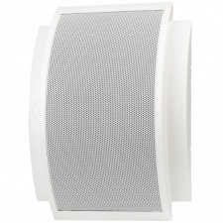
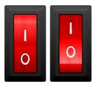
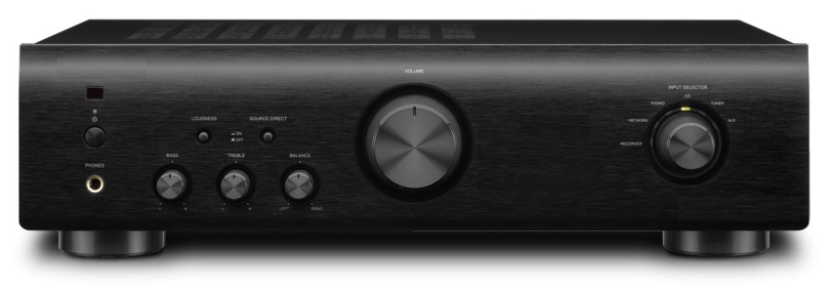
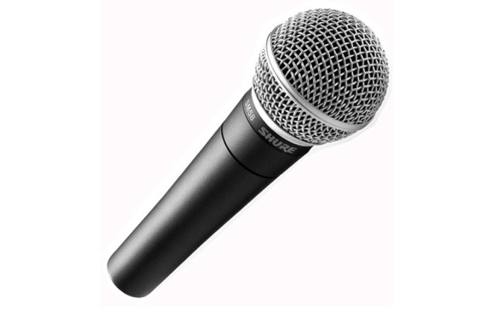
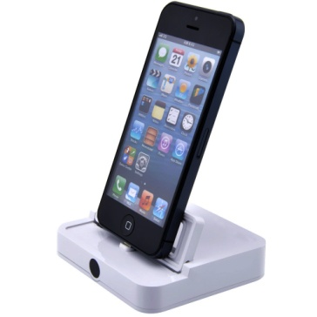
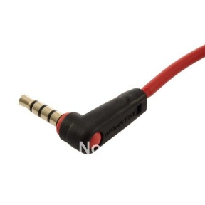
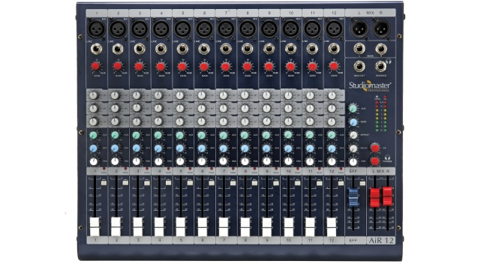
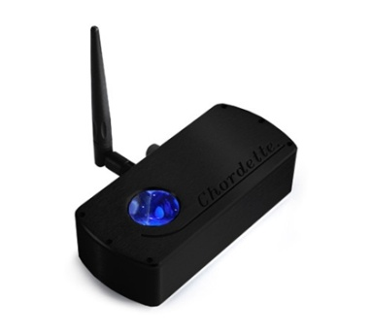
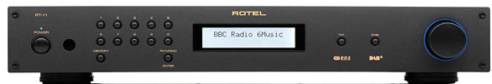
Speakers
Speaker Switches
Amplifier
Roaming Microphone
Mixer
AUX Lead
iPod Charger
DAB Radio
Bluetooth DAC

