Slide 1
SiteController
SecureSiteController
AdminSiteController
Membership.My.Registration.App
Admin.Member.Activate.App
Membership.New.Registration.App
Admin.Member.List.All.App
Club.Configuration.App
RegistrationApi
AdminMemberApi
CaptchaApi
ConfigurationApi
PlayerService
MemberService
ConfigurationService
Player
Junior
Guardian
ConfigurationItem
Fee
JuniorInfo
Member
AddressDetail
Kit
ContactDetail
ActivationEmail

Slide 2
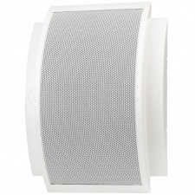
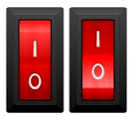
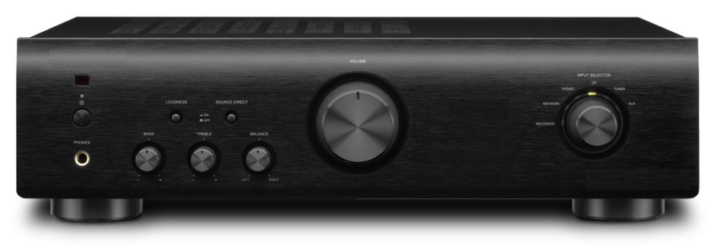
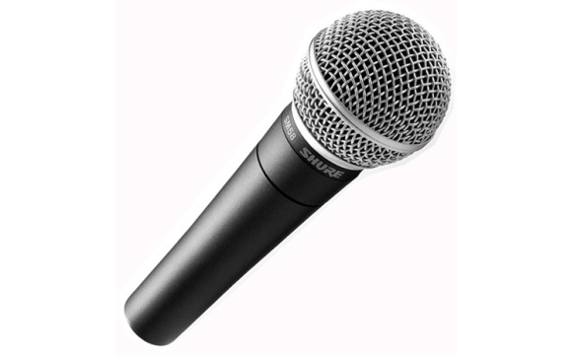
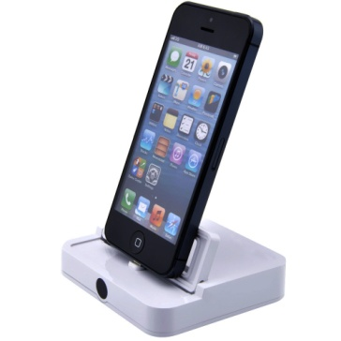
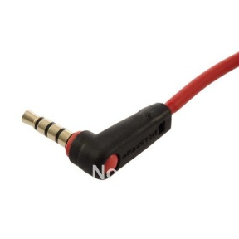
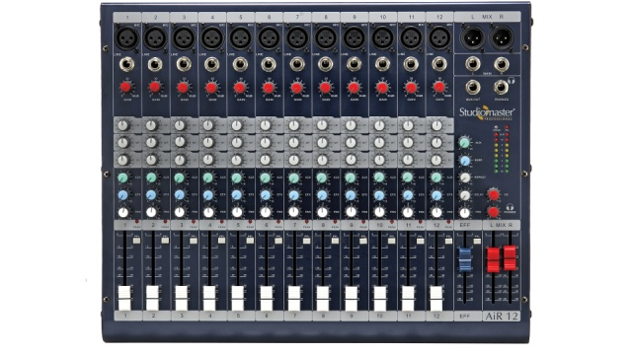
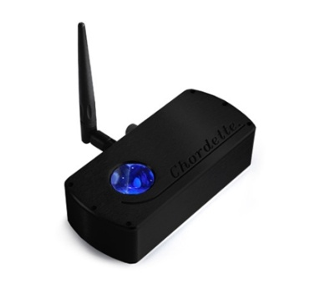
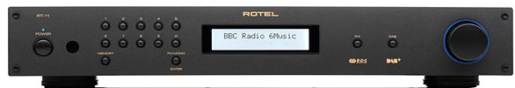
Speakers
Speaker Switches
Amplifier
Roaming Microphone
Mixer
AUX Lead
iPod Charger
DAB Radio
Bluetooth DAC

