Slide 1

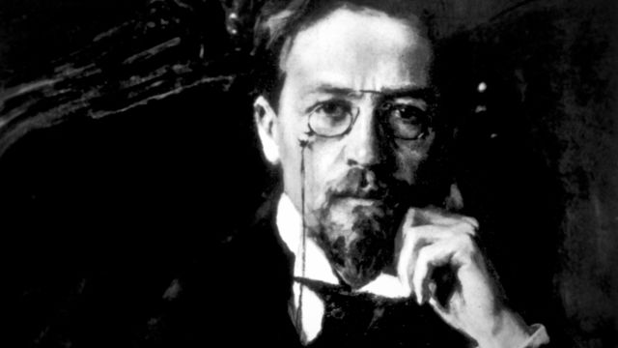
Team
Anton Chekhov

Slide 2
Borislava Hinova – arthemida
Ivailo Papazov – HellFiend
Kalin Dimchev – kalin.dimchev
Magdalina Buhova – magdalina.buhova
Rossitza Nikolova – rossitza.nikolova
Hristo Stefanov – h_stefanov
Team members

Slide 3
Goals
Create a console-based RPG
More specifically, a single player turn-based game
Put into practice all major OOP design principles
Improve one’s team collaboration skills using Git

Slide 4
All Requirements covered:
More than 15 classes (at least 3 abstract classes incl.)
Custom exception class
At least 5 interfaces
Polymorphism usage
At least 3 levels of inheritance
4 Enumerations
Several events with subscribers
Singleton design pattern used
1 structure used
Git used
All major OOP design principles put into practice

Slide 5
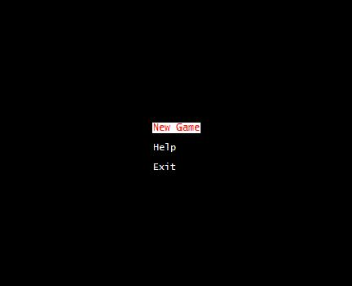
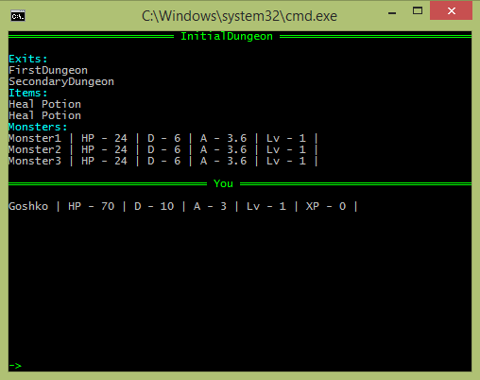
Main menu
Kill’Em All
Try to kill them all while dungeon crawling
Game screen

Slide 6
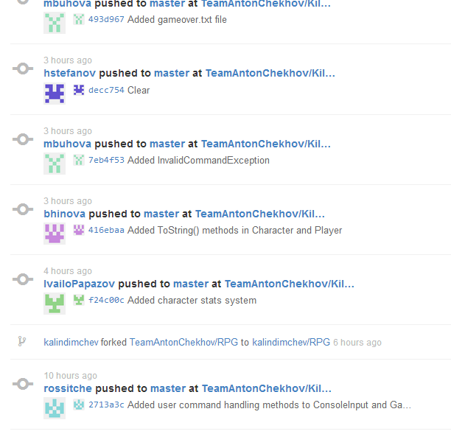
Everyone got involved…

Slide 7
and we kind of quite liked it!

Slide 8
Thank you for your attention ☺

