Slide 1
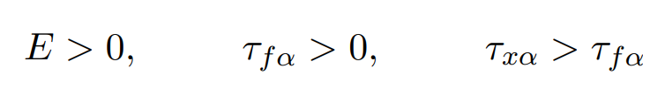
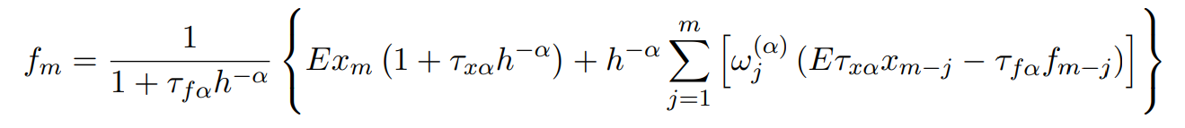
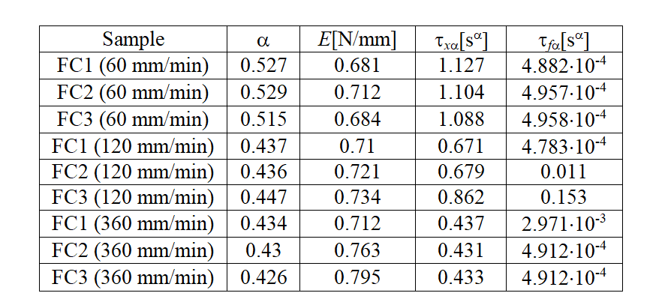
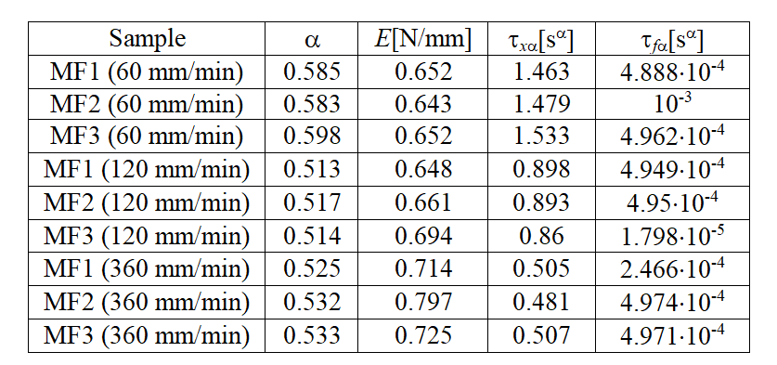
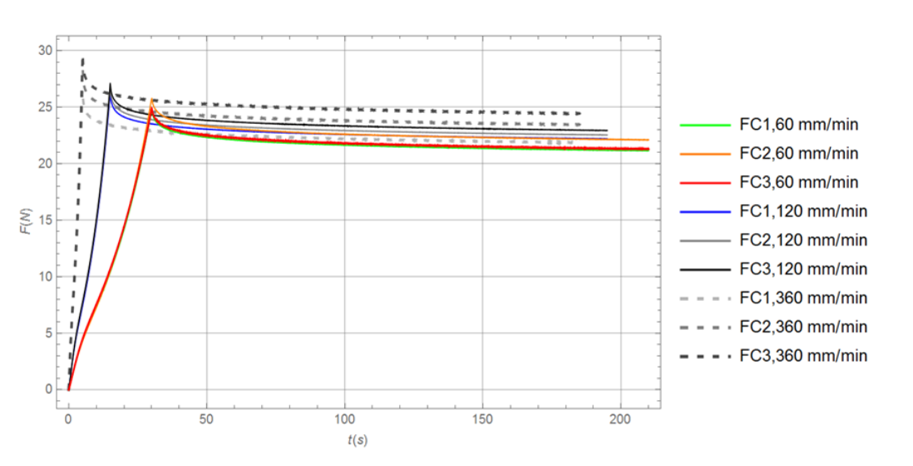
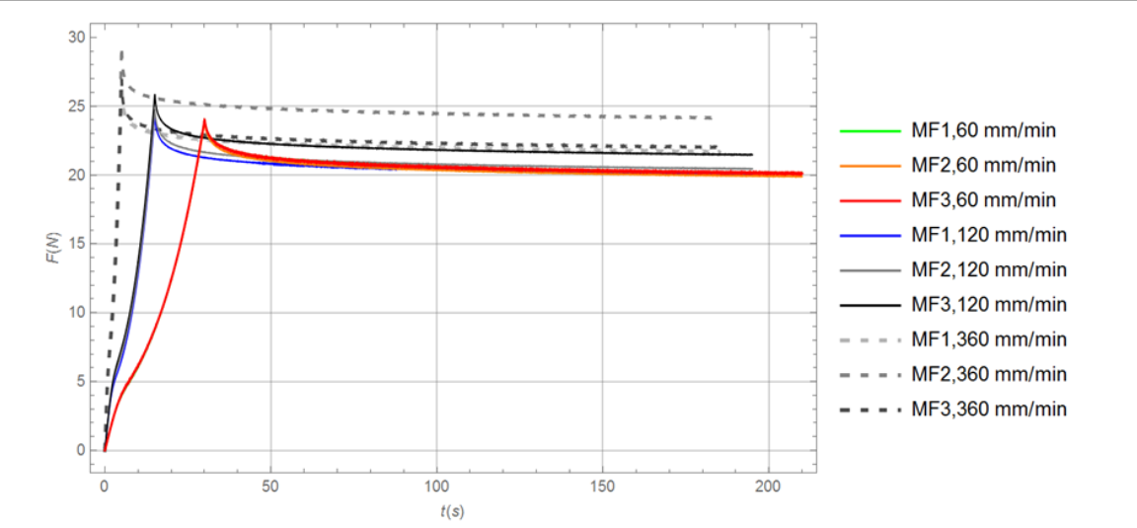
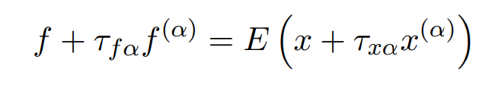
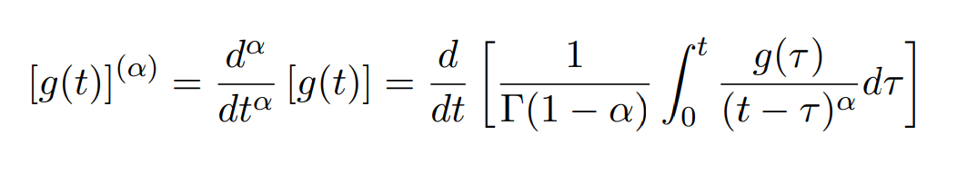
Summer School “Mechanics of active soft materials: experiments, theory, numerics, and applications”
Parameter identification of viscoelastic materials using different deformation velocities
Iva R. Janković, Nenad M. Grahovac, Miodrag M. Žigić
Faculty of Technical Sciences, University of Novi Sad, Serbia
Introduction
Parameters τ_{fα}, τ_{xα} and E must satisfy certain restrictions according to the second law of thermodynamics [9].
Our objective is to calculate the values of the model parameters (α, E, τ_{xα},τ_{fα}) for all samples and examine how changes in deformation velocity affect the obtained results.
The algorithm for obtaining the numerical solution for m = 0, 1, 2, . . . reads
Over the past few decades, polymers have gained popularity as a preferred engineering structural material due to their affordability, ease of processing, weight savings, corrosion resistance, and other notable benefits. Viscoelastic properties of polymer fibers has attracted considerable attention in different scientific areas.Experimental studies conducted with different polymers revealed rheological behavior which manifests non-linear elasticity, and almost ideal plasticity, or plasticity with strain hardening, strain-rate effects, creep and viscoelastic relaxation effects. Those kinds of properties of polymer materials play an important role in their application.
The identification of model parameters for viscoelastic materials has been conducted in numerous studies.. The values of model parameters determined on the bases of relatively simple experiments of stress relaxation and creep are sometimes used for modeling in collision problems, where deformation rates are much higher. This paper investigates the influence of deformation rate on the values of parameters of the fractional Kelvin-Zener model.
Results
Methodology
Following the procedure for parameter identification described in [7], where the Grünwald-Letnikov definition of fractional derivatives was used, the values of parameters of the viscoelastic model are determined for all samples, see also [10].
Stress-relaxation experiment
Eighteen different samples of polymer materials, i.e. nine fluorocarbon (FC) samples and nine monofilament (MF) samples were tested with the Instron test system. All samples had an initial length of 30 cm. During the first phase, the ramp phase, the samples were loaded under constant strain rate until a predetermined strain value of 10% was achieved.
Three sample groups were subjected to different deformation rates, specifically 60 mm/min, 120 mm/min, and 360 mm/min, so that the tension phase lasted 30 s, 15 s, and 5 s, respectively, for these three sample groups. After that, the samples were exposed to a relaxation phase in which the achieved deformation was held constant for a period of 180 s for all samples.
Figure 1. shows the experimental results for 9 samples of fluorocarbons, which were grouped into sets of three samples each. The experimental results for the monofilament samples are shown in Figure 2.
Table 1. Model parameter values for fluorocarbon
Table 2. Model parameter values for monofilament
From the obtained results, it can be noticed that there are no significant deviations in the parameter values within each group of three samples for both tested materials, indicating result repeatability. By observing the obtained results for the derivative order , it can be concluded that the values of at a deformation rate of 60 mm/min are slightly higher for both materials compared to the values obtained at higher speeds. With the increase of the deformation rate, there is a slight increase in the values of the parameter E.
The biggest change in the parameter values is observed in the parameter τxα, where the values decrease with the increase of the deformation rate. The values of the parameter τfα are very small for most of the samples compared to the obtained values of other parameters. Considering that this parameter multiplies the th derivative of the tensile force in equation (1), it can be concluded that the influence of this term is reduced.
Fig. 1. Experimental results for 9 fluorocarbon samples
Conclusion
In this paper we analyzed the influence of strain rate on the value of parameters of the fractional Kelvin-Zener viscoelastic model in a stress relaxation experiment. The behavior of two viscoelastic materials was tested, with three sample groups formed for each material, all subjected to the same deformation speed.
Very similar behavior was observed within each sample group, as evidenced by the small deviations in the parameter values obtained for each group.The change in deformation speed affected the parameter values in a very similar manner for both materials. The highest and lowest deformation speeds for the tested samples were in a 6:1 ratio.
It would be interesting to investigate the effect of a much larger ratio between the maximum and minimum deformation speeds, and to analyze the potential application of relatively simple relaxation and creep experiments to collision problems where deformation speeds are very high.
Fig. 2. Experimental results for 9 monofilament samples
The model
In this analysis we chose the Fractional Kelvin-Zener model which yields accurate results that match experimental data while using only four parameters. The constitutive equation has the following form:
where f and x stand for tensile force and elongation, τ_{fα} and τ_{xα} are model parameters expressed in s, E is expressed in N/m, while the real number represents the derivative order in the standard Riemann-Liouville form:
References
[7] Zigic, M., Viscoelastic response of the human hamstring muscle during a ramp-and-hold type of experiment, In: Proceedings of the 2nd International Congress of Serbian Society of Mechanics, Palić (Subotica), Serbia, 1-5 June 2009.
[9] Atanackovic, T. M., A modified Zener model of a viscoelastic body, Continuum Mech. Thermodyn., 14, pp. 137-148, 2002.
[10] Podlubny, I., Fractional differential equations, Academic Press, London, 1999.

