Slide 1
UNIT 9
critique

Slide 2
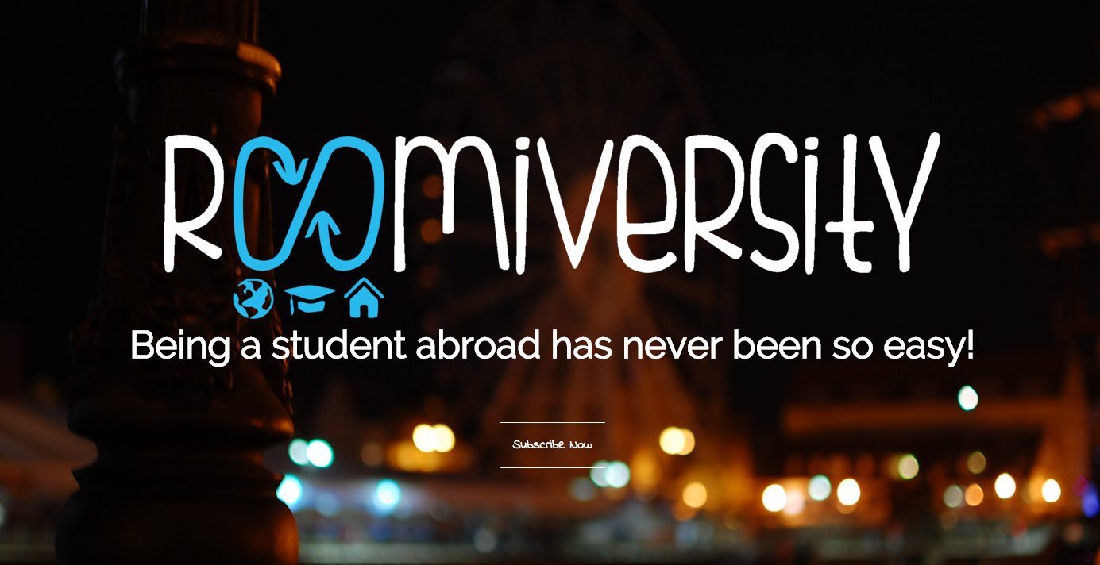
roomiversity A community of exchange students
http://ivale88.github.io/unit_8/index.html

Slide 3
Which existing websites out there most inspired your web site design thus far?
www.airbnb.com
My website is a mix of websites and services but Airbnb has a perfect modern layout, and its focus on travelling gives the perfect vibe to the website.
I like the large amount of pictures and the little text (images can say more than words).
I like the clear calls to actions.

Slide 4
Which parts of the design are you most proud of?
The header.

Slide 5
What struggles did you encounter in your design process?
Choosing fonts has been one of the hardest parts. It sounds like an easy task, but it was actually harder than colors.

Slide 6
Which struggles did you encounter during page development?
Aligning different elements
Managing images properly: there are many different options to manage images and each of them has pros and cons, some are better in certain cases while some others in other case. Figuring our which option work best was a lot of work (still working on it)

Slide 7
What did you learn from making your project responsive?
To think differently and to not be attached to content to the point you lose objectivity: there is always something that is not fundamental and can be eliminated.

Slide 8
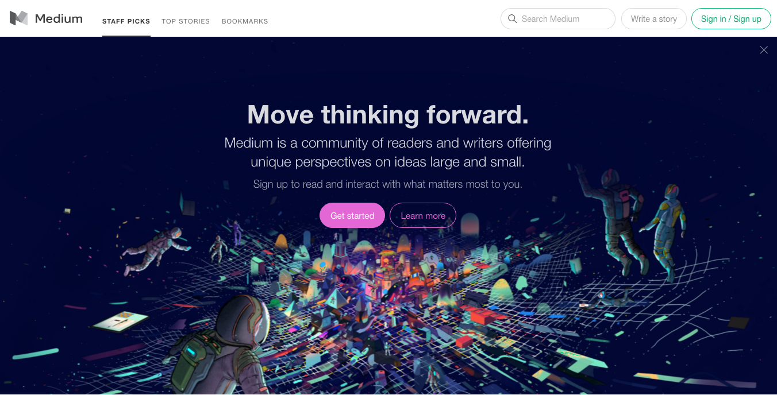
MEDIUM A community of readers and writers
https://medium.com/

Slide 9
LAYOUT
Overall I like the layout.
I like the header with the website slogan and claim.
I like how the menu has been positioned.
I like the contrast between the horizontal header, and the vertical columns for bot main content and sidebar.
I like also the balance between content and white space.
I am not a big fan of the logo on the top left. Maybe having only the image logo without the name of the website would make the top of the page cleaner.
I am also not totally convinced about the combination of rounded shapes for actions and the squared shapes for the menus; I would probably choose one layout and then differentiate it for instance with colors, especially because they give two very different feelings: rounded actions = modern and social, squared menu = sophisticated.
I would also consider making all image the same width and adding an image to all articles to make the layout more uniform.

Slide 10
TYPOGRAPHY
I think the selection of fonts makes sense for almost all elements (Sans-serif for the main titles and Serif for the text and buttons).
I am not one hundred percent sure of the fonts chosen for the menu tabs and the watermark. I think they add complexity.
I would eliminate the watermark or select a totally different font in contract with all the others; and
for the menu tabs (the one on the top and the one in the sidebar) I would probably use one of the other fonts and differentiate it with either colors or thickness, or maybe it’s just a matter of size and it’s just disproportionate, so try to increase the size and see how it looks

Slide 11
NAVIGATION
The navigation is pretty linear
I like how the content adjust to smaller screens, also the reduction of contents is appropriate

Slide 12
FLOW
The flow works pretty well
The attention is captured by the main slogan and claim because of the position, the font size, and the background image.
It is interesting to have the option of closing the header but I can’t decide whether I find it confusing
Colors and shapes help in identifying all next actions to take
I find it overall easy to navigate, although I wonder whether there are too many buttons leading to the same action
I would also consider some light “hovers” to add to buttons and menus

Slide 13
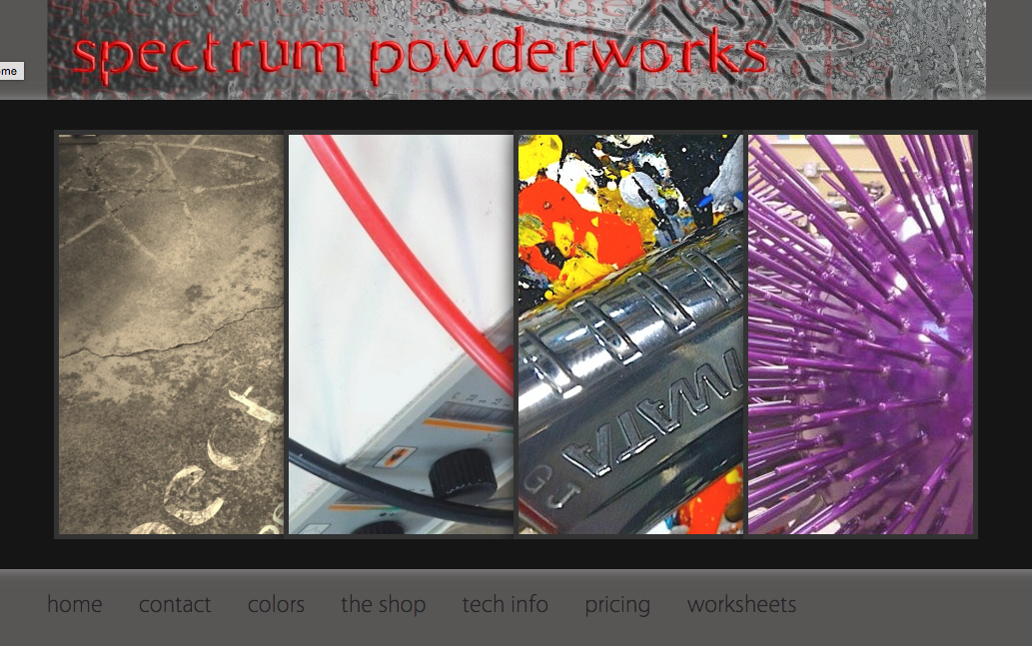
Spectrum powderworks Artistic painting service
http://www.spectrumpowderworks.com/

Slide 14
LAYOUT
I like the idea of the landing page to be made of one big image sliding kind of menu, but its layout should be made lighter and more modern.
I like also the balance between the emptiness of the page and the animation of the main menu.
The overall layout does not represent properly the service offered. The current layout reduces the website to a pure service without conveying the trendy cool side of it.
Shadows are dated, and the whole color palette should be rethought. They are talking about colors and painting, and this side should totally emerge from the website.
I would get rid of the background image for the website name, change the color of it, and align all elements properly (watermark and also bottom menu).
The contrast between background color (dark grey) and fonts (black) could be improved.
I would spread the bottom menu items to occupy the whole width of the main menu.

Slide 15
TYPOGRAPHY
I would try with a different font for the website name, or maybe once the background is removed and the color changed it actually looks like pain splatters.
I am not one hundred percent sure of the fonts chosen. Are they Comics San?
Keeping the current Sans Serif for the menu and the main titles my be okay, but I would try with different options for the contents.

Slide 16
NAVIGATION
The navigation is easy
The page does not adapt to smaller screens
Three menu items out of four redirect to an external site opening a new tab (I would consider creating a stream of pictures within the website

Slide 17
FLOW
I am not totally convinced about the items put in the main menu and those put in the bottom menu. I guess the main menu should have the most important information, but without browsing the bottom menu I feel like the user does not have a complete idea of what the company is doing
Maybe an alternative distinction could be to separate photo galleries from information
There is not much text nor colors, so the flow is suggested by the page layout, though images could have been more coherent with the content they represent to help the user interpret the website

