Slide 1
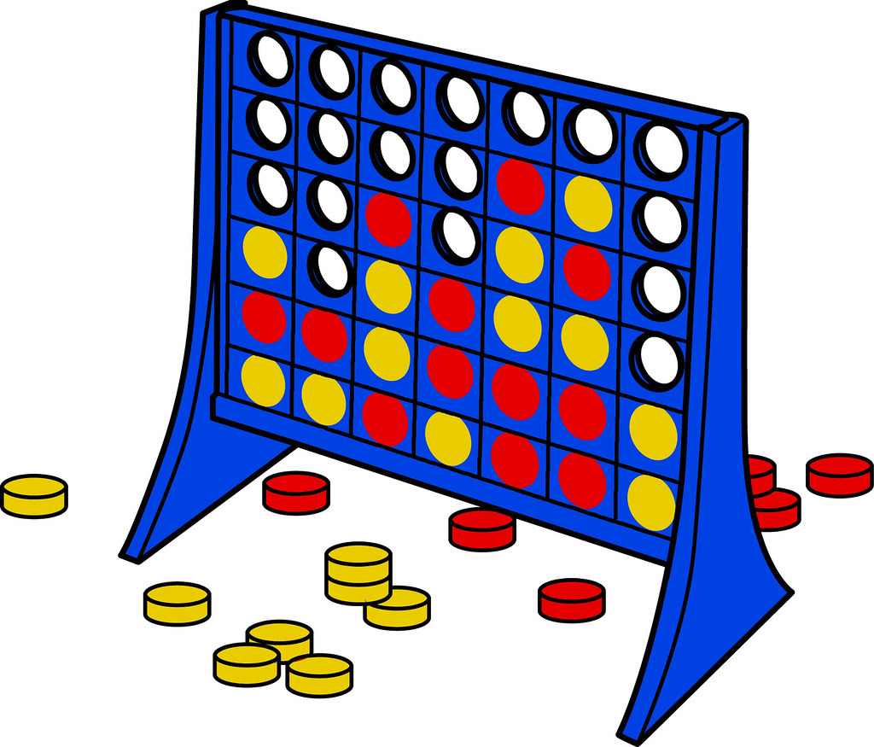
Connect 4
Ibrahim Velizade 211ADB065
Farid Aghazada 211ADB092

Slide 2
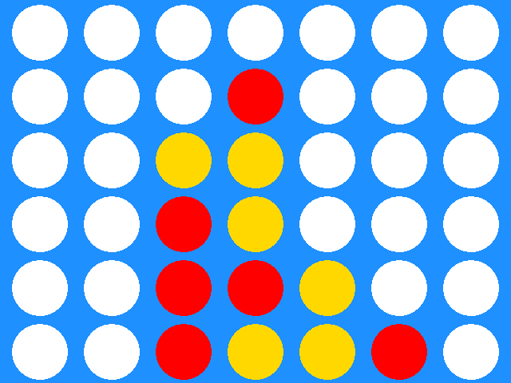
Connect 4
Objective: Align four discs of the same color in a row (horizontal, vertical, or diagonal) to win.
Players: Two players take turns dropping colored discs into a 7-column, 6-row grid.
Gameplay: Discs fall to the lowest available slot within the chosen column.
Winning Condition: The first player to connect four of their discs in a row wins.
Draw: If the grid is full and no player has connected four discs, the game ends in a draw.

Slide 3

Functional Requirements
Game Interface
Drop discs into columns
Real-time game state view
Game Logic: Implement Connect Four rules
Responsive Design: Adapts to screen sizes
Game State Management
Manage and update game state
Store disc positions on grid
Handle player turns
Additional Features
Restart game
Disk Selections

Slide 4
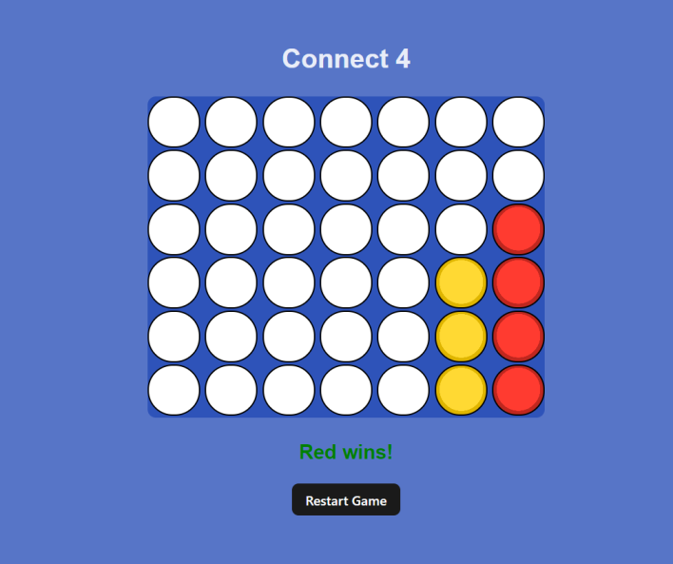
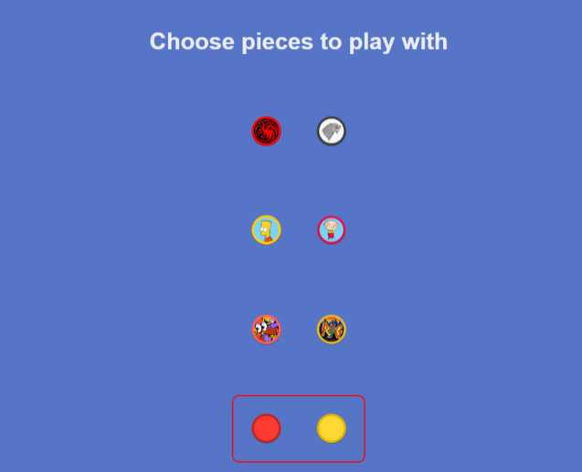
User Interface

Slide 5

Testing
Black Box Testing
Visual Testing
Developer Tools in Browser
Test programs

Slide 6

Technologies used
Languages:
HTML
CSS
JavaScript
React
For testing:
Jest
Vitest

Slide 7
GitHub & Report Link
GitHub Link: https://github.com/ivalizada14/DIP392-Team-21
Web application: https://celebrated-palmier-8aeb88.netlify.app/
Report Link: https://docs.google.com/document/d/1HKXkNI0HQSCSZH_sc6heXc-tjCQi03B2/edit?usp=sharing&ouid=110055982436121393753&rtpof=true&sd=true

Slide 8
THANKS FOR YOUR ATTENTION!
ANY QUESTIONS?

