Slide 1

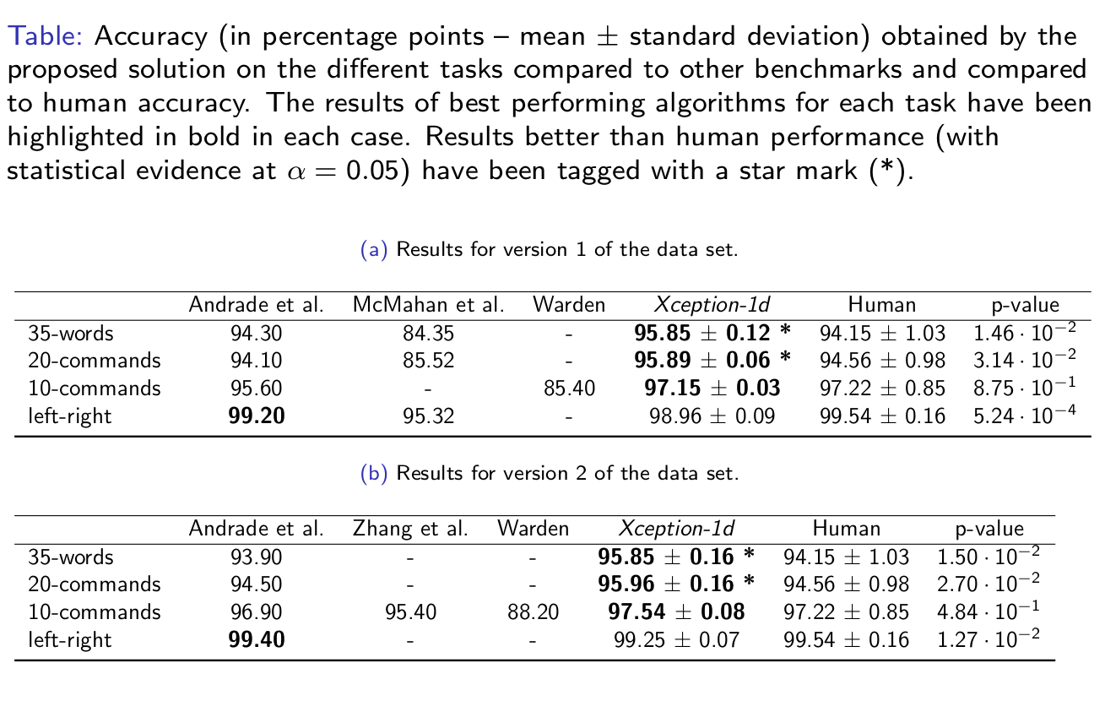
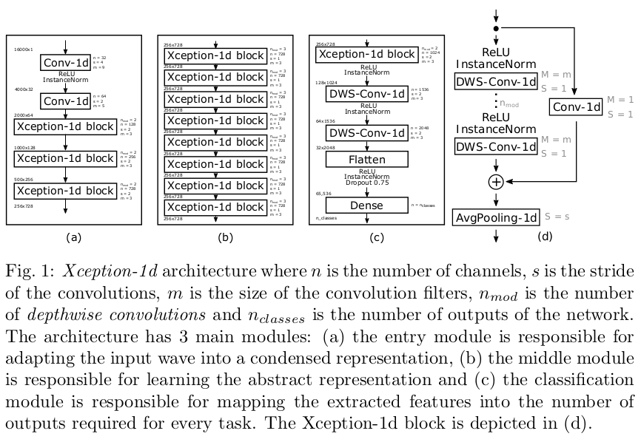
End to End Keyword Spotting using Xception-1d
Iván Vallés-Pérez, Juan Gómez-Sanchis, Marcelino Martínez-Sober, Joan Vila-Francés, Antonio J. Serrano-López, Emilio Soria-Olivas
Intelligent Data Analysis Laboratory, University of Valencia, Spain
MODEL
Xception 12 is a CNN-based deep learning architecture published by François Chollet (Google) in 2017 which recently achieved SOTA results in multiple computer vision tasks. It uses depthwise separable convolutions and residual connections. Both together lead to a very efficient yet deep CNN. I This algorithm is designed to work with images (2-D data). We have adapted it to work with sequences (1-D data): Xception-1d
EXPERIMENTAL FRAMEWORK
The data is splitted in train/dev/test (around 80%, 10% and 10% split) so that no speakers appear in more than one set.
The data set is augmented using random distortions (resampling, pitch shift, saturation, time offset and noise addition).
Four different tasks have been defined: (1) 35 words recognition, (2) 20 commands recognition + unknown (3) 10 commands recognition + unknown (4) left-right + unknown
INTRODUCTION AND OBJECTIVES
This work presents Xception-1d, a CNN architecture based on Xception published by François Chollet (2017), to tackle the speech commands recognition problem. Our contribution is summarized as follows:
(1) design of a depthwise separable CNN-based architecture with better results than the existing benchmarks (including human annotators), (2) description of an efficient methodology for augmenting audio data (multiplying its size by 5), (3) human performance quantification to use it as an additional baseline, (4) creation of a public repository to foster reproducibility.
The objectives of this study are:
- achieve the best possible accuracy on the recognition of speech commands under a limited vocabulary setting (Keyword Spotting).
- Measure the results against previously published benchmarks and against human performance.
DATA
The Google Tensorflow speech commands dataset contains mor than 100k 1-second length recordings from multiple speakers of the following words: “left”, “right”, “yes”, “no”, “down”, “up”, “go”, “stop”, “on”, “off”, “zero”, “one”, “two”, “three”, “four”, “five”, “six”, “seven”, “eight”, “nine”, “dog”, “cat”, “wow”, “house”, “bird”, “happy”, “sheila”, “marvin”, “bed”, “tree”, “visual”, “follow”, “learn”, “forward”, “backward”.
RESULTS
CONCLUSIONS
This work shows how a neural network which succeeded in the computer vision field, with an adaption and a set of tweaks, is able to surpass human performance at a speech recognition task with limited vocabulary achieving state of the art results.
This is why we suggest Xception-1d as the de facto architecture when facing a voice command recognition task with restricted vocabulary, considering the computing power is not a limiting factor due to its small size.
The algorithm presented can have multiple applications for improving voice-controlled systems.

