Slide 1
Introduction about Theory of Computation

Slide 2
ddfdffddf

Slide 3
d
dddddd

Slide 5
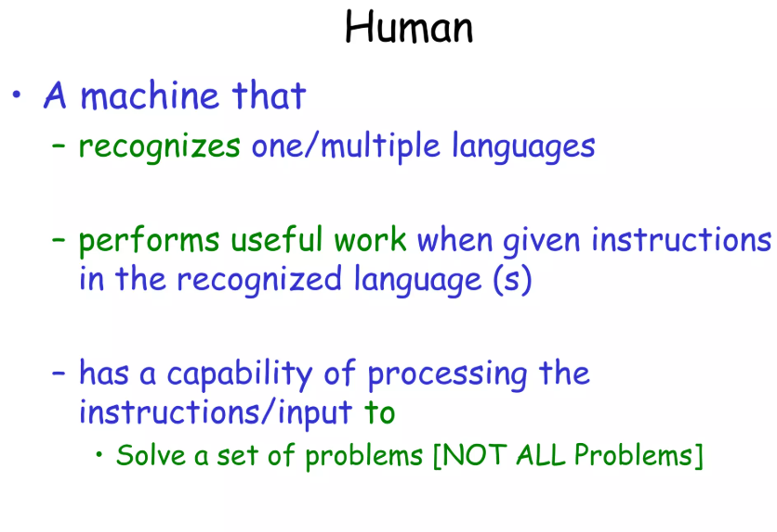

Slide 6
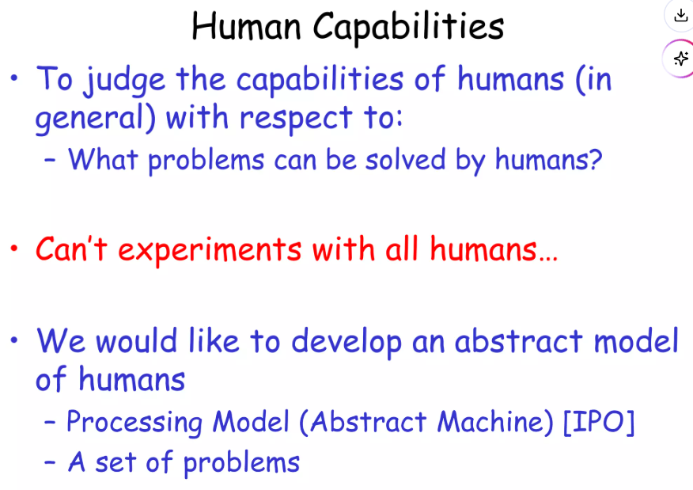

Slide 7
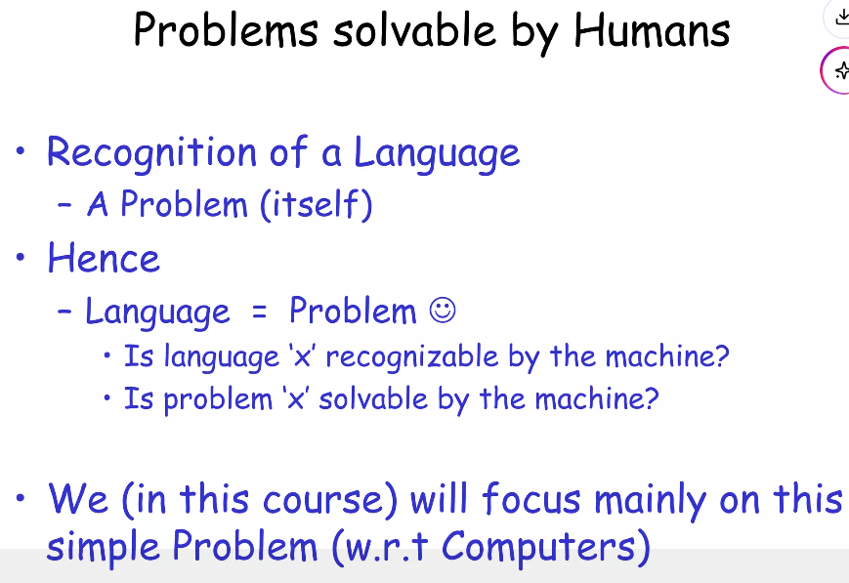

Slide 8
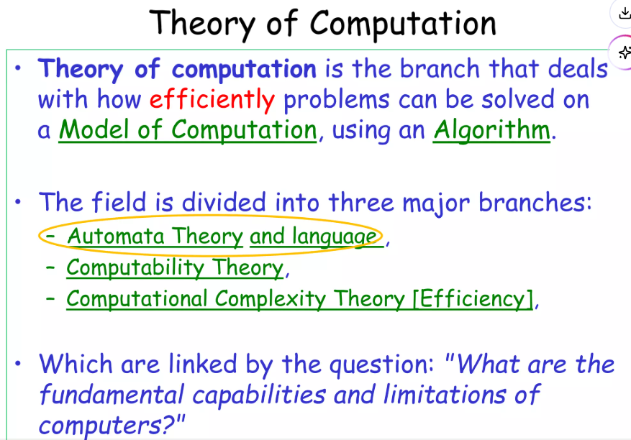

Slide 9
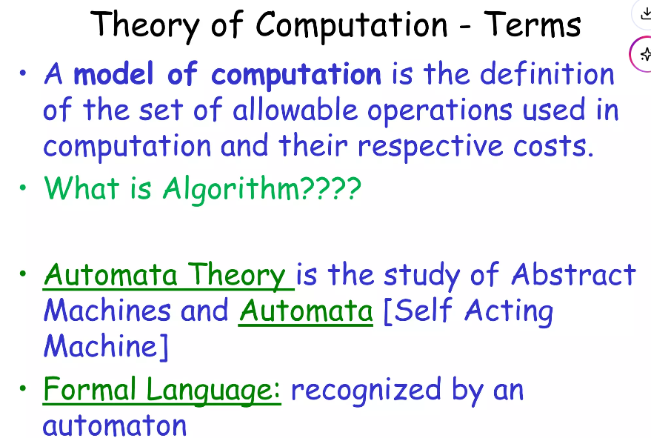

Slide 10
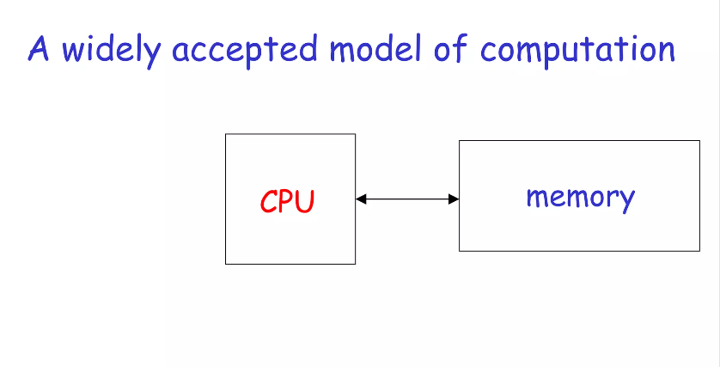

Slide 11
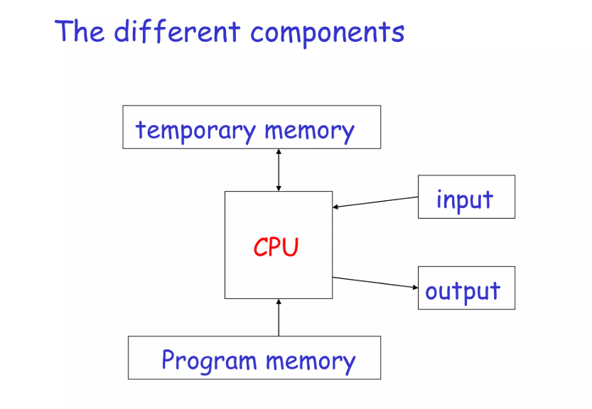

Slide 12
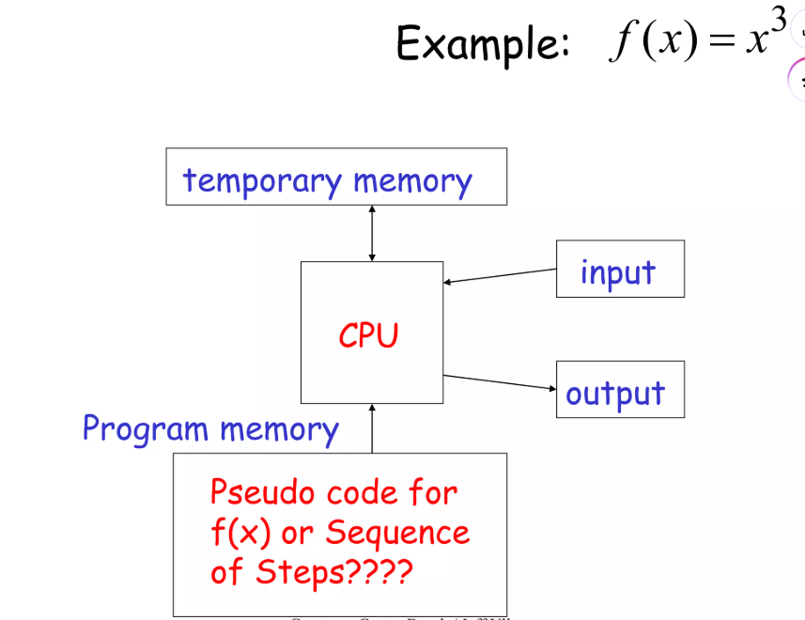

Slide 13
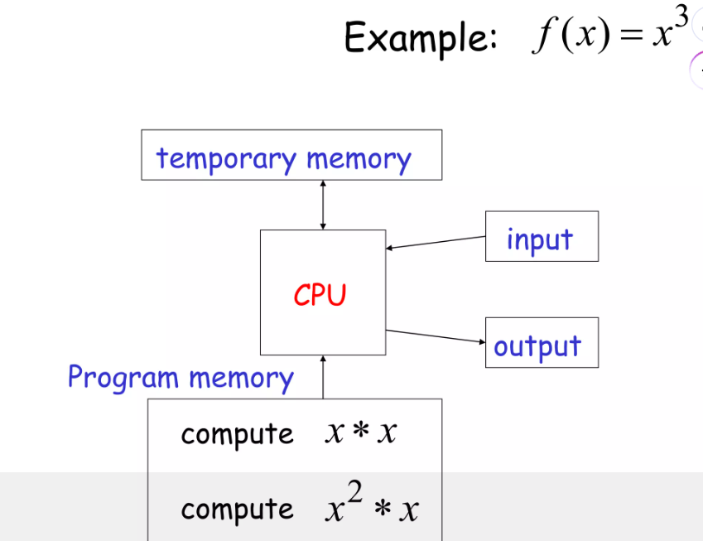

Slide 14
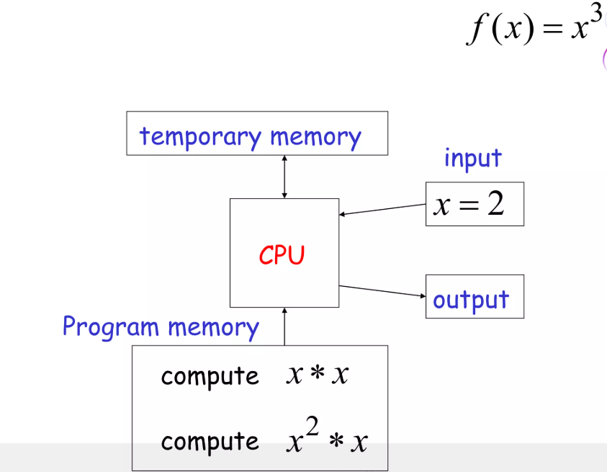

Slide 15
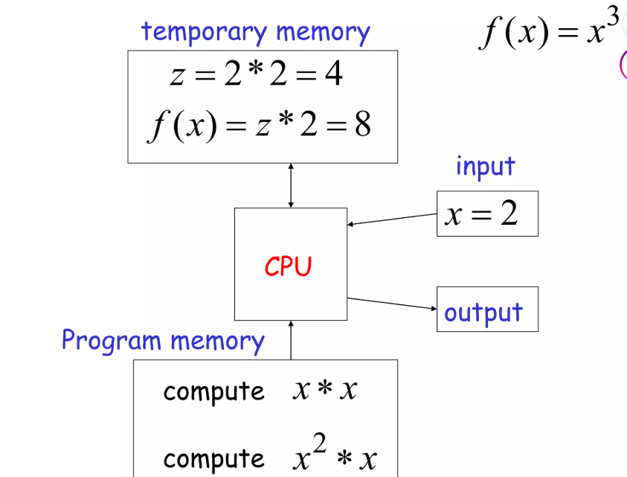

Slide 16
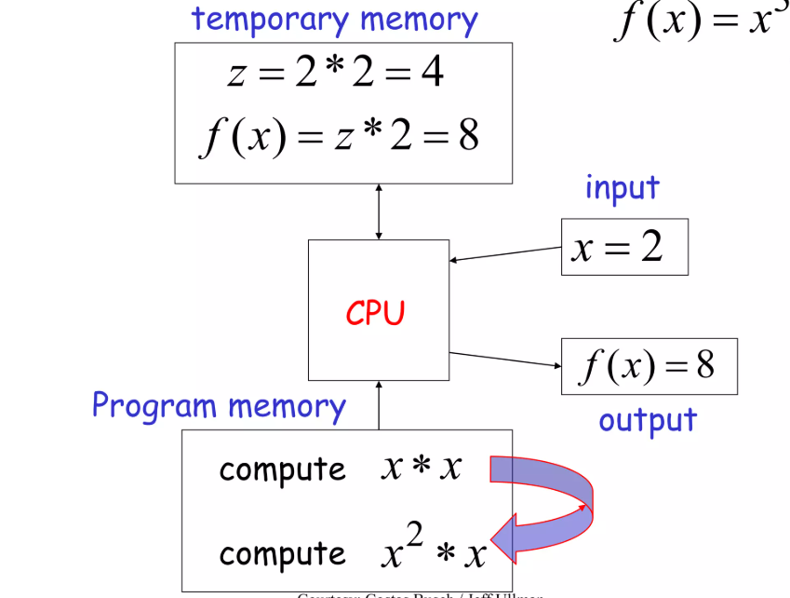

Slide 17
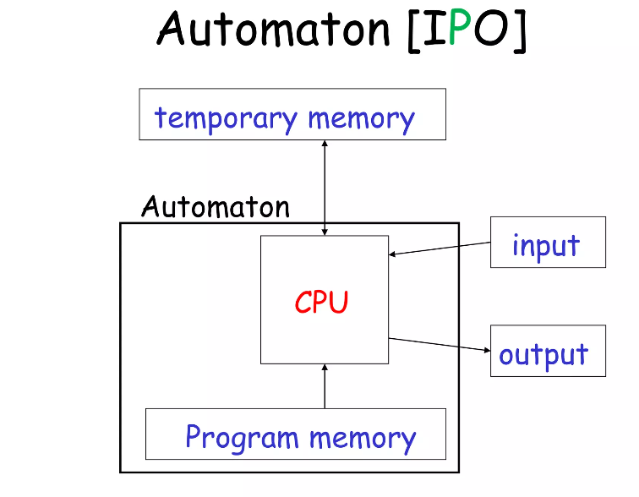

Slide 18
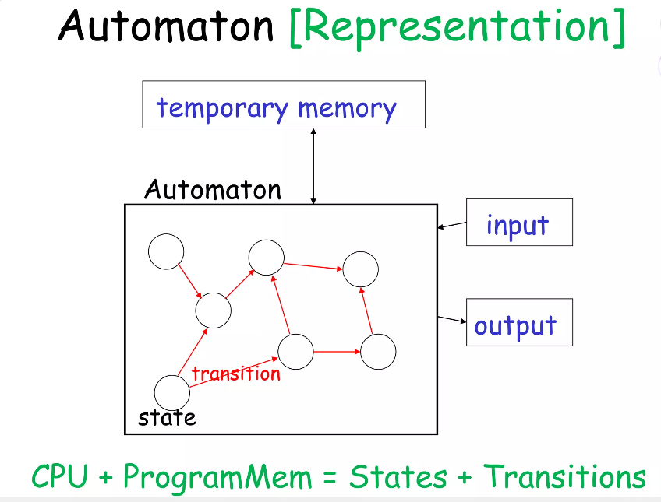

Slide 19
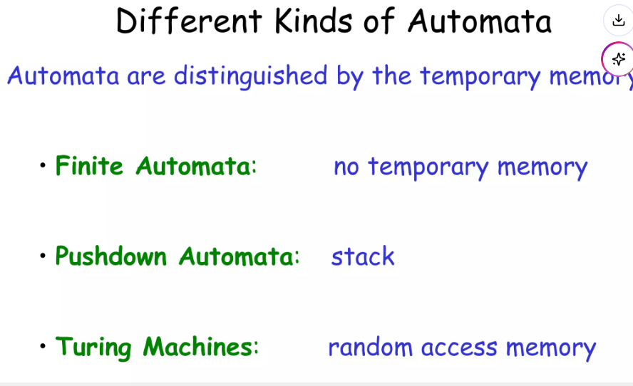

Slide 20
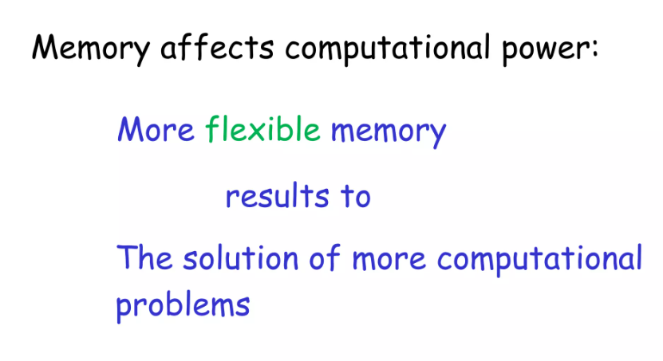

Slide 21
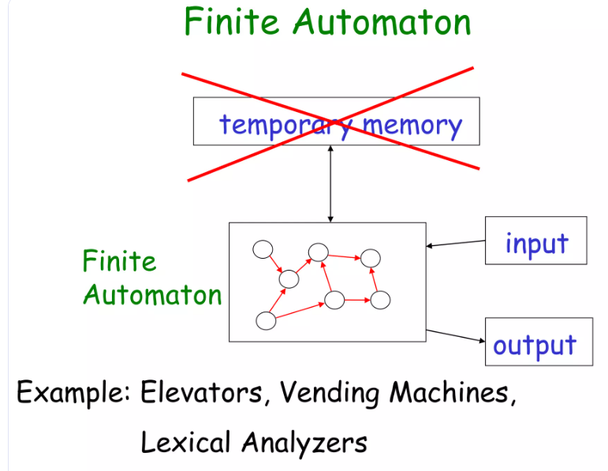

Slide 22
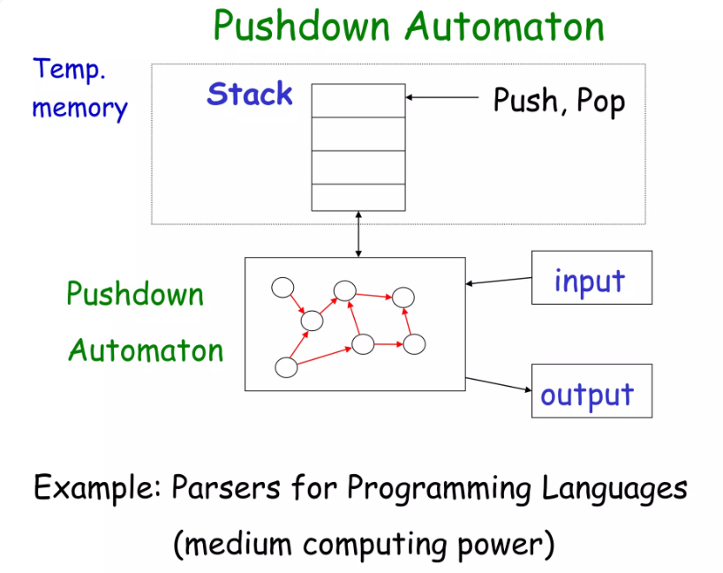

Slide 23
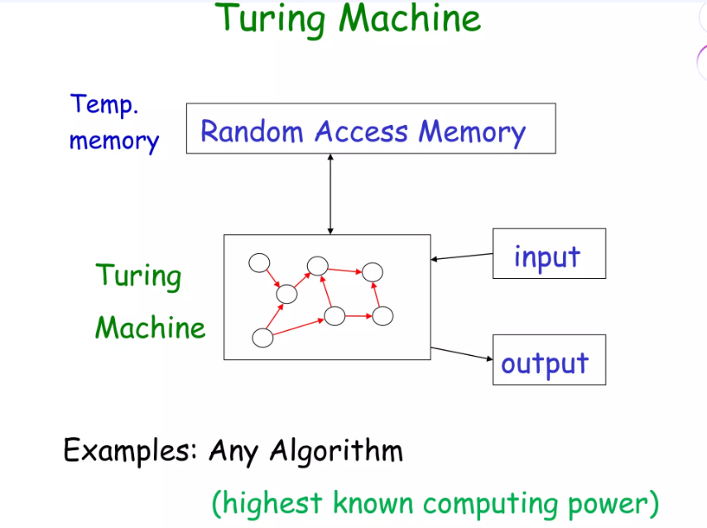

Slide 24
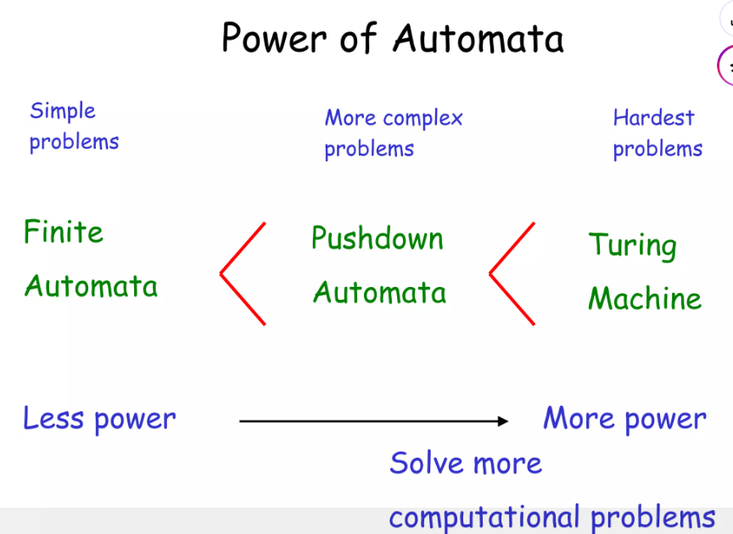

Slide 26
UNIT I - AUTOMATA AND REGULAR EXPRESSIONS
1. formal proof
2.Deterministic Finite Automata (DFA) - MINIMIZED D
3.Non-deterministic Finite Automata (NFA) - convert NFA TO DFA
4. NFA WITH EPCILON TO with out epcilon

Slide 27
UNIT II - REGULAR EXPRESSIONS AND LANGUAGES
1.Regular Expressions
2. Properties of Regular Languages
3. Pumping Lemma
4. Closure properties of regular languages.

Slide 28
UNIT III - CONTEXT FREE GRAMMAR AND PUSH DOWN AUTOMATA
1. Context-Free Grammars and Languages
2. Ambiguity in grammars
3. Push Down Automata
4. Equivalence of PDA's and CFG's
5. Deterministic Pushdown Automata

Slide 29
UNIT IV - NORMAL FORMS AND TURING MACHINES
1. Chomsky Normal Form (CNF
2. Greibach Normal Form (GNF)
3. Turing Machine

Slide 30
UNIT V - UNDECIDABILITY
1. A Language that is Not Recursively Enumerable
2. Post's Correspondence Problem (PCP)
3. Recursive and recursively enumerable languages
4. NP completeness Problem

