Slide 1
Library Management system
Developed by: Ivan Angelov

Slide 2
Purpose
The Library Management System (LMS) is designed to efficiently organize and oversee library operations
Enables librarians and admins to manage:
Book inventory
Authors and categories
User reservations and loans
Members can:
Explore the catalog
Leave reviews
Reserve books
View their borrowing history

Slide 3






technologies
Backend:
Golang
Gorilla/Mux (API framework)
GORM (Object Relational Mapping Framework)
PostgreSQL (Database)
Frontend:
Open UI5 (User interface)
Security & Authentication:
Keycloak (Role-based access control)

Slide 4
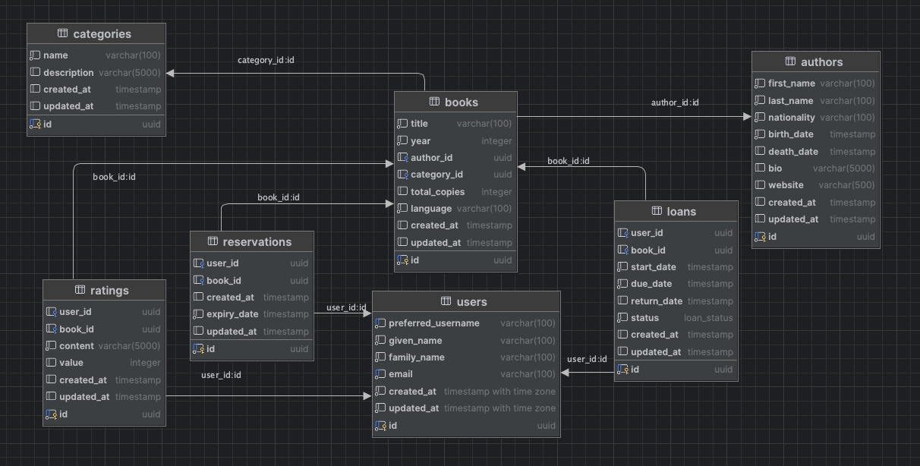
Domain model

Slide 5



Microservices

Slide 6

Challenges
Access management
Paging and filtering
UI framework

