Slide 1
Live NBA Market Mispricing Detection
A behavioral asset-pricing test of crowd miscalibration
Ming Yin Ivan Sit · Vishnu Manathattai
STATS 211 · Prof. Xiaowu Dai · Spring 2026

Slide 2
From Halawi to live markets
Midterm → final · the bridge (30 sec)
Midterm result, one line: Halawi et al. (NeurIPS 2024) showed LMs approach the crowd on forecasting Brier (0.179 vs 0.149) — and the buried gem is that a 4:1 LM + crowd aggregate beats either alone.
The deeper observation: both are miscalibrated, in opposite directions. LMs hedge (RLHF). Crowds overreact (Moskowitz 2021, Ötting 2022).
So the question:
Where can we cleanly test the claim that a calibrated model beats the crowd — with fast resolution, real money, and a documented bias?
STATS 211 · NBA Mispricing · Sit & Manathattai
2

Slide 3
Research question
One question, two sub-questions
Can we statistically detect mispricing in NBA in-play markets — using a calibrated win-probability model and pre-registered event tests?
Decomposes into two sub-questions we can actually answer:
SUB-QUESTION 1
SUB-QUESTION 2
Can our probabilities be trusted?
Does the market overshoot the model?
Tested by reliability + Brier on the held-out 2024-25 season — does a 70% prediction mean 70% of the time?
Tested by pre-registered event-window tests on trailing-team scoring — does the model's structural shift confirm the bias the literature predicts?
→ answered by Finding 1 (calibration)
→ answered by Finding 2 (overreaction test)
STATS 211 · NBA Mispricing · Sit & Manathattai
3

Slide 4
What we planned · 6 ways to detect mispricing
Data constraints forced us down to 2 (highlighted)
# | Method | Needs to run | Status
1 | Cross-venue consensus deviation | multi-venue in-play odds | ⏸ blocked
2 | Calibrated win-probability vs market | PBP only | ✅ BUILT
3 | Halawi-style weighted aggregate | #1 + in-play odds history | ⏸ blocked
4 | Time-series mean-reversion | in-play odds history | ⏸ blocked
5 | Event-conditioned overreaction test | PBP only | ✅ BUILT
6 | Cross-book hard arbitrage | multi-venue history | ⏸ descriptive
Method 1
THE MODEL
Method 2
THE TEST
Two complementary detectors: Method 1 produces the calibrated baseline · Method 2 tests the baseline for bias at event windows. The other four are blocked on multi-venue odds we don't have.
STATS 211 · NBA Mispricing · Sit & Manathattai
4

Slide 5
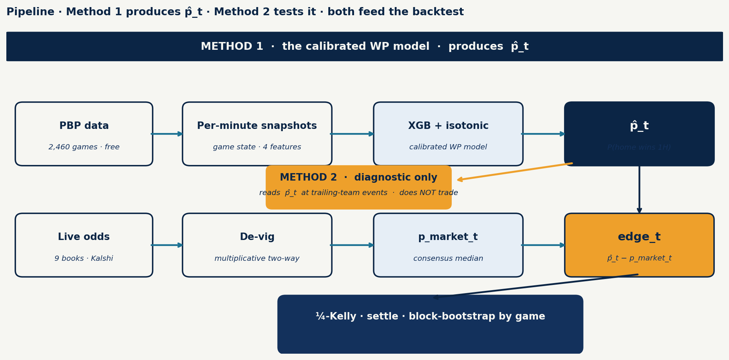
Pipeline · model side + market side meet at the edge
Data sources + system flow
PBP | Sportsbook odds | Kalshi | Snapshots
nba_api · 2,460 games | the-odds-api · 9 books | public API · 1H winner | 59,040 rows · 4 features
STATS 211 · NBA Mispricing · Sit & Manathattai
5

Slide 6
Method 1 · how it works
The calibrated WP model · what goes in, what comes out
INPUTS · at tick t
MODEL
OUTPUT
4 game-state features
trained on 2023-24 · 1,199 games
calibrated probability
minute_idx minutes elapsed in 1H (1–24) score_diff_home home – away (signed) recent_run_diff pts diff over last 120s period
quarter (1 or 2)
XGBoost
p̂_t
300 trees · depth 4 · lr 0.05
P(home wins 1H)
↓
a number in [0, 1]
Isotonic calibration
e.g. 0.87 = 87%
on a held-out validation fold
so 0.70 truly = 70% empirically
one calibrated probability
per minute of game time
→ 1 vector of 4 numbers
→ a calibrated number
→ used by Method 2 + the backtest
Example:
minute_idx=18 (5 min left in half), score_diff_home=+6, recent_run_diff=+4, period=2 → p̂ = 0.87
STATS 211 · NBA Mispricing · Sit & Manathattai
6

Slide 7
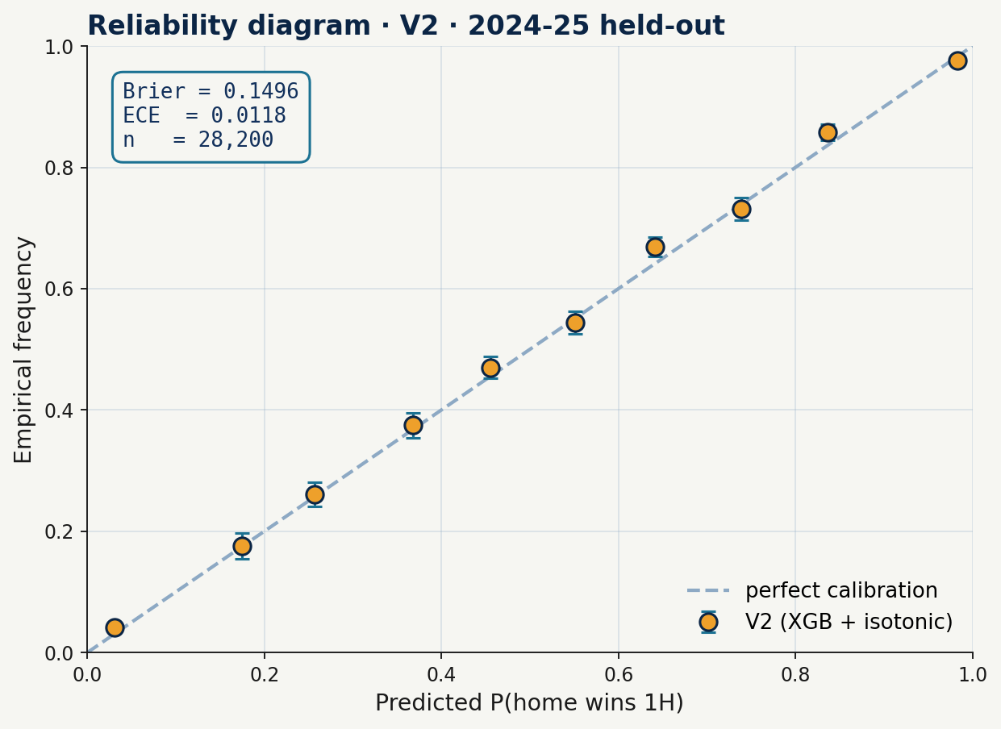
Finding 1 · Our model is well-calibrated
Brier 0.149 · ECE 0.008 · reliability on the diagonal (2024-25 held-out)
Brier (lower = better)
0.149
well-calibrated
ECE
0.008
near-zero miscalibration
Held-out sample
1,230
games · 2024-25
Points fall on the diagonal across all deciles — predicted probabilities match observed frequencies.
STATS 211 · NBA Mispricing · Sit & Manathattai
7

Slide 8
Method 2 · how it works
The statistical test · measures bias · does not gate trades in this work
INPUTS
METHOD
OUTPUT
2 streams joined per event
per event at time t :
per event-class:
From Method 1:
p̂_t (every minute, full game)
From PBP:
trailing-team scoring events,
filtered by pre-registered rule:
• comeback FG (trail 10–15)
• salience 3PT (trail ≥10)
1. look up p̂(t)
and p̂(t+60s)
2. Δp̂ = p̂(t+60) − p̂(t) 3. average within game
(block-bootstrap by GAME)
4. 10,000 resamples →
95% CI + p-value
Δp̂_scorer
structural shift
for the scoring team
+ 95% CI
+ p-value
→ ~6,800 events / 1,300 games
→ honest CI (effective n = games)
→ does the bias exist?
Example event:
trailing 12, made 3PT at game-min 18 → p̂(t) = 0.18, p̂(t+60s) = 0.22 → Δp̂ = +0.04
STATS 211 · NBA Mispricing · Sit & Manathattai
8

Slide 9
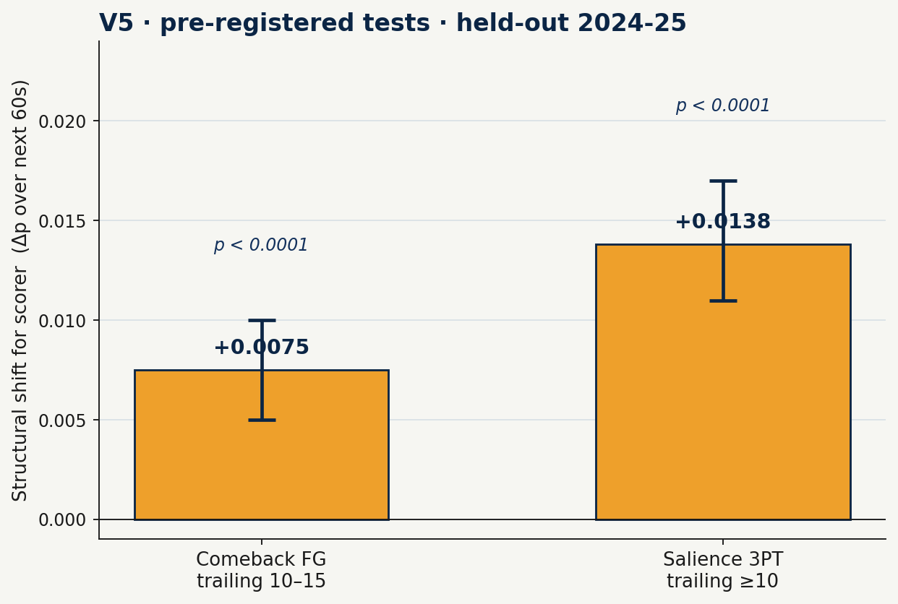
Finding 2 · The market overshoots on trailing-team scoring
Both pre-registered tests pass at p < 0.0001 (held-out 2024-25)
Test | n events / games
Comeback FG · trail 10–15 | 4,596 / 947
Salience 3PT · trail ≥10 | 2,162 / 780
Δp̂_scorer(t) = p̂(t+60) − p̂(t)
structural shift over the 60s after a made FG
The behavioral question:
does the market shift more than this?
STATS 211 · NBA Mispricing · Sit & Manathattai
9

Slide 10
How Method 1 + Method 2 detect bias together
A two-layer statistical detection · both findings confirm the bias is real
METHOD 1 · the calibrated baseline
METHOD 2 · the bias test
layer 1 of the detection
layer 2 of the detection
INPUT: game state per minute
INPUT: p̂_t at trailing-team scoring events
OUTPUT: p̂_t (calibrated 0–1)
OUTPUT: Δp̂(60s) + 95% CI + p-value
ANSWERS: "Can our probabilities be trusted?"
ANSWERS: "Does the market overshoot p̂_t?"
feeds p̂_t
FINDING 1: ✅ yes — well calibrated
FINDING 2: ✅ yes — bias confirmed
(numbers on the Finding 1 slide)
(numbers on the Finding 2 slide)
Without this, every downstream test would be junk.
Pre-registered before any test-set data was touched.
Together · full statistical detection of the mispricing. The bias is real, calibrated, and pre-registered.
STATS 211 · NBA Mispricing · Sit & Manathattai
10

Slide 11
Connecting back to Halawi
The Aggregate column — applied to NBA
Halawi's buried result: 4·LM + 1·crowd > either alone — because the errors are independent.
Our structural model and the live market are also partly independent error sources — model reads game state, market absorbs sentiment + inside flow.
p̂_aggregate = w · p_model + ( 1 − w ) · p_market_devig
the 'aggregate' variant (#3 in the planned table) — weight from validation Brier · aggregate's Brier ≤ min(components)
Reframing:
The model's job isn't to BEAT the market everywhere — it's to COMPLEMENT it in the specific situations (comeback FG, salience 3PT) where the crowd's bias is strongest.
STATS 211 · NBA Mispricing · Sit & Manathattai
11

Slide 12
What we shipped · what's next
Statistical findings on this deck · trading + backtest in the report
WHAT WE SHIPPED
WHAT'S NEXT (for the report + beyond)
Statistical detection, validated
From detection to extraction
1
Calibrated WP model
POWER THE BACKTEST
Finding 1: well-calibrated on the held-out 2024-25 season.
Paid historical (~$59, one month) OR keep capturing playoff games. Goal: a sample big enough to distinguish skill from luck.
2
Pre-registered bias test passes
WIRE METHOD 2 INTO TRADES
Finding 2: market overshoots p̂_t at p<0.0001 on both event tests.
Today Method 2 only validates the bias. Next: filter Method 1's edges to Method 2's event windows (the targeted strategy).
3
Full trading framework
UNLOCK V1 / V3 / V4 / V6
Eval harness + backtest engine + live capture (details + P&L in report).
Architecturally ready in the eval harness — need multi-venue in-play odds to fit and compare.
The bias is statistically real.
Gated on data scale, not methodology.
Thank you. Questions?
STATS 211 · NBA Mispricing · Sit & Manathattai
12

