Slide 1
Stream Max
Movie Selection Modeling and Recommender System

Slide 2
Overview
01
02
03
04
EDA PROCESS
METHODS
RESULTS &
NEXT STEPS
PROBLEM & PROPOSED SOLUTION
‹#›

Slide 3
PROBLEM & PROPOSED SOLUTION
01
‹#›

Slide 4
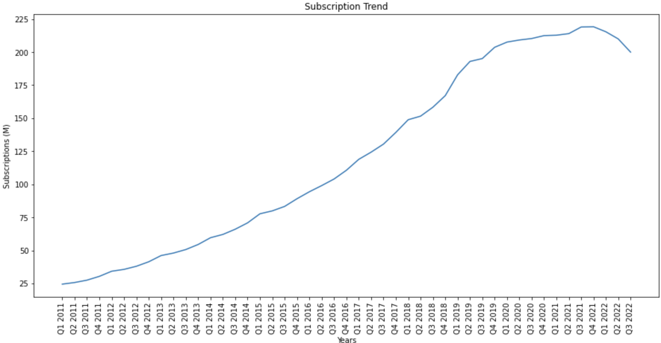
Company Background and Problem Statement
Stream Max is one of the most popular streaming services in the US
Over the past 6 quarters, Stream Max subscription rates have remained stagnant or decreased
Stream Max is looking to identify why subscribers are leaving the platform, and find ways that they can retain their subscribers
‹#›

Slide 5
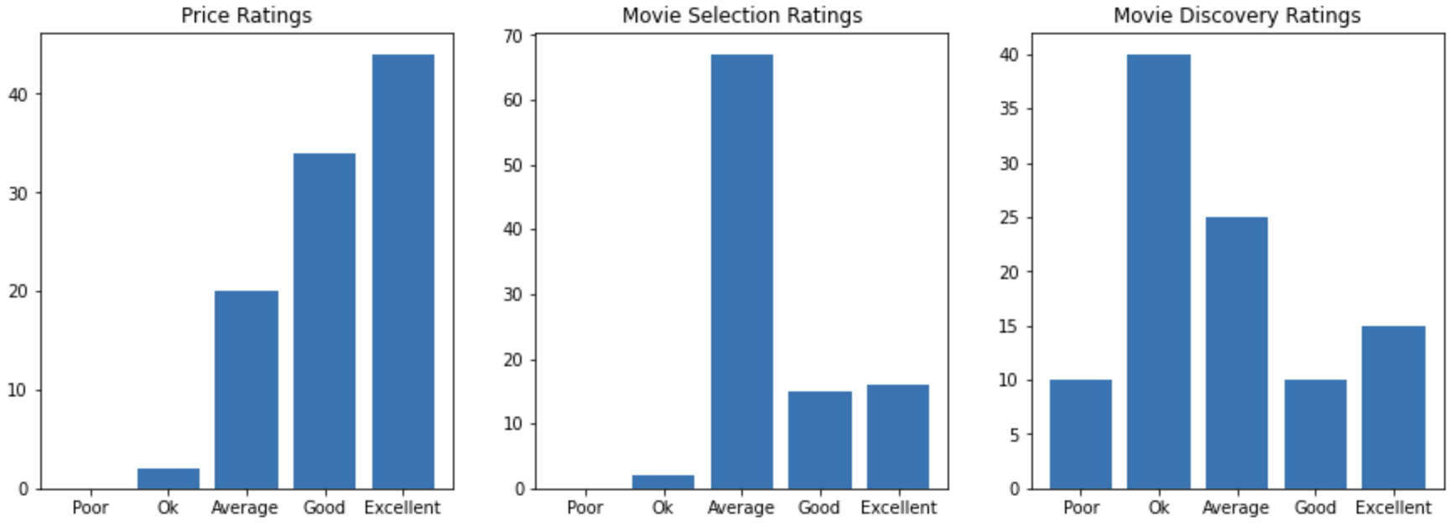
Problem Statement and Objective
Customer Exit Survey
Stream Max customers were satisfied with pricing but found the movie selection was average, and searching for new movies was tedious.
Stream Max requested their data science team to assist them in building a new recommender system, and build a predictive model to identify the best films to add to the platform
‹#›

Slide 6
Data Set
movies_metadata.csv (44,838 titles)
id
imdbId
genres (JSON)
popularity
original_title
keywords.csv
id
keywords
credits.csv
id
cast (JSON)
crew (JSON)
ratings.csv (26M records, 26K users)
userId
movieId
rating
ratings_small.csv (100K records, 671 users)
userId
movieId
rating
links.csv
movieId
imdbId
‹#›

Slide 7
Data Pre-Processing
movies dataframe
Clean dirty data/nulls
process JSON data features
generate dummy variables
Genre
Cast
Director
Production Company
Calculate and include Average Rating
derived from the full 26M ratings dataset
Predictive Model data (split 80/20)
Independent features
Target outcome variable
Recommender data (split 80/20)
ratings_small dataset
‹#›

Slide 8
EDA
PROCESS
02
‹#›

Slide 9
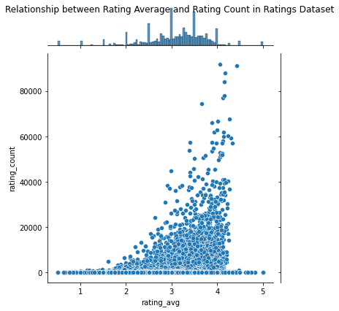
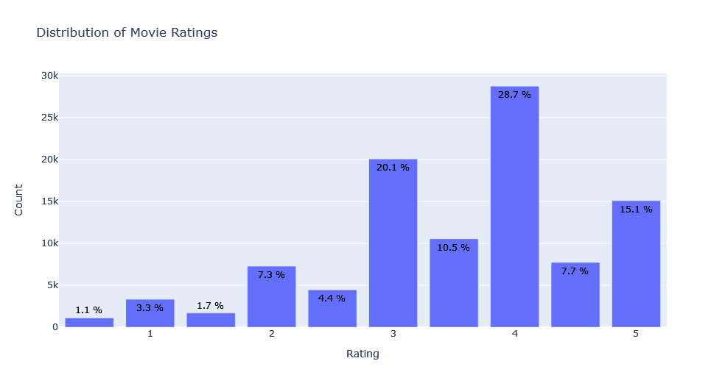
Data Mining Steps
Rating characteristics
‹#›
Notes:
Mean for Ratings is 3.5
Median is 4
std deviation is 1.06

Slide 10
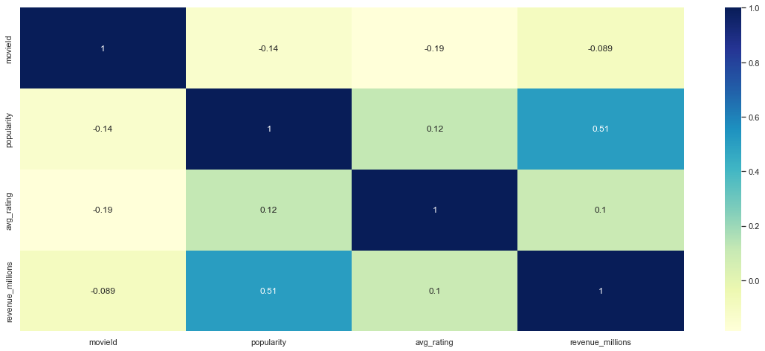
Data Mining Steps
Correlation Matrix Movie data Pre-Processed
‹#›
Notes:
Moderate correlation only between Popularity and Revenue, so no linear relationship between average rating and these variables

Slide 11
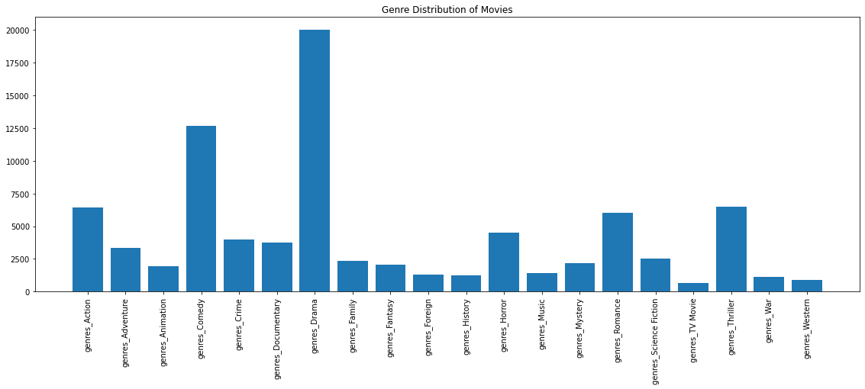
Data Mining
Genre Representation
‹#›
Notes:
Top Genres rated and represented are Drama, Comedy and Action

Slide 12
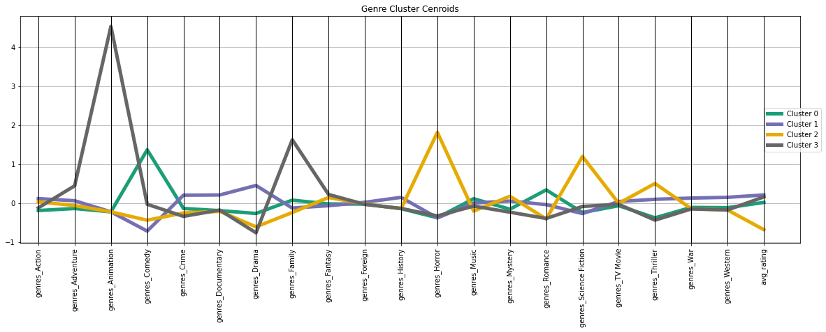
Data Mining
Relationship between Rating and Genre
‹#›
Notes:
Four clusters
Cluster 0 (4679 members): 53066.77 within cluster
Cluster 1 (7357 members): 160360.08 within cluster
Cluster 2 (2611 members): 43300.57 within cluster
Cluster 3 (714 members): 9706.69 within cluster
* Cluster 0 is characterized by a peak in Comedy, and smaller peaks in Family and Romance, with small spacing, but spacing in the average rating
* Cluster 1 (largest class) is characterized by small peaks in Crime, Documentary, Drama, small peak in History, and mid level in Thriller, War, Western and has similar average rating to Cluster 3.
* Cluster 2 (tends to rate movies lower than other clusters) is characterized by noticeable peaks in Horror, Science Fiction and Thriller, with a noticeable separation from the other clusters when it comes to the avg rating.
* Cluster 3 (smallest class) is characterized by a large peak in Animation and Family with similar avg rating as cluster 1
Outside of lower ratings for groups that prefer Horror/Science fiction (cluster 2) and slight separation for the cluster 0 that liked Comedy and Romance, there is no other obvious separation between the clusters when it came to average ratings with regard to Genre.

Slide 13
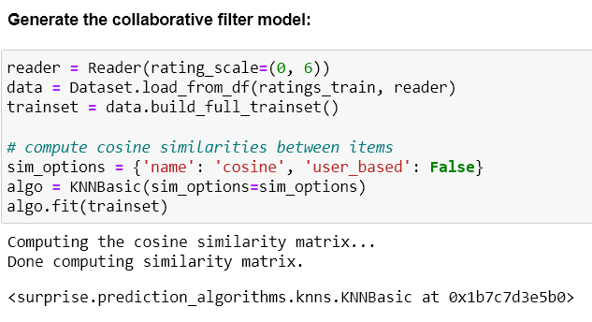
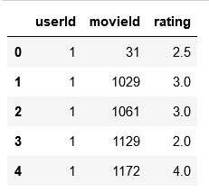
Recommender System
Item-Item Collaborative Filtering
‹#›
Notes:
** A key advantage of the collaborative filtering approach is that it does not rely on machine analyzable content and thus it is capable of accurately recommending complex items such as movies without requiring an “understanding” of the item itself. (Shmueli et al., 2020)
**collaborative filtering is considered an "unsupervised method" according to the book which explains the difficulty in "validating" predictions. The book mentions that the way of validating is usually through user feedback. (Shmueli et al., 2020, p.366)

Slide 14
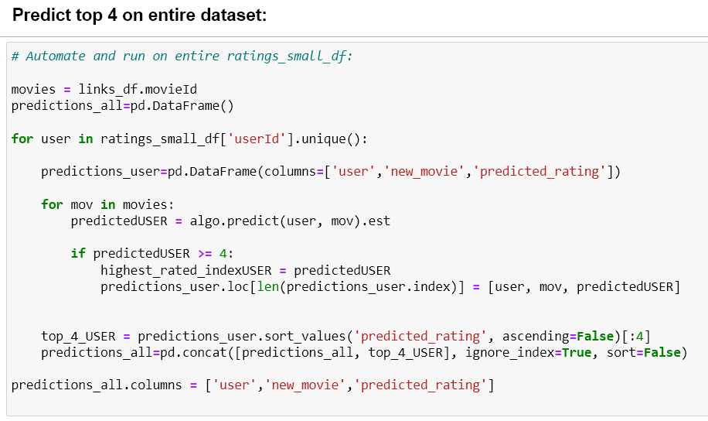
Item-Item Collaborative Filtering Implementation
‹#›

Slide 15
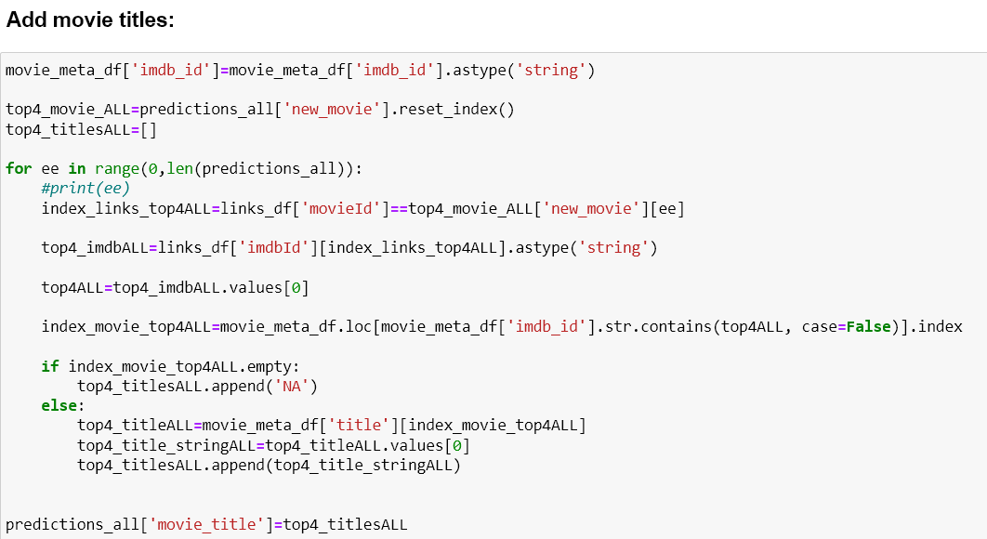
Item-Item Collaborative Filtering Implementation

Slide 16
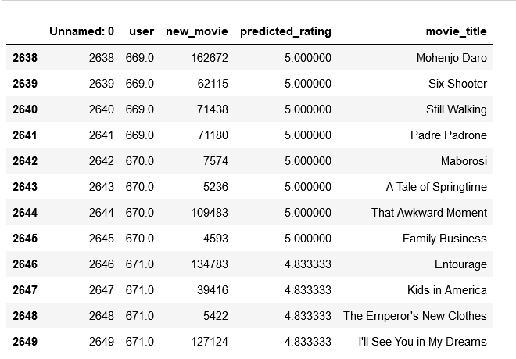
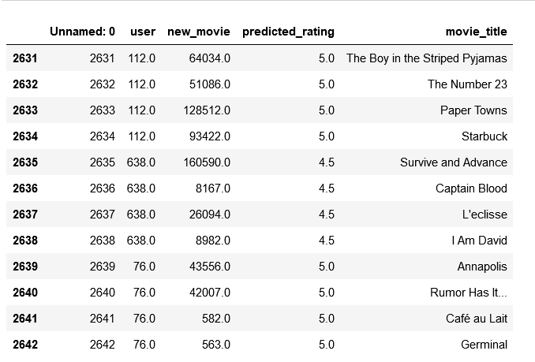
Item-Item Collaborative Filtering Output
Full dataset:
Validation dataset:
Notes:
Each user has 4 movie recommendations at most, 3, at the least, and alongside the movie title is the predicted rating for that movie.

Slide 17
METHODS
03

Slide 18
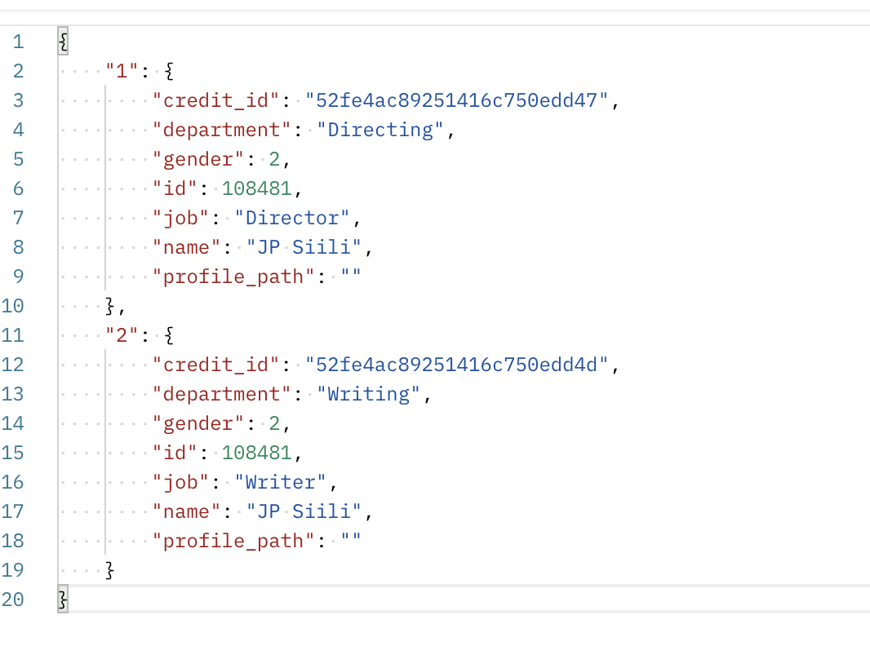
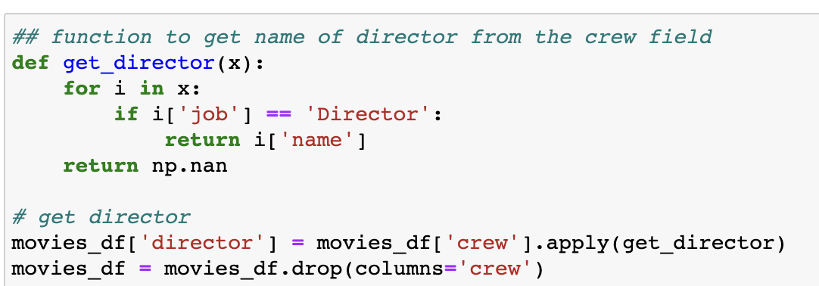
JSON Data Collecting
Example JSON Credit.csv

Slide 19
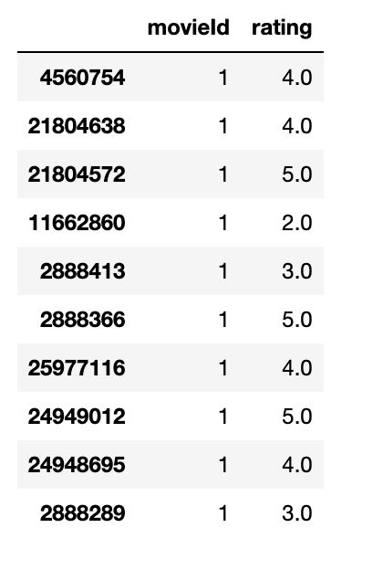
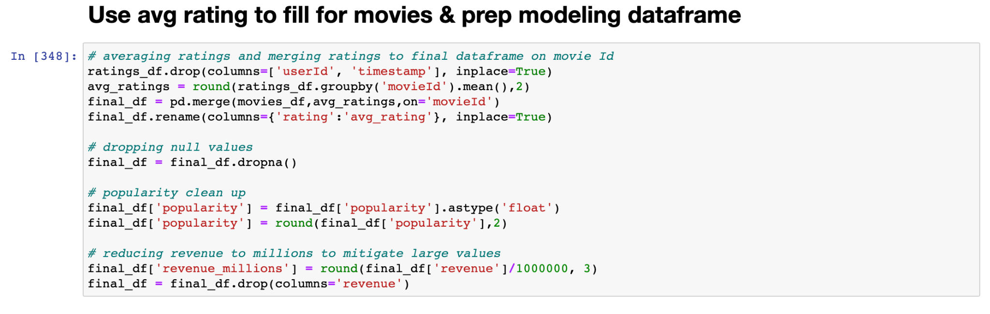
Ratings & Revenue

Slide 20
Feature Selection
Independent variables:
Genre dummy variables
Cast dummy variables
Director dummy variables
Popularity
Revenue (in Millions)
Target outcome variable:
Label
a binary categorical variable, derived from avg_rating
1 if > 3.4, 0 if < 3.4

Slide 21
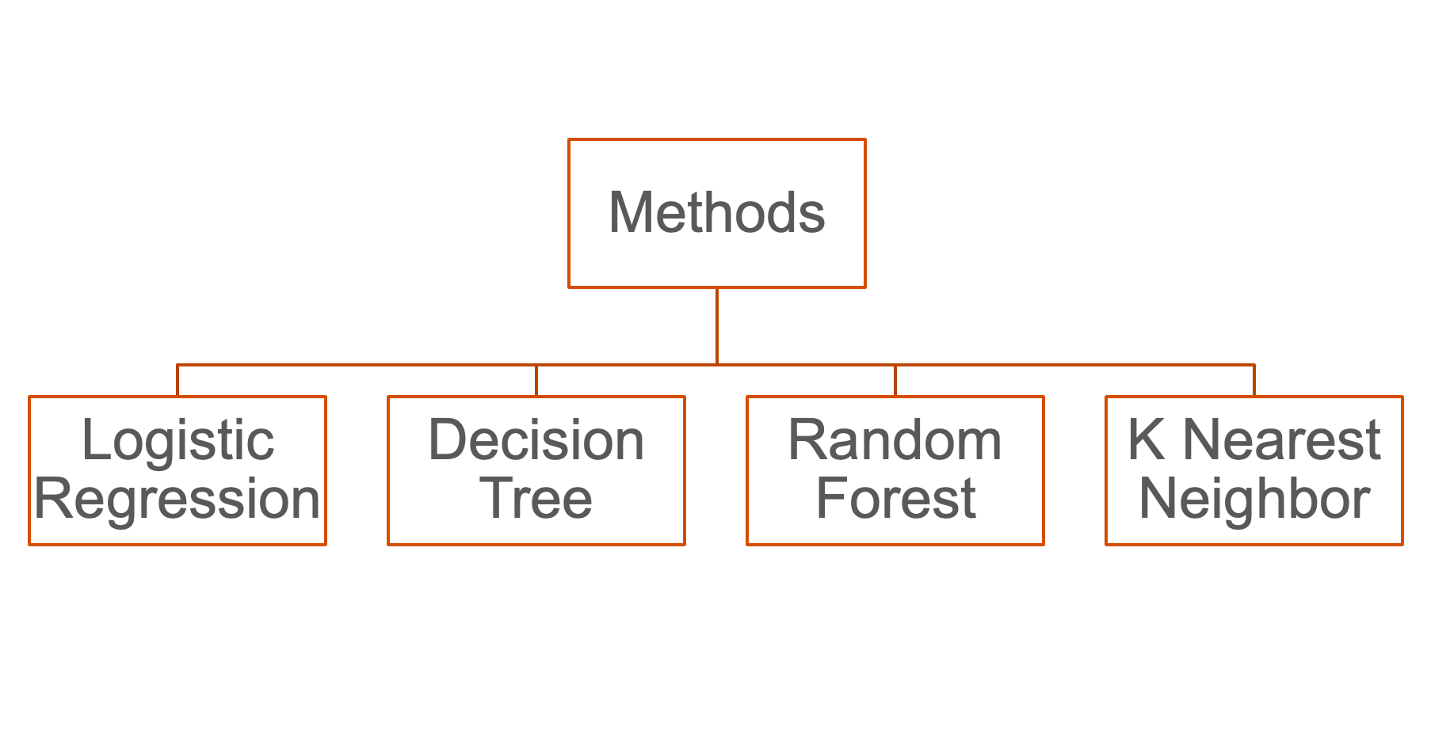
Modeling Methods

Slide 22
RESULTS &
NEXT STEPS
04

Slide 23
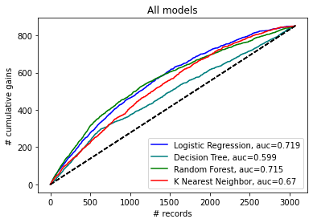
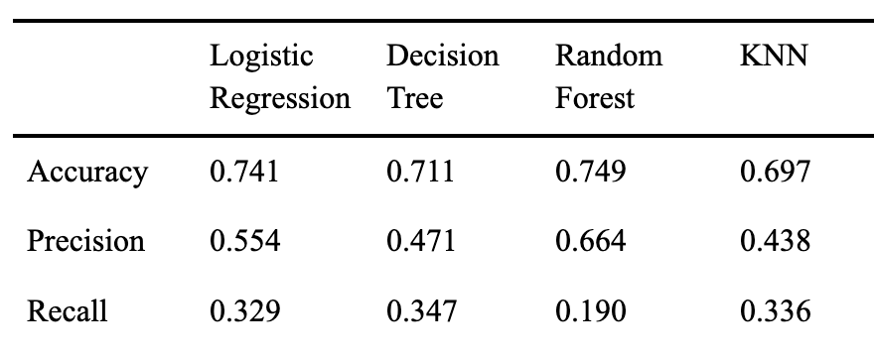
Results
‹#›

Slide 24
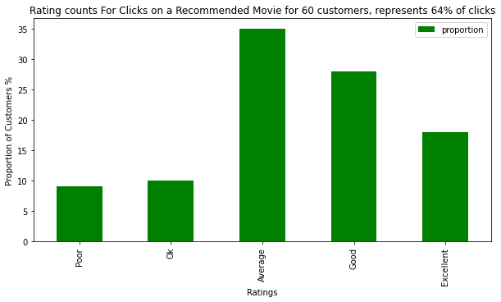
Recommender System
Preliminary Results
Notes:
Out of 67 users on which the Recommender was softly deployed, about 180 total clicks were made on the recommendations. Of those 180 clicks, 115 were rated by users. These are the results.
More feedback is needed as we move to validate the recommendations made by this algorithm

Slide 25
Next Steps
Implement a better method to group production companies (i.e. Disney, Disney Studios, Disney Productions, Disney Animations)
Incorporate a data pipeline to process new data as plenty of preprocessing techniques were utilized
Evaluate the best performing model (Random Forest) on unseen testing data prior to model deployment
Gather more feedback on recommender system
‹#›

Slide 26

THANKS!
GitHub:
https://github.com/ivan-usd/business-repo

Slide 27
References
Banik. (2017). The Movies Dataset (Version 7).Retrieved from https://www.kaggle.com/datasets/rounakbanik/the-movies-dataset
Shmueli, G., Bruce, P. C., Gedeck, P., & Patel, N. R. (2020). Data mining for Business Analytics: Concepts, techniques and applications in Python. Wiley.
Popularity. Api Docs. (n.d.). Retrieved October 15, 2022, from https://developers.themoviedb.org/3/getting-started/popularity
‹#›

