Slide 1
In the Wake of the
Great Resignation
Predicting Employee Churn
Notes:
Hi, I’m Halle Davis and I’m working with Ivan Chavez and Uyen Pham on a project entitled In the Wake of the Great Resignation: Predicting Employee Churn.

Slide 2
Overview
01
02
03
04
PROBLEM & SOLUTION
EDA PROCESS
METHODS
RESULTS &
NEXT STEPS
Notes:
H 1,3
U 2
I 4
This is an overview of the presentation we’ll be giving today on this project - we’ll walk you through our background, problem and solution, followed by a description of our EDA, a summary of our methods, and a look at our results and next steps.

Slide 3
PROBLEM & SOLUTION
01

Slide 4
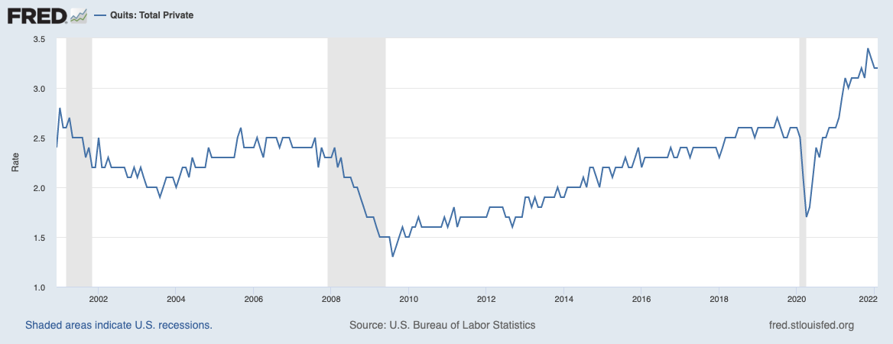
Background
Figure 1
Total Private Quits
Notes:
We are in the middle of the Great Resignation: Since the fall of the COVID-19 pandemic, a record amount of Americans have resigned from their jobs. In fact, resignations spiked in September 2021, when 4.4 million Americans quit their jobs. In 2022, resignations are not slowing down, as represented in this graph from the Federal Reserve Bank of St. Louis using U.S. Bureau of Labor Statistics data.
To add to the stakes, the Great Resignation is also intertwined with a global labor shortage. It is currently reported that there are more job postings than there are unemployed people in the United States.

Slide 5
Problem
Effects on Businesses
Lower customer satisfaction
Loss of potential profits
Complete shutdown resulting in major financial loss
Notes:
This affects businesses across the nation because their workforce may resign on them and they may not have a body of people to recruit from and backfill, meaning that they will personally suffer the consequences of global labor shortage: lower customer satisfaction due to longer wait times, potential loss profit due to not being able to fulfill orders and provide services, or even complete shutdown.
So how do we stop this from happening to us and how do we succeed in this global crisis?

Slide 6
Objective
Determine the best model that predicts whether or not an employee will voluntarily resign based on HR’s information about the employee
Notes:
What if a business was able to predict whether an employee was going to quit or not?
If they were identified as a potential quitter, we could enact proactive retention efforts, like giving them a raise, a promotion, a bonus, or other incentives.
If they were identified as a potential quitter, we could get a jumpstart on the recruitment process for their backfill.
All in all, we are enable to able to drive data-based decision making that empowers us to maintain our laborforce in these troubling times.
As a result, our solution to this problem and main objective is to determine the best model that predicts whether or not an employee will voluntarily resign based on HR’s information about the employee.

Slide 7
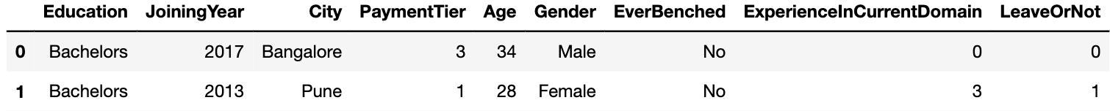
Data Set
Dataset: employee.csv downloaded from kaggle.com
Dummy data created for a hackathon
The dataset contained 9 variables and 4653 records
Notes:
We will complete this objective using a dataset created for this same purpose for a private hackathon. The data has a variety of information about the employee, including his education level, when he joined the company, his city office, his pay level, age, gender, whether or not he has been left out of a project, his experience level, and whether or not he will leave the company in the next 2 years.

Slide 8
EDA
PROCESS
02

Slide 9
Data Mining Steps
No missing data or outliers were found
There are 1,889 duplicates which were dropped
Cleaned dataset contained 2764 records (with 39% employees would leave and 61% would not)
Feature JoiningYear was transformed into Duration - how long an individual has worked in the company

Slide 10
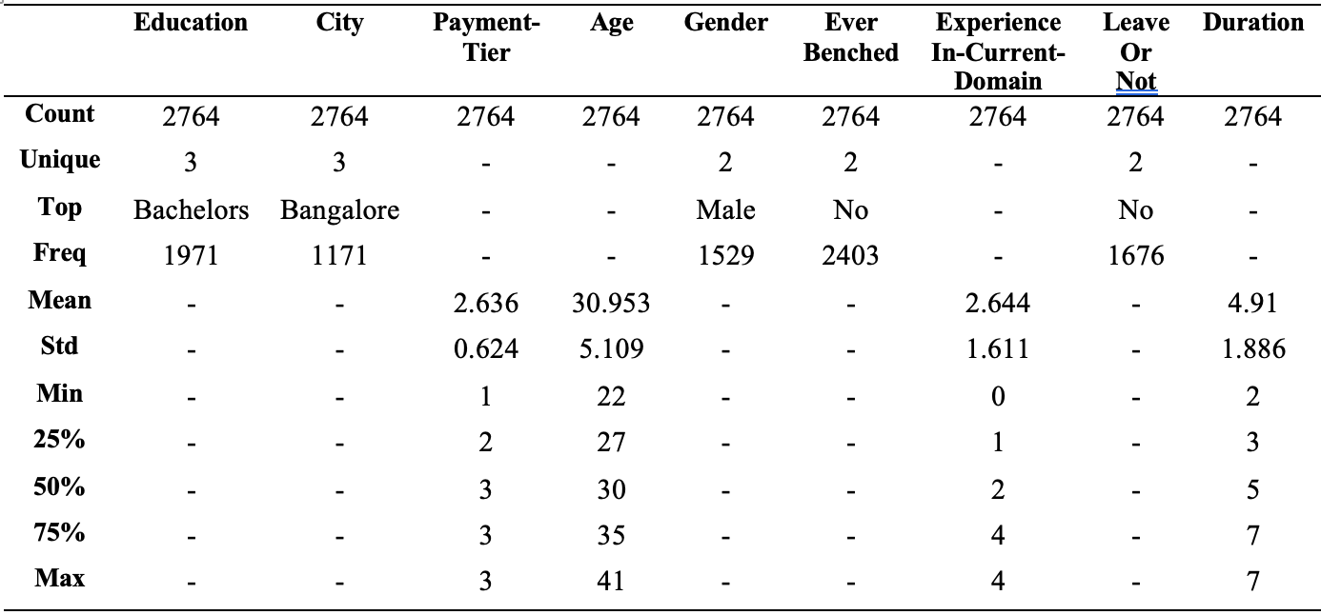
Summary Statistics
Table 1
Descriptive Statistics of Independent Variables

Slide 11
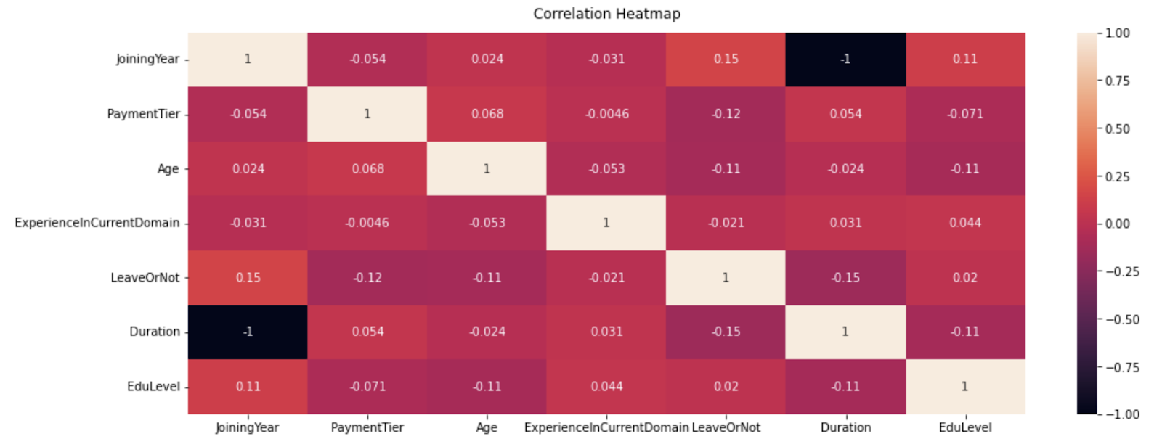
Variable Relationship
Figure 2
Correlation Heatmap

Slide 12
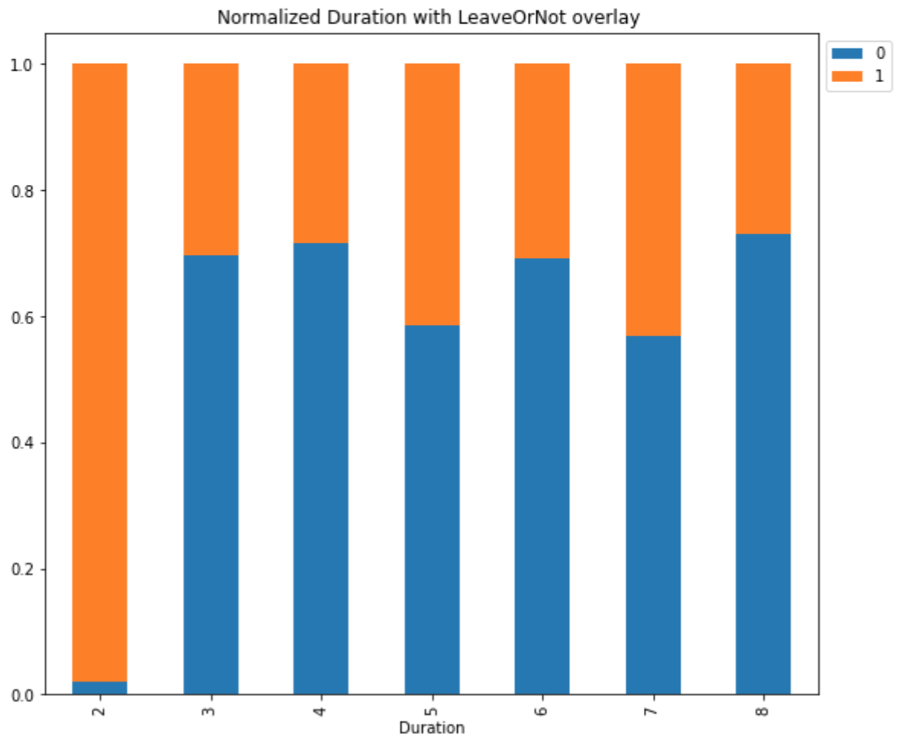
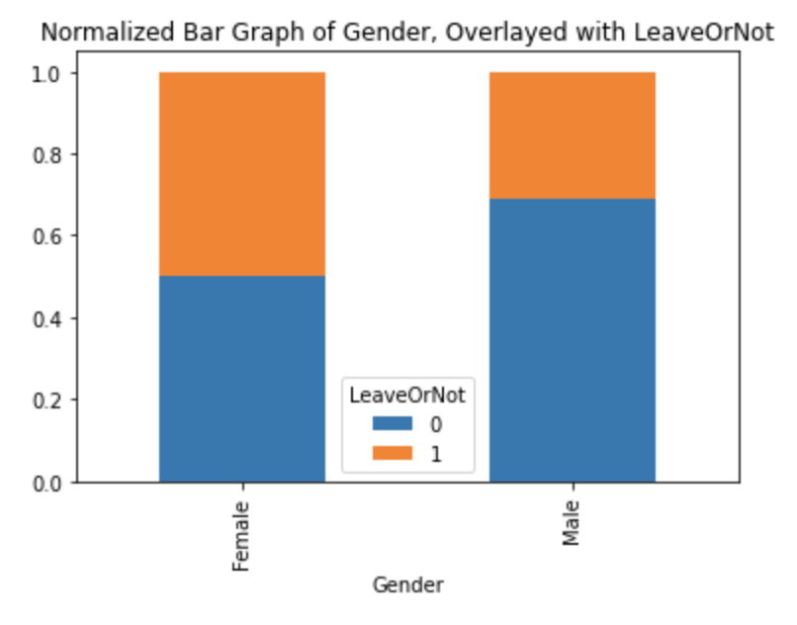
Variable Relationship
Figure 3
Various Overlayed Barplots

Slide 13
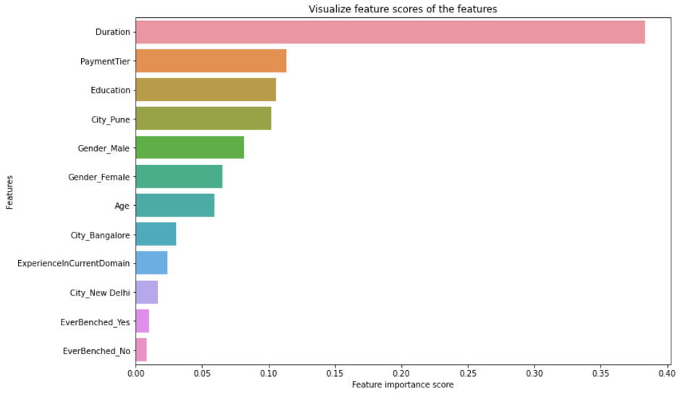
Feature Selection
Four feature were selected for the final model: Duration, Payment Tier, Gender, and City based on:
results of EDA
comparing iterations from various models
decision tree feature importance scores
Figure 4
Feature Scores for Independent Variables

Slide 14
METHODS
03

Slide 15
Methods
Methods
Probabilistic
Decision Tree
Dummy/Baseline
Naive Bayes
Logistic Regression
CART Decision Tree
C.5 Decision Tree
Random Forest
Notes:
To complete our project we will use the following 5 methods: Logistic Regression, Naive Bayes, CART Decision Tree, C.5 Decision Tree, and Random Forest.
All 5 methods are classification methods- C.5, CART, and Random Forest are decision tree methods, with Random Forest being an ensemble method. On the other hand, logistic gression and naive bayes are probabilistic methods.
We will also include a baseline model for reference. The baseline model classified 50% of the test values as negative and 50% as positive regardless of input values.

Slide 16
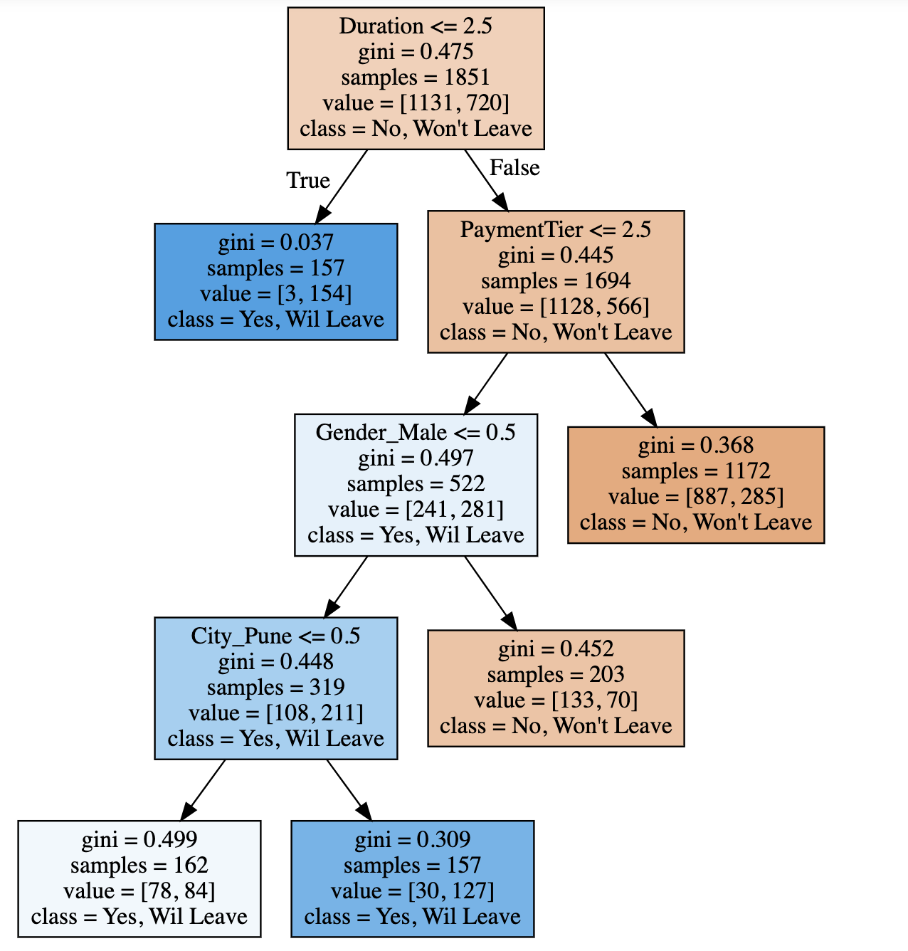
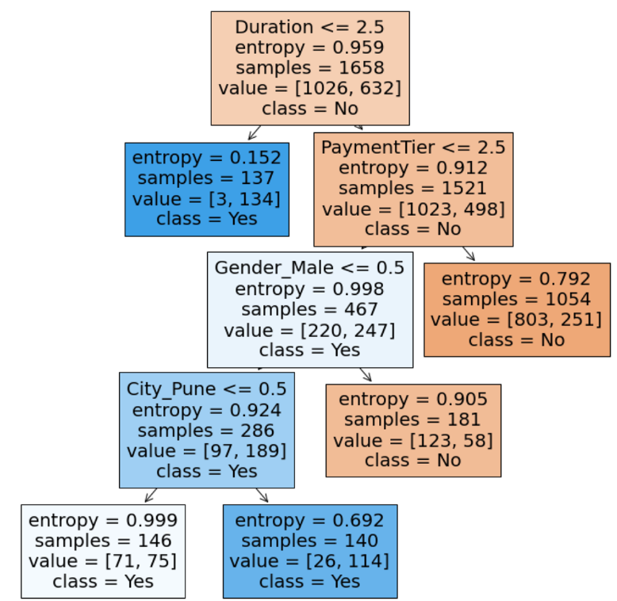
Decision Trees
Figure 5
CART Decision Tree
Figure 5
C.5 Decision Tree
Notes:
To briefly give some information into how our models are operating, we are showing the outputs of both the CART decision tree and the c.5 decision tree.
In both, if someone has been at the company for a short period of time – less than 2.5 years – they are classified as leaving.
Further we drill down and find those who are senior and with a pay tier 3 will not leave, those who are senior and paid less than tier 3 and are male will not leave, and those who do not fit into those categories will leave, particularly if they work in the Pune city office.

Slide 17
RESULTS &
NEXT STEPS
04

Slide 18
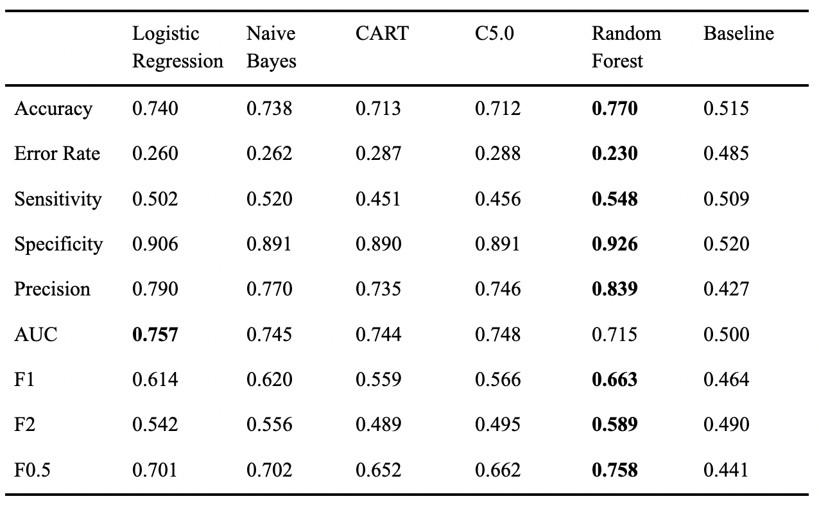
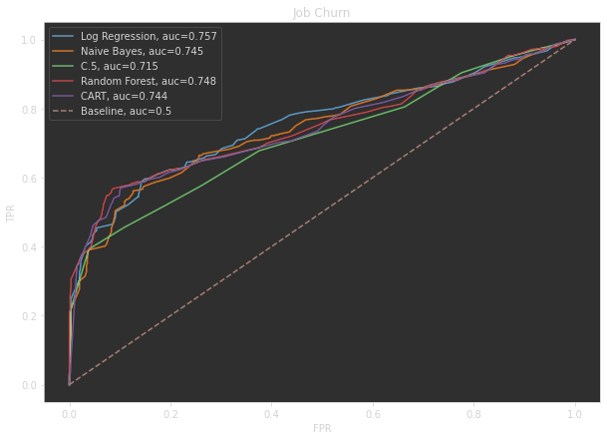
Results
Table 2
Evaluation Metrics For the Models
Figure 6
ROC Model Performance

Slide 19
Next Steps
Recommended Model: Random Forest
Adding Neural Network Modeling
Future Studies
Work with real data
Add new information to the data
Job Level – who is more likely to leave, an entry level employee, a VP, a C-level executive?
Industry – is IT more prone to flight than sales?
Race – are minority represented employees more likely to resign?
American data – Our dummy data was generated in India

Slide 20

THANKS!
GitHub:
https://github.com/ivan-usd/data-mine

Slide 21
References
Larose, C., & Larose, D. (2019). Data Science Using Python and R. Wiley.
Leonhardt, M. (2021, November 16). The great resignation is hitting these industries hardest. Fortune. Retrieved April 15, 2022, from https://fortune.com/2021/11/16/great-resignation-hitting-these-industries-hardest/
Tan, P.-N., Steinbach, M., Karpatne, A., & Kumar, V. (2020). Introduction to data mining (Second Edition). Pearson.
Tejashvi. (2021). Employee Future Prediction (Version 1). Retrieved from https://www.kaggle.com/datasets/tejashvi14/employee-future-prediction
U.S. Bureau of Labor Statistics, Unemployment Level [UNEMPLOY], retrieved from FRED, Federal Reserve Bank of St. Louis; https://fred.stlouisfed.org/series/UNEMPLOY, April 12, 2022.
U.S. Bureau of Labor Statistics, Quits: Total Private, retrieved from FRED, Federal Reserve Bank of St. Louis; https://fred.stlouisfed.org/series/UNEMPLOY, April 12, 2022.

