Slide 1
Tutor–Student
Assignment Optimization
HTX xData Technical Assessment
Ivan Lim | March 2026

Slide 2
Problem Overview
A tutoring organisation assigns new students to tutors each month, respecting skill requirements, capacity limits, and tutor branch preferences.
20
10
12
New Students
Tutors
Existing Students
4 branches, 2 need
Extensive tutoring
3 with Extensive skills,
capacity 3–8 each
Active assignments
from prior months
Scenario A:
Minimise tutors used + maximise tutor preferences
Scenario B: Balance tutor workload + maximise tutor preferences

Slide 3
Variables & Parameters
Decision Variable
x_{s,t} ∈ {0, 1} for all students s, tutors t
Symbol | Description | Values
k_{t} | Skill level for tutor t | 0 = Normal, 1 = Extensive
n_{s} | Tutoring need for student s | 0 = Normal, 1 = Extensive
q_{s,t} | Preference score of tutor t for student s's branch | 2 = 1st choice, 1 = 2nd, 0 = other
m_{t} | Maximum overall capacity (MOC) of tutor t | Integer, ≥ 1
e_{t} | Number of existing active students assigned to tutor t | Integer, ≥ 0, ≤ m(t)
Auxiliary: y_{t} ∈ {0,1} — tutor activation indicator (Scenario A) | d_{t} ≥ 0 — workload deviation (Scenario B)

Slide 4
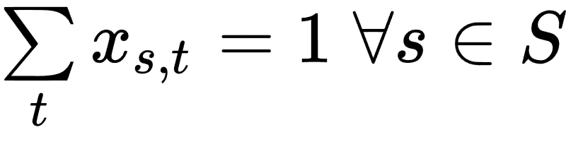
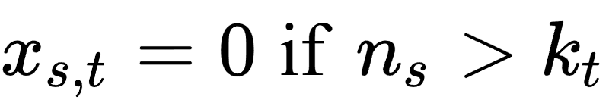
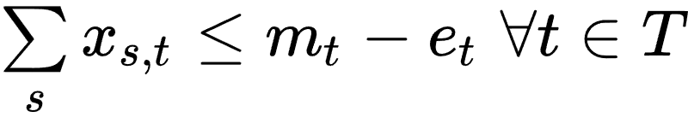
Constraints
Core constraints (both scenarios)
1
One tutor per student
Each student is assigned exactly one tutor.
2
Skill compatibility
Extensive-need students can only go to Extensive-skill tutors.
3
Capacity limit
New assignments cannot exceed a tutor's remaining capacity.

Slide 5
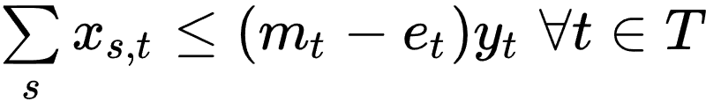

Constraints (Scenario A)
Replacement for common constraint 3
1
Capacity limit
New assignments cannot exceed a tutor’s remaining capacity.
2
Restriction of value of y_{t}
Restricts y_{t} from being 1 if no students are assigned to t.
Scenario A introduces a new auxiliary variable, y_{t}, which represents tutor assignment.

Slide 6
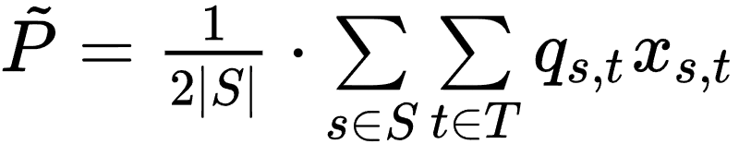

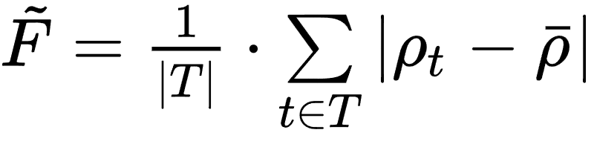
Objective Functions
Common metric — Normalised tutor preference satisfaction
Scenario A
Scenario B
Minimise tutor usage
Balance relative workload ρ(t) = total students / capacity
min α·Ũ − (1−α)·P̃
min α·F̃ − (1−α)·P̃
α ∈ [0, 1] controls the trade-off. α = 0.5 balances both objectives equally. All metrics normalised to [0, 1] for fair weighting.
Notes:
Sum of individual tutor preference scores for each student they are assigned, divided by the total number of new students

Slide 7
Results — Scenario A
4
39
0%
Tutors Used
Preference Score
Optimality Gap
out of 10
out of 40 (97.5%)
globally optimal
Key Findings
Only 4 tutors (A001, A002, A009, A010) needed to serve all 20 students
19 of 20 students assigned to a tutor's 1st-choice branch
One Extensive-need student (S0006) assigned to 2nd-choice branch — no Extensive-skill tutor has North as 1st choice
Solution is robust: identical result for all values of α (see sensitivity analysis)

Slide 8
Results — Scenario B
6.9%
36
57.3%
Avg. Deviation
Preference Score
Avg. Relative Workload
from mean workload
out of 40 (90%)
across all tutors
Key Findings
8 of 10 tutors assigned new students; workloads range from 37.5% to 66.7% of capacity
A005 & A007 receive no new students — already at 66.7% and 62.5% from existing load
A001 is the outlier (37.5%) — highest capacity (8) but prefers East branch, where only 4/20 students study
Preference score drops from 39 → 36 compared to Scenario A — expected trade-off for fairer distribution

Slide 9
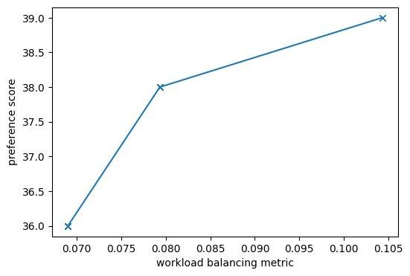
Weight Selection & Sensitivity
Approach
Scenario B — Pareto Frontier
Linear scalarisation with α ∈ [0, 1] to combine dual objectives into single objective problem
Both metrics normalised to [0, 1] so α represents true relative importance
Scenario B: F̃ was ~10× smaller than P̃, so scaled for comparable influence
α swept from 0 to 1 in steps of 0.05 to map the Pareto frontier
Three distinct optimal solutions as α varies.
Scenario A is fully robust — same result for all α.

Slide 10

Robustness of Modelling Choices
Preference Scoring Metric
Workload Balancing Metric
Original: 1st choice = 2, 2nd = 1, other = 0
Original: mean absolute deviation of relative workload (L/MOC)
Scheme | Scenario A | Scenario B
2 / 1 / 0 (original) | 4 tutors P̃ = 97.5% | F̃ = 0.069 P̃ = 90%
5 / 2 / 0 (alt. weighting) | 4 tutors P̃ = 95% | F̃ = 0.069 P̃ = 89%
1 / 0 / 0 (1st only) | 4 tutors P̃ = 95% | F̃ = 0.069 P̃ = 85%
Relative workload (chosen)
P̃ = 90%, F̃ = 0.069
Best balance — accounts for tutor capacity differences
Absolute workload
P̃ = 87.5%, counts: 2–5 students
Slightly worse preference; ignores capacity differences
Min-max workload
P̃ = 97.5%, but 6 tutors idle
High preference but poor balance — ignores under-loaded tutors
Scenario A: Identical solution across all schemes
Scenario B: Same F̃ and per-tutor student counts; only minor student shuffles
Relative workload metric gives the best trade-off between fairness and preference.

Slide 11

Solver Configuration
Solver
IBM CPLEX Community Edition via docplex Python API
Problem Type
Mixed-Integer Linear Program (MILP) — binary x(s,t) and y(t), continuous d(t)
parameters.advance = 2
Uses advanced start (warm start). Helps CPLEX find good feasible solutions faster by reusing prior basis information when re-solving with different α values.
parameters.threads = 10
Multi-threaded solve for the sensitivity analysis loop (21 solves per scenario). Reduces wall-clock time from minutes to seconds.
time_limit = 60s
Applied during sensitivity analysis for Scenario B, where solve times increase at higher α. Ensures the sweep completes in reasonable time.

Slide 12

Summary
Tutor assignment formulated as a weighted bi-objective MILP, solved to global optimality with CPLEX
Scenario A concentrates load on 4 tutors while achieving 97.5% preference satisfaction
Scenario B distributes workload across 8 tutors (avg. 6.9% deviation) at 90% preference
Sensitivity analysis confirms robustness: Scenario A is invariant to α; Scenario B yields a clean 3-point Pareto frontier
Choice of relative workload balancing metric and preference scoring scheme both validated against alternatives
Thank you!

