Slide 1
Vowel Classification using Machine learning
Ivan
Stošić
29/07/2017

Slide 2
Problem overview
Classify vowels of some language based on sound
Input consists of an audio stream or a file
Output should consist of a sequence of vowels detected

Slide 3
Approaches
Use a neural network as a classifier
What should the features be?

Slide 4
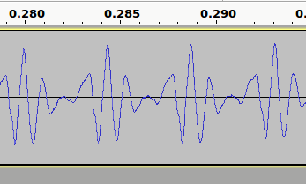
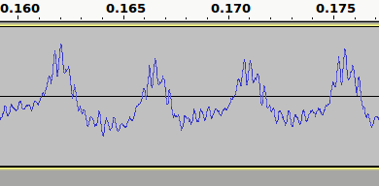
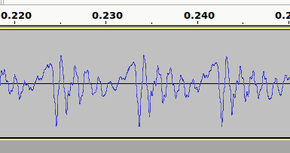
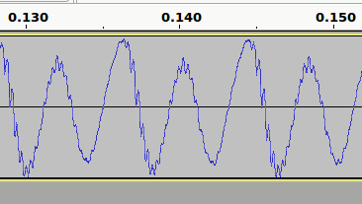
Approaches
Raw signal

Slide 5
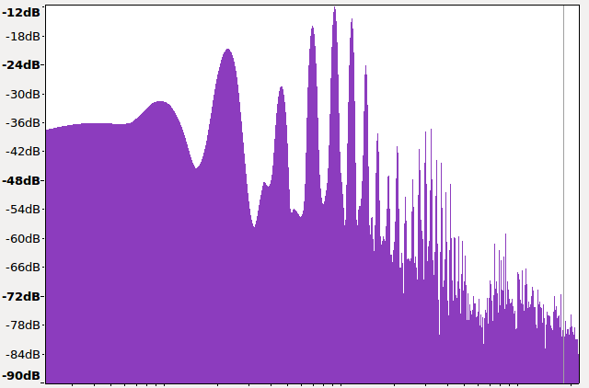
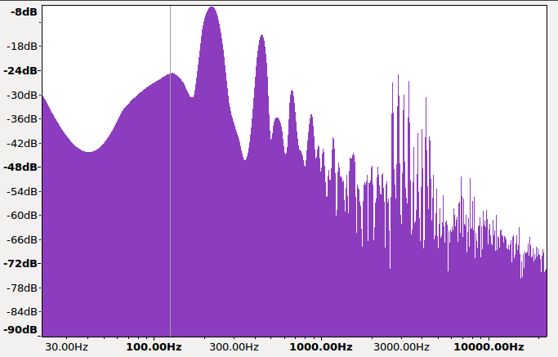
Approaches
Discrete Fourier Transform, computed using FFT
Autocorrelation

Slide 6
Approaches
FFT was used in the final design
Fully connected neural network with two hidden layers
[1024, 128, 32, 5]
Tensorflow, Adam Optimizer, Tanh activation, Softmax

Slide 7
Training
Small dataset
Each input file is split into windows of 1024 samples each, which may overlap
Augment the training set by pitch-shifting and adding noise
Around 62000 such windows were in the final training set

Slide 8
Results
>97% accuracy on the validation test
Confusion matrix:
t\g | a | e | i | o | u
a | 3560 | 3 | 0 | 45 | 8
e | 0 | 4137 | 2 | 4 | 1
i | 0 | 48 | 3977 | 0 | 7
o | 15 | 36 | 0 | 3808 | 13
u | 0 | 10 | 336 | 68 | 2964

Slide 9
Problems
The dataset is very small
Low quality audio equipment
In speech, vowels are often reduced

Slide 10
Conclusion
Simple neural networks can easily perform the task of classifying vowels with decent accuracy, even when trained on low-quality data
If you don’t have a lot of good data, just throwing it into the network will not produce good results

Slide 11
Thank you!

