Slide 1
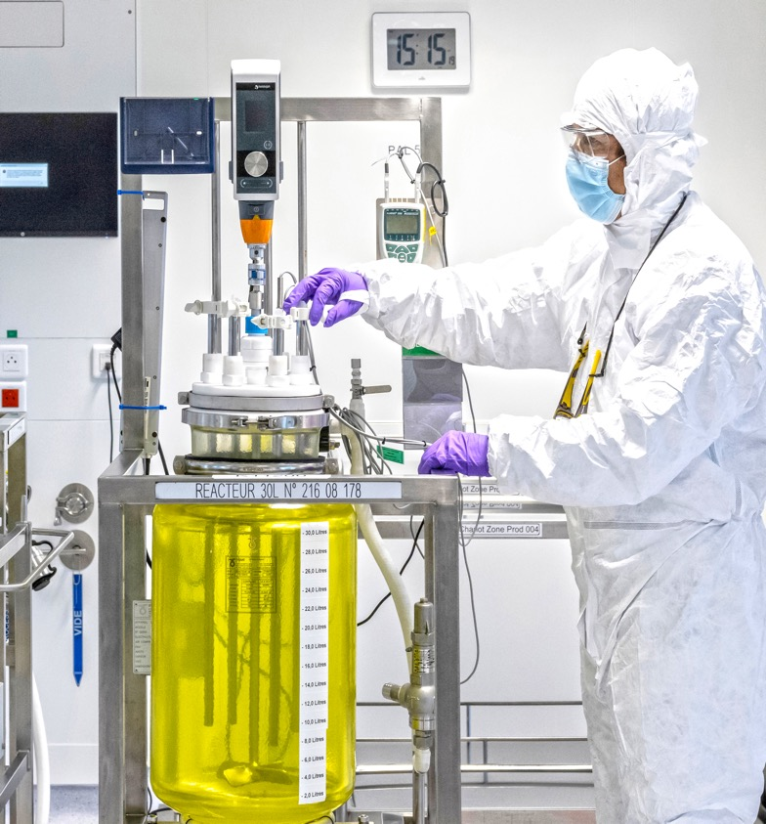
Please Replace this photo
in folder image/cover.jpg
thanks

