Slide 1
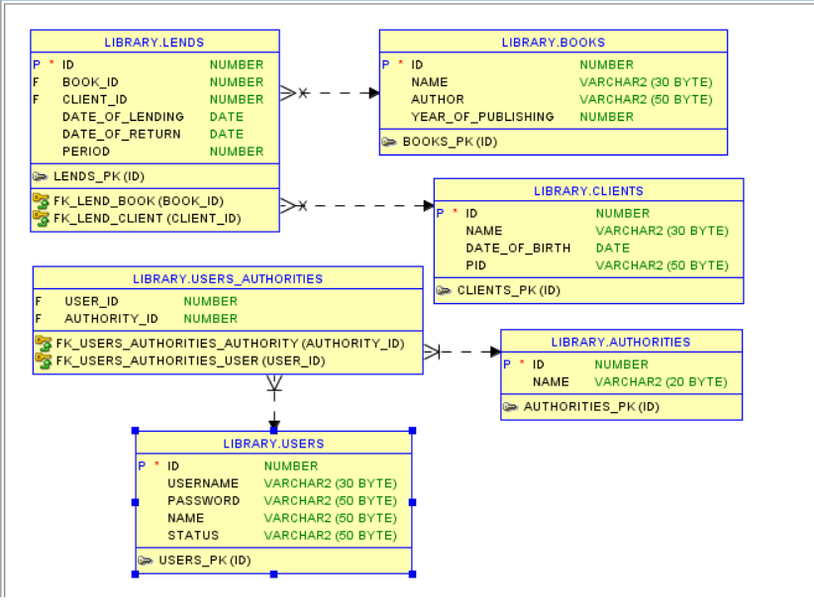
E/R Diagram

Slide 2
Architecture
Common | MVC | Services | DAO | Entities
MD5 UserUtils | BooksController ClientsController LendsController UsersController HomeController LoginController | BookService ClientService LendService UserService UserDetailsService | BookDao ClientDao LendDao UserDao | Book Client Lend User Authority

