Slide 1

“Portfolio managers’ skills or randomness during bull and bear markets” Iván Carrillo García Pedro José Agudo González Getafe, July 2022
University Degree in Finance and Accounting 2021-2022
Bachelor Thesis

Slide 2

Introduction
“Portfolio managers’ skills or randomness during bull and bear markets” – Iván Carrillo García
Are professional investors really skilled?
Can they be outperformed by investing randomly?
Main objective: differentiate between the results of a professional fund manager and the ones from a random investor and compare their performances during several market regimes

Slide 3
Methodology
“Portfolio managers’ skills or randomness during bull and bear markets” – Iván Carrillo García
A survivorship bias-free stock dataset is constructed to simulate random portfolios.
Data retrieved from CRSP database
ID data
Shares outstanding data
Price data
Filtering out small-caps
Market capitalization

Slide 4
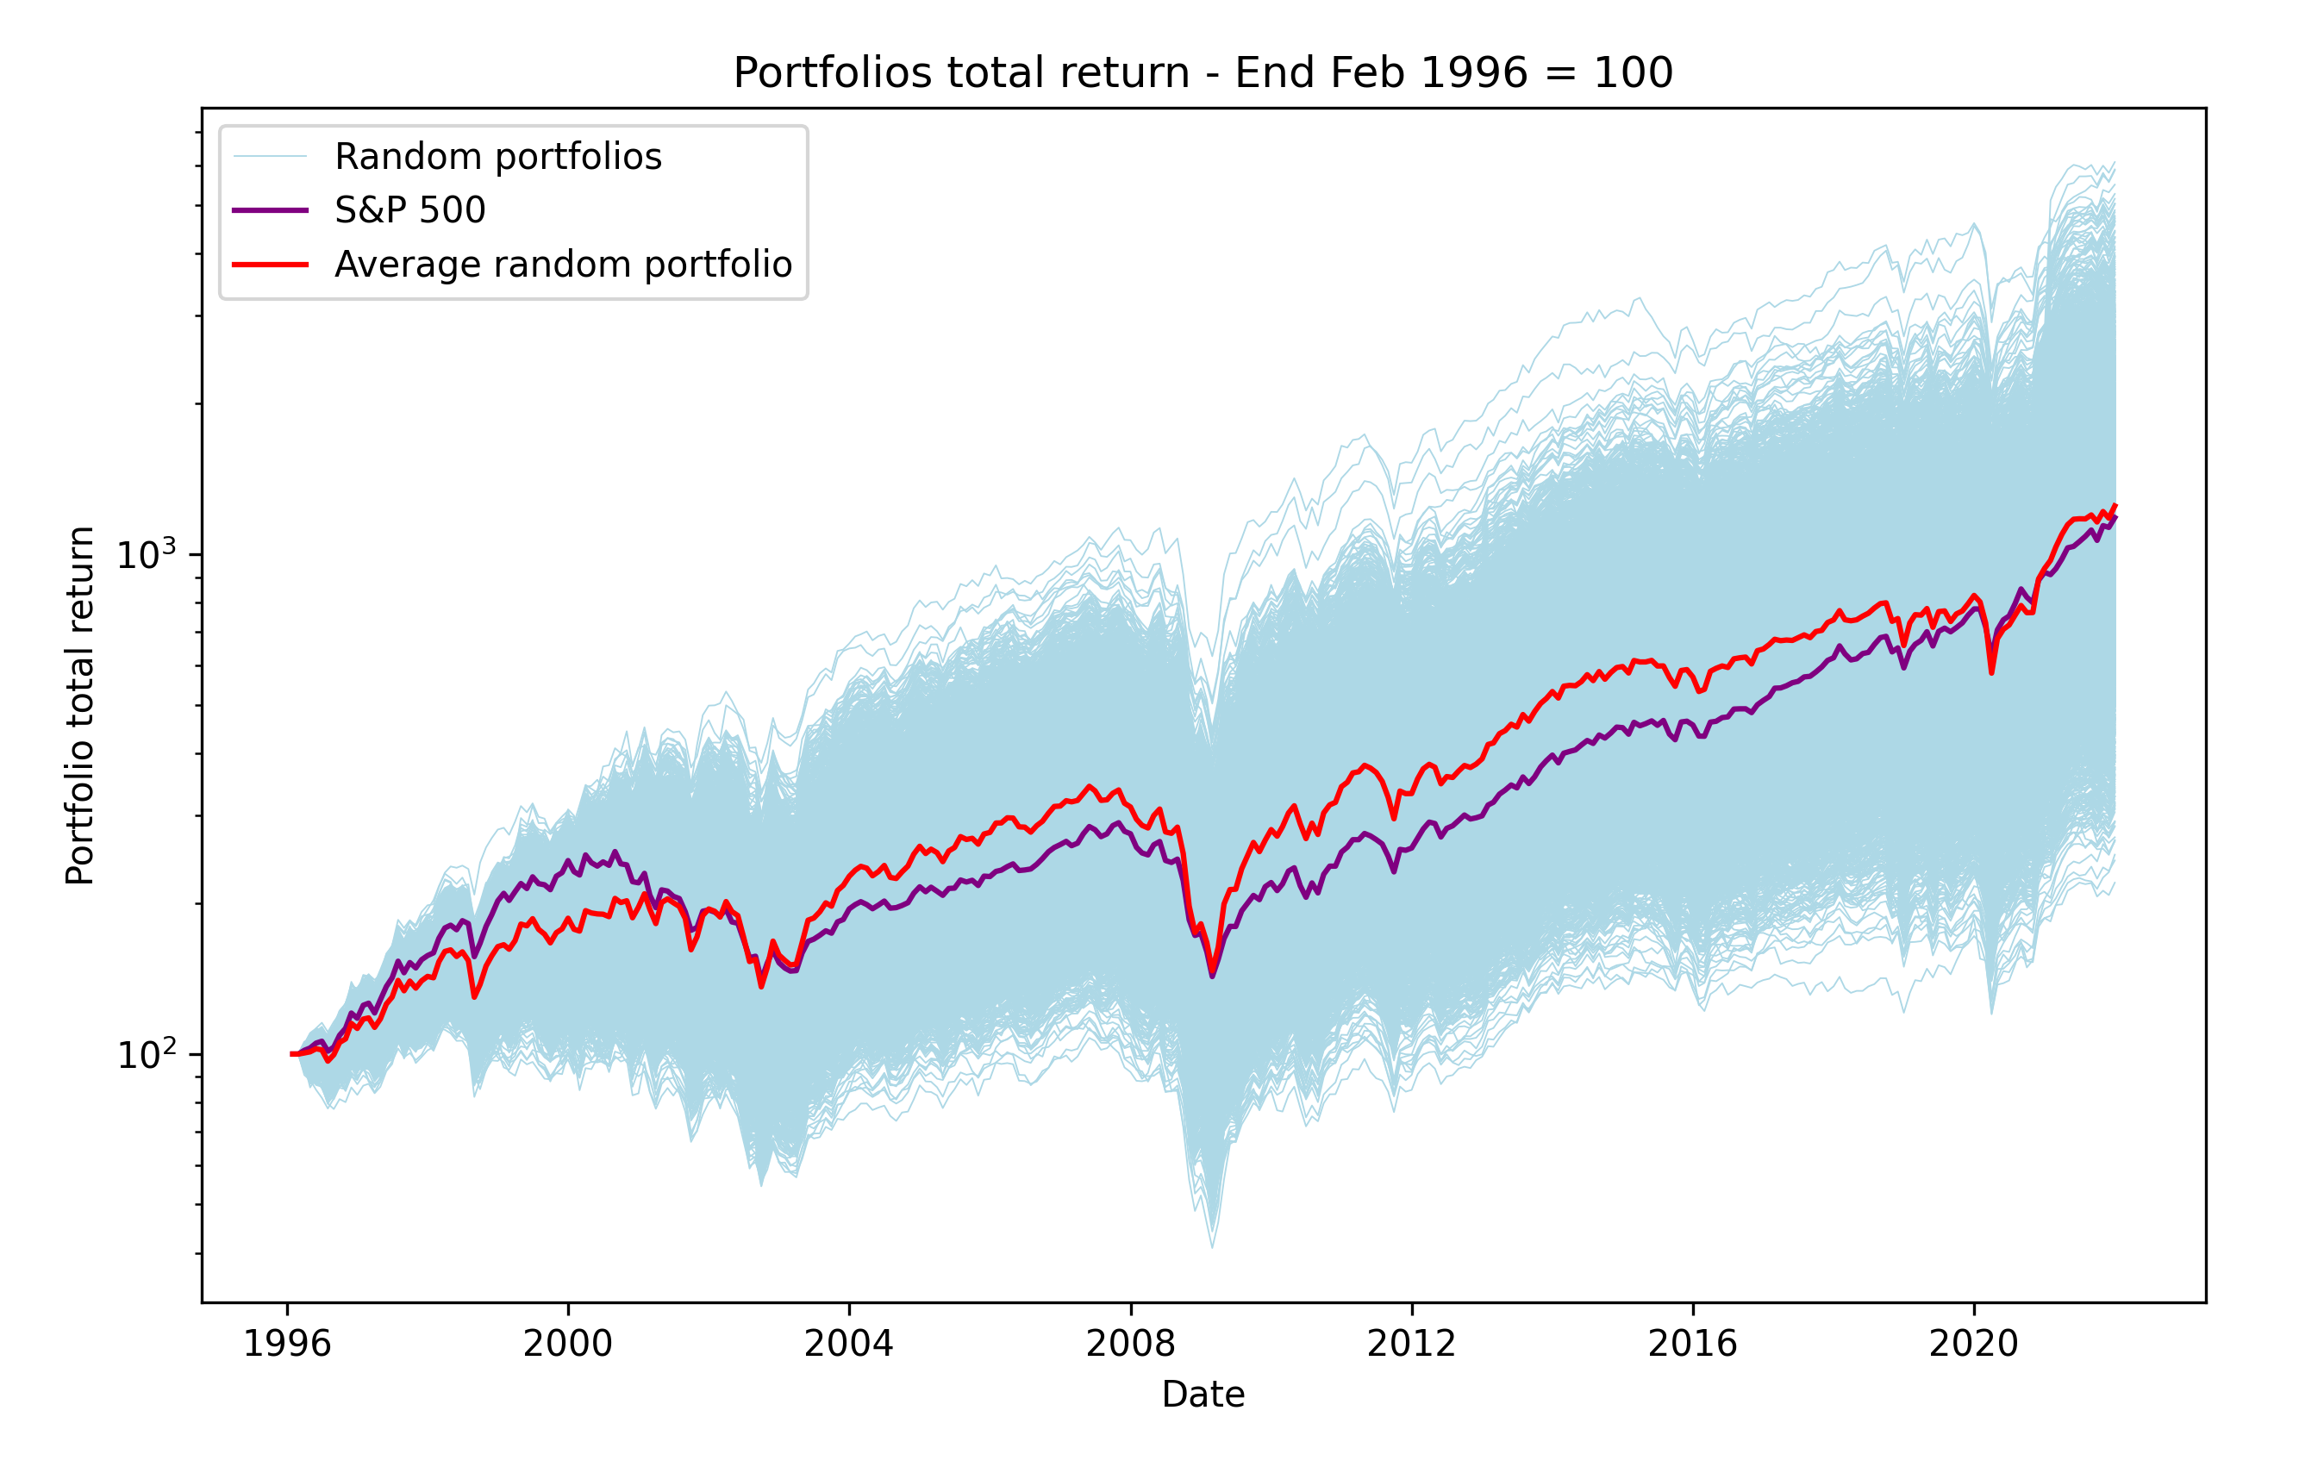
Portfolio simulations
“Portfolio managers’ skills or randomness during bull and bear markets” – Iván Carrillo García
Using a custom software, random portfolios are iteratively generated.
Rebalance frequency – Monthly
Stock-picking method – Random
Number of holdings – 20
Security weighting – Equally weighted
Time period – March 1996 - December 2021
Number of simulations - 10.000

Slide 5
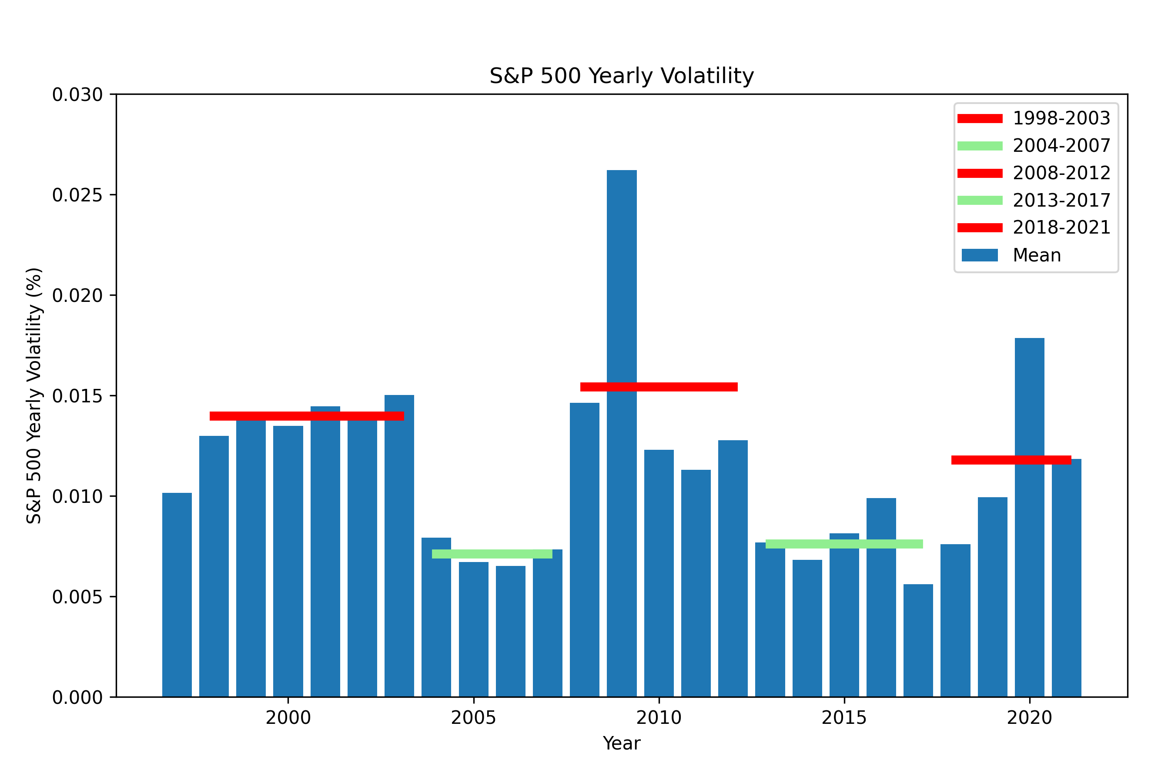
Volatility regimes
“Portfolio managers’ skills or randomness during bull and bear markets” – Iván Carrillo García
To establish fair comparisons, data is split according to market regimes based on volatility.

Slide 6
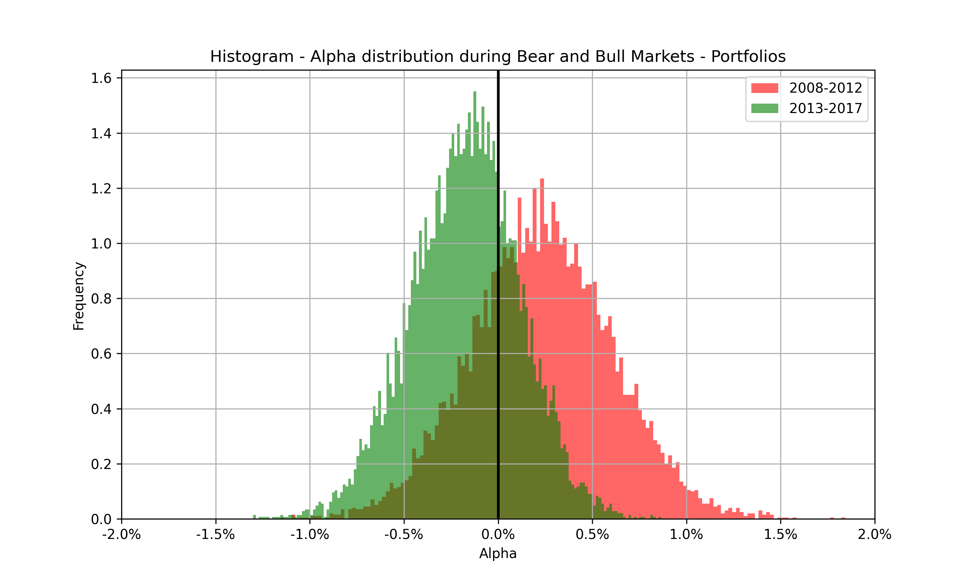
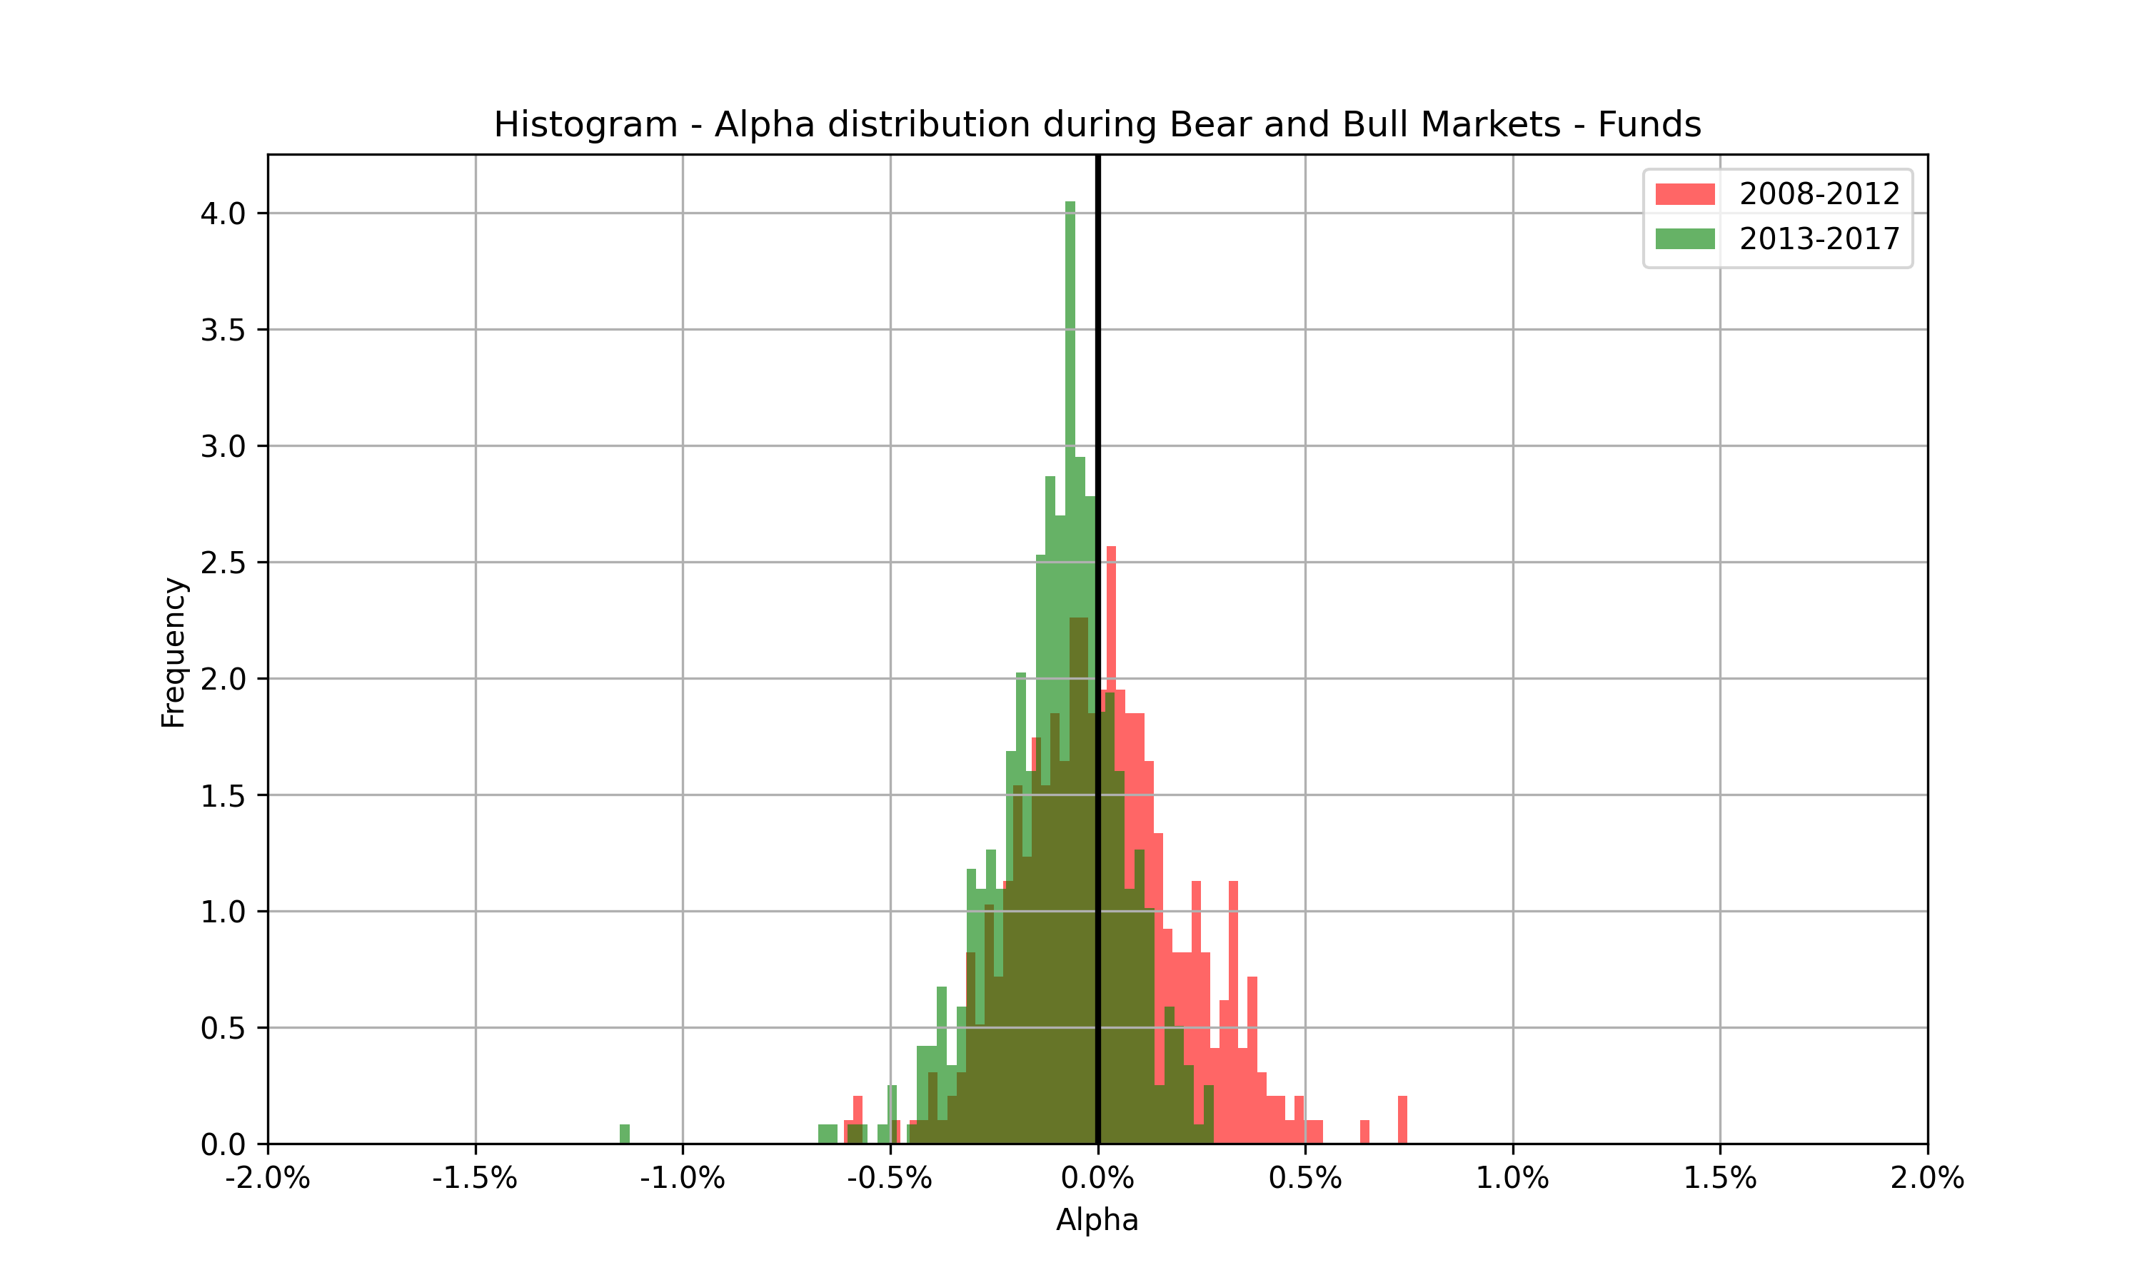
Alpha measurement
“Portfolio managers’ skills or randomness during bull and bear markets” – Iván Carrillo García
Alpha is computed under Fama-French five-factor model, for random portfolios and mutual funds during a bear and a bull market.

Slide 7
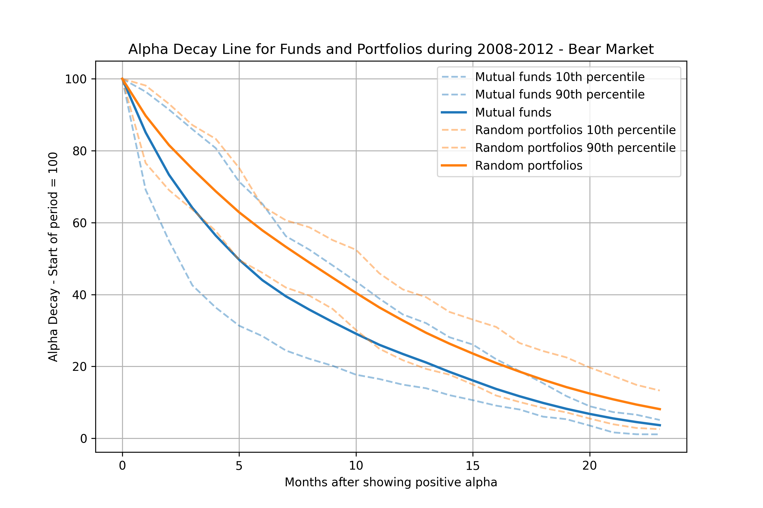
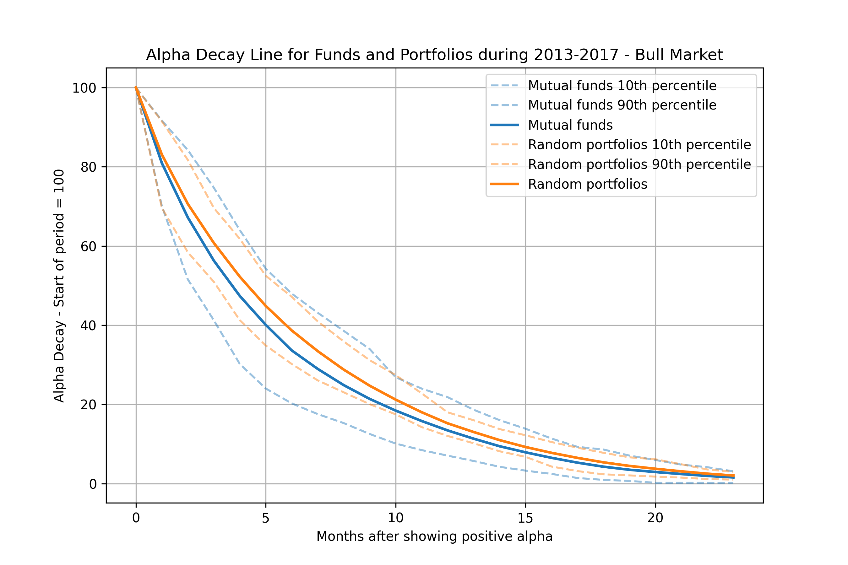
Alpha Decay Line
“Portfolio managers’ skills or randomness during bull and bear markets” – Iván Carrillo García
To measure alpha persistence, the “Alpha Decay Line” is introduced, where the proportion of portfolios and funds that continue to show alpha is computed.

Slide 8
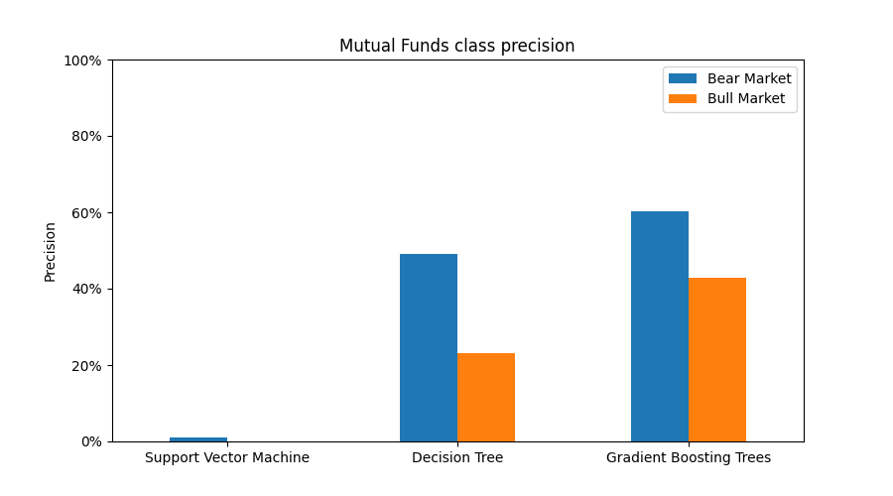
Machine learning models
“Portfolio managers’ skills or randomness during bull and bear markets” – Iván Carrillo García
Several machine learning algorithms are used to distinguish between mutual funds and random portfolios.

Slide 9
Conclusions
“Portfolio managers’ skills or randomness during bull and bear markets” – Iván Carrillo García
Results show underperformance of mutual funds managers compared to non-informed random investors, especially during bull markets.
Future work is desirable, with a more complete mutual fund database and a new market regime (inflationary bear market) in the data, as well as a look into the human biases that define markets.
In my opinion, active fund managers do not deserve the admiration they have, as they contribute to lower returns for their investors, who should increase the push towards index funds.

