Slide 1
Writing Workshop #3
Results and Discussion
  The examples on the following slides were all excerpted from real papers
  These illustrate common problems that students encounter when drafting their Results and Discussion sections
  When reviewing each of these examples, ask yourself whether your own paper could provoke a similar criticism.
  How might you change your own writing to address or avoid such criticisms?

Slide 2
Distinguish the assay from the concept
The GUS assay is a tool, not a concept
Assaying … promoter activity
To determine the activity of the … promoter in the wild type and mutant strains of AN12, we performed a GUS assay.
GUS = enzyme
gusA = gene
This one is closer
But it misses the point in the text
Transcriptional Fusion Assay Analysis
GUS assays were performed in order to both reveal whether or not the promoter is transcriptionally active and to measure the promoter activity in each of the different strains if it is transcriptionally active.
In order to perform the GUS assays, constructs were made by ligating the putative promoters from the … gene into the expression vector pAL280.

Slide 3
Distinguish the assay from the concept
Assaying … promoter activity
To determine the activity of the … promoter in the wild type and mutant strains of AN12, we performed a GUS assay.
Assaying … promoter activity
To determine the activity of the … promoter in the wild type and mutant strains of AN12, we performed a transcriptional fusion assay in which the promoter from the …gene was fused to the coding sequence of the β-glucuronidase reporter gene (gusA).
Transcriptional Fusion Assay Analysis
GUS assays were performed in order to both reveal whether or not the promoter is transcriptionally active and to measure the promoter activity in each of the different strains if it is transcriptionally active.
In order to perform the GUS assays, constructs were made by ligating the putative promoters from the … gene into the expression vector pAL280.
Transcriptional Fusion Assay Analysis
Transcriptional fusion assays were performed in which the putative promoter was fused to the open reading frame of the β-glucuronidase reporter gene (gusA). Measuring GUS activity in this way would both reveal whether the promoter is transcriptionally active and measure its activity in each of the different strains.
In order to perform the assays, constructs were made by ligating the putative promoters from the … gene into the expression vector pAL280.

Slide 4
Don’t overuse personal pronouns
To obtain a gentamicin-resistant transposome, we isolated our transposon from pMSR1 using...
eek!
eek!
To obtain a gentamicin-resistant transposome, we isolated the transposon from pMSR1 using...

Slide 5
Avoid lab slang
In order to determine if the transposome had really inserted at random into the genome, the plasmid rescues of all strains were sequenced...
Huh?
In order to determine whether the transposome had really inserted at random into the genome, we examined the sequences in the genome into which the transposons had inserted. To do this, we first recovered each of the transposons along with a portion of the adjacent genomic DNA via a plasmid rescue procedure (see Materials and Methods). Sequencing the genomic DNA recovered in this manner revealed...

Slide 6
Avoid lab slang
The plasmids were also sequenced using a forward primer for the transposome, and the upstream regions were BLAST compared for homology with known sequences.
Upstream of what?
Huh?
The plasmids were also sequenced using a forward primer for the transposome, and the sequences beyond the termini of the transposons were examined via a BLAST analysis (Altschul et al., 1990) to determine whether they resembled known sequences in GenBank.

Slide 7
Be wary of cryptic explanations
…the plasmid integrated into the genome by homologous recombination with the nimB and ORF5468 gene. A true breeding experiment of potential knockouts showed that the rate of plasmid loss after integration is very low.
Should I already know what this means?

Slide 8
Be wary of cryptic explanations
…the plasmid integrated into the genome by homologous recombination with the nimB and ORF5468 gene. A true breeding experiment of potential knockouts showed that the rate of plasmid loss after integration is very low.
Either explain the “true breeding experiment” fully in Materials and Methods or include more detail here.
…the plasmid integrated into the genome by homologous recombination with the nimB and ORF5468 gene. We tested the stability of the integrated plasmid via a true breeding experiment. In this experiment, recombinant cells were grown at the non-permissive temperature in the absence of antibiotic selection for approximately 10 generations. Following this period, aliquots from this culture were plated onto selective (LB with 5 mg/L gentamicin) or non-selective (LB) media. The ratio of the number of colonies on the selective plates to those on the non-selective plates reflected the proportion that had retained the integrated plasmid. This test of potential knockouts showed …

Slide 9
More cryptic statements
Transformants were successfully generated using (the transposome). In the first several transformation attempts, the positive control yielded between 10 and 20 colonies, while the … negative controls yielded none.
What positive control?
What condition are you controlling for?

Slide 10
More cryptic statements
Transformants were successfully generated using (the transposome). In the first several transformation attempts, the positive control yielded between 10 and 20 colonies, while the … negative controls yielded none.
… Transformants were generated using (the transposome). To test whether the cells were competent to take up exogenous DNA, positive control electroporations were carried with the plasmids pEP2 or pJP10 instead of transposome, and negative controls carried out with cells alone. In the first several transformation attempts, the positive control yielded between 10 and 20 colonies, while the … negative controls yielded none.

Slide 11
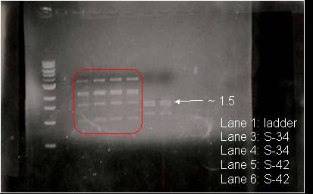
Eliminate unnecessary lanes in gels
Lanes not labeled
Multiple replicates
Lots of dead space
Other data that are not discussed
Redundant with legend
Fig.4. Verification of S-34, S-42 via HindIII and Pst1 digestion. Lane 1 contains a 1kb DNA ladder. Lane 3 and 4 contains S-34 plasmid rescue, which shows the expected 1.5 kb band between the respective restriction enzyme sites on the transposon. Similarly, lanes 5 and 6 contain the S-42 plasmid rescue, also showing the 1.5 kb band. Multiple other bands indicate presence of multiple HindIII sites in plasmid.

Slide 12


Eliminate unnecessary lanes in gels
1
2
3
~1.5
Fig.4. Verification of S-34, S-42 via HindIII and Pst1 digestion. Lane 1 contains a 1kb DNA ladder. Lane 3 and 4 contains S-34 plasmid rescue, which shows the expected 1.5 kb band between the respective restriction enzyme sites on the transposon. Similarly, lanes 5 and 6 contain the S-42 plasmid rescue, also showing the 1.5 kb band. Multiple other bands indicate presence of multiple HindIII sites in plasmid.

Slide 13
Eliminate unnecessary lanes in gels
1
2
3
~1.5
Fig.4. Verification of S-34, S-42 via HindIII and Pst1 digestion. Lane 1 contains a 1kb DNA ladder. Lane 3 and 4 contains S-34 plasmid rescue, which shows the expected 1.5 kb band between the respective restriction enzyme sites on the transposon. Similarly, lanes 5 and 6 contain the S-42 plasmid rescue, also showing the 1.5 kb band. Multiple other bands indicate presence of multiple HindIII sites in plasmid.
Figure 4. Plasmid Rescue of S-34, S-42. Lane 1, 1kb DNA ladder. Plasmids recovered from transposants S-34 (lane 2) and S-42 (lane 3) were digested by HindIII and PstI. Note, both plasmids produced the expected 1.5 kb band derived from the transposon. Additional bands indicate presence of multiple HindIII sites in plasmid. The similarity of these two plasmids suggest that the two transposants were clonally derived.

Slide 14
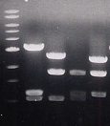
Figure legends shouldn’t be lists
Nice crisp image
Written as a list
Figure 4. Agarose gel electrophoresis (FspI digests of in vitro pCR2.1 TOPO transformants):
Lane 1: Molecular Weight Marker.
Lane 2: Colony #1, PCR transposome inserted into 1.7 kb segment of TOPO.
Lane 3: Colony #2, PCR transposome inserted into 1.1 kb segment of TOPO.
Lane 4: Digested TOPO, expected bands at 1.0 kb, 1.1 kb, 1.7 kb.
Lane 5: Colony #1, PCR transposome inserted into 1.7 kb segment of TOPO.
Lots of repetition
Lab slang
After all this, it’s not clear what main observation was supposed to be

Slide 15
Figure legends shouldn’t be lists
1
2
3
4
5
1.7 kb
1.1 kb
1.0 kb
Figure 4. Agarose gel electrophoresis (FspI digests of in vitro pCR2.1 TOPO transformants):
Lane 1: Molecular Weight Marker.
Lane 2: Colony #1, PCR transposome inserted into 1.7 kb segment of TOPO.
Lane 3: Colony #2, PCR transposome inserted into 1.1 kb segment of TOPO.
Lane 4: Digested TOPO, expected bands at 1.0 kb, 1.1 kb, 1.7 kb.
Lane 5: Colony #1, PCR transposome inserted into 1.7 kb segment of TOPO.
Figure 4. FspI digests of in vitro pCR2.1 TOPO transposants. Whereas digestion of pCR2.1-TOPO produces fragments at 1.0 kb, 1.1 kb and 1.7 kb (lane 4), each of three separate target plasmids had suffered insertions into a different one of these fragments (lanes 2, 3 and 5) increasing the size of the respective fragments by the expected 1.9 kb. Lane 1, molecular weight marker.

Slide 16
Name plasmids only after you’ve described their successful testing
Names them…
Purified PCR products were then excised from the gel, purified, and cloned separately into pCR2.1-TOPO (Figure 2). These constructs were named pTOPO_ERG12, pTOPO-ERG8, and pTOPO-MVD1, respectively, to distinguish between the genes that were cloned into each plasmid. The appropriate colonies were selected for each insert and the plasmids were extracted by miniprep. Verification of each of these pCR2.1-TOPO constructs was carried out by DNA sequencing and by various restriction enzyme digests, as shown in Figures 3, 4 and 5.
THEN tests them (which implies bias in the interpretation)

Slide 17
Name plasmids only after you’ve described their successful testing
Purified PCR products were then excised from the gel, purified, and cloned separately into pCR2.1-TOPO (Figure 2). These constructs were named pTOPO_ERG12, pTOPO-ERG8, and pTOPO-MVD1, respectively, to distinguish between the genes that were cloned into each plasmid. The appropriate colonies were selected for each insert and the plasmids were extracted by miniprep. Verification of each of these pCR2.1-TOPO constructs was carried out by DNA sequencing and by various restriction enzyme digests, as shown in Figures 3, 4 and 5.

Slide 18
Name plasmids only after you’ve described their successful testing
Purified PCR products were then excised from the gel, purified, and cloned separately into pCR2.1-TOPO (Figure 2). The appropriate colonies were selected for each insert and the plasmids were extracted by miniprep. Verification of each of these pCR2.1-TOPO constructs was carried out by DNA sequencing and by various restriction enzyme digests, as shown in Figures 3, 4 and 5. These constructs were named pTOPO_ERG12, pTOPO-ERG8, and pTOPO-MVD1, respectively, to distinguish between the genes that were cloned into each plasmid.

Slide 19
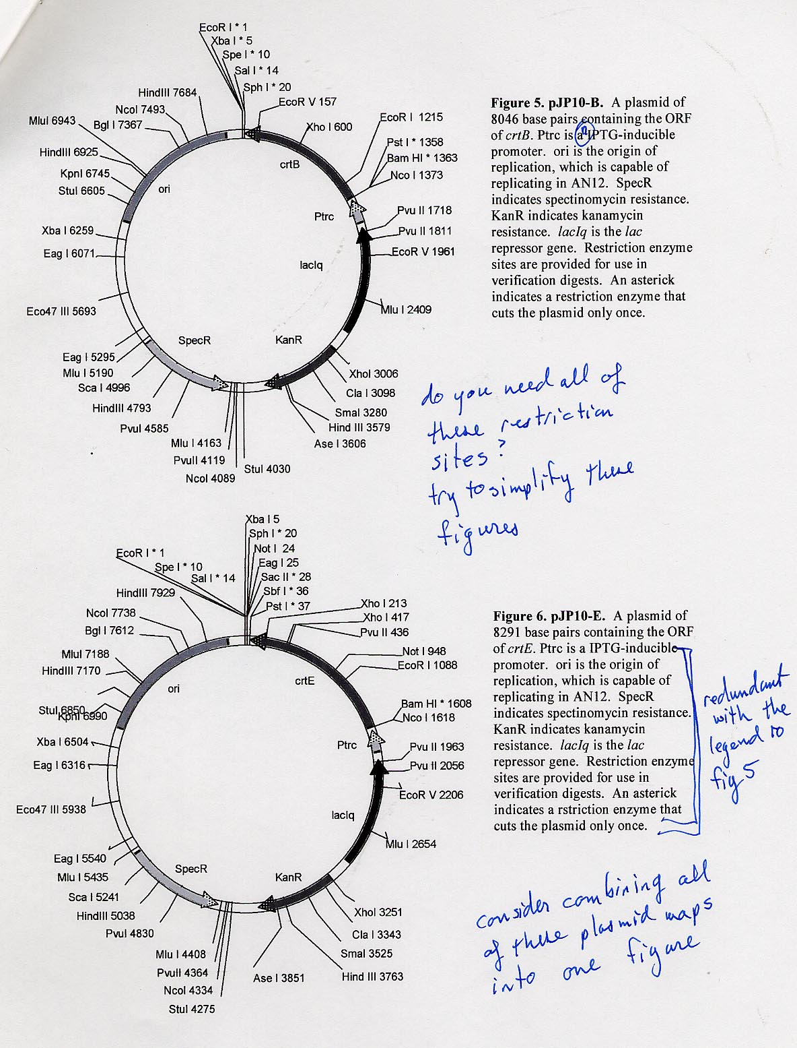
Eliminate unnecessary details
Way too many restriction sites
2 figures could be combined into one

Slide 20
Eliminate unnecessary details
EcoR I * 1
Xba I 5
Spe I * 10
Sal I * 14
Sph I * 20
Not I * 24
Eag I 25
Sac II * 28
Sbf I * 36
Pst I * 37
HindIII 6363
Bam HI * 42
NcoI 6172
Nco I 52
Pvu II 397
Bgl I 6046
Pvu II 490
Some features labeled but not defined
EcoR V 640
MluI 5622
Ptrc
HindIII 5604
lacIq
Mlu I 1088
KpnI 5424
NG2 ori
StuI 5284
pJP10
6725 bp
XhoI 1685
Xba I 4938
Cla I 1777
Some details not necessary
KanR
Eag I 4750
RP4 mob
SmaI 1959
Eco47 III 4372
SpecR
Ase I 2285
Eag I 3974
StuI 2709
Mlu I 3869
NcoI 2768
Sca I 3675
PvuII 2798
HindIII 3472
PvuI 3264
Mlu I 2842
Figure 5. pJP10. A plasmid of 6725 base pairs designed to express inserted genes from the trc promoter. Ptrc is an IPTG-inducible promoter. Ori is the origin of replication, which is capable of replicating in AN12. SpecR indicates spectinomycin resistance. KanR indicates kanamycin resistance. lacIq is the lac repressor gene. Restriction enzyme sites are provided for use in verification digests. An asterisk indicates a restriction enzyme that cuts the
plasmid only once.

Slide 21
Eliminate unnecessary details
EcoR I 1
Spe I 10
Sal I 14
Sph I 20
Not I 24
Sac II 28
Pst I 37
Bam HI 42
NcoI 6172
Nco I 52
Ptrc
NG2 ori
lacI^{q}
pJP10
6725 bp
KanR
SpecR
Could be written more succinctly
Redundant with image
NcoI 2768
Figure 5. pJP10. A plasmid of 6725 base pairs designed to express inserted genes from the trc promoter. Ptrc is an IPTG-inducible promoter. Ori is the origin of replication, which is capable of replicating in AN12. SpecR indicates spectinomycin resistance. KanR indicates kanamycin resistance. lacIq is the lac repressor gene. Restriction enzyme sites are provided for use in verification digests. An asterisk indicates a restriction enzyme that cuts the
plasmid only once.

Slide 22
Eliminate unnecessary details
EcoR I 1
Spe I 10
Sal I 14
Sph I 20
Not I 24
Sac II 28
Pst I 37
Bam HI 42
NcoI 6172
Nco I 52
Ptrc
NG2 ori
lacI^{q}
pJP10
6725 bp
KanR
SpecR
NcoI 2768
Figure 5. pJP10 expresses inserted genes from the IPTG-inducible trc promoter (Ptrc). NG2 ori, origin of replication, capable of replicating in AN12; SpecR, spectinomycin resistance marker; KanR, kanamycin resistance marker; lacI^{q}, lac repressor

Slide 23
Beginning the Discussion
Jumps right into the data…
On a negative note, no less…
Discussion
The sequence deviation of pFRO is not surprising because the shotgun sequencing method that was used to sequence the genome has potential holes.

Slide 24
Beginning the Discussion
Start by restating the hypothesis
Discussion
While many eukaryotes produce isoprenoids via mevalonate, very few prokaryotes use this pathway, the non-mevalonate pathway being much more common. Therefore it is not surprising to find genes encoding the entire enzymatic complement for the non-mevalonate pathway in the bacterium we studied. What is peculiar, though, is the presence of a gene encoding HMG-CoA reductase. In other organisms, this enzyme constitutes the first committed step toward isoprenoid biosynthesis via the mevalonate pathway, and the enzyme is rarely encountered in any other context. In this project we sought to determine the role of HMG-CoA reductase in this strain.
We cloned and sequenced the HMG-CoA reductase gene from the bacterrial chromosome and found a small number of sequence discrepencies relative to that reported in the genome database. This sequence deviation is not surprising because…

Slide 25
Citing the references
The location of the ptsH promoter is unknown, if there is a promoter for ptsH in Rhodococcus. In similar bacteria, such as Streptococcus salivarius, Shine delgarno sequences have been found upstream of the ptsH gene (Gagnon et al. 1993). Two carbon source regulated promoters for ptsH in Streptomyces coelicolor have also been found (Nothaft et al. 2003). Furthermore, promoters are normally found within…
And from this example we’ve learned…what?
Wait! You’re onto a 2nd topic and I still don’t understand the 1st.

Slide 26
Citing the references
The location of the ptsH promoter is unknown, if there is a promoter for ptsH in Rhodococcus. In similar bacteria, such as Streptococcus salivarius, Shine delgarno sequences have been found upstream of the ptsH gene (Gagnon et al. 1993). Two carbon source regulated promoters for ptsH in Streptomyces coelicolor have also been found (Nothaft et al. 2003). Furthermore, promoters are normally found within…
…In similar bacteria, such as Streptococcus salivarius, Shine Delgarno sequences have been found upstream of the ptsH gene (Gagnon et al., 1993), which enabled these researchers to identify the location of the ptsH promoter in that species. A similar strategy would be helpful for identifying the location of the ptsH promoter in Rhodococcus, had such a consensus sequence already been identified. Two carbon source regulated promoters for ptsH in Streptomyces coelicolor have also been found (Nothaft et al., 2003). The more proximal of these two promoters was constitutively expressed, whereas the distal promoter was strongly induced by glucose. This illustrates the possibility that…

Slide 27
“Discussion” as “True Confessions”
Oooh, harsh!
The transformation rate for B264-1 is almost so low as to be useless for the purposes of generating mutations. Given that in three months and as many different preparations of competent cells we only generated 3 transformants…
Such a tragedy…
Given how little is known about the mechanism of conjugal transfer between rhodococci, any progress in this field would be welcomed. Rhodococcus sp. B264-1 has the ability to transfer DNA to other Rhodococcus strains, and it is reasonable to suspect that the genes required for this activity lie on one of the two megaplasmids that reside within B264-1. While it is clear that there is still much work to do, we have taken the first steps toward genetically tagging the elements required for conjugal transfer in Rhodococcus sp. B264-1…

Slide 28
Ending the Discussion
…Another possible explanation for the knockout growth is that over longer periods, quinones and other metabolic byproducts have diffused from the KY1 side of the plate to the 50A2 side (Figure 3c) and the cells are able to metabolize these, if poorly.
The End
Ending with this comment makes it seem as though this issue of quinone metabolism was the most important conclusion of the research

Slide 29
Ending the Discussion
…Another possible explanation for the knockout growth is that over longer periods, quinones and other metabolic byproducts have diffused from the KY1 side of the plate to the 50A2 side (Figure 3c) and the cells are able to metabolize these, if poorly.
The results we have obtained to date argue in favor of the hypothesis that nimB encodes a function that is critical for naphthalene metabolism in Rhodococcus sp. KY1. However, it is also clear that more work will be needed to confirm the precise role of this gene as well as that of the neighboring gene, ORF5468. Continued research into this area will shed important light on the degradation of aromatic hydrocarbons among rhodococci.

