Slide 1



轉移性癌組織模型預測
Group B / Part 2 / Group 19
Team members:
313554033許晴鈞、313554060 林呈軒
1

Slide 2





CONTENT
Problem Setting
Proposed Methods
Experimental Setting
Experimental Results
Introduction
Background
Motivation
Research Aims
Challenges
Contribution
Problem Description
Evaluation Metrics
Data Understanding
Data Preparation
Data Modeling
Evaluation
Datasets
Baseline & SOTA Methods
Evaluation Strategy
Environment
Experimental Results
Conclusion, Insights & Limitations
Demo
2

Slide 3
CONTENT
Problem Setting
Proposed Methods
Experimental Setting
Experimental Results
Introduction
Background
Motivation
Research Aims
Challenges
Contribution
3

Slide 4
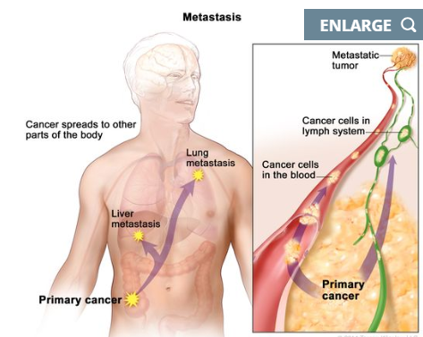
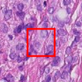
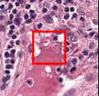
Background
Metastasis matters. Lymph-node metastasis is a key prognostic factor and drives treatment decisions in many cancers (e.g., breast cancer).
Histopathology is the gold standard. Pathologists read H&E slides, but WSI are huge; manual screening is time-consuming and subject to fatigue/variability.
Our dataset & task. We use Kaggle – Histopathologic Cancer Detection (HCD): 96×96 H&E patches; binary label indicates whether the central region contains metastatic tumor cells (1/0).
a.Metastasis
b.H&E patch examples
(pos/neg)
ref:https://visualsonline.cancer.gov/details.cfm?imageid=9803&utm_source=chatgpt.com
ref:https://www.kaggle.com/competitions/histopathologic-cancer-detection
4
Notes:
糖尿病是一種慢性代謝性疾病，目前正影響著全球數百萬人。
由世界衛生組織的報告中可以知道，近年來生活方式的改變以及肥胖率增加。 導致糖尿病越來越盛行。
此外，糖尿病主要的併發症有以下三類，心血管疾病，腎臟病，以及神經病變。
如果能夠盡早發現糖尿病，可以有效預防這些併發症的發生。
Ref:
https://www.lipotype.com/lipidomics-applications/lipidomics-of-cardiovascular-diseases/
https://www.vascularcures.org/kidney-failure-and-vascular-disease
https://my.clevelandclinic.org/health/diseases/21621-diabetic-neuropathy

Slide 5




Motivation
Early detection of lymph-node metastasis
More challenging than standard cancer classification
Reliable and scalable AI assistance
5
Notes:
以下是我們的動機
第一點是提早偵測與預防。
我們希望能夠在臨床症狀出現之前評估其風險並採取預防措施。
第二點是降低醫療保健成本。
透過提供初步風險評估來減少對昂貴測試的需求。
第三點醫生提供決策支援。
幫助醫療保健專業人員根據數據驅動的見解做出更明智的決策。
Early detection and prevention: Enabling individuals to assess their risk and take preventive actions before clinical symptoms appear.
Cost reduction in healthcare: Reducing reliance on expensive tests by providing an initial risk assessment.
Decision support for doctors: Assisting healthcare professionals in making better-informed decisions based on data-driven insights.

Slide 6


Research Aims
Systematic Comparative Analysis
Performance Benchmarking
Model Implementation
6
Notes:
我們的目標受眾是
醫生、潛在的病患、及醫療院所

Slide 7

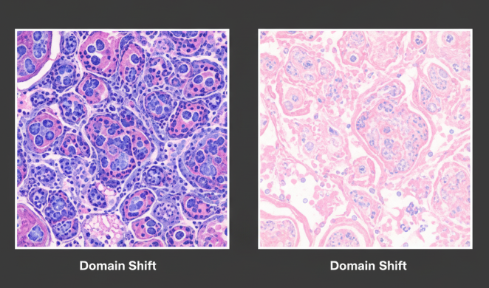
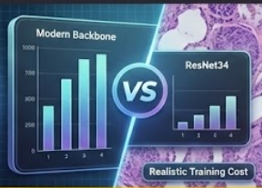

Challenges
Stain & Color Variability
Model Performance vs. SOTA
Towards Clinically Useful AI Assistance
How should we handle stain and color differences in H&E lymph-node patches?
Can a modern backbone beat ResNet34 under realistic training cost?
How can we build a robust and interpretable system that truly assists pathologists in lymph-node screening?
7
Notes:
Dataset issues:
我們已經有稍微確認過 dataset，裡面包含一些 missing value 以及 data imbalance 的問題。
第二點是模型泛化
我們需要確保模型在未見過的資料上表現良好，並且不會 overfitting 這個資料集。
第三點是 feature selection 與可解釋性。
我們需要確保模型不是黑盒子，能提供糖尿病的風險因素，及決策的依據

Slide 8




Contribution
Stain-Robust Classifier for Lymph-Node Metastasis
Systematic Evaluation of Stain/Color Pipelines and CNN Baselines
Explainable AI Assistance for Pathologists
8
Notes:
這是我們希望這像專案能夠擁有的主要貢獻。
第一個是能夠準確預測糖尿病的 model
第二個是提供糖尿病的風險因素
第三個是希望能讓醫療院所擁有低成本的輔助診斷工具。

Slide 9
CONTENT
Problem Setting
Problem Setting
Proposed Methods
Experimental Setting
Experimental Results
Introduction
Problem Description
Evaluation Metrics
9

Slide 10



Problem Description
Lymph-Node Metastasis Patch Classification
Binary classification of histopathologic image patches from lymph-node tissue into metastatic vs. non-metastatic.
Input:
A 96x96 pixel H&E stained image patch from a lymph node tissue sample.
Output:
A binary prediction indicating whether the central region contains metastatic tumor cells (1/0)
10
Notes:
Early detection and prevention: Enabling individuals to assess their risk and take preventive actions before clinical symptoms appear.
Cost reduction in healthcare: Reducing reliance on expensive tests by providing an initial risk assessment.
Decision support for doctors: Assisting healthcare professionals in making better-informed decisions based on data-driven insights.
我們此次挑選的資料集是做糖尿病的預測
input會是病患資料，包含九個properties，後續會比較詳細的介紹
output會是預測該患者是否有糖尿病，以及若後續採用DL model，會有confidence score to support我們的模型預測結果

Slide 11

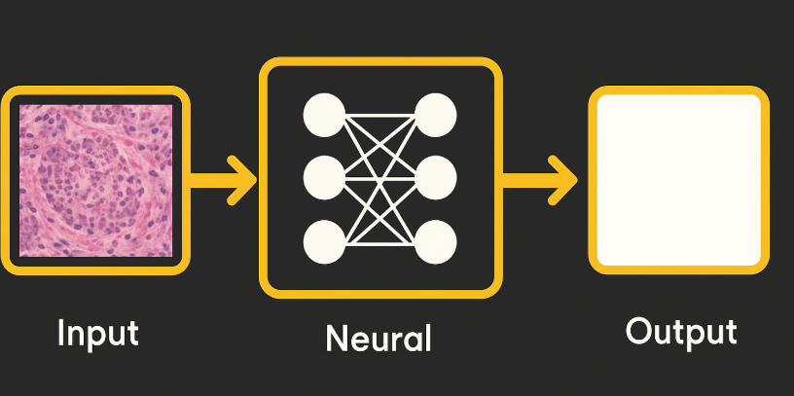
Problem Description
Input
Process
Output
Data Split & Preprocessing
CNN Classifier & Training
Evaluation & Model Selection
96×96 H&E patch
Binary class label
Performance metrics (AUROC, F1, Precision, Recall)
11

Slide 12








Evaluation Metrics
Metrics
1
2
AUROC
F1-score
Primary Metric: Evaluates overall model potential, independent of the decision threshold.
Key Application Metric: Balances precision and recall to measure practical performance
4
3
recall
Precision
The fraction of actual positives that are correctly identified, showing the model's ability to capture positive cases.
The proportion of true positive predictions among all positive predictions made, reflecting the model's exactness.
12
Notes:
Accuracy
模型預測正確的比例
Precision
模型預測為positive的樣本中有多少是true positive
模型預測有糖尿病的人，主要真的有糖尿病患者的有幾個
Recall 召回率
找出病患的能力，也就是漏報程度，當 Recall 越高，漏報越少。
F1-score 是綜合評估指標，由 Precision 與 Recall 計算而來。

Slide 13
CONTENT
Problem Setting
Proposed Methods
Experimental Setting
Experimental Results
Introduction
Data Understanding
Data Preparation
Data Modeling
Evaluation
13

Slide 14



Methodology Overview
Data Understanding
Data Preparation
Data
Class balance of train / val / test
HSV mean per patch (pos vs neg)
RGB channel KDE → stain intensity variation & color bias risk
Stratified 70 / 15 / 15 split (train / val / test)
2×2 color–stain design:
Raw HCD vs Macenko-normalized
With vs without color augmentation
Resize to 256×256 & normalize (mean, std)
Kaggle Histopathologic Cancer Detection (HCD)
220k 96×96 H&E lymph-node patches
Label = central region metastatic (1) vs non-metastatic (0)
Deployment
Evaluation
Modeling
HCD Lymph Node Cancer Assistant
Precision
Recall
AUROC
F1-Score
EfficientNetV2-S
14
Notes:
- 我們觀察到大部分使用 PCA 的方式進行特徵篩選，可以相較於沒有使用的 work 能提升不少performance。
- 資料缺失的問題我們可能可以透過 MICE 的方式進行填補。
- 我們希望能公平的比較，並且盡量避免overfitting 的問題，所以不希望刪除太多 row 以及使用 SMOTEENN 的方法人工合成資料。

Slide 15
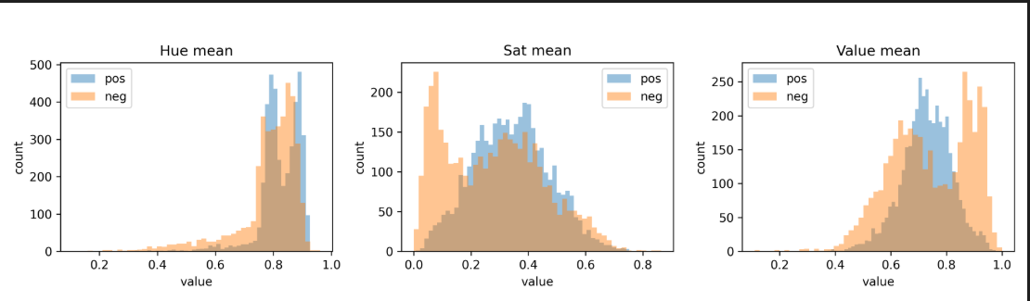
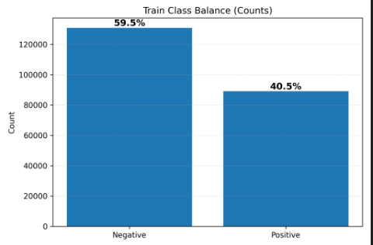
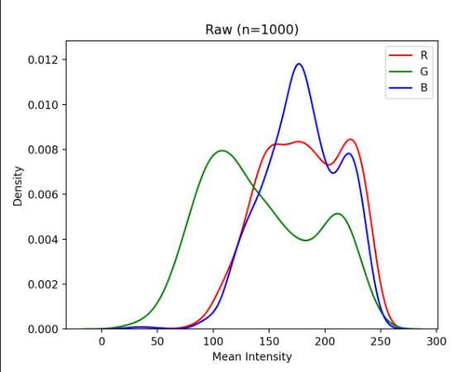
Data Understanding
Moderate class imbalance
Hue is not discriminative
Brightness & saturation shift
Stain intensity variation
HSV mean per patch distributions
Class balance bar chart
RGB channel KDE
15
Notes:
- 我們觀察到大部分使用 PCA 的方式進行特徵篩選，可以相較於沒有使用的 work 能提升不少performance。
- 資料缺失的問題我們可能可以透過 MICE 的方式進行填補。
- 我們希望能公平的比較，並且盡量避免overfitting 的問題，所以不希望刪除太多 row 以及使用 SMOTEENN 的方法人工合成資料。

Slide 16
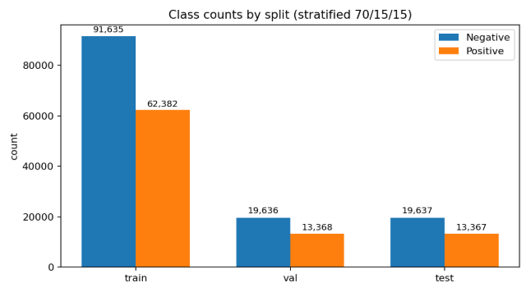
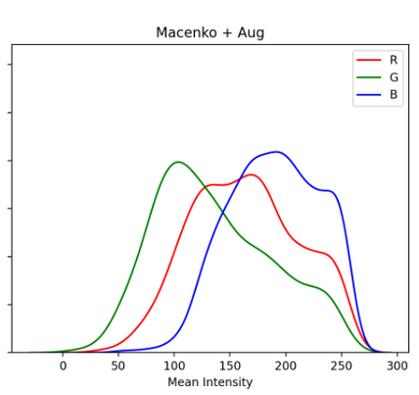
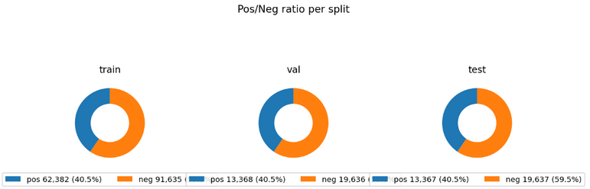
Data Preparation
Stratified split
Macenko stain normalization to reduce stain intensity variation
Careful color augmentation to simulate realistic stain differences
stratified 70/15/15 split
Stain normalization & Color enhancement
16
Notes:
- 我們觀察到大部分使用 PCA 的方式進行特徵篩選，可以相較於沒有使用的 work 能提升不少performance。
- 資料缺失的問題我們可能可以透過 MICE 的方式進行填補。
- 我們希望能公平的比較，並且盡量避免overfitting 的問題，所以不希望刪除太多 row 以及使用 SMOTEENN 的方法人工合成資料。

Slide 17
Data Preparation (Details)
Raw patch → (optional) Macenko-normalized patch → Resize to 256×256 → Train loader (with / without color aug)
2×2 design: {Raw, Macenko} × {Color augmentation ON, Color augmentation OFF}
Stain normalization – Macenko
• Goal: reduce slide-to-slide stain intensity variation
• Method (Macenko on H&E patches):
– Convert RGB image to optical density (OD) space
– Estimate two stain basis vectors for Hematoxylin & Eosin
– Project each patch onto this basis and align stain intensities
– Reconstruct a normalized RGB patch with consistent stain colorsColor augmentation strategy
17
Notes:
- 我們觀察到大部分使用 PCA 的方式進行特徵篩選，可以相較於沒有使用的 work 能提升不少performance。
- 資料缺失的問題我們可能可以透過 MICE 的方式進行填補。
- 我們希望能公平的比較，並且盡量避免overfitting 的問題，所以不希望刪除太多 row 以及使用 SMOTEENN 的方法人工合成資料。

Slide 18
Data Preparation (Details)
Raw patch → (optional) Macenko-normalized patch → Resize to 256×256 → Train loader (with / without color aug)
2×2 design: {Raw, Macenko} × {Color augmentation ON, Color augmentation OFF}
Color augmentation strategy
• Raw HCD:
– OneOf three branches with moderate brightness/contrast + gamma
– Sometimes add a small RGBShift
– 10% of patches keep almost original colors
• Macenko-normalized:
– Already standardized, so we apply gentler color changes
– Only small brightness/contrast and slight gamma variation
• Purpose:
– Simulate realistic stain differences while avoiding unrealistic colors
– Supports our 2×2 design: Raw vs Macenko × with vs without color augmentation
18
Notes:
- 我們觀察到大部分使用 PCA 的方式進行特徵篩選，可以相較於沒有使用的 work 能提升不少performance。
- 資料缺失的問題我們可能可以透過 MICE 的方式進行填補。
- 我們希望能公平的比較，並且盡量避免overfitting 的問題，所以不希望刪除太多 row 以及使用 SMOTEENN 的方法人工合成資料。

Slide 19
Data Modeling
Cancer probability
Sigmoid
Model structure
EfficientNetV2-S patch classifier (ImageNet-1k pretrained)
Input: 256×256 H&E patch → EfficientNetV2-S backbone → GAP → FC(1) → Sigmoid
Output: cancer probability (binary metastasis prediction)
Loss: class-balanced BCEWithLogits to up-weight metastatic patches
Modeling parameters
Optimizer: AdamW, base LR = 3e-4, cosine LR schedule
Batch: 64 / GPU, grad accumulation = 4 (global batch ≈ 1.8k)
Epochs: 12, weight decay = 1e-4
Loss weight: pos_weight_scale = 1.5
Training: 256×256 input, channels-last + AMP, DDP on 8 GPUs
FC (1)
Global Average Pooling
EfficientNetV2-S backbone
256×256 H&E patch
19
Notes:
- 我們觀察到大部分使用 PCA 的方式進行特徵篩選，可以相較於沒有使用的 work 能提升不少performance。
- 資料缺失的問題我們可能可以透過 MICE 的方式進行填補。
- 我們希望能公平的比較，並且盡量避免overfitting 的問題，所以不希望刪除太多 row 以及使用 SMOTEENN 的方法人工合成資料。

Slide 20
Evaluation
Metrics
AUROC
F1-score
Precision
recall
AUROC
F1-score
recall
Precision
20
Notes:
Accuracy
模型預測正確的比例
Precision
模型預測為positive的樣本中有多少是true positive
模型預測有糖尿病的人，主要真的有糖尿病患者的有幾個
Recall 召回率
找出病患的能力，也就是漏報程度，當 Recall 越高，漏報越少。
F1-score 是綜合評估指標，由 Precision 與 Recall 計算而來。

Slide 21
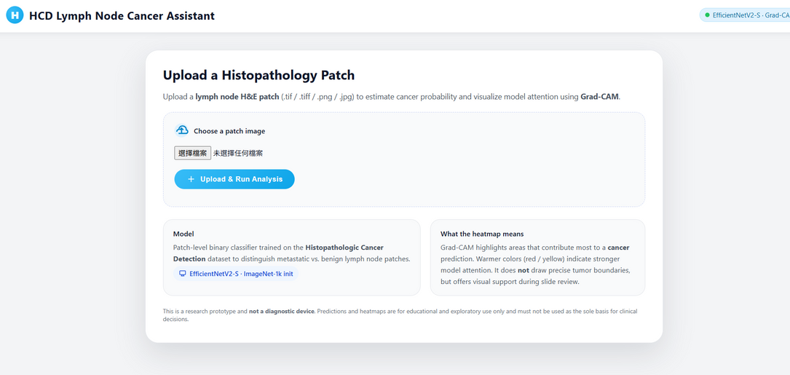
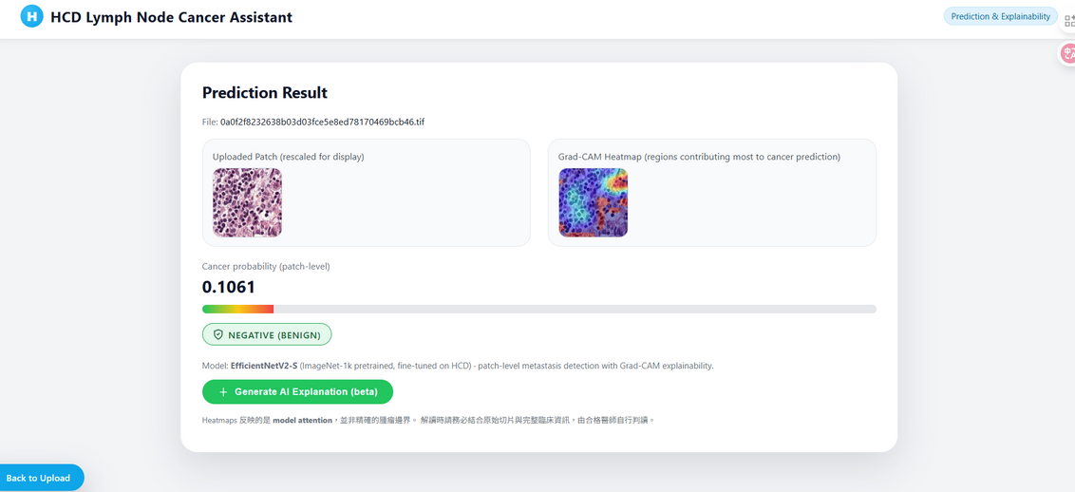
Deployment
Web-based assistant for lymph node H&E patch analysis
Backend: EfficientNetV2-S patch classifier (ImageNet-1k pretrained, fine-tuned on HCD)
Workflow: Upload patch → Preprocess (256×256, normalize) → Model inference
Outputs:
Patch-level cancer probability + Positive / Negative label
Grad-CAM heatmap highlighting regions contributing to the prediction
Optional “Generate AI Explanation (beta)” for text summary
21
Notes:
- 我們觀察到大部分使用 PCA 的方式進行特徵篩選，可以相較於沒有使用的 work 能提升不少performance。
- 資料缺失的問題我們可能可以透過 MICE 的方式進行填補。
- 我們希望能公平的比較，並且盡量避免overfitting 的問題，所以不希望刪除太多 row 以及使用 SMOTEENN 的方法人工合成資料。

Slide 22
CONTENT
Problem Setting
Proposed Methods
Experimental Setting
Experimental Results
Introduction
Datasets
Baseline & SOTA Methods
Evaluation Strategy
Environment
22

Slide 23
Dataset
Histopathologic Cancer Detection
Link:https://www.kaggle.com/competitions/histopathologic-cancer-detection
23
Notes:
我們的資料集是利用美國皮馬族印地安人糖尿病的資料庫作為分析對象

Slide 24
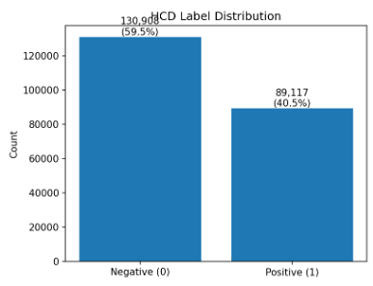



Dataset
Source:
Kaggle Competition / PatchCamelyon (PCam)
Content
96x96 pixel H&E stained image patches
Size
220,000+ labeled training images
Labels
Binary (1/0): Tumor in central region.
24
Notes:
這是我們希望這像專案能夠擁有的主要貢獻。
第一個是能夠準確預測糖尿病的 model
第二個是提供糖尿病的風險因素
第三個是希望能讓醫療院所擁有低成本的輔助診斷工具。

Slide 25
Baseline & SOTA Methods
Reference work
Dataset: Kaggle Histopathologic Cancer Detection (HCD), 220k 96×96 H&E patches
Pre-processing: remove over-bright/dark patches, random crop to 90×90, random H/V flip, ImageNet mean/std normalization
Baseline: logistic regression on patch pixels
SOTA: ResNet-18/34/50/152 (ImageNet-pretrained) with full fine-tuning; best model = ResNet-34-all
Our adaptation
Use the same ResNet architecture and training recipe (90×90 crop + H/V flip + normalization)
Baseline in our experiments: ResNet-18-all
SOTA reference: ResNet-34-all (paper’s best setting) + used as a strong baseline against our EfficientNetV2-S
Key difference from the paper:
Paper: random 8:1:1 split of the 220k patches
Ours: stratified 70/15/15 split, keeping similar cancer / non-cancer ratio in train / val / test for more stable AUROC and fair comparison
25
Notes:
這是我們希望這像專案能夠擁有的主要貢獻。
第一個是能夠準確預測糖尿病的 model
第二個是提供糖尿病的風險因素
第三個是希望能讓醫療院所擁有低成本的輔助診斷工具。

Slide 26




Evaluation Strategy
Stratified 70 / 15 / 15 data split
Model selection by validation AUROC
Test metrics: AUROC + F1 / Precision / Recall
Same protocol for all models
26
Notes:
以下是我們的動機
第一點是提早偵測與預防。
我們希望能夠在臨床症狀出現之前評估其風險並採取預防措施。
第二點是降低醫療保健成本。
透過提供初步風險評估來減少對昂貴測試的需求。
第三點醫生提供決策支援。
幫助醫療保健專業人員根據數據驅動的見解做出更明智的決策。
Early detection and prevention: Enabling individuals to assess their risk and take preventive actions before clinical symptoms appear.
Cost reduction in healthcare: Reducing reliance on expensive tests by providing an initial risk assessment.
Decision support for doctors: Assisting healthcare professionals in making better-informed decisions based on data-driven insights.

Slide 27
Environment
Hardware
8-GPU(DPP)
Each GPU with enough VRAM for batch size 64 (per GPU)
Mixed-precision training (AMP) to speed up training
Software
OS: Ubuntu Linux (server)
Programming language: Python 3.10
Frameworks: PyTorch
Data augmentation: albumentations
Metrics & utilities: scikit-learn, pandas, numpy
Development: VS Code
27
Notes:
這是我們希望這像專案能夠擁有的主要貢獻。
第一個是能夠準確預測糖尿病的 model
第二個是提供糖尿病的風險因素
第三個是希望能讓醫療院所擁有低成本的輔助診斷工具。

Slide 28
CONTENT
Proposed Methods
Experimental Setting
Experimental Results
Introduction
Problem Setting
Experimental Results
Conclusion, Insights & Limitations
Demo
28

Slide 29

Experimental Results
Re-implemented paper baseline (ResNet18) and SOTA (ResNet34) on our stratified 70/15/15 split
Our EfficientNetV2-S achieves the best AUROC and F1-score
Recall improves from ≈0.94 to 0.97, which is crucial for not missing metastatic patches
Model / Setting | AUROC | F1-score | Precision | Recall
ResNet18 baseline | 0.9889 | 0.9419 | 0.9455 | 0.9383
ResNet34 (paper SOTA) | 0.9897 | 0.9449 | 0.9505 | 0.9393
EfficientNetV2-S (ours, raw + color aug) | 0.9957 | 0.9694 | 0.9710 | 0.9678
29
Notes:
這是我們希望這像專案能夠擁有的主要貢獻。
第一個是能夠準確預測糖尿病的 model
第二個是提供糖尿病的風險因素
第三個是希望能讓醫療院所擁有低成本的輔助診斷工具。

Slide 30
Ablation Study – Stain Normalization × Color Augmentation
Color augmentation slightly improves F1 on raw HCD patches
Macenko stain normalization consistently underperforms raw HCD in this setting
Gentle color augmentation on Macenko cannot close the gap to raw HCD
 | Color aug OFF | Color aug ON
Raw HCD | AUROC 0.9955, F1 0.9676 | AUROC 0.9957, F1 0.9694
Macenko | AUROC 0.9854, F1 0.9346 | AUROC 0.9855, F1 0.9342
30
Notes:
這是我們希望這像專案能夠擁有的主要貢獻。
第一個是能夠準確預測糖尿病的 model
第二個是提供糖尿病的風險因素
第三個是希望能讓醫療院所擁有低成本的輔助診斷工具。

Slide 31


Conclusion, Insights & Limitations
Key Insights & Conclusion
Raw H&E + color augmentation gives the best patch-level performance
Macenko stain normalization slightly degrades performance, suggesting that it may remove useful stain variation
Modern backbone (EfficientNetV2-S) clearly outperforms ResNet18/34 baselines on the same stratified split and is deployed as a web assistant with Grad-CAM & AI explanation
31
Notes:
這是我們希望這像專案能夠擁有的主要貢獻。
第一個是能夠準確預測糖尿病的 model
第二個是提供糖尿病的風險因素
第三個是希望能讓醫療院所擁有低成本的輔助診斷工具。

Slide 32
Conclusion, Insights & Limitations
Limitations & Future Work
Single public dataset (HCD) with one stratified 70/15/15 split; no external cohort or full k-fold cross-validation
Model family limited to ResNet18/34 and EfficientNetV2-S with supervised training; future work: self-supervised pretraining and more stain-robust architectures
32
Notes:
這是我們希望這像專案能夠擁有的主要貢獻。
第一個是能夠準確預測糖尿病的 model
第二個是提供糖尿病的風險因素
第三個是希望能讓醫療院所擁有低成本的輔助診斷工具。

Slide 33
 | 林呈軒 | 許晴鈞
Survey | V | V
Data Understanding | V | V
Data Preparation | V | V
Data Modeling | V | V
Evaluation | V | V
Thank you for listening
33

